Slide 1
Getting started…

Slide 2
MARINO MONZINI
Born in Buenos Aires, Argentina, in 1948, married with 3 children
Hobbies: Family, Classic music, Cinema, sports
Education:
- Bacchalaureat in Paris
- Graduate in Business Mgm at Bocconi Uni.
Lived 35 years abroad

Slide 3
MARINO MONZINI
1975-1983: Philips White goods Division Marketing Manager Built in products
1983-1985: Candy Elettrodomestici, General manager Built-in Products Division
1985-1989: Faema Coffee machines: Sales&Mkt Director
1989-1993 Whirlpool Italy: Director of Freestanding Division

Slide 4
MARINO MONZINI
1994-1995 Nokia Consumer Electronics: C.E.O. of the Italian subsidiary
1996 Nokia Consumer Electronics: Director Sales&marketing TV for Europe (Dusseldorf)
1997 Semi -Tech Consumer Electronics: Vice President Sales&marketing South Europe (Paris)
1998-2000 Philips Consumer Electronics Europe (Amsterdam) Senior Vice President Marketing&International sales

Slide 5
MARINO MONZINI
2001 Aprilia Group ( Aprilia,Moto Guzzi, Laverda ) Vice President sales & Marketing
2002-2011 Ferrero:
-2002-2005 Global Category Director;(Lux) Nutella,Tic Tac Duplo, Esta The…
-2005-2009 C.E.O. Ferrero Asia
-2010-2011 Special projects ;India and South Africa.

Slide 6
MARINO MONZINI
More than 35 Years management experience in global international corporations, more than 20 years of this in Senior Executive positions as Director or C.E.O. of Business area’s
Particular areas of experience
- Global Marketing
- International sales and distribution mgm
- Business development in new markets

Slide 7
EMERGING MARKETS ?

Slide 8
EMERGING MARKETS
Emerging markets are countries in which the pro-capita income is low
But it is growing strongly…even the growth from an average of 7% in the past decade has been only 4% in 2013.
Philippines is growing by 7%
Nigeria 6.2%
-Morocco 5,1%

Slide 9
EMERGING MARKETS who are they?
BRICS; Brazil, Russia, India,Cina, South Africa
BRICI; BRIC + Indonesia
STIM; South-Africa, Turkey, Indonesia, Mexico
N11; Bangladesh, Egypt, Indonesia, Iran, South Korea, Mexico, Nigeria, Pakistan, Philippines, Turkey and Vietnam

Slide 10
BRIC (Russia,Brazil,India ,China
In 2004 China was representing 13% of the world growth and the rest of BRIC 9%, with a quite similar growth rate.
In 2013 China was representing 29% of the world growth and the rest of BRIC 7%

Slide 11
Characteristics and elements to be taken in consideration

Slide 12
CHARACTERISTICS
The total population of BRIC is 2,8 billion
The population is younger than in developed markets
The “trigger point” of consumption is around 2000- 3000 dollars
In China, India, Indonesia, Malaysia, Thailand the people with an income over 3000 dollars will grow by more 40% between 2010-2015
Notes:
Young population with the possibility to make a good growth of productivity will allow a good increase of wages which will push up the confidence and as the consequence the GDP .

Slide 13
THE BIGGEST GROWTH OPPORTUNITY
BY 2025
The annual consumption will be $ 30 trillions
In 2010 has been 12 !
Developed countries will be $ 34 trillions,26 in 2010
Notes:
Winning the $30 trillion decathlon; Mckinsey quarterly report ,June 2012

Slide 14
CHARACTERISTICS
There are big differences between the emerging countries (infrastructures, distribution, duties, laws…)each market has is own identity; China and India case
The markets of the emerging countries are, generally, big in term of population but low in term of consumption pro-capita
A complex array of forces drive growth
Notes:
Vedere il libro di Valdani p.17 per le differenze tra Cina e India.

Slide 15
WHY TO ENTER IN THE EMERGING MARKETS?
The emerging markets are growing faster than the developed countries
Is part of the Internationalisation of a company
The average productivity increase in a company is about 2-3% per annum
2/3 of the global population is participating to the growth
Labor and natural resources are available at lower costs
The internal consumption will strongly grow( they are “decoupling economies” )
The income is growing as the credit availability .Actually this is questionable
The rules of the successes are not changed, they are the classic one
- understanding the consumer
- build economies of scale
- design products in line with the price points of the different segments
Notes:
Instruction is good especially in some countries like Korea , China, India….

Slide 16
Why to enter in the emerging markets
To learn to compete with the new companies created in the emerging markets experimenting also new business models.
Notes:
.Oblige the companies to stay active and dynamic.

Slide 17
THREATS OF THE EMERGING MARKETS

Slide 18
THREATS OF THE EMERGING MARKETS
Different cultures
Protectionism latent
Fast changes (of the law ,the consumption ..)
Big differences between the markets
Specific products in many cases needed
Strong local competition
Scarcity of the information on the consumer
Modern distribution not always present
Political instability ( at least for some areas)
Notes:
Big differences between the markets; thy have not been yet internationalised , no general consumption pattern

Slide 19
IN WHICH COUNTRY?;FIVE STEPS
In which countries to focus the analysis
Analysis of the main indicators of the pre-chosen countries
Analysis of the demand
The competition; structure and dynamics
Internal analysis to the company

Slide 20
Analysis of the main indicators
PIL, PIL by inhabitants and their growth
Social demographic split (by age, by income)
Geographic repartition of the population by area ,the split between urban and rural (China vs. India)
Different cultures
Duties and laws on the different products
Political stability
Attitude of the government on the international companies.
Protection on the intellectual property

Slide 21
ANALYSIS OF THE MAIN INDICATORS
Dimension of the market and is potential .
Import duties and the regulations between the countries
Infrastructures
Distribution (traditional or modern )
Logistic
Advertising costs (taste imprinting )
Availability of distributors and suppliers
Availability of skilled resources and their costs
Notes:
For the soft drink China is the first market in the world even if the consumption pro capita is low

Slide 22
IN WHICH COUNTRY
The biggest countries like China , India, Russia, Brazil…are in fact countries with different cultures, level of income in the same country and each area can be considered different
In China the consumers in the three tiers cities are , at least for the moment, more willing to buy local brands than global brands

Slide 23
CHINA
Dimensions: 9.596.961 Km
Population:1.355.700.000 inhabitants (2014)
Density:141hab/km
Climate: extremely divers, tropical in South and sub arctic in North
56 Ethnics, Han 92% of the population
$ 13,39 trillions (2013 est.) n.2 in the world in term of PPP ( Purchase power parity)
Pro capita income 9.800 $ ( 2013.est)
First exporter in the world
Notes:
C.i.a .fact book data 9100 pro capita estimation for 2012

Slide 24
CHINA
Strong Growth also in term of income pro capita
Strong urban population, actually 50,6%, in 2040 70%
Political stability
Good infrastructures (at least for the moment )
Consumer confidence high
Large number of skilled human resources
Modern trade predominant 62%
City clusters
Notes:
Mckinsey quarterly report October 2012

Slide 25
CHINA EVOLUTION
18TH Congress of the Chinese Communist party fixed the new direction
More Internal consumption and services
It will be supported by an increase of the productivity in order to support high wages (in 2012 the average increase of wages has been between 14% up to 20% depending of the districts)
More competition in the financial sector in order to decrease interest rates ( shadow banks)

Slide 26
CHINA EVOLUTION
The traditional bank Loans have accounted more than 90% of the total credit in the last decade , fell to little more than half of new financing in 2013.
Shadow banking in 2013 have represented Rmb 47bn or 84% of the GDP
Anticorruption law has impacted the sales of the luxury market end 2013.
.

Slide 27
CHINA EVOLUTION
Increase competition in the services (energies, telecommunication, health care…)
Increase of consumer confidence will push up the consumption , more than the increase of the GDP, due to the reduction of the family saving (estimated from 42% to 36% )
The development of the services will allow to increase occupation .
The mechanization the agriculture will push people towards the cities
Notes:
Verificare non chiaro

Slide 28
CHINA EVOLUTION
In the next 10 years the the GDP will be equally split between between industry and services( 46% ) with agricultural stabilizing around 8%
Strong push in the new energies , less pollution
The bigger push will come from the cities especially the one’s having 1.5 millions of inhabitants which will represent 40% of the urban development ,the one’s between 1.5 and 5 millions will represent 25% the one’s above 5 millions will represent 35%
The concept of megacities or “clusters” will become very important
Actually 6 Megacities Beijing, Qingdao, Shanghai, Hangzhou, Shenzhen, Chongqing. Within 2025, 3 more including Chengdu
Notes:
McKinsey quarterly report

Slide 29
AFRICA
1,070 Billions people ( Asia 4,250 Billions people)
2000 dialects
30,415 millions Km ( Asia 43,810 Km )
35 inhabitants/Km (97 inhabitants /km )
Very rich in natural resources (10 % of the world wide oil, 40% of the Gold ,80-90% of Chrome and platinum )

Slide 30
AFRICA ( CONT)
Rural 60%, Urban 40 %
Countries are very different
Strong Growth of revenue’s ($ 800 billion’s by 2020) mainly coming from the Distribution to the consumer, Telecommunications, Bank and Business link to the infrastructures, Agricultural and natural resources.
“explosive” population growth; 40% of the population growth to 2030 .

Slide 31
AFRICA (CONT)
Very young population, 50% under 20 years old
Optimistic about the future 84 % thinks that it will be better ,with the exception of the North Africans
By 2020 the African households which will have discretionary income will rise from 85 million up to 130 million
The big increase will come from the households who have more than $20,000
Urban spending is increasing twice as fast as rural spending
Notes:
See Lions on the move :The progress and potential of African economies ,McKinsey Global Institute ,June 2010,mckinsey.com

Slide 32
Mexico
Surface; 1.964.000 Km
Population; 119.000.000
Median age ;27,7
Urbanization ; 78%
GDP ,1,798 $ trillion (12)
GDP pro capita $15.400

Slide 33
Mexico
In the last three decades transition from a commodity and agricultural based economy to one dominated by manufacturing and services as the Brasil
Firmly situated within North- America supply- chain.
Strongly involved in the Trans-pacific Partnership ( TPP ) and Pacific alliance.

Slide 34
Mexico
Mexico boasts free-trade agreements with over 40 countries.
Trade to GDP ratio who measure the economic openness is over 60% surpassing US, Brazil and China.
Strong President Pena Nieto from whom are expecting important reforms.
Investments in infrastructures are needed

Slide 35
INDIA MAIN FACTS
Climate ; from tropical monsoon to temperate in North
Population 1.236 .400 ( 2013 July est. )
Median age 27
Average growth since 1997 up to 2012 7%
Growth rate 3,2% ( 2013 est.) 8% estimation in 2015
Public debt 51,8%

Slide 36
INDIA MAIN FACTS ( CONT.)
Deficit ; 5,7% ( 2013 est.)
GDP pro capita $ 4.000
Gross national saving 33.7% of GDP ( 31)
Inflation rate ;9,6% ( 2013 est)

Slide 37
REFORMS NEEDED IN INDIA
1) accelerating the jobs creation
27 millions in manufacturing
40 millions in services
50 millions in construction
The farm jobs will represent 37% of the work force in 2022

Slide 38
REFORMS NEEDED IN INDIA
Accelerate critical infrastructure for power and logistics
Reduce the administrative burden on business
Remove tax and markets distortions
Rationalize land market
Take phased steps to make labour markets more flexible

Slide 39
REFORMS NEEDED IN INDIA
Help poor workers build skills with government-funded mechanisms

Slide 40
REFORMS NEEDED IN INDIA ( CONT)
2) Raising farm productivity from 2,3 T per hectare in 2012 to 4.0T
3) Increasing publics spending on basic services ; energy ,health-care.infrastucture
4) Making basic services more effective ( from 50% to 75% )

Slide 41
Where to find the main indicators
The world fact Book
IMF
UN
World Bank

Slide 42
IN WHICH COUNTRY?;FIVE STEPS
In which countries to focus the analysis
Analysis of the main indicators of the pre-chosen countries
Analysis of the demand
The competition; structure and dynamics
Internal analysis to the company

Slide 43
Analysis of the demand
Actual demand, who is the buyer, which are the characteristics and the trends of the different segments, where are they buying and why
Potential demand, the markets are created by the “offer” especially in the emerging markets in which the percentage of the young's is high and the people are open to test new products thanks to the strong increase of the personal income.” Need to look at the no consumers.
Price points levels

Slide 44
NEW CONSUMERS
The lack of organized information's will oblige to look strongly at the “soft elements”.

Slide 45
THE NEW CONSUMER CHARACTERISTICS
The communication has to be simple
The word of mouth is key and more important than in the developed countries
The TV media is still a very appreciated support
In many countries the consumer is looking at the local TV (in China ,there are more than 3000 chains)

Slide 46
THE NEW CONSUMERS CHARACTERISTICS
The experience for the purchase of many products is low (early stage of the consumer cycle), the ownership is a social aspect , due to low income the purchase has to be the “right one”(focus in a small area)
To put the brand in the mind set of the consumer is very important and has to be made at the early stage. Normally they have 3 brands in mind by category and generally at 60% they will buy one of these three brands.( in developed countries is only 30%-40% and 25%in U.S)
The point of sales is key because the “consumer shop day’ is more long than in the developed countries and the consumer is visiting many point of sales and asking many questions

Slide 47
VIRTUAL CIRCLE
Notes:
The production increase will allow to increase also the automation ( can be also the simple one ) in order to have a better productivity which will increase the wages of the workers

Slide 48
IMPORTANCE OF THE EMERGING MARKETS
Unilever ( 49,78 Billions Euro’s) ; 60% of the turnover
Nestle ( 98,2 Billions Euro’s ) 43% of the turnover
P&G ( 62,4 Billions Euro’s ) 39% of the turnover

Slide 49
ANALYSIS OF THE COMPETITION
Who are the main competitors direct and indirect ( Nutella vs. Peanut Butter )
The market shares, imprinting taste and possibility of reaction (full capacity or not?)
International and local (market power )
The price points and the related segments
Check by Channel

Slide 50
LOCAL COMPETITION
Have a strong consideration of the local competition
- better knowledge of the local consumer’s
- big knowledge of the distribution and strong relationship with them built in the years
- lower costs
- generally recent companies line and innovative

Slide 51
HUAWEI
Chineese company ;turnover $ 39.7Billions
3/4 of is revenues are coming from outside China
75% coming from Telecom equipments
20% Mobile phone and smartphones (8%MKT share worlwide)
5% Supplying data equipment to corporations

Slide 52
INTERNAL ANALYSIS
Products availability ;are they suitable for the emerging markets in term of specs , costs, price points, life cycle …
Possibility of changes, culture of the company, level of automation in the operations
International competencies in term of personnel, marketing, sales, R&D
Financial situation of the company ; possibility of investments

Slide 53
DIFFERENT KIND OF STRATEGIES
To “ export” to the emerging markets (Trading concept)
To “build a market or markets” in the emerging markets
Considering in this case a long term plan with investments which can be a step by step approach without investments in production or R&D at least in the first phases

Slide 54
FOCUS
A “step by step” approach is key in order to test the strategy , the products ,the marketing mix and to avoid big investments
Especially in this first phase the focus can be put only on one or few area’s of a country (India) or even a city or few cities (China)
The soft aspects are very important in order to succeed in the emerging markets.” The learning approach”

Slide 55
Some examples
Volvo buses
Ferrero India

Slide 56
FERRERO IN INDIA
1999 ; ferrero enter in India via 5 distributors importing only Tic Tac ,Nutella and Rocher in order to check the market
2003 local production in Shri Lanka and India( Bangalora) using a local company
2004 Ferrero Marketing service is created in order to “ market” Tic Tac .Nutella and Rocher is also imported via an importer.

Slide 57
Ferrero entering in India
2006 ; Ferrero decided to make in depth test on two products –Kinder Joy and Tic Tac – focus only on four Area’s of South of India ;Kerala,Kamataka, Andhra Pradesh Tamil Nadu ( this area represents 25-30 % of the total Indian market) Is the only area in which can be done a regional adv campaign.

Slide 58
FERRERO entering in India
2007 Due to the good results it has been decided to have is own factory for the production of Kinder Joy and Tic Tac
2008 Ferrero India PVT ltd is created in order to sale and market this two products
2010 ;After the success in the South Ferrero decided to launch this two products in all India

Slide 59
VOLVO BUSES CASE in India
The C.E.O. of Volvo buses Mr. Akash Passey has to launch the buses;
Average price of the market ; $24.000 (Tata motors, Ashok Leyland )
Price of Volvo buses ; $82.000
Volvo after some years succeeded to have 60% market share of de Luxe segment with sales of 600- 700 per year. How he succeeded ?

Slide 60
WHAT IS NEEDED TO ENTER

Slide 61
WHAT IS NEEDED TO ENTER
Focus in urban growth clusters (440 emerging-market cities will generate half of consumption growth
Understanding the local segmentations and the needs
“Build Brands” with a clear and simple positioning (new consumers in the early stage of the consumption)
Strong route to market ( good control)
Recruit and develop leaders with an entrepreneurial mind-set
Anticipate explosive growth
Notes:
The situation can be very different between rural areas and cities , with the last one having a more open mind and more open to the new things

Slide 62
Comparison China /India
China
India

Slide 63
CONSUMER SEGMENTATION

Slide 64
CONSUMER SEGMENTATION
To segment means dividing the markets in many parts ( segments) ,in each of which are put consumers who have some characteristics in common and increasing in this way the effectiveness of the marketing mix by underlining ,to the interested segments, the characteristic of a product in which they are interested (USP )
To have a good segmentation needs a good understanding of the consumers and products

Slide 65
Consumer segmentation
Segmentation by income
Segmentation by product characteristics ; price ,usage ( personal , family , gifting…)
Geographic Area
Life style…….
Psychografic
Create new segmentation

Slide 66
PSYCOGRAFIC SEGMENTATION
Segmenting the consumer based on lifestyle, their behaviours and their habits
( resigned, aspirer, explorer…..)

Slide 67
CONSUMERS SEGMENTATION

Slide 68
CHINA RICH CONSUMERS
The “rich Chinese” will be 4,4 millions in 2015, more than those of U.S and U.K. together (Mc Kinsey study)
80% will be less than 45 years old in US only 30%
More positive on International brands ( 52% are positive about them , for the total only the 11% are positive)
Heavy users of Internet and traveling in all the world
They have different attitudes and can be divided in
different segments in term of psychographic

Slide 69
THE MIDDLE CLASS CONSUMERS
They are the one’s that are buying the products of the good-enough segments
They are very different from country to country with a different level of income
They represent half of the global population
They have ,generally, a fixed work
Mc Kinsey study indicated the consumer’s part of this category are the one ‘s which have at least a third of their income as discretional (after food and housing).

Slide 70
THE NEXT BILLION CONSUMERS
They around one billion of the global population
They have fluctuant income ( between$ 100-700 ) but they are growing faster than the others
They have the TV sets and they are aware about the main brands
They will represent the new middle class ( creation of loyalty ? )
They are looking at well known branded products with a good
quality ( they cannot make mistakes in buying new products)
They prefer to buy where they can be “supported”(in terms of credit and information’s ) and the “ word of mouth “ is key.
The advertising has to give the right information's on the product

Slide 71
NEXT BILLION CONSUMERS
They are using small size sku’s
Living in small towns or in the neighbours of the big cities
They have some income for the discretionary expenses ; no more than 30%

Slide 72
EVOLUTION OF THE NEEDS
With the growth of the income the needs are changing
In the first phase” the visible consumption" is growing; cars, bikes mobile phones
This will be the starting point of a growing consumption of other durable goods, TV, computer’s….
The expectation on the increase of income is improving which will push the consumption up
The increase of the consumption will be supported by the credit….
They are younger than those of the developed countries. They well change faster their needs and they will be less loyal

Slide 73
CONSUMER ;SUMMARY
Importance of the confidence index and his influence in the trading up or the cut of expenses.
Consumers are young in term of purchase acts ; the advertising has to be clear and have a good balance between rational and emotion.( emotional bonding)
Brands are important
Fast changes on the consumption typology.
Big differences between countries
Notes:
Cut of the spending ; Brazil 66% , India 49%, China 33%,

Slide 74
CONSUMER
THEY WILL CHANGE
SPEED OF THE CHANGES WILL DEPENDS COUNTRY TO COUNTRY

Slide 75
WHICH PRODUCT?
Analysis of the main indicators of the single market (laws, duties, political, technologies, distribution of the population…)
Analysis of competition (number of competitors their market share…)
Analysis of the demand (segments ,price points, distribution, information's available…)
Internal analysis to the company ( range of products available their characteristics ,resources available in term of human resources and financial one’s )
Consumer test of the products

Slide 76
Products and positioning
The choice of the product or the brand define in which segment the company will enter
- premium, global product
-good-enough
- local
- low cost
The rules of success in the emerging markets are not different from the developed one’s; understand the consumer need, make economy of scale in order to reduce cost which will allow or to reduce the prices if needed or increase the investment
Generally the brand is more important in the emerging markets than in the developed countries
The in store activities are key (promotions, merchandising…)

Slide 77
PRODUCTS
The import duties may have an influence on the products characteristics ( Nuts for kinder Joy in India) or from where the products are coming.
The religion for some products have an influence on the characteristics or the location of products ( el al products ).
The temperature and the distribution may have an influence on the choice of the product

Slide 78
PRODUCTS
Premium price segment ; in this case the International companies are using global products which have higher costs but a good productivity coming from the global volumes and not from the local markets.
Good-enough segment. Low costs and prices are coming from high volumes which are possible only if their characteristics are in line with the needs of the local consumers; reengineering of the products or new products if needed after a market check.

Slide 79
PRODUCTS ( CONT)
In case of new products adapted to the local market is better to use R&D located in the emerging markets or to buy a local manufacturer.
“reverse innovation “ products for local markets are modified to cover the low price segment in the developed countries ; Dacia brand in car. “Think local then global”.

Slide 80
PRODUCTS (CONT)
The emerging markets need products with good quality and not basic characteristics ( depend on the cost ).
Many companies are starting with only one product/brand in order to make some experience before launching other products /brands ( Ferrero case in Korea )
Products/brands are tested in small cities before launching in big cities or clusters.

Slide 81
BRANDS
In many emerging markets the global /foreigners brands have a better perception of the locals one in term of quality and reliability (local production)
Over 50% of the rich Chinese rely more on foreigner brand than local.
To enter in the emerging markets give a great opportunity in term of repositioning of a brand /product (Agnes b. in HK and China ).
Notes:
In order to define if a product and a brand is strong enough in order to sustain a higher or has to be reengineered to decrease the costs

Slide 82
POSITIONING
The final objective of a brand is to create a strong emotional bonding with consumers
Create an image or identity in the minds of the target market for its product, brand " WHAT THE BRAND STANDS FOR”
Brand Pyramid is the tool which will allow you to define the positioning

Slide 83
Key elements in building a brand

Slide 84
Key element in order to create a strong brand
Relevant
Familiar
Preferred

Slide 85
THE 6 W’S
Who ( who is buying)
What ( what category of products)
When ( At what time of the day )
Where ( in which place ;office, in front of TV, socializing ….)
Why ( what reasons ;hungry, relaxing…)
Why not ( reasons not to buy ;health, cost..

Slide 86
BRAND PYRAMID
Features & attributes ;divide the characteristics of the brand/product in categories the most desirables or the more differentiating
Functional benefits; identify what consumer will experience by using your product or service; time savings, cost saving, improving health….
Emotional benefits; identify the intangible benefits that consumer will experience: happiness, peace of mind ,confidence…

Slide 87
BRAND PYRAMID ( CONT.)
Brand personality: Your brand personality will dictate how consumers will respond to your brand on an emotional level . It manifest itself in human characteristics such as competence ,fun, sincerity…has to be in line with the core values of the target consumers for the brand.
Brand idea; This the essence of your brand , as to be simple as possible and his the idea that you want your customer to think every time they hear or see your brand

Slide 88
Brands case in China
GARNIER
REVLON

Slide 89
BRAND CASES IN CHINA
Choose your category carefully. China demanding consumer’s redraw the lines between luxury, premium ,affordable and mass market products virtually weekly.
It’s hard to balance expansion and exclusivity
Garnier was offered through supermarkets but too expensive for those seeking a cheaper alternative to l’Oreal( distributed in department stores)

Slide 90
GARNIER Case in China
In 2014 L’Oreal company decided to withdraw from ChinaGarnier which has beein introduced in the market in1997 where it was accounting for 1% of the total group company turnover .
Garnier was distributed in the supermarkets

Slide 91
BRAND CASES IN CHINA
Consumers viewed Garnier has a” cheap l’Oreal” ( Shaun Rein at China Market Research)
“Garnier is not cheap enough and it’s not luxury enough.

Slide 92
BRAND CASES IN CHINA
Do not assume that you can apply brand and marketing approach in the same way or with the same effect ,across the borders ( Garnier a main brand globally ,only 1 % turnover of total l’Oreal turnover in China)
Act local ; look carefully at your local competitors
Look deeply at the market evolution ( increase of the distribution , new competitors in term of category and market ) you need very good managers locally

Slide 93
L’OREAL BRAND STRUCTURE IN CHINA

Slide 94
REVLON CHINA CASE
Less growth in the economy and in the relative market
Disappointing performance; after 17 years China only account’s for 2% of Revlon global sales turnover. Profitable?

Slide 95
Revlon why disappointing results?
Absence of clear market position;
- high premium or mass-market ?
- distribution via super and hyper
- prices more expensive than similar products of Maybelline ( mass market products )
- poor advertisement ;in 17 years only one adv campaign (mass market?)

Slide 96
Revlon why disappointing results?
Poor localisation ( in term of adaptation), packaging and displays are the same than the one’s in USA
Local brands more agressive and the Chineese traditional ingredients are becoming fashionable ( is important to check if the products and the ingredients are appreciated by the consumers of the different countries)

Slide 97
On the road to the brand success
Penetration; Target undeveloped segments
Frequency ; Innovate against needs for greater shares of occasions
Notes:
October festival in Hk and south of China. Taiwan chieneese new year launch of the chocolate

Slide 98
PUSH OR PULL STATEGY ?
The two are possible in the emerging markets
The choice of one of the two will have an impact on the targeted market share and the speed to reach it
The rotation is always a key element
In the emerging markets the point of sales is even more important than in the developed markets (in store promotions, merchandisers…)
In the case of “push strategy” the focus on a market, area, channel, category of shop will be fundamental.

Slide 99
Media

Slide 100
Media
Notes:
At july 2014 the usrs in China were 632 milions and US277 milions with a Turnover in 2013 of295 billion in China and 270 billions in US
The penetration was for China 46% and 87% in US

Slide 101
Media

Slide 102
Packaging is it important?
What is is role?

Slide 103
PACKAGING AND IS ROLE
Communication ;the positioning of the product (Rocher case )and his contents
The image shown is fundamental in “low literacy consumers" and is one element in building loyalty
Adapted to the price point (single dose in India)
Different by function ( personal use, sharing, gifting…) with the same product
Protecting the good from the high temperature and the logistic .
Possibility of reusing ( Rocher )
Labeling is very important (knowledge of the local laws)

Slide 104
packaging

Slide 105
How to fix a price ?

Slide 106
PRICING ; how to fix it
Based on the cost on goods ( cost plus )
Based on the demand of the market ( margin per product)
Based on the competition ( price points )
Notes:
Basd on the demand adatto alla domanda anche locale ( tipo di citta ad esempio per gli alberghi) che valore da al prodotto il consumatore.
Prezzo di lancio del prodotto con uno sconto speciale per fare provare il prodotto aspettando che la conscenza del prodotto o del marchio aumenti

Slide 107
PRICING
In order to fix the right price has to be considered the decrease of the costs linked to the evolution of the cost of raw materials , the exchange rate modification ,the evolution of the inflation and the increase of the productivity ( investments , better coverage of the fixed costs , learning curve in case of new products or productions ) , the evolution of the market share and the strengthening of the brand ( higher price).

Slide 108
PRICING ( CONT)
The price chosen has to provide enough margin in order to allow to implement the right marketing mix and the profit objectives.
The margin for the distribution has to be considered.
“reverse engineering” starting from the price point build a new business model and a product with new specs ( Kinder Joy India )

Slide 109
PRICING STARTEGY
Market skimming; The price are kept high in order to attract the premium consumer adapting the distribution and promotions
Price penetration ; low prices in order to maximize the volumes with relatively low margins. A loss for a period can be accepted
Low margin per unit in order to block the competition ( Nokia mobile phone )

Slide 110
PRICING ,don’t forget
The price has to respect the positioning of the product/brand within the category in which is competing.
Within an area, made by different countries , the prices have to be aligned in order to avoid the parallel import problem ( Singapore ).
Notes:
The education of the consumer in case of high prices or new products is important ., it contributes strongly to create a new market

Slide 111
ROUTE TO MARKET

Slide 112
POINT OF SALES
The point of Sales is Key for the consumers good .Is the main point of engagement with the consumer.
For a strong Brand in the mind of the consumer ,the problems are starting when the consumer is entering in to the “arena.” ( the point of sales).

Slide 113
Categories of point of sales

Slide 114
POINT OF SALES
In emerging markets in which the urban population is higher in term of % the distribution is more concentrated and the modern trade more present.
In the rural countries ( e.g. India )the distribution is more fragmented and the largest part of the shops is represented by papa’s and mama’s one’s
In many emerging markets the CVS are very present and can represent a large part of the distribution (Taiwan 40% in some business as confectionery )
Notes:
.Traditional ;problemi , manca spesso l’area condizionata , pagamenti spesso individui e non societa.
Per quel che riguarda I Kioschi molto spess il propietario non ha soldi per comprare molta merce quindi I clienti devono essere riforniti spesso ed e costos ed e anche difficile fare cambiare merca perche bisogna sostituire un concorrente

Slide 115
Outlets in India

Slide 116
Outlets in India

Slide 117
Shopping Mall in Dongguang

Slide 118
Shopping Mall in Guangzhou

Slide 119
Modern Distribution %
India 2%
Indonesia 15%
Philippines 22%
Argentina 32%
Venezuela 40%
Thailand 41%
Turkey 46%
Brazil 50%

Slide 120
Modern Distribution %
Russia 53%
South –Africa 55%
Mexico 58%
China 62%

Slide 121
DISTRIBUTION IN CHINA
Modern trade is important in China ;62%
The concentration of distribution is still low; the biggest chain has only 1% of the total sales ( 10% in US ).

Slide 122
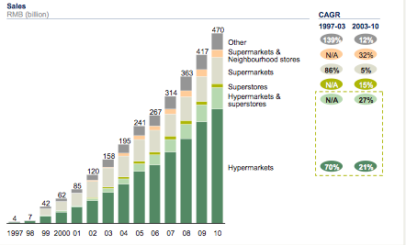
Distribution In China

Slide 123
POINT OF SALES
In the emerging markets the Hyper markets are in many cases an attraction .
The consumer, especially the youngs, are going there to see the new products
Displays and promotion in the point of sales are more important than in the advanced countries
The role of merchandisers is very important

Slide 124
POINT OF SALES
In china 45 % of consumers make purchasing decisions inside shops (24% in US ).

Slide 125
L’UNIVERSO RETAIL
CANALE IMPORTANZA IN VALORE
Fonte: ACNielsen.Jan 2008
Fonte: ACNielsen retail audit 06/07

Slide 126
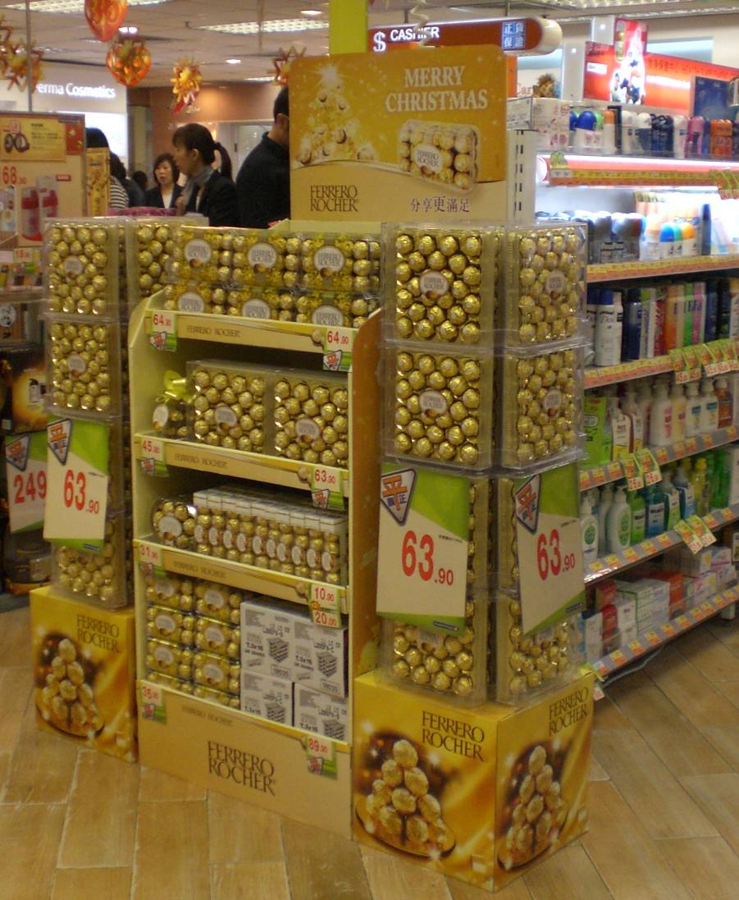
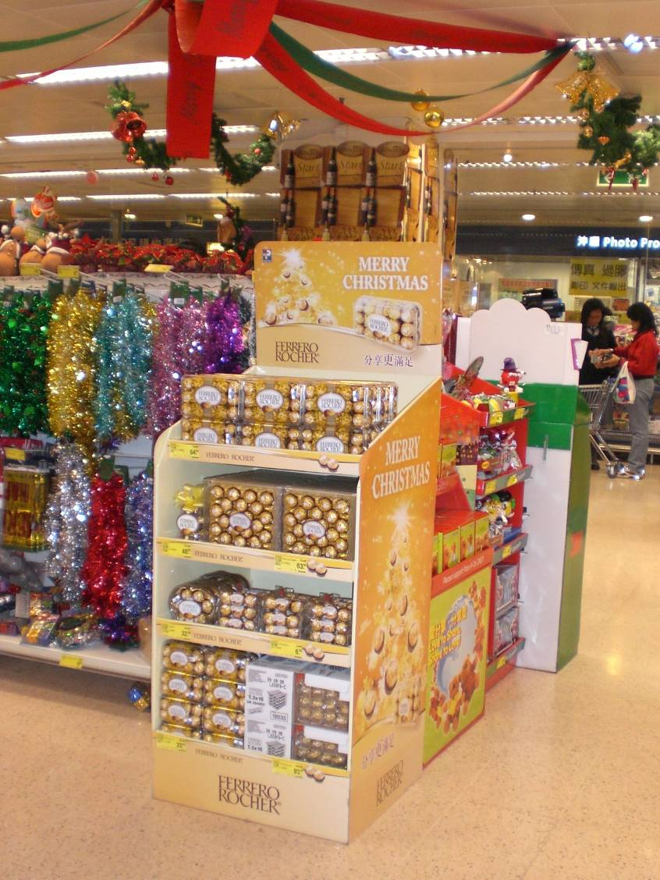
Floor Stands

Slide 127
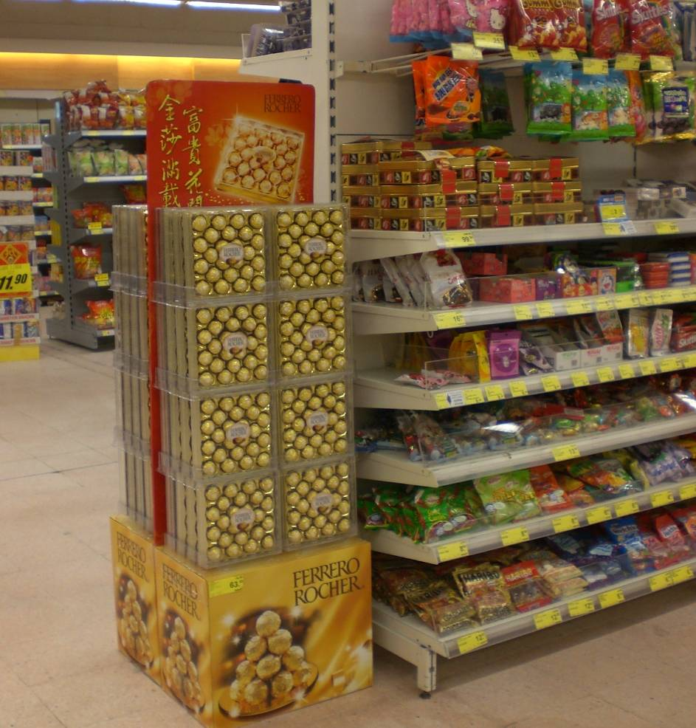
T24 quarto di pallet display in SMKT

Slide 128
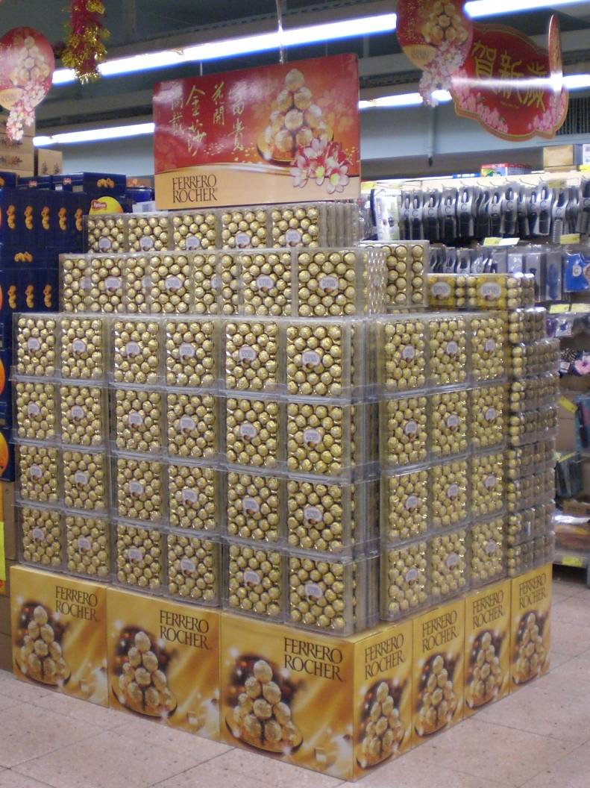
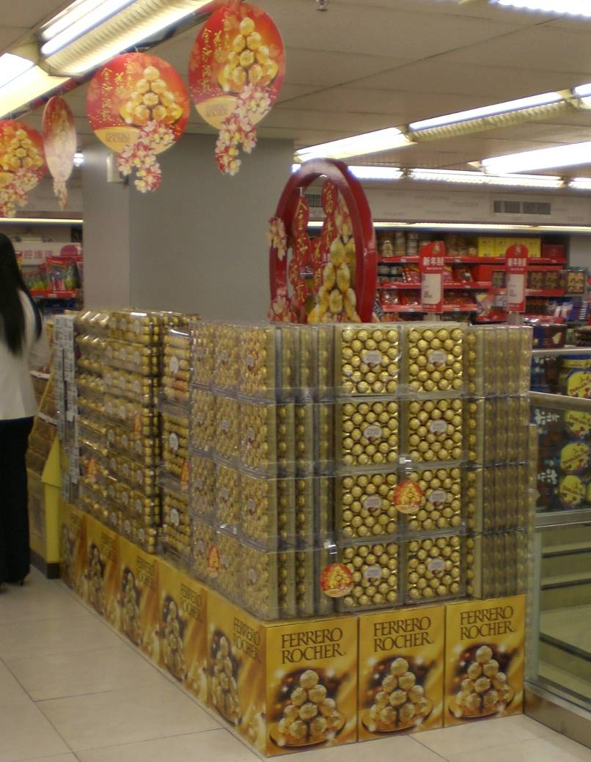
Smaller island display in Drugstores

Slide 129
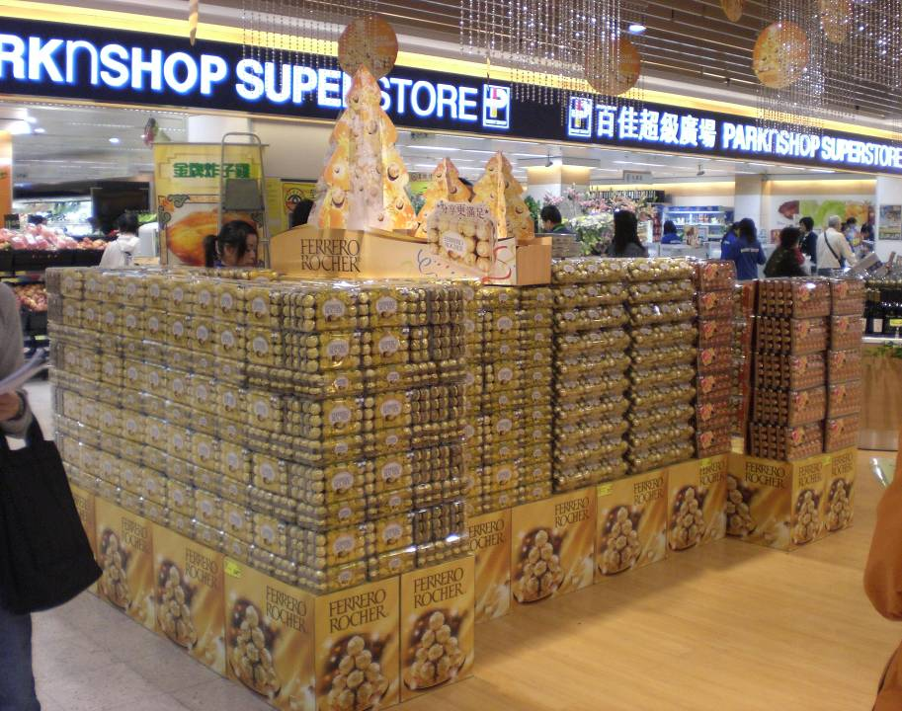
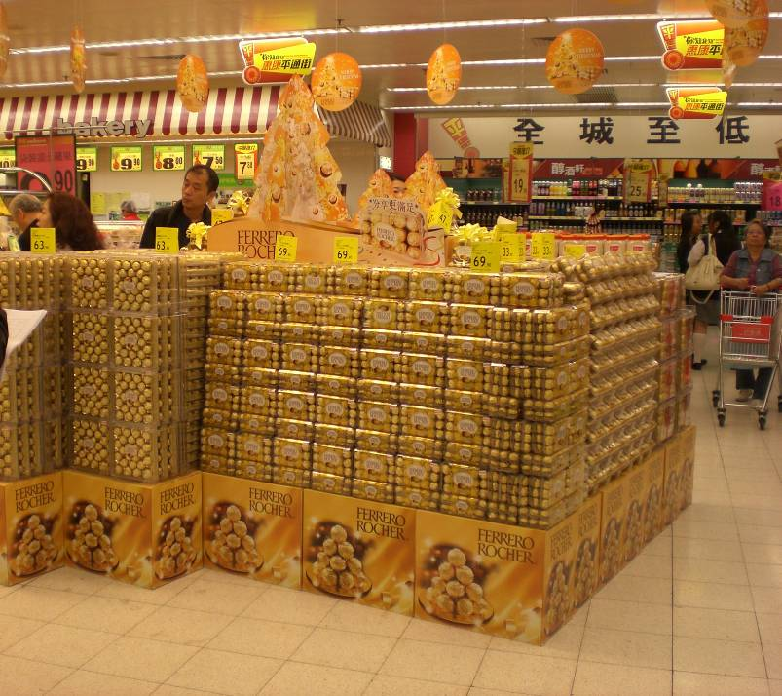
Giant Display in Supermarkets

Slide 130
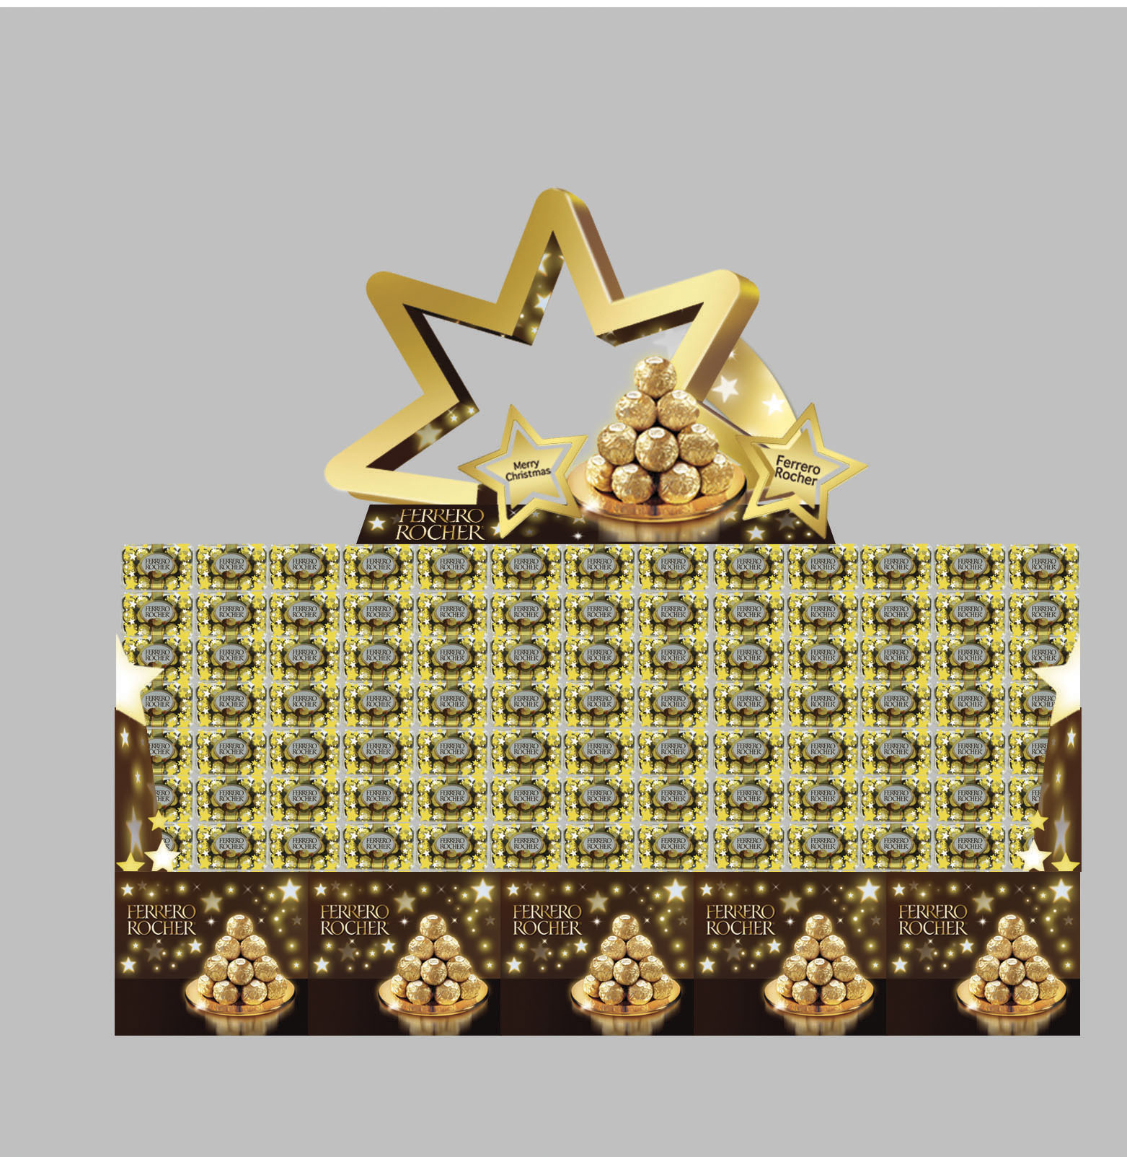
Christmas

Slide 131
CHOICE OF THE SHOPS

Slide 132
Route to market ;the process

Slide 133
DISTRIBUTION ; The choice !
Define the consumers that we want to reach on the basis of the product positioning or the products
Define where you can find this consumers in term of geography ( area , urban ,rural)
Define the category of shops where they are used to go (mamas papa shops Supermarkets ,Hypermarkets, CVS , Drugstores, Exclusive shops).

Slide 134
Potential of the point of sales
Is difficult to define the potential of the different point of sales.
Some parameters can help; dimensions of point of sales, type of area in term of income , presence of offices , range of the products…
High medium and low potential (hyper , SM,MM, CVS ,…)
Notes:
Potential and not actual sales even the actual sales are difficult to judge

Slide 135
Categorization of the point of Sales
Range per period ( high seasonality, low seasonality , festivities …)

Slide 137
How the Chinese buy in the hyper
5 times a week
The average basket is $ 10-30
Mainly food and fresh food
40% of the shoppers are going by foot
The hyper is renting the space and not buying ( flexibility )
Average space 10.000sq meters
Sales per sqm only 40% of the us one’s
Notes:
Vendite per sqm basse in China per due fattori; famiglie piccole , case piccole e mangiano anche piu piccole quantita, non vanno in macchina ma a piedi quindi non possono portare grosse quantita

Slide 138
Investments by category
Services ; number of deliveries per week, number of visit per month…
Support; merchandisers, promotions
Incentives; listing fees, end year bonuses..
How to displays the products; in shelf, out shelves, dimensions of the displays
Remuneration; margin

Slide 139
DISTRIBUTION
To reach a weighted and numerical distribution in line with the objectives is vital for the success
Weighted distribution is not enough
Visibility is key (controlling the points of sales)
The number of points of engagement is important (number of shops and within the shop)
The distribution mix (in term of channels) is important for the P&L also in term of power for the negotiation with the big chains
Notes:
Numerical serve a definire il numero dei punti di vendita dunque le persone necessarie

Slide 140
Hyper or Super

Slide 141
Negotiation with the trade
Listing fees on the space ,number of phasing
Margin per product ( the total margin is based on the rotation )
Paying for the “services” % of the turnover for the displays, number of displays or fixed amount

Slide 142
COMMERCIAL POLICY
“Price Control” is very important in order to keep a good value of your brands/products.
When the ‘fight on prices” is starting in many case is “positive” ! Your Brand is appealing.
Clear conditions and measurable

Slide 143
TRADE MARKETING
Trade marketing include all activities directed to the customer ( trade ) ,they are also called the ‘below the line “ activities.
The above the line are the one’s directed to the consumer’s without a support from the trade or the distributor

Slide 144
How to increase profitability
Notes:
togliere

Slide 145
How to increase profitability
Notes:
togliere

Slide 146
TYPES OF DISTRIBUTION

Slide 147
TYPES OF DISTRIBUTION
Direct, managed directly by the manufacturer
Shared, managed e.g. with a local manufacturer or by Franchising
Indirect, managed by importer, distributors, wholesaler

Slide 148
DIRECT DISTRIBUTION
Directly to the consumer or customer, a good turnover is needed when selling through shops (depends on the territory dimensions )due to the cost involved ( they are not shared) but gives a “good control” .
More affordable in the B to B ,but it depends of the number of customers and of the dimension of the territory
Generally are used agents , own personnel or Corner shops

Slide 149
SHARED DISTRIBUTION
Using a local manufacturer, advantage in term of costs , the products have to be complementary in term of distribution (e.g. chocolate with yogurts ), problem of focus of the organization
Priority will be given to the own products
Franchising good solution when you want to have shops with own label without big investments.
Control is key

Slide 150
INDIRECT DISTRIBUTION
Via consumer Chains, Wall mart, Carrefour, Auchan, Metro…..
Via companies specialized in importation and distribution or only distribution. Less costly than the proper sales force but needs control
Generally used in a first stage of introduction in a country

Slide 151
ADVANTAGE IN USING DISTRIBUTORS
Gives a knowledge of a new market at a reasonable cost which allows to evaluate his potential without big investments
Portfolio leverage
Reduce the financial risk
Can be used also for some channels ( mama’s &papa’s shops or channels with less potential or with a small density
Can be used as service providers for the high potential channels ( processing the orders ,invoicing, deliveries and payment )

Slide 152
DISADVANTAGE IN USING DISTRIBUTORS
No product focus
No direct contact with the market
Difficulty in the control of the marketing-mix (prices, stocks in the point of sales, visibility…)
Hard to contain geographically

Slide 153
How to choose the distributors
Choose the distributor and not vice versa
Financially strong
Have experience in marketing new products or new brands
Good coverage of the distribution (multi channel) and a developed informatics system in order to share the information's
Good in negotiation
Control the implementation plan and the results

Slide 154
Route to market
Objective; Design the best sales force in order
To maximize the sales by “controlling “the point of sales.
Principle ; the ‘Building blocks;
Freshness
Distribution
Price
Visibility
Displays
Notes:
Togliere

Slide 155
Luxury-goods market in China
By 2015 Chinese consumers will account for more than 20 % of the global luxury market .According to Mc Kinsey $27 billion or $40 billion's in the global world
Wealthy consumers ( above $ 45.000 )will represent the majority of the consumers ,the biggest new growth will come from the consumers with an income above $ 33.000 ( 76 millions household by 2015 ).

Slide 156
Luxury goods consumers
Luxury services are growing faster than the luxury goods
Been more exposed to this goods via Internet , overseas travel ,and first hand experience they become more discerning.
They know more brands
They want International brands and are against counterfeit

Slide 157
Luxury goods market (cont.)
The number of cities with a sizable market of Luxury goods are growing ;60 cities have yet a market above $ millions dollars, neverless the the 76 % of the market ,by 2015 , will be still concentrated in the top 36 cities

Slide 158
Luxury good distribution
Proliferation of single- brand stores
Lack of multi –brands stores and department stores. The owners act more as landlords than as retailers.
Many foreign retails brands (Gap, H&M…)have executed a single-brand self –run retail strategy in first tier cities ( Beijing ,Shanghai , Shenzhen , Guangzhou .)

Slide 159
Luxury goods distribution
In the second ,third –tier level cities often leads the brands to pursue a franchise /retail operator model in this areas .
To find a local partner will be important to find the right locations , negotiating the rents and adapting the right merchandise and promotions for the area.
The difficulty is to ensure a consistent brand image and maintaining a good operative control.

Slide 160
Distribution in luxury goods
Multi-brands retailers are the ideal channel for national expansion for industries like beauty and fast-moving goods.
In HK Sasa or the drugstores Chains like Watson
On-line are developing strongly linked to the younger's consumers'. The e-commerce allows brands to keep the control of the brand image and provides to engage at a low cost in lower tier’s cities

Slide 161
Changing strategies
A company before entering in this new markets has to check and to test the right strategy and be ready to adapt to the changes of the consumers approach or the one’s of the retail world.

Slide 162
Italian food in China
Some similarities between Italian and Chinese food; spaghetti vs. noodles, ravioli vs. noodles.
The penetration of Italian food I still low compared to the one of other ethnics'.

Slide 163
Italian food development in China
Focus on the most open minded areas ( Shangai region, Beijing and the region Guangzhou- Shenzhen ).
Use the out of home channel in order to communicate ;restaurants ( depends on the products )
Focus on the point of sales; communication, merchandiser's…

Slide 164
Italian food development in China (cont)
Use the modern trade ( hypermarkets, Super , MM. Choosing the right one’s
Make test in small area’s in order to fix the right business model.

Slide 165
Q&A

Slide 166
Organization
The “best organization “ does' not exist
The light organization's are the most effective. Cultural and politics aspects are difficult to overcome.
The head quarter role is to fix a general strategy ,to decide where to invest and the amounts , to transfer the excellence’s ( centre of competences ) and to control the result’s

Slide 167
Organization
To be successful a company has to know well the characteristics of his managers ; specialists and generalists.
The successes are made by the peoples. Leaders are more more important
The executives have to have a clear vision of the strategy. And to be open minded and able to delegate .

Slide 168
Organisation
Divide the world in areas ; geographically or in term of development . They have to have enough synergies. ( cultural ,life cycle of the consumer’s , development of the income , distribution….. ).
Strong support has to be given to the people close to the markets.
Transfer the best in class experiences.

Slide 169
OWNER SHIP CONCEPT
The people have to feel that they are part
of a team but that they are the ‘owners ’
of a brand of a product….
Is key to find a good balance between local and global ; « GLOCAL »

