Slide 1
Lecture IV securitization
International Financial Markets- 2015

Slide 2
What is Securitization?
An entity (bank, SPV, UCITS) pools together identifiable cash flows over time and packages the pool of collaterals into notes, with explicit priority of payments and sells them to investors.
Thus securitization is, first and foremost, a financing mechanism for the issuer of the collaterals.
The tranche structure makes securitization interesting, in terms of risk.

Slide 3
Types of Securitizations
Securitization types are defined based on the type of the underlying pool of assets
mortgage loans ==> MBS
consumer loans ==> ABS
corporate loans ==> CLO
corporate bonds ==> CBO
Mortgage backed securities (MBS) were the first ones and are still the most predominant type of securitization.

Slide 4
Securitization + tranching
Securitization: with it, investors are able to gain exposure to asset classes, such as leveraged loans, whose performance across the business cycle may differ from that of other eligible assets.
Tranching: it can be very helpful for those investors that have to invest in highly rated securities
Tranching offers the following benefits:
Tranches allow for the ability to create one or more classes of securities whose rating is higher than the average rating of the underlying collateral asset pool or to generate rated securities from a pool of unrated assets.
This is accomplished through the use of credit support specified within the transaction structure to create securities with different risk-return profiles.
The equity/first-loss tranche absorbs initial losses, followed by the mezzanine tranches which absorb some additional losses, again followed by more senior tranches.

Slide 5
The Waterfall
Asset Cash Flows
Senior Tranche
Mezzanine Tranche
Equity Tranche

Slide 6
Asset Backed Security (Simplified)
Senior Tranche
Principal: $80 million
Return = LIBOR + 60bp
Asset 1
Asset 2
Asset 3

Asset n
Principal:
$100 million
SPV
Mezzanine Tranche
Principal:$15 million
Return = LIBOR+ 250bp
Equity Tranche
Principal: $5 million
Return =LIBOR+2,000bp

Slide 7
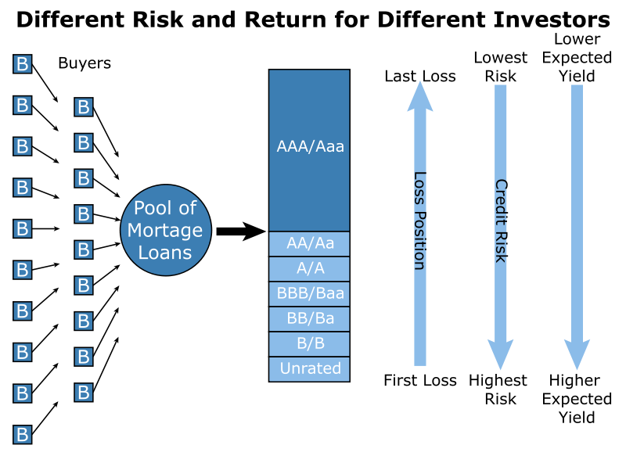

Slide 8
What happened…
Starting in 2000, mortgage originators in the US relaxed their lending standards and created large numbers of subprime first mortgages.
This, combined with very low interest rates, increased the demand for real estate and prices rose.
To continue to attract first time buyers and keep prices increasing they relaxed lending standards further
Features of the market: 100% mortgages, ARMs, teaser rates, NINJAs, liar loans, non-recourse borrowing

Slide 9
What happened...
Mortgages were packaged in financial products and sold to investors
Banks found it profitable to invest in the AAA rated tranches because the promised return was significantly higher than the cost of funds and capital requirements were low
In 2007 the bubble burst. Some borrowers could not afford their payments when the teaser rates ended. Others had negative equity and recognized that it was optimal for them to exercise their put options.
U.S. real estate prices fell and products, created from the mortgages, that were previously thought to be safe began to be viewed as risky
There was a “flight to quality” and credit spreads increased to very high levels

Slide 10
Key Mistakes Made By the Market
Default correlation goes up in stressed market conditions
Assumption that a BBB tranche is like a BBB bond

Slide 11
Need to Align Interests of Originators and Investors
There is evidence that mortgage originators used lax lending standards because they knew loans would be securitized
For a rebirth of securitization it is necessary to align the interests of originators and investors
Regulators are insisting that when credit risk is transferred a certain percentage (5% to 10%) of each tranche is retained by the originator

Slide 12
Transparency
ABSs and ABS CDOs were complex inter-related products
Once the AAA rated tranches were perceived as risky they became very difficult to trade because investors realized they did not understand the risks
Arguably the onus should be on the creators of the products to provide a way for potential purchasers to assess the risks (e.g., by providing software)

Slide 13
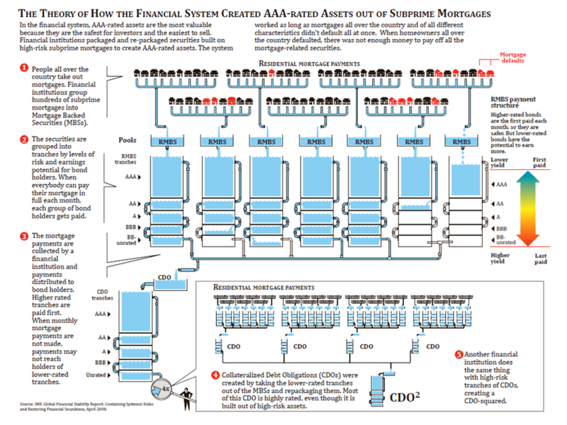

Slide 14
More Emphasis on Stress Testing
We need more emphasis on stress testing and managerial judgement; less on the mechanicistic application of VaR models (particularly when times are good)
Senior management must be involved in the development of stress test scenarios

