Slide 1
LATERAL LINKS
Martina Dal Molin
mdalmolin@liuc.it
AA 2015/2016

Slide 2
Agenda
Introduction
Planning and control
Performance control
Action planning
Connection mechanisms

Slide 3
Introduction (1/2)
Lateral links
Planning and control
Connection mechanisms
Output standardization
Mutual adjustment

Slide 4
PLANNING AND CONTROL
AA 2015/2016

Slide 5
Planning…..
Planning
Is the specification of an output at t + 1
The output is specified in terms of:
Quantity
Quality
Cost
Time
Examples:
Budget, program, objectives, operational plan

Slide 6
….. And control
Control
Is the evaluation if the objective has been achieved
The output is evaluated in terms of:
Quantity
Quality
Cost
Time

Slide 7
Planning and control (1/2)
There are two types of planning and control:
Performance evaluation
Ex-post results’ evaluation
Action planning
Action are defined before
Profit rate should be improved from 7% to 10%
Manolo Blahnik Green has to be be sold to young and old women

Slide 8
Planning and control (2/2)
ACTION PLANNING
DECISION 1
DECISION 2
DECISION 3
DECISION 4
DECISION 5
DECISION 6
DECISION n
ACTION 1
ACTION 2
ACTION 3
ACTION 4
ACTION 5
ACTION 6
ACTION n
PERFORMANCE CONTROL

Slide 9
Performance control (1/2)
Performance control has the objective of controlling the results of an organizational units
In June 2016 200 pairs of Manolo Blahnik should be produced

Slide 10
Performance control (1/2)
OVERLAPPING WITH GROUPING
Obj, budget, operational plans are defined for each units
Units’ performance is controlled and evaluated according to the defined standard
Performance results are transferred to the strategic apex
RELEVANT IN UNITS GROUPED ON THE MARKET
RESULS ARE EVALUATED WITH RESPECT TO «TIME» AND TO IN RELATION WITH SPECIFIC DECISION OR ACTION

Slide 11
Performance control: finalities
EVALUATION
To identify lower performances and to introduce corrective actions
To support and encourage better performances
MOTIVATION, problems:
Tendency t define low performance standards
Problem of when to plan
Sometimes performance standards are not achieved for «external» and contextual reasons

Slide 12
Actions planning (1/2)
Planning actions means taking a specific decision that is related to (a set of) specific actions
Stop producing blu Manolo Blahnik. Start production of Emerald one

Slide 13
Actions planning (2/2)
Examples of action planning:
New product
Building new plant
Sell old machinery
It does not respect the autonomy of organizational unit
Decision could also be inter-unit
Since it is based on specific decision, action planning isn’t a proper standardization of output
PERFORMANCE CONTROL
ACTION PLANNING
FORMALIZATION of BEHAVIOUR
High regulation
Low regulation

Slide 14
Performance control and action planning
PERFORMANCE CONTROL
The strategic apex defines obj, bdg, …
These obj are articulated in sub-obj in the form of operational plan (top-down)
OR
Obj are proposed by the operating core to the strategic apex (botto-up)
ACTION PLANNING
The strategic apex defines the organizational strategy
The strategy is translated in decision
Decision are translated into actions (top-down process)

Slide 15
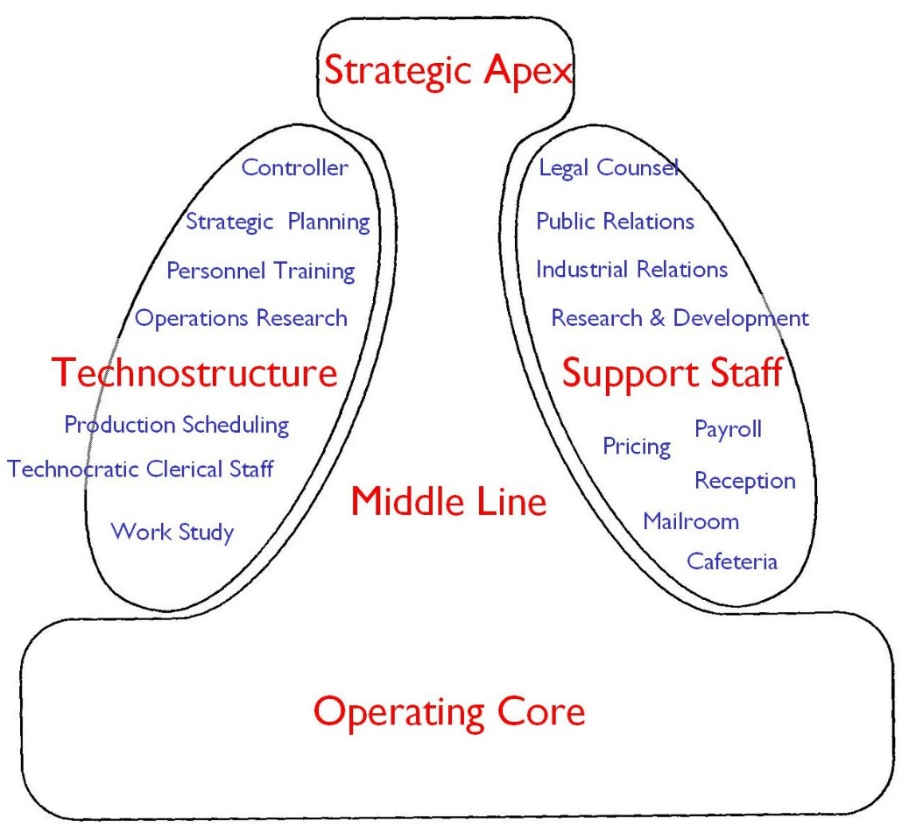
Find performance control

Slide 16
Find action planning

Slide 17
CONNECTION MECHANISMS
AA 2015/2016

Slide 18
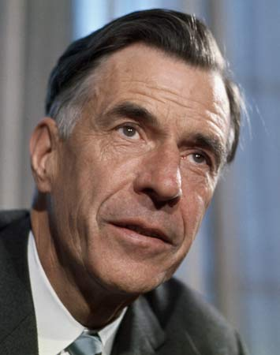
Connection mechanisms
Connection mechanisms have the objective of favoring mutual adjustment with the final aim of regulating interdependencies that could not the controlled through direct supervision and standardization
John Kenneth Galbraith (1973) identified a continuum of four connection mechanisms:
liason positions
Task forces and committees
Integration managers
Matrix structure

Slide 19
Liason positions
They are used to to:
Coordinate the activities of two units
Favor the direct flow of information
No formal authority, but informal power
Power is related to information, not to the formal position
They could be created:
Between different line units
Engineering and production, engineering and purchase
Between line and staff units
HR and and accounting

Slide 20
Task forces and commitees
Focus on meetings, that favor mutual adjustment
Informal meeting
Formal and institutionalized meeting
i.e. meetings that are regularly scheduled
i.e. meeting that are art of the formal organization
Meetings are institutionalized throguh two channels:
Tasks forces, i.e. temporary committee with a specific task
Committee, i.e. interunit committee that organizes regular meeting to dicuss specific problems

Slide 21
Integration managers
Liason position with formal authority
Formal power is related to the decision making process, not to people
Formal power is related to:
Power to approve decision (e.g. to approve the budget)
«Previsional» power with respect to decision (e.g. definition of the budget that in approved by units)
Power to control the decision-making process (e.g. the managers gives resources to units according to their results)
Examples:
Product managers
Project managers
Program managers

Slide 22
Matrix structure
Starting point: no grouping basis is able to manage all the interdependencies
We know that organizations can solve the problem by adopting one of the following three configuration:
Hierarchical structure
Line and staff structure
Structure with connection mechanisms

Slide 23
Hierarchical structure

Slide 24
Line and staff structure

Slide 25
Line and staff structure

Slide 26
Structure with connection mechanisms

Slide 27
Matrix structure
Hierarchical structure
Line and staff structure
Structure with connection mechanisms
They all privilege one grouping basis compared to others. Sometimes it is necessary to combine different configurations (e.g. market and product, geopgraphical location and output)
Matrix structure

Slide 28
Matrix structure (1/2)
The principle of uniqueness of command is not satisfied
Formal authority is divided and it creates joint responsibilities
Differen managers are equally responsible for the same decision
Managers must manage divergencies by creating an internal equilibrium

Slide 29
Connection mechanisms?

