Slide 1
Management Principles and Human Resources
Martina Dal Molin
mdalmolin@liuc.it
AA 2016/2017

Slide 2
Agenda
Job Order Costing (JOC)
Process Costing (PC)
Operation Costing (OC)

Slide 3
JOB ORDER COSTING

Slide 4
Costing Techniques
Costing techniques:
Job order costing
Process costing
Operation Costing
Activity Based Costing
Costing Techniques | Direct Material | Direct Labor | Overhead
Process Costing | Proportional | Proportional | Proportional
Operation Costing | Causal | Proportional | Proportional
Job order costing | Causal | Causal | Proportional
Activity Based Costing | Causal | Causal | Causal

Slide 5
JOC: general features
The basis for costs’ allocation is the “job” (composed by a single unit of products or bay a batches of products)
Precision
Direct labor and direct material as the major costs’ components
Onerous (job scheduling)
It cannot be applied in companies that operate with continuous processes
It is used, in general, in companies whose production is based on clients’ order

Slide 6
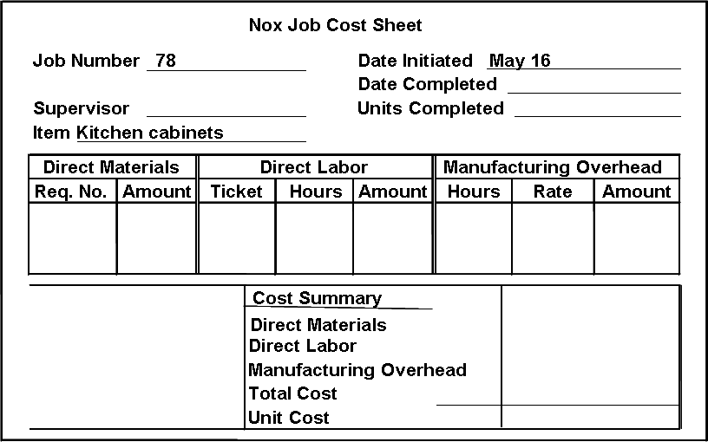
JOC: costs identification
Fulfillment of a “job-cost sheet” for each job
Job = single product or batches of products
The schedule summarizes all the production costs associated to each job

Slide 7
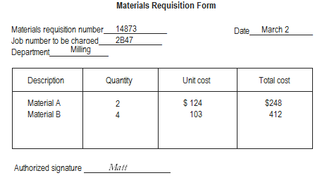
JOC: costs identification – direct materials
Charge direct material costs to each job as work is performed
Costs of direct materials= estimation in storehouse

Slide 8
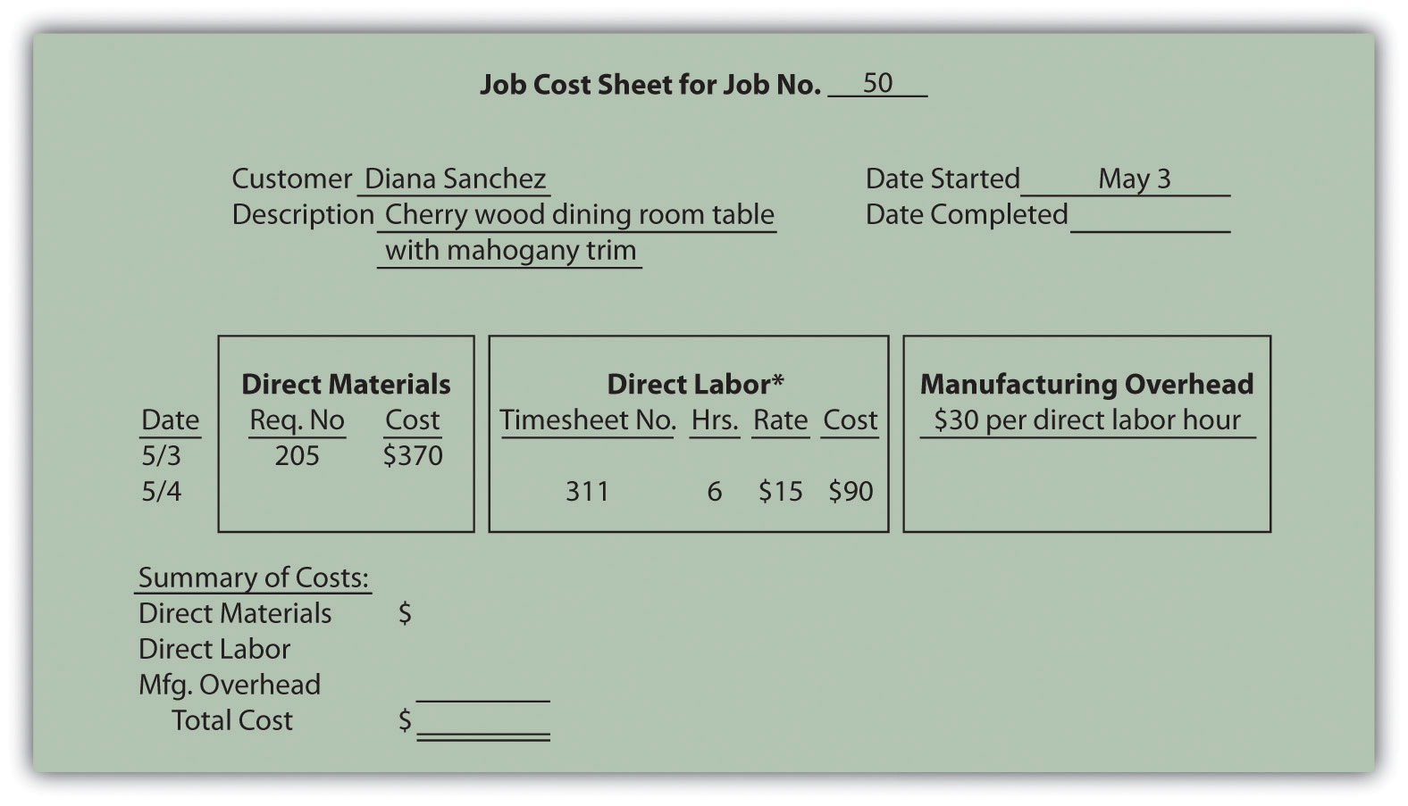
JOC: costs identification – direct labor
Charge direct labor costs to each job as work is performed
Costs of direct labor= hourly labor cost

Slide 9
JOC: costs identification – overhead (1/3)
Manufacturing overhead are allocated to jobs according proportionally to the use of a specific productive factor (in general direct labor)
The productive factor used to allocate overhead is called “allocation base”
The allocation of overhead is performed in 2 steps:
To calculate the allocation coefficient (K):
Tot. of OVHj/Tot DLj
To allocate overhead:
K*ABj

Slide 10
JOC: costs identification – overhead (1/2)
- 2 products, A and B, produced in batches
- Tot. overhead: 6.000€
- Job sheet:
1) K= Tot. of OVHj/Tot DLj = 6.000/(1.000 + 2.000) = 2
2) Allocation of OVH = K*ABj
A= 2*1.000= 2.000
B= 2*2.000= 4.000
Batches | Direct Labor (€) | Direct Material (€)
A | 1.000 | 500
B | 2.000 | 500

Slide 11
JOC: costs identification – overhead (1/2)
Why we need an allocation base?
It is impossible or difficult to trace overhead costs to particular jobs.
Manufacturing overhead consists of many different items ranging from the grease used in machines to the production manager’s salary.
Many types of manufacturing overhead costs are fixed even though output fluctuates during the period.

Slide 12
Exercise
Siano (Teacher)
Jerle (students)

Slide 13
OPERATION COSTING

Slide 14
Costing Techniques
Costing techniques:
Job order costing
Process costing
Operation Costing
Activity Based Costing
Costing Techniques | Direct Material | Direct Labor | Overhead
Process Costing | Proportional | Proportional | Proportional
Operation Costing | Causal | Proportional | Proportional
Job order costing | Causal | Causal | Proportional
Activity Based Costing | Causal | Causal | Causal

Slide 15
OC: general features (1/2)
The basis for costs’ allocation is the “operation” (composed by a single unit of products or bay a batches of products)
We start by calculating the conversion cost related to a single operation
Operation = homogeneous phase of the productive cycle (e.g. printing phase of a textile company)
For each operation we should calculate the total amount of conversion costs (direct labor + OVH)
The total amount of conversion costs should then be allocated to each batch proportionally (e.g. by using the total meters produced)

Slide 16
OC: general features (2/2)
OC is used to companies in which:
Cost related to direct material are the prevailing costs’ item
The productive cycle is composed by a limited number of operation
Productive batches are mainly homogeneous
It is typically used in textile companies

Slide 17
PROCESS COSTING

Slide 18
Costing Techniques
Costing techniques:
Job order costing
Process costing
Operation Costing
Activity Based Costing
Costing Techniques | Direct Material | Direct Labor | Overhead
Process Costing | Proportional | Proportional | Proportional
Operation Costing | Causal | Proportional | Proportional
Job order costing | Causal | Causal | Proportional
Activity Based Costing | Causal | Causal | Causal

Slide 19
PC: general features (1/2)
The basic idea is to detect the total cost of each organizational unit and to split them following the total production
In case of WIP variation, it necessary to introduce a corrective element, named equivalent unit
By using the idea of equivalent unit, each WIP is transformed in a unit of finished good
To do that, we need to calculate the degree of completion that describes the total cost that are absorbed by the WIP
Neq = Qc + Ʃqi + cdi

Slide 20
PC: general features (1/2)
It is used in homogeneous production cycle
Mono production
Fe products with similar production cycle
Continuous production cycle (e.g. chemical sector)

