Slide 1
Management Principles and Human Resources
Martina Dal Molin
mdalmolin@liuc.it
AA 2016/2017

Slide 2
General information
Lessons: from 23/09 to 16/12
Time: 9.15 – 12.30 (15 minutes break)
Appointment: write to mdalmolin@liuc.it
La Torre building, first floor, office 1.4

Slide 3
Course structure
First semester (from 23/09 to 16/12)
Financial Accounting
Management Accounting
Strategy
Second semester (from 20/02 to 01/06)
Capital budgeting Cristina Soppelsa
Organization Martina Dal Molin
Martina Dal Molin

Slide 4
Course structure: philosophy of teaching
What we are going to do:
Frontal lessons
Exercise (together and alone)
Assignment (organization)
Material:
Slides
Additional material provided by the teacher

Slide 5
Course structure: final mark (whole course)
Final mark is composed by
Written test: management and financial accounting 40%
Written test: capital budgeting 30%
Oral exam (whole program) 30%
Assignment (organization) (bonus 0-2)

Slide 6
Course structure: final mark (partial course)
Part 1 - 1° semester
Written test: management and financial accounting 70%
Oral exam (whole program) 30%
Part 2 – 2° semester
Written test: capital budgeting 70%
Oral exam (whole program) 30%
Assignment (organization) (bonus 0-2)

Slide 7
1° Semester: detailed program
Financial accounting
Balanche Sheet
Income statement
Cash Flow statement
Exercise (double entry method)
Ratio Analysis
Exercise
Management accounting
Costs
Job costing, process costing, operation costing
Exercise
Strategy
Company activity, business model, the competive environment
Competitive differentials
Type of startegy

Slide 8
INTRODUCTION
AA 2016/2017

Slide 9
Company: terminology
Depending on the context…
Company as an organized economic activity aimed at creating value/profit
Company as the set of material and immaterial goods necessary for the company’s activities

Slide 10
The company and the context (1/2)
SOCIO-POLITICAL SYSTEM
THE COMPANY
ECONOMIC AND FINANCIAL SYSTEM

Slide 11
The company and the context (1/2)
SOCIO-POLITICAL SYSTEM
CONTINUOUS CHANGE AS THE ORDINARY «STATE OF BEING»
THE COMPANY
RISK MANAGEMENT AS IMPLICIT PART OF THE COMPANY
INNOVATION AS THE TOOL FOR ADAPTATION TO EXTERNAL CHANGES or TO FAVOR EXTERNAL CHANGES
ECONOMIC AND FINANCIAL SYSTEM

Slide 12
The company and the economic-financial system
Company’s activities are funded by shareholders outside the company
ECONOMIC AND FINANCIAL SYSTEM
Following this view, the company is strongly dependent from the external environment. But, in your opinion, are there some «elements» in which the company is independent from the external environment?
COMPANY
INPUT
OUTPUT
Inputs are bought outside the company (typically from other companies)
Inputs are sold outside the company (clients, other companies, public administration)
STRONG INTERDEPENDENCIES BETWEEN THE COMPANY AND THE EXTERNAL ENVIRONMENT
Notes:
INPUT: esempio di BREMBRO che vende gli impianti frenanti a MERCEDES

Slide 13
Company independence from external context
Company’s boundaries: clients, output, geographical position, HR, tecnology, organizational structure
Funds searching
«Birth» and Growth
Life-time and «death»: failure, liquidation, break-up, absorption
All of these aspect are not pre-determined, but they depend from the company’s choiches
AA 2016/2017

Slide 14
The company as part of the economic and financial system
TECHNOLOGY of the COMPANY
BUSINESS PORTFOLIO
COMPANY’s IMAGE
THE COMPANY
ACTIVITIES PORTFOLIO
(MAKE or BUY)
LEGAL AND FINANCIAL FORM of the COMPANY
ECONOMIC AND FINANCIAL SYSTEM

Slide 15
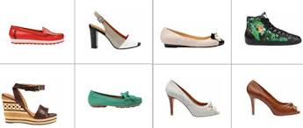
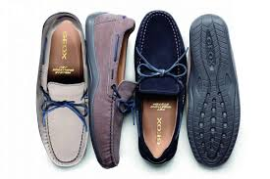
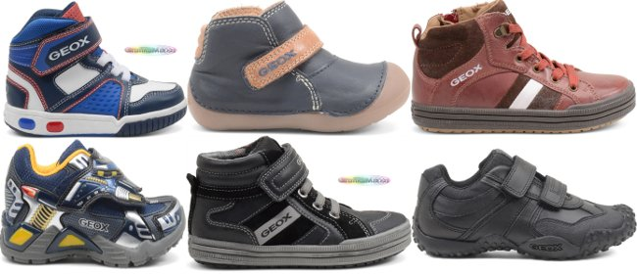
The boundaries of a company: BUSINESS PORTFOLIO (1/3)
Focused business portfolio: one product
THE SHOES THAT BREATH

Slide 16
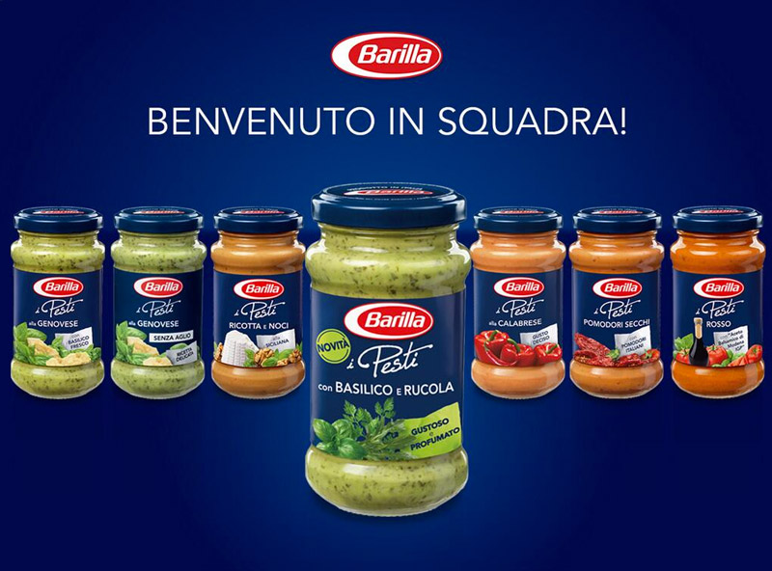
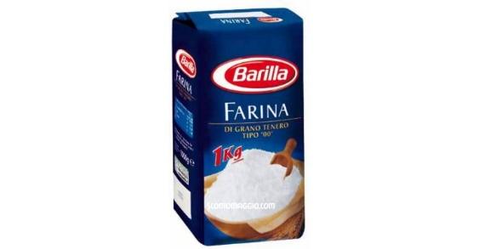
The boundaries of a company: BUSINESS PORTFOLIO (2/3)
Correlated business portfolio: two or more products, that share similarities (clients, distribution, technology)

Slide 17
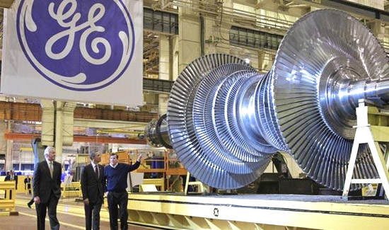
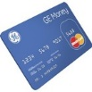
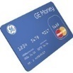
The boundaries of a company: BUSINESS PORTFOLIO (3/3)
Conglomerated business portfolio: different products that are different in term of clients, distribution, technology, ..

Slide 18
The boundaries of a company: ACTIVITIES PORTFOLIO (3/3)
Once the business portfolio is defined, the company should produce the good(s)
DEFINITION of the GOOD
DEFINITION of the GOOD
CHOICE «TO MAKE OR BUY»
ACQUISITION of INPUTS
ACQUISITION of INPUTS
TRASFORMATION of INPUTS in OUTPUTS
TRASFORMATION of INPUTS in OUTPUTS
DISTRIBUTION of OUTPUTS
DISTRIBUTION of OUTPUTS
MARKETING
MARKETING
STRATEGIC CHOICE
PRODUCTS SALE
PRODUCTS SALE
CUSTOMER ASSISTANCE
CUSTOMER ASSISTANCE

Slide 19
The boundaries of a company: TECHNOLOGY
Companies’ products (OUTPUT) are realized through technologycal assets and organizational configurations that usually evolve over time
Evolution (qualitative and quantitative) of the DEMAND SIDE
Evolution of the related PRICE SYSTEM
Paucity of critical resources
Availability of new technology
Availability of new (material or immaterial) infrastructures

Slide 20
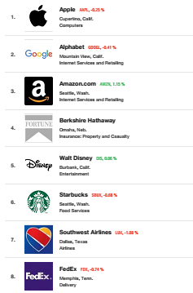
The boundaries of a company: IMAGE
The IMAGE of a company, a its REPUTATION, is linked to:
Economic performance
Quality of products
Quality of the management
Ability of acting competitively on the market
Ability to innovate
Quality of the human resources
Ability of attracting talents
Social responsibility

Slide 21
The boundaries of a company: LEGAL FORM
The company could chose between different «type» of legal form (see later)
Depending on the company’s legal form, it has different duties with respect to stakeholders and shareholders

Slide 22
The company as part of the socio-political system
SOCIO-POLITICAL SYSTEM
THE COMPANY
ECONOMIC AND FINANCIAL SYSTEM

Slide 23
The company as part of the socio-political system
The company as a SOCIAL INSTITUION:
The company try to answer to the social need through its goods and services;
Society provides the required inputs for the company’s productive processes
The company should adapt to the society values (e.g. environmental sustainability)
The company must respect the laws of the State and the idea of Corporate Social Responsibility (CSR)

Slide 24
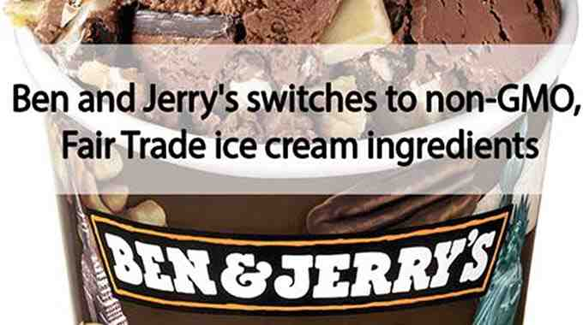
Corporate Social Responsiblity (CSR): some examples

Slide 25
Change, innovation and risk
Since the company lives and works in an economic and social environment, three aspect related to the company’s life have to be mentioned:
Change
Innovation
Risk

Slide 26
Change (1/2)
«Change» represents the «normal» condition for companies:
Contenxtual changes affect company’s decisions
Companies affect contextual changes
Companies need to manage external changes
Changes of the socio-political context
Values and life style
Technology
Infrastructures
Laws
Critical resources

Slide 27
Change (2/2)
«If you want to be reborn you have to die first. (….) At every big tech group cpmpetition turns profitable products into margin-killers. To protect earnings, companies must move into adjacent areas.»
Financial Times, 2011

Slide 28
Innovation (1/5)
What types of change for a company?
Company’s portfolio
To make or to buy
Technology
Corporate governance
Company’s image
INNOVATION

Slide 29
Innovation (2/5)
What does INNOVATION mean?
Innovation is the successful exploitation of new ideas
Industrial innovation includes the technical, design, manufacturing, management and a commercial activities in the marketing of new or improved products or process
Innovation is the specific tool of entrepreneurs, the means by which they exploit change as an opportunity for a different business or service
An innovative business is one that lives and breathes «outside the box». It is not good ideas, it is a combination of good ideas, motivated staff and instinctive understanding of what customer wants
Tidd and Bessant, (2009), Managing Innovation. Integrating Technological, Market and Organizational Change, 4° edition, John Wiley&Sons

Slide 30
Innovation (3/5)
What are the most innovative companies worldwide?
23. Eataly
32. Soundcloud
1. Warby Parker
Not only technology….
But successfull ideas
39. Revolution foods
2. Apple
3. Alibaba
40. Ikea
4. Google
41. Samsung
5. Instagram
30. Netflix
https://www.fastcompany.com/section/most-innovative-companies-2015

Slide 31
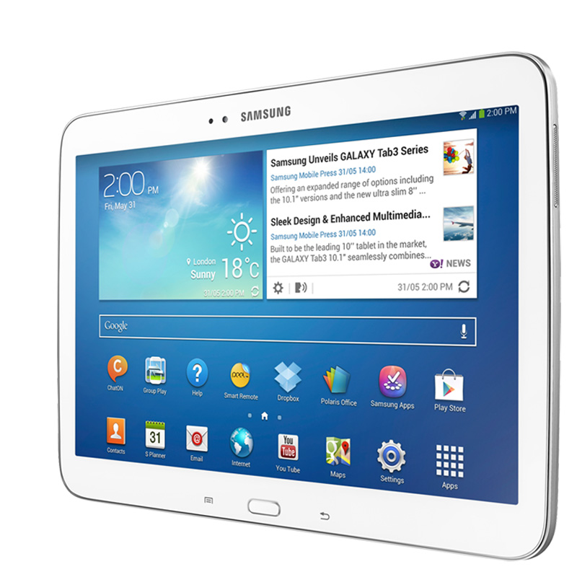
Innovation (4/5)

Slide 32
Innovation (5/5)

Slide 33
Risk
Without risk, we do not have companies:
Risk is always present
Risk means that company does not have any certanty about decision taken
Future results of current decisions could not be predicted
Risk must be managed by the company by finding trade off between riskiness and profitability

