Slide 1
ORGANIZATIONAL STRUCTURES
Martina Dal Molin
mdalmolin@liuc.it
AY 2016/2017

Slide 2
General information
Lessons: from 26/04 to 19/05
Time: 9.00 – 12.00 (15 minutes break)
Appointment: write to mdalmolin@liuc.it
La Torre building, first floor, office 1.4

Slide 3
Course structure and material
What we are going to do:
Frontal lessons
Assignment (see later)
Material:
Slides
Assignment
Topic: description and analysis of an organization
What you have to prepare:
Power point presentation - IN GROUP, presentation will be the 24/05
Word report on the case studies (word) – INDIVIDUAL, to be send BEFORE 28/05

Slide 4
Final exam (1/2): whole course (Sept – May)
Final mark is composed by:
Written test: management and financial accounting 40% (Me)
Written test: capital budgeting 30% (Prof. Cristina Sopplesa)
Oral exam (whole program) 30% (Me)
Assignment (case descrption and analysis) (bonus 0-2) (Me)
The oral exam is the 31/05 – you will get your final mark

Slide 5
Final exam (1/2): partial course (Feb – May)
The final mark is composed by:
Written test: capital budgeting 70% (Prof. Cristina Sopplesa)
Oral exam (whole program) 30% (Me)
Assignment (organization) (bonus 0-2) (Me)
The oral exam is the 31/05 – you will get your final mark

Slide 6
What we are going to study?
Topics
Organizational design: the core elements
Coordination mechanisms
The five parts of an organization
The design of the individual positions
The design of the macro-structure
The organizational configurations

Slide 7
ORGANIZATIONAL DESIGN: THE CORE ELEMENTS
AA 2015/2016

Slide 8
Agenda
Organization: some definitions
The coordination mechanisms
The five parts of an organization

Slide 9
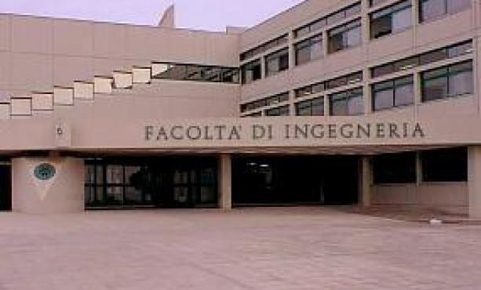
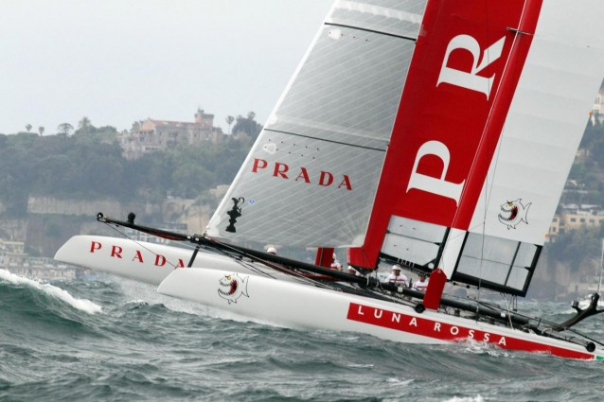
Some definitions
Organizations are
Social entities that are goals directed and that are designed as deliberated structure and coordinated activity system and that are linked to the external environment

Slide 10
How to design an organization? (1/2)
Organizational variables MUST be designed and selected following the internal situation and with the external context in which the company works
The parameters for the organizational design should be combined in order to define some ideal configurations.
Literature distinguishes between 5 ideal-type of organizational configurations
Henry Mintzberg

Slide 11
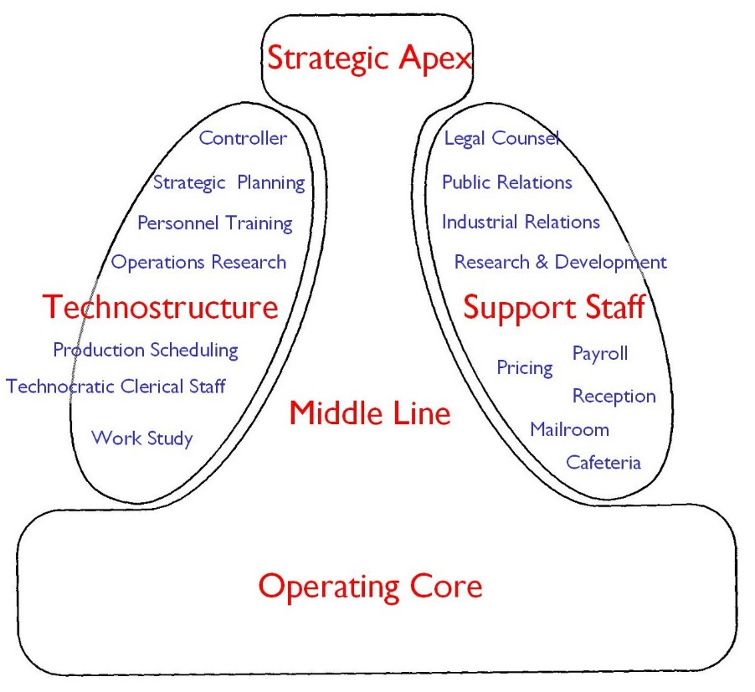
How to design an organization? (2/2)
Which elements or variable should we FIRST consider to design organization?
COORDINATION MECHANISMS
THE (5) PARTS OF AN ORGANIZATION

Slide 12
COORDINATION MECHANISMS
AA 2015/2016

Slide 13
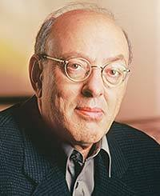
Coordination mechanisms (1/2)
ORGANIZE: what does it mean in your opinion?
The division of labour in different activities
The coordination of these activities

Slide 14
Coordination mechanisms (2/2)

Slide 15
Mutual adjustment (1/2)
MANAGER
CORE ELEMENTS
Coordination is achieved through informal communication
Activities are monitored by who carries out these actvities (i.e. the operator)
Simple
ANALYST
OPERATOR
OPERATOR

Slide 16
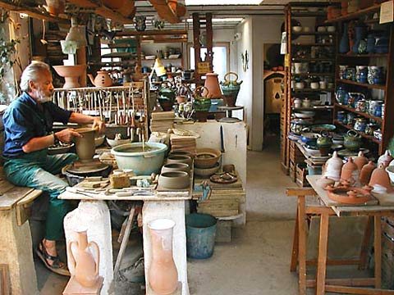
Mutual adjustment (1/2)
In which type of companies do you expect to find this coordination mechanism?
But also…..

Slide 17
Direct supervision (1/2)
MANAGER
CORE ELEMENTS
Coordination is achieved through the direct supervision of the manager
The manager has the responsibility over the others’ activities
ANALYST
OPERATOR
OPERATOR

Slide 18
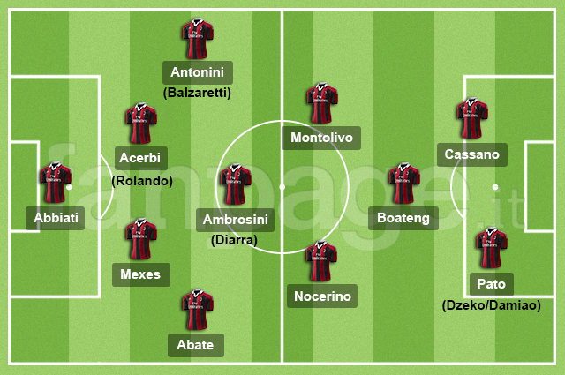
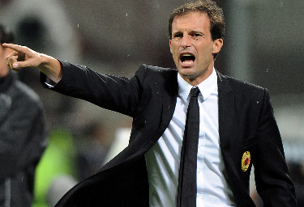
Direct supervision (2/2)
Think about a football team…..

Slide 19
Standardization (1/2)
MANAGER
CORE ELEMENTS
Definition of activities
Three types of standardization:
Input and skills
Work processes
outputs
ANALYST
OPERATOR
OPERATOR
INPUT SKILLS
WORK PROCESSES
OUTPUTS

Slide 20
Standardization (2/2)
….Of WORK PROCESSES
Activities and «content» are specify
….Of OUTPUTS
Final characteristics of the products are defined (e.g. features, dimension, performance)
….Of INPUT SKILLS
Education, skills and capabilities are defined

Slide 21
Summary
MUTUAL ADJUSTMENT
DIRECT SUPERVISION
PROCESSES STANDARDIZ.
OUTPUTS STANDARDIZ.
INPUT SKILLS STANDARDIZ.
MUTUAL ADJUSTMENT
LOW COMPLEXITY
HIGH COMPLEXITY
!!! ORGANIZATIONS USUALLY COMBINE THE FIVE TYPE OF MECHANISMS!!!
Indeed, formal and Informal organization are interconnected

Slide 22
THE FIVE PARTS OF AN ORGANIZATION
AY 2016/2017

Slide 23
The five parts of an organization (1/2)

Slide 24
The five parts of an organization (2/2)
SUPPORT STAFF:
Provision of support services
HIGH COMPLEXITY
TECHNOSTRUCTURE:
The higher complexity of the organization requires standardization
MIDDLE LINE:
Line of authority between the strategic apex and the operating core
STRATEGIC APEX:
Increased dimension of the
More complex division of labour
Direct supervision
OPERATING CORE:
Output production and/or provision of services
Mutual adjustement
LOW COMPLEXITY

Slide 25
Operating core
People directly involved in the production of output/provision of services
Principal functions:
Find input
Trasformation of input in output
Support services (from input to output)
Max standardization
It is the «core» of every organization

Slide 26
Strategic Apex
People who are in charge of monitoring the whole organization and who are responsibile for its results
Principal functions:
Direct supervision
Managing organizational boundaries
Strategy definition
They represent the organizational vision and
mission
Low repetitiveness, complex decision
making, low standardization

Slide 27
Middle line
Middle management and they are responsible for the activities of the operating core
Principal functions:
Collect performance information
Provide performance information to the
strategic apex
Internal boundaries management
Defne internal strategy
Direct supervision

Slide 28
Technostructure
Analysts who define «rule» for the others’ core activities
Principal functions:
To design and plan the others’ work
processes
Three categories
Work analysists
Audit and control analysists
Human Resources analysts

Slide 29
Support Staff
Provision of support services
Provision of SPECIFIC functions without defining
rules for standardization
«small» organization with its own
operating core

Slide 30
How the organization works?
5 perspectives:
Flow of formal authority
Flow of defined and regulated actvities
Flow of informal communication
Work constellation
Ad hoc decision-making process

Slide 31
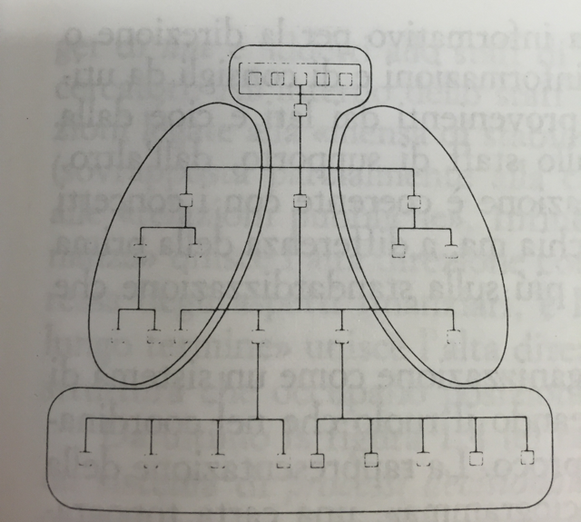
Flow of formal authority
The organization is seen as a system of formal authority
It is represented by the organizational chart
It does not represent the informal flow of power and communication
The organizational chart represent the division of labour:
Which working positions exist
How these positions are grouped to form organizational units
The formal power over organizational units

Slide 32
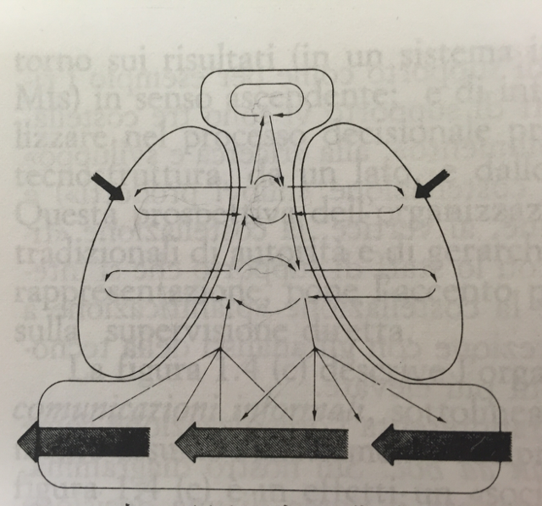
Flow of regulated activities
The organization is seen as a set of rules to monitor the operating core and to provide performance information to the strategic apex
Focus on:
Standardization
Direct supervision

Slide 33
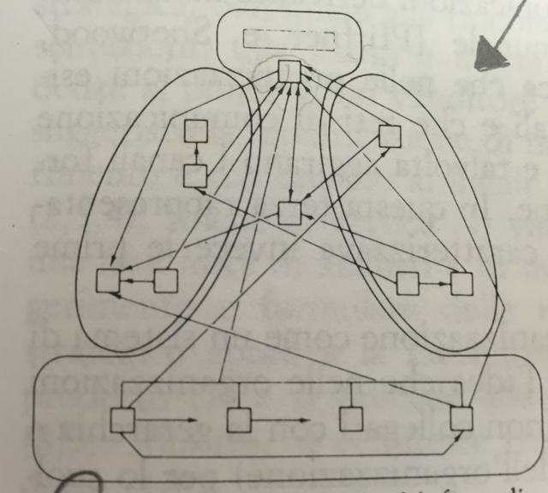
Flow of informal communication
Representation of the real system of communication and power within the organization
It highlights the existence of informal communication flows and «non-official» decision making centres
Focus of mutual adjustement

Slide 34
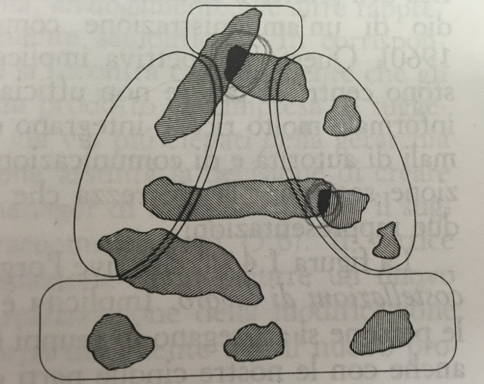
Work constellation
«Work constellation» refers to the creation of groups of people for specific activities
Specific decisions are taken according to the gerarchical position of the constellation

Slide 35
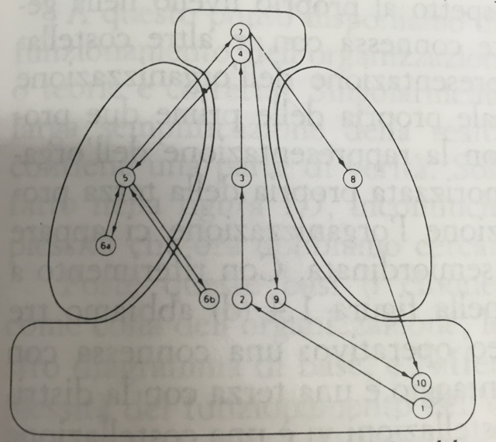
Ad hoc decision-making power
The organization is seen as a set of specific decision-making process

