Slide 1
Management Principles and Human Resources
Martina Dal Molin
mdalmolin@liuc.it
AA 2016/2017

Slide 2
Agenda
Legal forms of companies
Corporate governance
The Annual Financial Report
AA 2016/2017

Slide 3
STAKEHOLDERS and SHAREHOLDERS

Slide 4
Stakeholders
A person, group or organization that has interest or concern in an organization.
Stakeholders can affect or be affected by the organization's actions, objectives and policies
Some examples of key stakeholders are creditors, directors, employees, government (and its agencies), suppliers, unions, and the community from which the business draws its resources.
AA 2016/2017
Notes:
Shareholders have a right to inspect the company's books and records or sue the corporation for misdeeds of the directors and officers, for example. Common shareholders are also entitled to vote on major corporate matters, such as who sits on the board of directors and whether a proposed merger should go through. Most importantly, in the event that a company liquidates its assets as a result of bankruptcy or dissolution, its shareholders have a right to a proportionate allocation of the proceeds.

Slide 5
Shareholders
A shareholder is any person, company or other institution that owns at least one share of a company’s stock. Because shareholders are a company's owners, they reap the benefits of the company's successes in the form of increased stock valuation. If the company does poorly, however, shareholders can lose money if the price of its stock declines.
Shareholders do have rights, which are defined in the corporation's charter and by laws.
Rights and duties of shareholders vary according to the legal form of the company
Notes:
Shareholders have a right to inspect the company's books and records or sue the corporation for misdeeds of the directors and officers, for example. Common shareholders are also entitled to vote on major corporate matters, such as who sits on the board of directors and whether a proposed merger should go through. Most importantly, in the event that a company liquidates its assets as a result of bankruptcy or dissolution, its shareholders have a right to a proportionate allocation of the proceeds.

Slide 6
LEGAL FORMS
AA 2016/2017

Slide 7
Introduction
Economic perspective:
INPUT
COMPANY
OUTPUT
Legal perspective:
Company as owner of rights and duties
Company that acts according the national laws
For a company to start, it is mandatory to select the most suitable legal form
The legal form affects the set of company’s rights and duties
Notes:
Shareholders have a right to inspect the company's books and records or sue the corporation for misdeeds of the directors and officers, for example. Common shareholders are also entitled to vote on major corporate matters, such as who sits on the board of directors and whether a proposed merger should go through. Most importantly, in the event that a company liquidates its assets as a result of bankruptcy or dissolution, its shareholders have a right to a proportionate allocation of the proceeds.

Slide 8
The choice of the legal form
ECONOMIC DIMENSION
RISK
FINANCIAL RESOURCES
LEGAL FORM
TYPE of ACTIVITY
FULLFILMENT OF LEGAL DUTIES
Notes:
Shareholders have a right to inspect the company's books and records or sue the corporation for misdeeds of the directors and officers, for example. Common shareholders are also entitled to vote on major corporate matters, such as who sits on the board of directors and whether a proposed merger should go through. Most importantly, in the event that a company liquidates its assets as a result of bankruptcy or dissolution, its shareholders have a right to a proportionate allocation of the proceeds.

Slide 9
The choice of the legal form
Sole proprietorship (sole trader)
Partnership
Corporation
Limited Company
Limited Liability Company
Nonprofit
Notes:
Shareholders have a right to inspect the company's books and records or sue the corporation for misdeeds of the directors and officers, for example. Common shareholders are also entitled to vote on major corporate matters, such as who sits on the board of directors and whether a proposed merger should go through. Most importantly, in the event that a company liquidates its assets as a result of bankruptcy or dissolution, its shareholders have a right to a proportionate allocation of the proceeds.

Slide 10
Sole proprietorship
The company is owned by only one person
It is the easiest entity to form and maintain, requiring little to no paperwork or approvals to begin
The owner has the full control of the business
Personal assets of the owner are available to pay the debts of the business and your personal obligations may be satisfied by business assets
Limited ability to raise capital
Notes:
Shareholders have a right to inspect the company's books and records or sue the corporation for misdeeds of the directors and officers, for example. Common shareholders are also entitled to vote on major corporate matters, such as who sits on the board of directors and whether a proposed merger should go through. Most importantly, in the event that a company liquidates its assets as a result of bankruptcy or dissolution, its shareholders have a right to a proportionate allocation of the proceeds.

Slide 11
Partnership
Two or more entities join together for a common business purpose
The partners control a partnership according to their agreement. They have a great deal of flexibility
Since a partnership is a voluntary association, you or any partner can end it at any time. Partners can simply say they no longer wish to be a partner.
The death of a partner also automatically ends a partnership.
Notes:
Shareholders have a right to inspect the company's books and records or sue the corporation for misdeeds of the directors and officers, for example. Common shareholders are also entitled to vote on major corporate matters, such as who sits on the board of directors and whether a proposed merger should go through. Most importantly, in the event that a company liquidates its assets as a result of bankruptcy or dissolution, its shareholders have a right to a proportionate allocation of the proceeds.

Slide 12
Corporation
Corporation is a legal entity created under state law
An advantage of corporations is that they insulate you from liability. If the corporation operates according to laws and regulations, creditors only have access to the corporate assets for business debts.
Notes:
Shareholders have a right to inspect the company's books and records or sue the corporation for misdeeds of the directors and officers, for example. Common shareholders are also entitled to vote on major corporate matters, such as who sits on the board of directors and whether a proposed merger should go through. Most importantly, in the event that a company liquidates its assets as a result of bankruptcy or dissolution, its shareholders have a right to a proportionate allocation of the proceeds.

Slide 13
Limited Company
The Limited Company is the most common legal form in use for running a business.
A Limited Company is owned by its members – those who have invested in the business
Limited liability – i.e. the company’s finances are separate from the personal finances of their owners and as a general rule creditors of the business may only pursue the company’s assets to settle a debt.
Notes:
Shareholders have a right to inspect the company's books and records or sue the corporation for misdeeds of the directors and officers, for example. Common shareholders are also entitled to vote on major corporate matters, such as who sits on the board of directors and whether a proposed merger should go through. Most importantly, in the event that a company liquidates its assets as a result of bankruptcy or dissolution, its shareholders have a right to a proportionate allocation of the proceeds.

Slide 14
Limited Liability Company
The LLC is neither a corporation nor a partnership. This type of business entity, when properly structured, is designed to combine the benefits of corporate liability protection with the management flexibility of a partnership.
The control of an LLC is in the hands of the owners, called members, and should be defined in your operating agreement. Members elect managers from among the membership or from outside.
Notes:
Shareholders have a right to inspect the company's books and records or sue the corporation for misdeeds of the directors and officers, for example. Common shareholders are also entitled to vote on major corporate matters, such as who sits on the board of directors and whether a proposed merger should go through. Most importantly, in the event that a company liquidates its assets as a result of bankruptcy or dissolution, its shareholders have a right to a proportionate allocation of the proceeds.

Slide 15
Limited Liability Company
The LLC is neither a corporation nor a partnership. This type of business entity, when properly structured, is designed to combine the benefits of corporate liability protection with the management flexibility of a partnership.
The control of an LLC is in the hands of the owners, called members, and should be defined in your operating agreement. Members elect managers from among the membership or from outside.
Notes:
Shareholders have a right to inspect the company's books and records or sue the corporation for misdeeds of the directors and officers, for example. Common shareholders are also entitled to vote on major corporate matters, such as who sits on the board of directors and whether a proposed merger should go through. Most importantly, in the event that a company liquidates its assets as a result of bankruptcy or dissolution, its shareholders have a right to a proportionate allocation of the proceeds.

Slide 16
Nonprofit
Creating value is not the main reason of partners, but the join each other for other purposes
These purposes may be religious, charitable, scientific, testing for public safety, literacy, educational, fostering a national or international amateur sports competition, or the prevention of cruelty to children or animals.
Nonprofits are prohibited from distributing Net Income to owners, members, directors, or officers but they may pay fair compensation to their employees.
It is controlled by the member themselves
Notes:
Shareholders have a right to inspect the company's books and records or sue the corporation for misdeeds of the directors and officers, for example. Common shareholders are also entitled to vote on major corporate matters, such as who sits on the board of directors and whether a proposed merger should go through. Most importantly, in the event that a company liquidates its assets as a result of bankruptcy or dissolution, its shareholders have a right to a proportionate allocation of the proceeds.

Slide 17
CORPORATE GOVERNANCE
AA 2016/2017

Slide 18
Corporate Goverance
The system of rules, practices and processes by which a company is directed and controlled
Focused on preventing corporate collpases and to ensure profitability and the long term surviror of the company
It essentially involves balancing the interests of the company’s main stakeholders
Primarily concerned with public listed companies and largest corporations
A key concern is the separation between:
Ownership
control
Notes:
Shareholders have a right to inspect the company's books and records or sue the corporation for misdeeds of the directors and officers, for example. Common shareholders are also entitled to vote on major corporate matters, such as who sits on the board of directors and whether a proposed merger should go through. Most importantly, in the event that a company liquidates its assets as a result of bankruptcy or dissolution, its shareholders have a right to a proportionate allocation of the proceeds.

Slide 19
Corporate Goverance
The system of rules, practices and processes by which a company is directed and controlled
Focused on preventing corporate collpases and to ensure profitability and the long term surviror of the company
It essentially involves balancing the interests of the company’s main stakeholders
Primarily concerned with public listed companies and largest corporations
A key concern is the separation between:
Ownership
control
Notes:
Shareholders have a right to inspect the company's books and records or sue the corporation for misdeeds of the directors and officers, for example. Common shareholders are also entitled to vote on major corporate matters, such as who sits on the board of directors and whether a proposed merger should go through. Most importantly, in the event that a company liquidates its assets as a result of bankruptcy or dissolution, its shareholders have a right to a proportionate allocation of the proceeds.

Slide 20
Ownership and control (1/2)
You are the manager of a company and you have to decide on an investment, that:
Will give you a personal “profit” of 100.00 euro
Will provide a company loss of 100.00 euro
What will you decide?
Notes:
Shareholders have a right to inspect the company's books and records or sue the corporation for misdeeds of the directors and officers, for example. Common shareholders are also entitled to vote on major corporate matters, such as who sits on the board of directors and whether a proposed merger should go through. Most importantly, in the event that a company liquidates its assets as a result of bankruptcy or dissolution, its shareholders have a right to a proportionate allocation of the proceeds.

Slide 21
Ownership and control (2/2)
Typically, we have:
When
OWNERSHIP = CONTROL
CONFLICT of INTERESTS
OWNERSHIP
CONTROL
Shareholders
Managers
Notes:
Shareholders have a right to inspect the company's books and records or sue the corporation for misdeeds of the directors and officers, for example. Common shareholders are also entitled to vote on major corporate matters, such as who sits on the board of directors and whether a proposed merger should go through. Most importantly, in the event that a company liquidates its assets as a result of bankruptcy or dissolution, its shareholders have a right to a proportionate allocation of the proceeds.

Slide 22
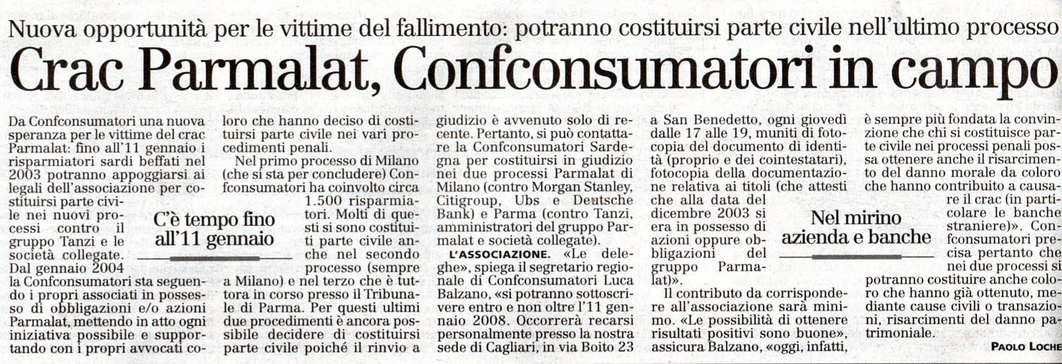
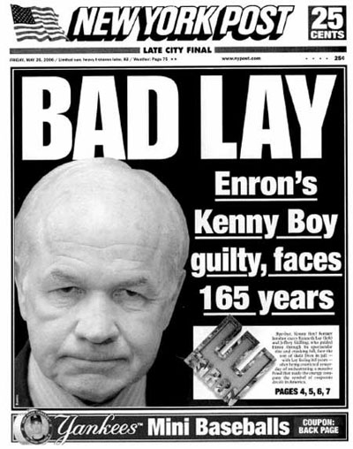
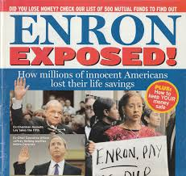
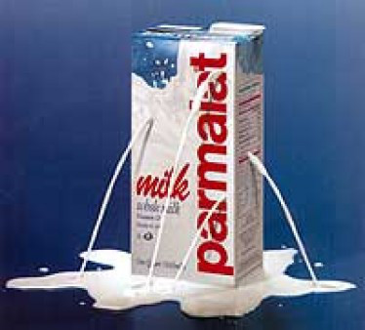
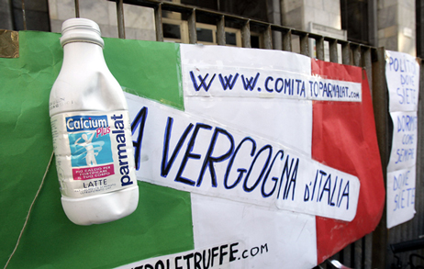
Why we need corporate governance?
To share performance
Better access to external finance
Improved company performance
To reduce the risk of corporate crisi and scandals
Notes:
Shareholders have a right to inspect the company's books and records or sue the corporation for misdeeds of the directors and officers, for example. Common shareholders are also entitled to vote on major corporate matters, such as who sits on the board of directors and whether a proposed merger should go through. Most importantly, in the event that a company liquidates its assets as a result of bankruptcy or dissolution, its shareholders have a right to a proportionate allocation of the proceeds.

Slide 23
Corporate Goverance: parties and bodies
PARTIES:
Shareholders
Directors
Managers
BOARDS:
Shareholders annual general meetings
Board of Directors (B of D)
Notes:
Shareholders have a right to inspect the company's books and records or sue the corporation for misdeeds of the directors and officers, for example. Common shareholders are also entitled to vote on major corporate matters, such as who sits on the board of directors and whether a proposed merger should go through. Most importantly, in the event that a company liquidates its assets as a result of bankruptcy or dissolution, its shareholders have a right to a proportionate allocation of the proceeds.

Slide 24
Shareholder annual general meeting
It is a meeting of all shareholders of a company, held every year to:
Appoint the board of directors
Approve the Annual Financial Report of the company for the past year
Take any other decision
In most of the systems, the annual general meeting is required by law
All decisions are taken by voting - one share, one vote – and different majorities are required
It is an opportunity for the shareholders for asking any questions to the members of the board about past and future decisions
Notes:
Shareholders have a right to inspect the company's books and records or sue the corporation for misdeeds of the directors and officers, for example. Common shareholders are also entitled to vote on major corporate matters, such as who sits on the board of directors and whether a proposed merger should go through. Most importantly, in the event that a company liquidates its assets as a result of bankruptcy or dissolution, its shareholders have a right to a proportionate allocation of the proceeds.

Slide 25
Board of Directors: composition (1/2)
It strongly influences the corporate governance: it is the highest authority in the management and supervision of the corporation
It is tasked with making important decision (e.g. defining the divided policy)
Board activities are determined by the powers, duties, and responsibilities conferred by the organization’s law (i.e. internal rules)
It is often composed by:
Inside members, that are the major shareholders, funders an executives
Independent directors, chosen for their experience og managing and directing other large companies
Notes:
Shareholders have a right to inspect the company's books and records or sue the corporation for misdeeds of the directors and officers, for example. Common shareholders are also entitled to vote on major corporate matters, such as who sits on the board of directors and whether a proposed merger should go through. Most importantly, in the event that a company liquidates its assets as a result of bankruptcy or dissolution, its shareholders have a right to a proportionate allocation of the proceeds.

Slide 26
Board of Directors: composition (2/2)
Inside Director
A director who has a relevant connection with the organization (shareholder, manager, …)
Outside Director
A director who has no meaningful connection to the organization
Executive Director
An inside director is also Executive director as:
CEO
CFO
COO
Non-executive Director
A director who is not an executive within the organization
Notes:
Shareholders have a right to inspect the company's books and records or sue the corporation for misdeeds of the directors and officers, for example. Common shareholders are also entitled to vote on major corporate matters, such as who sits on the board of directors and whether a proposed merger should go through. Most importantly, in the event that a company liquidates its assets as a result of bankruptcy or dissolution, its shareholders have a right to a proportionate allocation of the proceeds.

Slide 27
Board of Directors: responsabilities, power and functions
Establishing the corporate strategy, significant policies and objectives;
Taking decisions for significant issues
Establishing the internal control system
Selecting, appointing, supporting and reviewing the performance of the CEO
Approving the annual budget and preparing the Annual Financial Report
Accounting to the stakeholders for the organization’s performance
Ensuring the availability of adequate financial resources
Setting the salaries and compensation of company management
Defining the amount of dividends yearly paid to the shareholders
Notes:
Shareholders have a right to inspect the company's books and records or sue the corporation for misdeeds of the directors and officers, for example. Common shareholders are also entitled to vote on major corporate matters, such as who sits on the board of directors and whether a proposed merger should go through. Most importantly, in the event that a company liquidates its assets as a result of bankruptcy or dissolution, its shareholders have a right to a proportionate allocation of the proceeds.

Slide 28
Corporate Governance: four pillars
ACCOUNTABILITY
FAIRNESS
TRANSPARENCY
INDEPENDENCE
Notes:
Shareholders have a right to inspect the company's books and records or sue the corporation for misdeeds of the directors and officers, for example. Common shareholders are also entitled to vote on major corporate matters, such as who sits on the board of directors and whether a proposed merger should go through. Most importantly, in the event that a company liquidates its assets as a result of bankruptcy or dissolution, its shareholders have a right to a proportionate allocation of the proceeds.

Slide 29
Corporate Governance: four pillars
ACCOUNTABILITY
Ensure that management is accountable to the Board
Ensure that the Board is accountable to shareholders
FAIRNESS
Protect shareholders rights
Treat all shareholders (including minorities) equitably
Provide effective redress for violation
Notes:
Shareholders have a right to inspect the company's books and records or sue the corporation for misdeeds of the directors and officers, for example. Common shareholders are also entitled to vote on major corporate matters, such as who sits on the board of directors and whether a proposed merger should go through. Most importantly, in the event that a company liquidates its assets as a result of bankruptcy or dissolution, its shareholders have a right to a proportionate allocation of the proceeds.

Slide 30
Corporate Governance: four pillars
TRANSPARENCY
Ensure timely, accurate disclosure on all material matters, including the financial situation, performance, ownership and corporate governance
INDEPENDENCE
Procedures and structures are in place as to minimize, or avoid completely conflicts of interest
Independent Directors and Advisers, i.e. free from others’ influence
Notes:
Shareholders have a right to inspect the company's books and records or sue the corporation for misdeeds of the directors and officers, for example. Common shareholders are also entitled to vote on major corporate matters, such as who sits on the board of directors and whether a proposed merger should go through. Most importantly, in the event that a company liquidates its assets as a result of bankruptcy or dissolution, its shareholders have a right to a proportionate allocation of the proceeds.

Slide 31
THE COMPANY, STAKEHOLDERS, AND THE FINANCIAL REPORTS
AA 2016/2017

Slide 32
The company and its stakeholders
Will the company pay for raw materials?
Can we grant a loan to the company?
BANK
SUPPLIERS
Is the company able to favor local development?
MANAGEMENT
EMPLOYEES
Will I receive my salary?
LOCAL COMMUNITIES
CUSTOMERS
Will the company pay taxes?
Am I satisfied by the goods of the company?
PUBLIC INSTITUTIONS
Notes:
Shareholders have a right to inspect the company's books and records or sue the corporation for misdeeds of the directors and officers, for example. Common shareholders are also entitled to vote on major corporate matters, such as who sits on the board of directors and whether a proposed merger should go through. Most importantly, in the event that a company liquidates its assets as a result of bankruptcy or dissolution, its shareholders have a right to a proportionate allocation of the proceeds.

Slide 33
Stakeholders and company’s report (1/2)
All the stakeholders have the necessity to know if the company has the ability to satisfy their needs
The ability of satisfying the stakeholders’ needs depends on the generation of resources that has to be bigger than those absorbed
To know if there is this kind of ability, stakeholders must have economical information and data of the company.
The question is: is it an healthy company?
Notes:
Shareholders have a right to inspect the company's books and records or sue the corporation for misdeeds of the directors and officers, for example. Common shareholders are also entitled to vote on major corporate matters, such as who sits on the board of directors and whether a proposed merger should go through. Most importantly, in the event that a company liquidates its assets as a result of bankruptcy or dissolution, its shareholders have a right to a proportionate allocation of the proceeds.

Slide 34
Stakeholders and company’s report (2/2)
Asymmetric information between managers and stakeholders
The company has to reduce this gap through an effective communication
Among the different communication channels (e.g. websites, articles in press, social and environmental reports, …), the traditional and the more effective tool is the Annual Financial Report
By reading the Annual Financial Report, you know if the company is able to satisfy all its stakeholders
Notes:
Shareholders have a right to inspect the company's books and records or sue the corporation for misdeeds of the directors and officers, for example. Common shareholders are also entitled to vote on major corporate matters, such as who sits on the board of directors and whether a proposed merger should go through. Most importantly, in the event that a company liquidates its assets as a result of bankruptcy or dissolution, its shareholders have a right to a proportionate allocation of the proceeds.

Slide 35
The basic idea
Event
Rules
Annual Financial Report
Notes:
Shareholders have a right to inspect the company's books and records or sue the corporation for misdeeds of the directors and officers, for example. Common shareholders are also entitled to vote on major corporate matters, such as who sits on the board of directors and whether a proposed merger should go through. Most importantly, in the event that a company liquidates its assets as a result of bankruptcy or dissolution, its shareholders have a right to a proportionate allocation of the proceeds.

Slide 36
Financial Accounting
Financial accounting is the activity of:
Reporting to stakeholders historical financial information
Emphasis on financial consequences of past activities, objectivity and verifiability
Mandatory for Annual Financial Report
Notes:
Shareholders have a right to inspect the company's books and records or sue the corporation for misdeeds of the directors and officers, for example. Common shareholders are also entitled to vote on major corporate matters, such as who sits on the board of directors and whether a proposed merger should go through. Most importantly, in the event that a company liquidates its assets as a result of bankruptcy or dissolution, its shareholders have a right to a proportionate allocation of the proceeds.

Slide 37
Pros and cons of the financial report
PROS
Public and mandatory document
Available every year
Available for every company
Presented in a standard way
Written according to well known rules
CONS
It looks back to the past
It doesn’t tell us the entire story
It can contain false or manipulatedinformation
Notes:
Shareholders have a right to inspect the company's books and records or sue the corporation for misdeeds of the directors and officers, for example. Common shareholders are also entitled to vote on major corporate matters, such as who sits on the board of directors and whether a proposed merger should go through. Most importantly, in the event that a company liquidates its assets as a result of bankruptcy or dissolution, its shareholders have a right to a proportionate allocation of the proceeds.

Slide 38
The componenets of the financial report
THE LETTER TO SHAREHOLDERS
It gives a broad overview of the company’s business and financial performance
THE BUSINESS REVIEW
It summarizes a company’s recent developments, trends and objectives
THE FINANCIAL REVIEW
It presents a company’s business performance in monetary term
It is composed by:
Management’s discussion and analysis
Financial statement:
Balance sheet
Income statement
Cash flow statement
Notes:
Shareholders have a right to inspect the company's books and records or sue the corporation for misdeeds of the directors and officers, for example. Common shareholders are also entitled to vote on major corporate matters, such as who sits on the board of directors and whether a proposed merger should go through. Most importantly, in the event that a company liquidates its assets as a result of bankruptcy or dissolution, its shareholders have a right to a proportionate allocation of the proceeds.

Slide 39
Balance Sheet
It provides a financial picture of the company in a specific moment of time (t)
It is composed by two opposite parts
ASSETS = LIABILITIES
ASSET SIDE OF THE BALANCE SHEET | LIABILITY SIDE OF THE BALANCE SHEET
Resources that can contribute to generate financial flows | Rights over resources: Shareholders Third parties
Notes:
Shareholders have a right to inspect the company's books and records or sue the corporation for misdeeds of the directors and officers, for example. Common shareholders are also entitled to vote on major corporate matters, such as who sits on the board of directors and whether a proposed merger should go through. Most importantly, in the event that a company liquidates its assets as a result of bankruptcy or dissolution, its shareholders have a right to a proportionate allocation of the proceeds.

Slide 40
Income Statement
It synthetizes the economic flows related to the company’s activities
It is based on the accrual accounting principles, according to:
Revenue/income (accrual accounting) = effective alienation of the good or service
Cost (accrual accounting) = amount of resources used to produce the specifc goos or services that create value during the financial exercise
Notes:
Shareholders have a right to inspect the company's books and records or sue the corporation for misdeeds of the directors and officers, for example. Common shareholders are also entitled to vote on major corporate matters, such as who sits on the board of directors and whether a proposed merger should go through. Most importantly, in the event that a company liquidates its assets as a result of bankruptcy or dissolution, its shareholders have a right to a proportionate allocation of the proceeds.

Slide 41
Cash Flow Statement
It synthetizes the financial flows related to the yearly activity of the company:
(INITIAL) CASH
+ CASH REVENUE
CASH OUTFLOWS
= (FINAL) CASH
It gives information on the ability of the company to self-finance its actrivities
Notes:
Shareholders have a right to inspect the company's books and records or sue the corporation for misdeeds of the directors and officers, for example. Common shareholders are also entitled to vote on major corporate matters, such as who sits on the board of directors and whether a proposed merger should go through. Most importantly, in the event that a company liquidates its assets as a result of bankruptcy or dissolution, its shareholders have a right to a proportionate allocation of the proceeds.

