Slide 1
Management Principles and Human Resources
Martina Dal Molin
mdalmolin@liuc.it
AA 2016/2017

Slide 2
Agenda
Assets
Liabilities
AA 2016/2017

Slide 3
INTRODUCTION

Slide 4
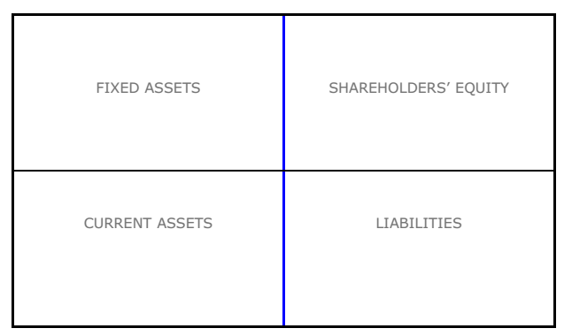
The Balance Sheet (1/5)
It provides a financial picture of the company in a specific moment of time (t)
It shows what the company owns and what it owes
It is composed by two opposite parts

Slide 5
The Balance Sheet (2/5)
It is composed by two opposite parts:
ASSETS, always presented first
SHAREHOLDERS EQUITY and LIABILITIES
In the standard accounting model we have:
ASSETS = SHAREHOLDERS’ EQUITY + LIABILITIES
Indeed, from an economic point of view, each euro (or dollar, ..) of assets MUST be funded by a dollar of liabilities or equity
Reported assets, liabilities and equity are subdivided into line items or groups of similar account having a monetary amount

Slide 6
The Balance Sheet (3/5)
ASSETS = SHAREHOLDERS’ EQUITY + LIABILITIES
SHAREHOLDERS’ EQUITY = ASSETS - LIABILITIES
E1 = A1 – L1
R2 = Revenues
C2 = Costs
E2 = Equity
E2 = R2 – C2
E2 – E1 = R2 – C2
E2 = E1 + R2 – C2

Slide 7
The Balance Sheet (4/5)
ASSETS SECTION
It includes all the goods and property owned by the company and uncollected amount due to the companies from others
SHAREHOLDERS’ EQUITY SECTION
It represents the shareholders’ ownership interest in the company (i.e. what the company’s assets would be worth after all claims upon those assets were paid)
LIABILITIES SECTION
It includes all debts and amount payables to other parties

Slide 8
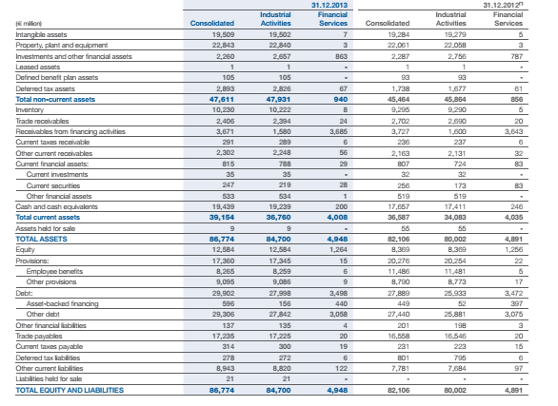

Slide 9
Understanding the basic logic
The story of Mr. Smith

Slide 10
THE BALANCE SHEET: ASSETS

Slide 11
Assets: basic model (1/2)
Assets represent the monetary value of the resources owned by the company:
Technological and financial resources
Human resources and resources related to the company’s image
The economic value represents the expected cash flow related to the use of such resources
The assest side of the BS reports only the resources that can be expressed with a monetary value

Slide 12
Assets: basic model (2/2)
Resources are organized and presented according to their temporal usability with respect to the operational cycle of the company (in general 12 months):
Non current assets – usability < 12 months
Current assets – usability > 12 months
Discontinuing operations – usability = 0

Slide 13
How to account for assets?
Criteria used to account for assets generally are:
Acquisition cost
Fair value
Value in use

Slide 14
Acquisition cost
Price payed by the company to buy the resource (or to have the benefits related to the use of the resource)
E.g. the price payed by the company to buy a production plant
Cost sustained by the company to develop/produce the resource
E.g. the economic value of the inputs used to develop a specific plant
Notes:
Shareholders have a right to inspect the company's books and records or sue the corporation for misdeeds of the directors and officers, for example. Common shareholders are also entitled to vote on major corporate matters, such as who sits on the board of directors and whether a proposed merger should go through. Most importantly, in the event that a company liquidates its assets as a result of bankruptcy or dissolution, its shareholders have a right to a proportionate allocation of the proceeds.

Slide 15
Fair value
Price following which the resource could be exchange and sold on the market
E.g. the willingness to pay of the company A to buy a plant of the company B
Fair value reflects objective values determined outside the company and linked the market value of that resource
Notes:
Shareholders have a right to inspect the company's books and records or sue the corporation for misdeeds of the directors and officers, for example. Common shareholders are also entitled to vote on major corporate matters, such as who sits on the board of directors and whether a proposed merger should go through. Most importantly, in the event that a company liquidates its assets as a result of bankruptcy or dissolution, its shareholders have a right to a proportionate allocation of the proceeds.

Slide 16
Value in use
Value of the financial flows for the company that are related to the use of the resources
E.g. for a specific equipment that produces the good x, the value in use of that equipment is represented by the flow of costs and revenues related to the production of x.

Slide 17
Asstes side of the BS: the model
NON CURRENT ASSETS/FIXED ASSETS
Property, Plant and Equipment
Investment properties
Start-up and intangible activities with indefinite useful life
Holdings
Other financial activities
CURRENT ASSETS
Receivable (commercial credits)
Inventories
Work in progress on ordination
Current financial activities
Cash
DISCONTINUIUNG OPERATIONS

Slide 18
Property, Plant and Equipment: description
The item refers to the goods owned by the company, that are tangible and that have a durable use and that are used by the company to produce profit
Some examples:
Production plants
Administrative buildings, industrial areas
Lands used by the company to carry out its own activities
Ships, aircrafts
Equipment, facilities

Slide 19
Property, Plant and Equipment: description
The item refers to the goods owned by the company, that are tangible and that have a durable use and that are used by the company to produce profit
Some examples:
Production plants
Administrative buildings, industrial areas
Lands used by the company to carry out its own activities
Ships, aircrafts
Equipment, facilities

Slide 20
Property, Plant and Equipment: accounting
Initial Value: acquisition cost, therefore:
Price payed by the company to buy the good
Cost for the development of the good
Value after: two criteria for the evaluation
Cost less depreciation
Fair value

Slide 21
Property, Plant and Equipment: VALUE after (1)
COST LESS DEPRECIATION
With respect to goods that have a durable useful life, a depreciation must be calculated
DEPRECIATION
It refers to the amount of the acquisition cost that must be reduced (from the initial acquisition cost) after the use of the good
It is an accounting convention that allows a company to write-off the value of an asset over time
It is considered a non-cash transaction

Slide 22
Property, Plant and Equipment: VALUE after (1)
HOW TO CALCULATE THE DEPRECIATION
We need (for the good x):
Acquisition cost
Residual value
Useful life
DEPRECIATION = (ACQUISITION COST – RESIDUAL VALUE) / USEFUL LIFE
VALUE of the GOOD X
Value Good x (t) = ACQUISITION COSTS - Ʃ DEPRECIATION ( 0 t)

Slide 23
Property, Plant and Equipment: VALUE after (1)
Ever year, the BS reports the acquisition cost less depreciation
Example
Plant bought 31/12/2011, 1.000 k€
Useful life: 5 years
Residual value: 200 k€
Depreciation = (1.000 – 200)/5 = 160
 | 2011 | 2012 | 2013 | 2014 | 2015 | 2016 | 2017
Value | 1.000 | 840 | 680 | 520 | 360 | 200 | 0
Deprec. | 0 | 160 | 160 | 160 | 160 | 160

Slide 24
Property, Plant and Equipment: VALUE after (1)
FAIR VALUE
Every year, the value reported is the fair value, i.e. the current value on the market
The fair value is then compared with the expected value of the good (on the BS) and:
Fair value > expected value = re-evaluation (value of the good )
Fair value < expected value = write-down (value of the good )
In both cases, the depreciation must be re-calculated
The changed value of the good should be accounted in the “reserve” of the BS (liabilities)

Slide 25
Property, Plant and Equipment: VALUE after (2)
FAIR VALUE
Example:
A plant was bought on the 31/12/2001 (useful life 30 years) for a price of 300.000 €
In 2006, the fair value of the good is 275.000€ (initial value in 2006: 250.000)
How to account for this change and what is the value of the good?

Slide 26
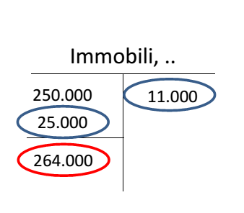
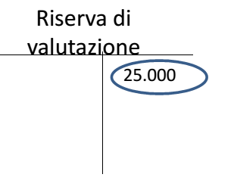
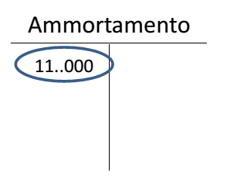
Property, Plant and Equipment: VALUE after (1)
FAIR VALUEExample:
1) Increase of 25.000 (275.000 – 250.000) in Property, Plant and Equipment
2) Increase of 25.000 in Revaluation Reserve
3) Calculate the depreciation
Depreciation= 275.000/25 years = 11.000€
The value of the good (in 2016) is 264.000
Depreciation
Property, …
Reserve

Slide 27
Property, Plant and Equipment: Impairment test (1/2)
It is implemented to verify possible durable loss of value and to identify the possible how much of the recoverable amount of the asset
Recoverable amount = max (fair value – charges to the sale; usable value)
To account for, we should chose the minimum value between the linear model and the value in use

Slide 28
Property, Plant and Equipment: Impairment test (2/2)
Example: consider three different e valuations for three equipments
Evaluation | Equipment 1 | Equipment 2 | Equipment 3
Linear model | 840 | 520 | 200
Fai value | 500 | 300 | 300
Usable value | 400 | 400 | 400
Linear model | 840 | 520 | 200
Max (fair value; usable value) | 500 | 400 | 400
Accounting Min [linear model; max (fair value; usable value)] | 500 | 400 | 200

Slide 29
Investment properties: description
The item refers to the properties of the company, owned to receive the payment of a rent.
It refers, therefore, to all the properties that are not used for the core activities of the company
Some examples:
Lands for investments
Buildings of the company, but rent to third parties to receive
Concept of
Financial leasing
Operational leasing

Slide 30
Investment properties: accounting
Initial Value: acquisition cost, therefore:
Price payed
Cost
Value after: two criteria for the evaluation
Fair value
Cost less depreciation

Slide 31
Investment properties: VALUE after
FAIR VALUE
Every year, the value of the property = fair value
We do not have to calculate the depreciation
Changes in the fair value are accounted as revenue or cost following the accrual accounting principle
No impairment test
COST
Every year, the value of the property = acquisition cost – depreciation
But the depreciation has not to be calculated
Therefore the impairment test is necessary

Slide 32
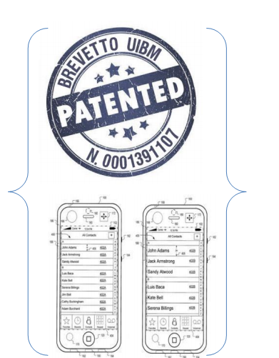
Start-up and intangible activities: description
It refers to intangible goods, controlled by the company, that are able to produce future revenues
BRANDS
PATENTS and LICENSES

Slide 33
Start-up and intangible activities: description
Depending on their lives, intangibles can be distinguished in two categories:
Intangible with indefinite life (e.g. brands)
Intangible with definite life (e.g. cost products development)

Slide 34
Intangible: Start-up and goodwill
It refers to:
Business Corporation
It represents the potential increases of the company’s financial flows
INITIAL VALUE
Difference between the acquisition cost and the current value of assets and liabilities when the transaction occurred:
Positive value – assets
Negative value – cost (accrual accounting)
AFTER VALUE
Depreciation has not to be calculated BUT
The Impairment test has to be done once a year
Losses of value should be accounted as cost (accrual accounting)

Slide 35
Intangible: Brands
INITIAL VALUE
Model of cost, therefore:
Price payed to use the resource (the brand)
Cost of the “inside” production
AFTER VALUE
Depreciation has not to be calculated BUT
The Impairment test has to be done once a year
Losses of value should be accounted as cost (accrual accounting)

Slide 36
Intangible: Costs of development
It refers to:
Cost related to internal design and production
Cost related to external design and production
Overhead related to project
INITIAL VALUE
Model of cost, therefore:
Price payed to use the resource (the brand)
Cost of the “inside” production
AFTER VALUE
Defined life: acquisition cost less depreciation
Indefinite life: impairment test

Slide 37
Holdings: description
The item refers to the share owned by the company with respect to other companies ( = the company is a shareholder of other companies)
Other companies:
Controlled companies
Linked companies
Joint ventures
Control:
When the company A has, directly or indirectly, more than 50% of the votes in the general assembly of the company B
When the company A, although it doesn’t have more than 50% of votes has a relevant power with respect to B of D

Slide 38
Holdings: accounting
Initial Value: acquisition cost, that, in this case is equal to the fair value + transaction costs
Value after:
Fair value
Cost

Slide 39
Other financial activities: description
The item refers, in general, to equity instruments
Securities and financial instruments, i.e. every contract between two companies that represents:
A financial asset for the company A
A financial liability for the company B
INITIAL VALUE
Acquisition costs
IMPAIRMENT TEST
Mandatory
Losses are accounted in the Income Statement

Slide 40
Asstes side of the BS: the model
NON CURRENT ASSETS/FIXED ASSETS
Property, Plant and Equipment
Investment properties
Start-up and intangible activities with indefinite useful life
Holdings
Other financial activities
CURRENT ASSETS
Receivable (commercial credits)
Inventories
Work in progress on ordination
Current financial activities
Cash and cash equivalent
DISCONTINUIUNG OPERATIONS

Slide 41
Receivables: description
The item refers, in general, to commercial credits that are accounted according to expected value oh having the credits
Difference between the nominal value of the credit and the expected loss
INITIAL VALUE
Acquisition costs
IMPAIRMENT TEST
To be executed periodically

Slide 42
Inventories: description
The item refers to:
Finished goods that will be sell on the market
Raw material that will be used to produce finished goods
INITIAL VALUE
We have to choose the lower value between:
Acquisition cost
Net value to realize the good
If there is a de-evaluation of inventories, the related loss of value represent a cost (accrual accounting – Income Statement)

Slide 43
Inventories: accounting
ACQUISITION COST
All the cost related to the production of the good are considered here
Two method could be applied:
FIFO method (First In; First Out)
Average weighted Cost: every unit of the goods are bought at the same price
NET VALUE
Estimate sale price - (cost to finish the good + estimated cost of sale)

Slide 44
WIP on ordination: description and account
The item refers to a contract put in place to develop a product or a set interrelated set of goods (for their design, production and technology)
To account for this WIP, it is necessary to define the State of Progress, through one of the three methods:
Costs
Delivered units
Physical measurement

Slide 45
Current financial activities: description and account
The item refers to financial assets (e.g. obligations) that are owned to be negotiated or to be sold
INITIAL AND AFTER VALUE
Fair value
Changes of the value should be accounted as:
Profit or loss (accrual accounting)
The same amount of money should be balanced on the item Reserve (liabilities)

Slide 46
Cash: description and account
The item refers to:
Cash
financial assets payable in a short time period
Current account
INITIAL AND AFTER VALUE
Current monetary value

Slide 47
Asstes side of the BS: the model
NON CURRENT ASSETS/FIXED ASSETS
Property, Plant and Equipment
Investment properties
Start-up and intangible activities with indefinite useful life
Holdings
Other financial activities
CURRENT ASSETS
Receivable (commercial credits)
Inventories
Work in progress on ordination
Current financial activities
Cash
DISCONTINUIUNG OPERATIONS

Slide 48
Discontinuing operations: description and account
The item refers to a heterogeneous item in which we can find all the activities that are going to finish or that have been sold before the end of the accounting year, but before the definition of the BS
Each item should be accounted following its specific rules, but the depreciation has not to be calculated

Slide 49
THE BALANCE SHEET: LIABILITIES

Slide 50
The Balance Sheet
It provides a financial picture of the company in a specific moment of time (t)
It shows what the company owns and what it owes
It is composed by two opposite parts

Slide 51
Balanche Sheet: liabilities
The liabilities side of the Balance Sheet reports the monetary value of the rights that shareholders and third parties have with respect to the company’s assets
A liability is a contractual or legal obligation that is due and payable to a “third party”
A third party is a subject external to the company (e.g. banks, suppliers, employees,…)
We distinguish between:
Equity, i.e. the rights of the shareholders
Liabilities, i.e. rights of third parties (current and non current)

Slide 53
Liabilities side of the BS: the model
EQUITY
Issued capital
Reserves
Retained earning
Net income/loss
NON CURRENT (LONG-TERM) LIABILITIES
Non current financial liabilities:
Obligation
Debt to banks
Other non current financial liabilities
Provision for risks and charges
Funds related to personnel
CURREENT LIABILITIES
Non current financial liabilities:
Obligation
Debt to banks
Other non current financial liabilities
Debt to suppliers
Tax liability
Other debts
DISCOINTINUING LIABILITIES

Slide 54
Shareholders’ Equity
Equity = Assets – liabilities
It represents the amount of funds contributed by the owners (the shareholders) plus the retained earnings (or losses).
It represents the rights of the shareholders over the company
The item comprehends:
Issued share capital
Reserves
Net Income/Loss

Slide 55
Issued Share Capital
Share capital refers to the amount of funding a company raises through the sale of shares of stock to public investors. Share capital constitutes the main source of equity financing and can be generated through the sale of common or preferred shares.
Issued share capital refers to the monetary value of the shares of stock a company actually offers for sale to investors. The number of issued shares generally corresponds to the amount of subscribed share capital, though neither amount can exceed the authorized amount.

Slide 56
Issued Share Capital: capital increase
When new shares are issued, the capital increase (liabilities) is equal to:
Capital increase = n. of new shares * nominal value of new shares
When new shares are issued, we also have a financial flow (cash in) – assets side of the BS
Cash in = n. of new shares * market value of the new shares

Slide 57
Capital increase: three cases
MARKET PRICE = NOMINAL VALUE
Value of the capital increase = n. of new shares*nominal value
Cash in= n. of new shares*market price
2) MARKET PRICE is DIFFERENT from the NOMINAL VALUE
Value of the capital increase = n. of new shares*nominal value
Cash in= n. of new shares*market price
Share premium account = n. of new shares* (MP – NV)
3) CAPITAL INCREASE WITHOUT NEW SHARES
Value of the capital increase = n. of new shares*nominal value
Cash in= 0
Share premium account = n. of new shares* nominal value

Slide 58
Reserves
Reserves represent other type of rights of the shareholders, that derives from the ordinary activities of the company
In general, we can distinguish between:
Share premium account
Retained earnings
Revaluation reserves
Other reserves

Slide 59
Share premium account
The reserve increases when new shares are issued by the company and their market price is higher that their nominal value
In this case the difference (MP and NV) that originate a cash flow in are balanced through the modification the share premium account item

Slide 60
Retained earnings
Income of the previous year, not used as divided for sharholders
Example
Revenues of the previous year = 100.000 k€
30% of revenues are dividens for shareholders
What is the amount of retained earning?

Slide 61
Revaluation reserve (1/2)
Modification of the value of one asset item (e.g. fair value or impairment test)

Slide 62
Revaluation reserve (2/2)
1) Increase of 25.000 (275.000 – 250.000) in Property, Plant and Equipment
2) Increase of 25.000 in Revaluation Reserve
3) Calculate the depreciation
Depreciation= 275.000/25 years = 11.000€
The value of the good (in 2016) is 264.000
Depreciation
Property, …
Reserve

Slide 63
Other reserves
The item refers to:
Legal reserve (in Italy)
Statutory reserve

Slide 64
Net Income/loss
The item refers to the economic results realized during the year owen by the shareholders
It is determined as Total assets - liabilities

Slide 65
Liabilities side of the BS: the model
EQUITY
IssuedIssued capital
Reserves
Retained earning
Net income/loss
NON CURRENT (LONG-TERM) LIABILITIES
Non current financial liabilities:
Obligation
Debt to banks
Other non current financial liabilities
Provision for risks and charges
Funds related to personnel
CURREENT LIABILITIES
Non current financial liabilities:
Obligation
Debt to banks
Other non current financial liabilities
Debt to suppliers
Tax liability
Other debts
DISCOINTINUING LIABILITIES

Slide 66
Non current financial liabilities
The item refers to financial liabilities that are due beyond the normal productive cycle of the company (12 months)
Non current financial liabilities include:
Obligation
Debt to banks
Other non current financial liabilities

Slide 67
Non current financial liabilities: Obligations
In general, financial obligations represent any outstanding debts or regular payments that one must make.
Almost any form of money represents a financial obligation (e.g. coins, bank notes or bonds) all promises that you will be credited the accepted value of the item.
They are qualifying debt item provided by the company to collect money
The company ensure to third parties that they will have an interest rate and the reimbursement of money at the end of the defined period

Slide 68
Non current financial liabilities: Debt to bank
The item includes all the financial debt of the company with respect to bank, credit institution
They are expected to finish in 12 months

Slide 69
Provision for risk and charges
The item includes liabilities that have an uncertain amount or expiring date according to which the company has an obligation as results of a past event
Some examples:
Fund for legal disputes
Tax fund

Slide 70
Funds related to personnel
The item includes all the obligation of the company with respect to their employees (i.e. the item represents the rights of the employees over the resources of the company)
Concept of TFR

Slide 71
Liabilities side of the BS: the model
EQUITY
Issued capital
Reserves
Retained earning
Net income/loss
NON CURRENT (LONG-TERM) LIABILITIES
Non current financial liabilities:
Obligation
Debt to banks
Other non current financial liabilities
Provision for risks and charges
Funds related to personnel
CURREENT LIABILITIES
Non current financial liabilities:
Obligation
Debt to banks
Other non current financial liabilities
Debt to suppliers
Tax liability
Other debts
DISCOINTINUING LIABILITIES

Slide 72
Non current financial liabilities
The item refers to financial liabilities that are due during the normal productive cycle of the company (12 months)
Non current financial liabilities include:
Obligation
Debt to banks
Other non current financial liabilities

Slide 73
Debt to suppliers
The item refers to the debts that the company has with respect to its suppliers. The item includes:
Commercial debt
Debt related to services
Debt of professional services

Slide 74
Tax debt
The item refers to the amount of money that the company should èay to the fiscal authority at the end of the productive cycle

Slide 75
Liabilities side of the BS: the model
EQUITY
Issued capital
Reserves
Net income/loss
NON CURRENT (LONG-TERM) LIABILITIES
Non current financial liabilities:
Obligation
Debt to banks
Other non current financial liabilities
Provision for risks and charges
Funds related to personnel
CURREENT LIABILITIES
Non current financial liabilities:
Obligation
Debt to banks
Other non current financial liabilities
Debt to suppliers
Tax liability
Other debts
DISCOINTINUING LIABILITIES

Slide 76
Discountinuing liabilities
The item simply refers to the liabilities related to the discountinuing assets

Slide 77
THE RECLASSIFICATION OF THE BALANCE SHEET

Slide 78
The Balance Sheet
ASSETS
LIABILITIES
NON CURRENTS ASSETS
Property, Plant and Equipment
Intangible assets
Financial assets
SHAREHOLDERS EQUITY
Issued capital
Reserves
Retained earning
Net income/loss
CURRENTS ASSETS
Receivable (commercial credits)
Inventories
Work in progress on ordination
Current financial activities
Cash and cash equivalent
LIABILITIES
Current liabilities
Non current liabilities

Slide 79
The reclassification of the Balance Sheet
Does the Balance Sheet allow us to understand the “state of health” of the company?
A Balance Sheet could be reclassified to provide more information on the state of health of the company
Reclassifying = reorganizing data and items, using all the information we have

Slide 80
The Balance Sheet reclassification: CAPITAL EMPLOYED
ALL USES OF FUNDS
(Capital employed)
SOURCES OF FUNDS

Slide 81
The Balance Sheet reclassification: CAPITAL EMPLOYED
NON CURRENTS ASSETS
+ Technical assets
+ Intangible assets
+ Financial assets
SHAREHOLDERS EQUITY
NET BEDT
+ current and non current bank debts and other borrowings
-Obligations (markateable securities)
-Cash and cash equivalents
CURRENTS ASSETS
+ Receivable (commercial credits)
+ Inventories
- Commercial debts
OTHER ASSETS

Slide 82
The Balance Sheet reclassification: CAPITAL EMPLOYED
The Balance Sheet reclassification (capital employed) allowS to:
Evaluate the amount of capital employed and the resources available
Evaluate the amount of resources necessary in the operating cycle, i.e. the operating working capital (OWC)

Slide 83
The Balance Sheet reclassification: SOLVENCY and LIQUIDITY
LIST OF ALL ASSETS
SHAREHOLDERS’ EQUITY
LIST OF ALL LIABILITIES

Slide 84
The Balance Sheet reclassification: SOLVENCY and LIQUIDITY
NON CURRENTS ASSETS
+ Technical assets
+ Intangible assets
+ Financial assets
SHAREHOLDERS EQUITY
NON CURRENT DEBT
+ non current bank debts and other borrowings
…..
Assets that will still appear in the BS of the following year
Liabilities that will be paid later than the following year
CURRENTS ASSETS
+ Receivable (commercial credits)
+ Inventories
+ Discontinuiung operations
CURRENT DEBT
+ current bank debts and other borrowings
…..
Assets that will still disappear in the BS of the following year
Liabilities that will be paid within the following year

Slide 85
The Balance Sheet reclassification: SOLVENCY and LIQUIDITY
The Balance Sheet reclassification (capital employed) allowS to:
Evaluate the ability of the company to pay all the short term liabilities (without selling non current assets)
Evaluate the assets of the company (in term of timing)
Evaluate the financial structure of the company

Slide 86
Exercise

