Slide 1
ORGANIZATIONAL CONFIGURATIONS
Martina Dal Molin
mdalmolin@liuc.it
AA 2015/2016

Slide 2
Introduction
HOW TO COMBINE THEM TO CREATE A TAXONOMY FOR ORGANIZATIONAL CONFIGURATIONS?
5 CONFIGURATIONSin which there is a prevailing coordination mechanisms, a different part of the organization and a type of decentralization
5 Coordination mechanisms
5 types of decentralization
5 parts of an organization

Slide 3
Organizational configurations
Configuration | Coordination mechanism | Part of the organization | Type of decentralization
Simple structure | Direct supervision | Strategic apex | Vertical and horizontal centralization
Mechanical bureaucracy | Standardization of work processes | Technostructure | Limited horizontal decentralization
Professional bureaucracy | Standardization of skills and capabilities | Operating core | Vertical and horizontal decentralization
Divisional solution | Output standardization | Middle management | Limited vertical decentralization
Adhocrazia | Mutual adjustment | Support staff | Selective decentralization

Slide 4
Please pay attention
The 5 configurations are a simplification of reality
The 5 configurations can be matched and find «together» in real organization
Each configuration represent an ideal and theoretical type of organization

Slide 5
SIMPLE STRUCTURE
AA 2015/2016

Slide 6
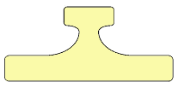
Simple structure in brief
Prevailing coordination mechanism
direct supervision
Fundamental part of the organization
strategic apex
Principal parameters for organizational design
Centralization
Organic structure
Situational factors
young and small
not sophisticated technical system
simple and dynamic external context
need of power from manager

Slide 7
Simple structure: basic features (1/3)

Slide 8
Simple structure: basic features (2/3)
Not elaborate structure
Limited technostructure, small support staff, not rigid division of labour, minimum degree of differentiation, limited behaviour formalization, low use of planning
Coordination: direct supervision
Strategic apex is the most important part of the organization
The strategic apex (one person) control the core operating core
Informal communication
Flexible decision-making process, in the hand of the strategic apex

Slide 9
Simple structure: basic features (3/3)
HIGH DEGREE OF CONTROL FROM STRATEGIC APEX
ANY STAFF UNIT
NEGLIGIBLE MIDDLE MANAGEMENT

Slide 10
Simple structure: conditions
Simple and dynamic context
Not sophisticated technical system and low degree of regulation
Newly constituted company
Small company
No separation between ownership and management (e.g. entrepreneurial company)

Slide 11
Simple structure: variations on theme
Synthetic organization
External crisis that calls for a rapid organizational answer
Power centralization
Authocratic organization
Accumulation of power in the hand of the General Director
No formalization of behaviour
Charismatic organization
Wokers give power in the hand of the General Director

Slide 12
Simple structure: typical problems
Centralized decision-making power
Ability to rapidly answer to changes in the external environment BUT
Confusing picture between strategic problems and operative problems
Risk
All the organization striclty depends from one single
Its effectiveness is restricted to small set of conditions
Simple context
Dynamic context

Slide 13
MECHANICAL BUREAUCRACY
AA 2015/2016

Slide 14
Mechanical bureaucracy in brief
Prevailing coordination mechanism
Standardization of work processes
Fundamental part of the organization
Technostructure
Principal parameters for organizational design
Formalization of behaviour
Horiz. And verti. Specialization of skills
Big units (operating core)
Vertical centraliz. And limited horizontal decentr.
Action Planning
Situational factors
Old and big
technical system strongly regulated
simple and stable external context
External control

Slide 15
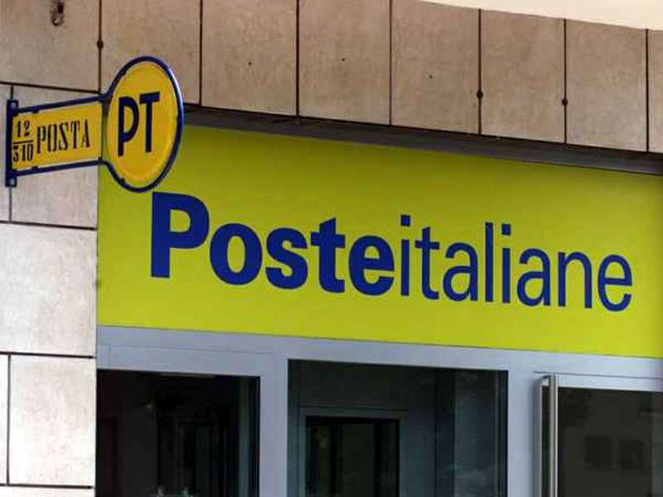
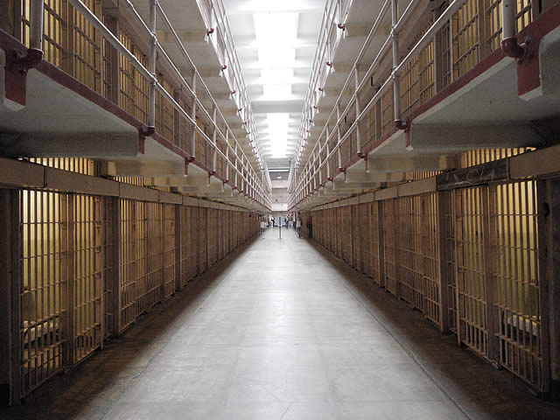
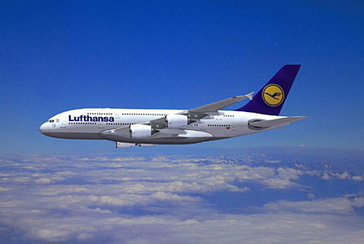
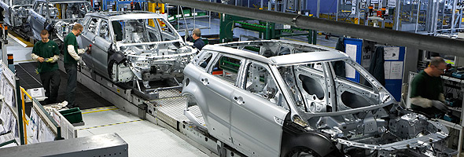
Mechanical bureaucracy: basic features (1/7)

Slide 16
Mechanical bureaucracy: basic features (2/7)
Specialized and routinized activities
Formalized procedures for the operating core
A lot of rules and norms
Formal and formalized communication
Big organizational units grouped based on their function
Centralized decision-making power
Clear division between staff and line units

Slide 17
Mechanical bureaucracy: basic features (3/7)
OPERATING CORE
Formalized work flows, simple and repetitive operational activities
No technical skills and abilities are required
Clear division of labour – standardization of processes
Behaviour is highly formalized
Big organization units

Slide 18
Mechanical bureaucracy: basic features (4/7)
MIDDLE MANAGEMENT
Diversified in functional units
Tasks of the middle management:
To manage conflicts that arise inside the operating core
To create a link between the technostructure and the operating core
To favor the vertical flow of information (both top-down and then bottom-)

Slide 19
Mechanical bureacracy: basic features (5/7)
TECHNOSTRUCTURE
Highly and complex articulation
The most important part of the organization
Analysts of the technostructure formalize the processes of the organization
Strong informal power

Slide 20
Mechanical bureaucracy: basic features (6/7)
STRATEGIC APEX
The most important task is to ensure cohesion within the different parts of the organization
To exercise the direct supervision
To ensure the coordination of the other units’ work
Strong formal and informal power
Strong informal power
To formulate the organizational strategy
To plan actions

Slide 21
Mechanical bureaucracy: basic features (7/7)
STRUCTURED AND COMPLEX STRATEGIC APEX
SUPPORT STAFF AND TECHNOSTRUCTURE ARE FOCUSED ON THE OPERATING CORE
SUPPORT STAFF AND TECHNOSTRUCTURE ARE FOCUSED ON THE OPERATING CORE
BIG UNIT AT THE OPERATING CORE LEVEL, BUT SMALL MIDDLE MANAGEMENT

Slide 22
Mechanical bureaucracy: conditions
Simple and stable external context
Old and big companies
Highly regulated technical system
(in general) string external control that leads to centralization

Slide 23
Mechanical bureaucracy: typical problems
Three main categories of problem
@ the operating core: workers are not considered humans, but machinery (e.g. no thinking, no autonomy, no wealth being of workers); buropathologies
@ the managerial level: managerial labour division, differentiation, focus on its own managerial staff, need for direct supervision, too centralized decision-making power
@ the strategic apex: inability of a taking decision rapidly; problems with rapid and reliable information that MIS can’t solve

Slide 24
PROFESSIONAL BUREAUCRACY
AA 2015/2016

Slide 25
Professional bureaucracy in brief
Prevailing coordination mechanism
Standardization of skills and capabilities
Fundamental part of the organization
Operating core
Principal parameters for organizational design
Formalization
Horizontal specialization of skills
Horizontal and vertical decentralization
Situational factors
Complex and stable environment
Not sophisticated technical system and low degree
of regulation

Slide 26
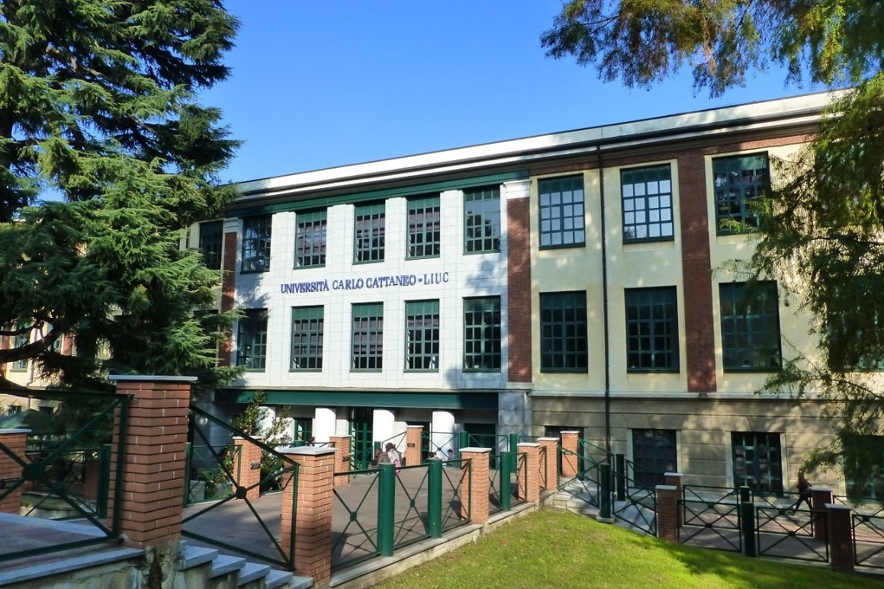
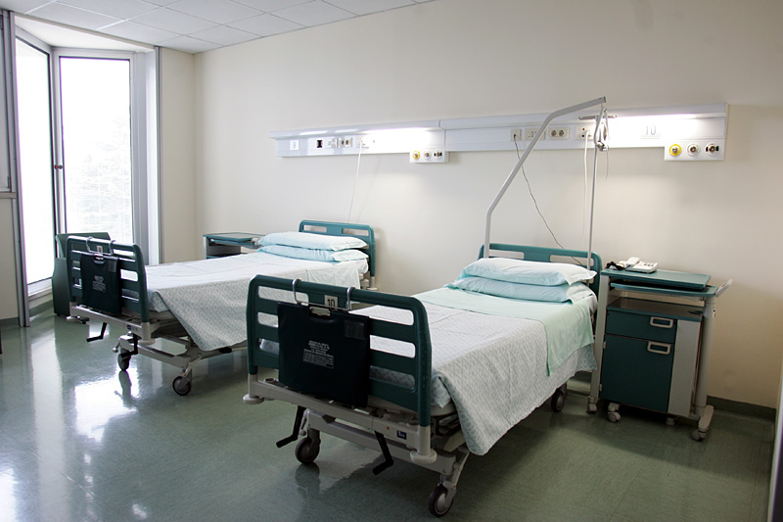
Professional bureaucracy in brief

Slide 27
Professional bureaucracy: basic features (1/8)
Routinized but complex activities
Activities must be controlled direclty by professionals responsible for their own activities
Standardization of skills, to achieve simultaneously:
Standardization (bureaucracy)
Decentralization (professional)

Slide 28
Professional bureaucracy: basic features (2/8)
OPERATING CORE
Standardization of skills thanks to learning and indoctrination
Professionals control their own work
Activities are highly specialized in the horizontal dimension, but they are vertically enlarged
Coordination is achieved thanks to skills standardization
Considerable discretion of professionals for their own job
It is the most important part of the organization
They want/ask for participation in the decision-making process

Slide 29
Professional bureaucracy: basic features (3/8)
SUPPORT STAFF
Together with the operating core, the support staff is the most developed part of the organization
Professionals must receive all the support they need
They carry out routinized activities of support

Slide 30
Professional bureaucracy: basic features (4/8)
RELEVANCE OF THE OPERATING CORE AND SUPPORT STAFF
STRUCTURED AND COMPLEX STRATEGIC APEX

Slide 31
Professional bureaucracy: basic features (5/8)
A DIFFERENT BUREAUCRACY
Coordination is achieved through the definition of standards
But standards are defined by external communities, not by the organization to which professional belong to
Power of competencies
Learning and indoctrination can «substitute» the four coordination mechanisms

Slide 32
Professional bureaucracy: basic features (6/8)
MIDDLE MANAGEMENT
Professional of the operating core partly act as part of the middle management
«Democratic» middle management
Mutual adjustment – relevance of links’ mechanisms (e.g. task forces and committees)
Two lines of hierarchy
Bottom-up for professional
Top-down for support staff
What role(s) for managers=?

Slide 33
Professional bureaucracy: basic features (8/8)
STRATEGIC APEX
Difficult definition of objectives to be achieved
Each professional has an «own strategy»
«Own strategy are influenced by:
Previous studies (e.g. university)
External context in which the professional works
Strategy of the organization = Ʃ of professionals’ strategy

Slide 34
Professional bureaucracy: conditions
Stable, but complex environment
The external environment is the most important condition for the professional bureaucracy: dimension and age have a low impact

Slide 35
Professional bureaucracy: variations on theme
SCATTERED/DISPERSED PROFESSIONAL BUREAUCRACY
Professional bureaucracy geographically diffused
PROFESSIONAL BURO-ADHOCRACY
Mixed type between professional bureaucracy and adhocracy
SIMPLE PROFESSIONAL BUREAUCRACY
The professional bureaucracy has a strong leader

Slide 36
Professional bureaucracy: typical problems
In one line: Control over professionals’ activities is not possibile and problems to be addressed are chosen by the same professionals
Problem of coordination
For the operating core
Between professionals and support staff
Between professionals themselves
Problem of discretionality (professionals)
Problem of innovation

Slide 37
DIVISIONAL SOLUTION
AA 2015/2016

Slide 38
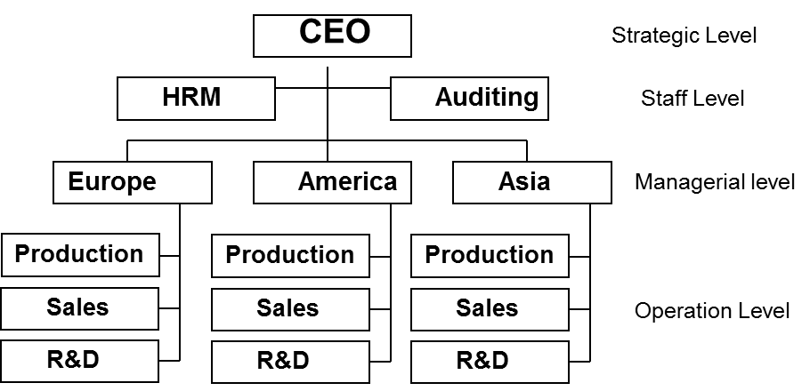
Divisional solution in brief
Prevailing coordination mechanism
Standardization of outputs
Fundamental part of the organization
Intermediate line
Principal parameters for organizational design
Market-based grouping mechanism
Performance control
Limited vertical decentralization
Situational factors
Diversified markets
Old company
Big company

Slide 39
Divisional solution: basic features (1/3)
Units are created following the market criteria
Low interdependencies between units that are autonomous
High decentralization from the CEO
Decentralized power is delimited and defined
Centralized structure
Relevance of performance control and
Output standardization
Limited use of
Skills standardization
Direct supervision

Slide 40
Divisional solution: basic features (2/3)
Possible overlapping with the other organizations structures
Best fit with the mechanic bureaucracy – output standardization
Degree of decentralization:
More decentralized compared to the simple structure
Uncertainties with respect to the mechanical bureaucracy
Less decntralized compared to the professional bureaucracy

Slide 41
Divisional solution: basic features (3/3)
Clear division of labor, power and decision making between CEO and the divisions
Limited and formalized communication between CEO and divisions
Personal, but delimited, personal relationship between managers
Power of the strategic apex:
Definition of the whole organizational strategy
Resources allocation
Definition of performance standards and performance control
Power of appointing new divisional managers
Direct supervision with respect to divisions
Definition of common support services

Slide 42
Divisional solution: conditions
Structured and articulated technical system
Market diversity as the most important contingent factor (carbon copy bureaucracy)
(in general) not so different from the environment of the mechanical bureaucracy
Limited field of application/use
(in general) big and old organization
Need of power from the middle management
(aggressive managers)

Slide 43
Divisional solution: variations on theme
Personalized divisional solution
Socialized divisional solution
Multiple divisional solution

Slide 44
Divisional solution: advantages
Efficient allocation of financial resources
Ability to creare (throguh learning and experience) general managers
Distribution of risks
Strategic flexibility

Slide 45
Divisional solution: typical problems
General managers have the tendency of seizing the power of divisions’ managers and to centralize «divisional» decisions
«Social» consequences of the performance control:
Focus on quantity and not quality
Social «a-responsibility» and «no-responsibility»
Limited market competition (social cost)

Slide 46
ADHOCRACY
AA 2015/2016

Slide 47
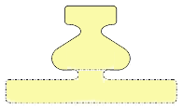
Adhocracy in brief
Prevailing coordination mechanism
Mutual adjustment
Fundamental part of the organization
Support staff (administrative adhoccracy)
Support staff + operating core (operational adhocracy)
Principal parameters for organizational design
Connection mechanisms
Selective decentralization
Horizontal specialization of tasks
Training and learning
Temporary market and functional grouping
Situational factors
Complex and dynamic environment
Young
Articulated technical system

Slide 48
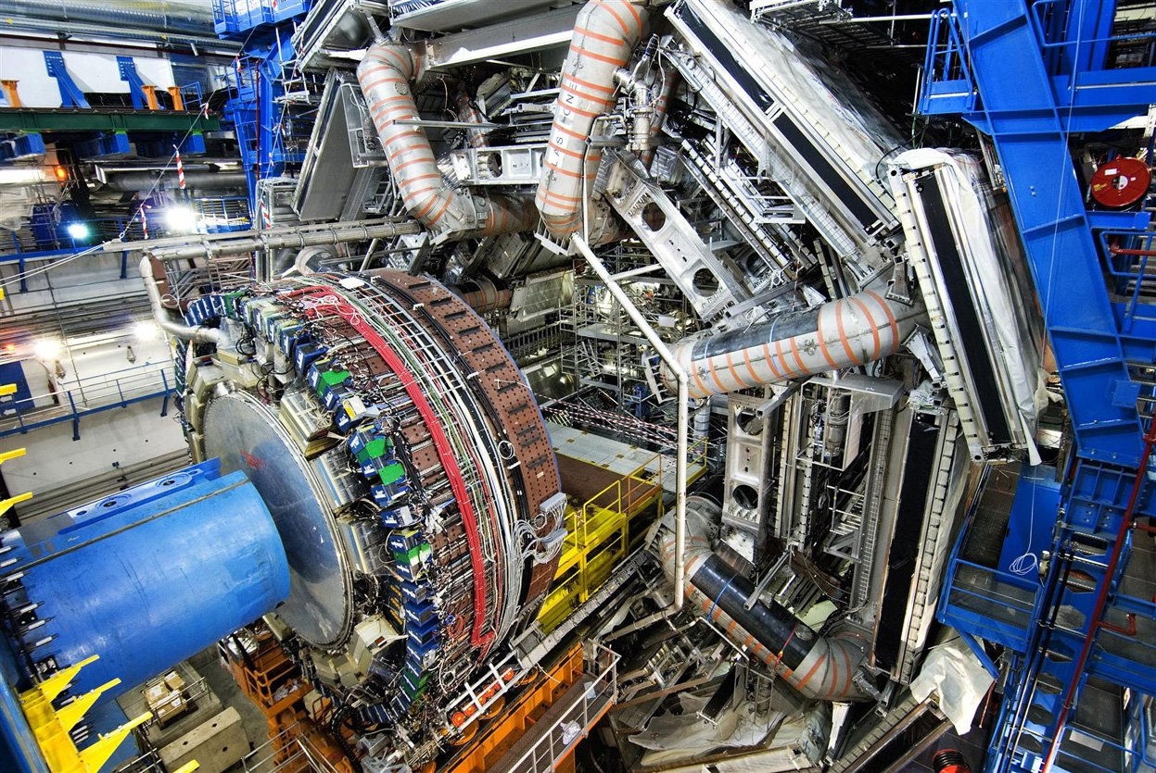
Adhocracy in brief

Slide 49
Adhocracy: basic features (1/6)
Low formalization of behavior
High horizontal specialization of tasks
Functional units for professional similarity, but re-aggregated in market-based projects
Connection mechanisms to favor mutual adjustment between groups
Selective decentralization within groups
No standardization (focus on innovation)
No traditional idea of «unit of command»
Flexible and informal information flows and
Decision-making process

Slide 50
Adhocracy: basic features (2/6)
Power to professional and experts for their technical knowledge
Not standardized skills
Need for new knowledge and capabilities
Need to break the boundaries of specialization
Multidisciplinary teams
Co-existence of functional and market grouping
Mutual adjustment favored by the use of
connection mechanisms
Managers do not manage, but they create links
between goups

Slide 51
Adhocracy: basic features (3/6)
PROFESSIONAL ADHOCRACY
It is focused on solving clients’ problems
E.g.: consultancy groups, advertising agency
Power is decentralized to professionals (focus on innovation)
Mutual adjustment of professionals
Managerial activities and operational activities
in the hand of professionals
Work constellation

Slide 52
Adhocracy: basic features (4/6)
MANAGEMENT
Low relevance of the middle management
Managers are part of the multidisciplinary group and they are responsible for the group’ results
Managers act as colleagues
Relevance of the support staff
Low relevance of the technostructure

Slide 53
Adhocracy: basic features (5/6)
STRATEGY FORMULATION
The strategy is formulated following a shared process in which are involved the different parts of the organization
The strategy is implicitly formulated by the single decisions
No distinction between strategy formulation and implementation
Low relevance of the technostructure

Slide 54
Adhocracy: basic features (6/6)
STRATEGIC APEX
Focus on managing conflicts between professionals
To control the project and related results
To create links with the external environment

Slide 55
Adhocracy: conditions
Complex and dynamic environment
Young organizations
Structured technical system for administrative adhocracy

Slide 56
Adhocracy: typical problems
Organizational ambiguity
«Politicization» of the organization
Low efficiency with respect to routinized activities

Slide 57
BEYOND THE 5 CONFIGURATIONS
AA 2015/2016

Slide 58
Going beyond the 5 configurations
The 5 configuration can be read as a «system of strenghts», that tries to move the organization in different direction:
Strategic apex moves throught centralization and direct supervision and therefore to a simple structure
Technostructure focuses on standardization and therefore on mechanical bureaucracy
Operating core focuses on professionalization, moving the organization to a professional bureaucracy
The middle management focuses on autonomiy of managing their own organization moving to a divisional solution
The support staff focuses on innovation moving the organization through an adhocracy

