Slide 1
Management Principles and Human Resources
Martina Dal Molin
mdalmolin@liuc.it
AA 2016/2017

Slide 2
Agenda
Introduction
Cost concepts
Typologies of costs
Costing Techniques

Slide 3
INTRODUCTION

Slide 4
From Financial Accounting….
Financial Accounting focus on the whole company by providing synthetic information to stakeholders
Information of financial accounting are too synthetic to support the company’s decision-making process
The company needs to understand which goods and units are responsible for the company’s results

Slide 5
….to Management Accounting (1/2)
The company needs to understand which goods and units are responsible for the company’s results
Management Accounting
Revenues and costs are allocated according to their “destination”
When a resource is consumed, the management accounting identifies the related cost that is linked to the unit or the good that actually consumed that resource

Slide 6
….to Management Accounting (2/2)
Revenues and costs are allocated according to their “destination”
It is possible to achieve three different objectives:
To identify the correct value of inventories (wip and finished goods)
To evaluate the performance of an organizational unit
To evaluate the degree of goods’ profitability

Slide 7
Financial and Management Accounting
 | Financial Accounting | Management Accounting
Users | External persons who make final decisions | Managers who plan for and control an organization
Time and focus | Historical perspective | Future emphasis
Verifiability vs relevance | Emphasis on verifiability and objectivity | Emphasis on relevance
Precision versus timeliness | Emphasis on precision | Emphasis on timeliness
Subject | Company wide report | Products reports
Rules | Specific rules (e. g. IAS) | Any rules or law to prescribe a format
Requirement | Mandatory for external reports | Not mandatory

Slide 8
COST CONCEPTS

Slide 9
Manufacturing costs
Direct labor
Overhead
Direct materials
The product

Slide 10
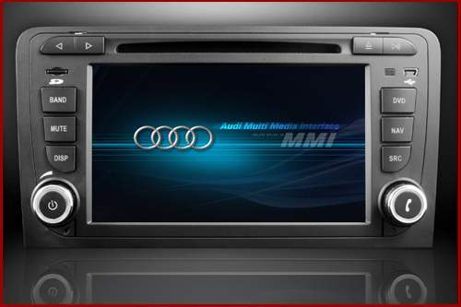
Direct materials
Raw materials that become an integral part of the product and that can be conveniently traced directly to it.

Slide 11
Direct labor
Those labor costs that can be easily traced to individual units of product

Slide 12
Overhead
Manufacturing costs that cannot be easily traced directly to specific units produced
INDIRECT MATERIALS
INDIRECT LABOR
Materials used to support the
production process.
Examples: lubricants and cleaning
supplies used in the automobile
assembly plant
Wages paid to employees who
are not directly involved in
production work.
Examples: maintenance workers,
janitors, and security guards.

Slide 13
Non manufacturing costs
SELLING COSTS
ADMINISTRATIVE COSTS
Costs necessary to secure
the order and deliver the
product.
All executive,
organizational, and clerical
costs.

Slide 14
TYPOLOGIES of COSTS

Slide 15
Cost and revenues «by destination»
Management Accounting classifies costs and revenues following their “destination”
Revenue related to a good is identifiable through a specific and tangible document, i.e. the invoice
For costs much more “subjectivity” exists

Slide 16
The problem of costs (1/2)
Should we or should we not consider the salary of Mr. Stadler for the development of a car?

Slide 17
The problem of costs (2/2)
To a same “object of cost” is it possible to associate different cost configurations
To understand the different cost configurations, we need to analyze the different typologies (or categorization) of costs:
PRODUCT COST vs PERIOD COSTS
VARIABLE COST vs FIXED COSTS
HISTORICAL COST vs STANDARD COSTS
AVOIDABLE COST vs NOT AVOIDABLE COSTS (decision-making)

Slide 18
Product costs vs period costs
PRODUCT COSTS
They represent the value of resources used for the realization of a specific product / service, for the physical transformation of the input in output
Direct labor, direct material, manufacturing overhead
PERIOD COSTS
They represent the value of resources used in activities not associated with the making of a product / service according to a causal link (i.e. not directly related to processing operations in physical input output), but necessary for the functioning of the company in whole
R&D, selling costs and administrative costs, general expendes

Slide 19
Product costs vs period costs: quick check
Which of the following costs would be considered a period rather than a product cost in a manufacturing company?
A. Manufacturing equipment depreciation.
B. Property taxes on corporate headquarters.
C. Direct materials costs.
D. Electrical costs to light the production facility.
E. Sales commissions.

Slide 20
Variable costs vs fixed costs (1/2)
FIXED COSTS
Total fixed cost is not affected by changes in the activity level within a relevant period of time
VARIABLE COSTS
Total variable cost Increase to changes in the activity level
A cost is variable if it varies proportionately to variation of the productive volume

Slide 21
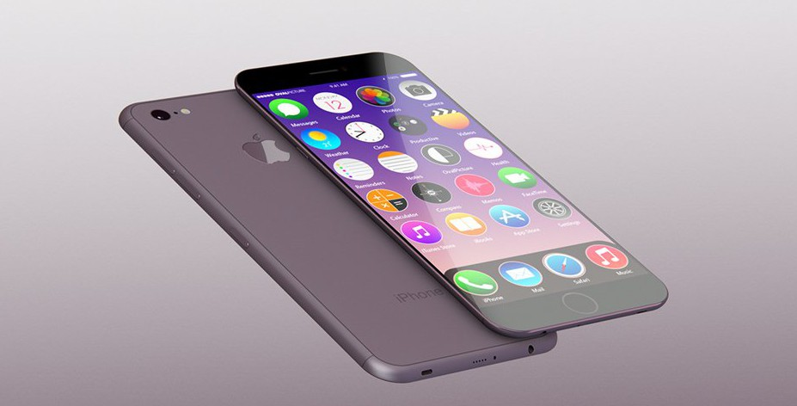
Variable costs vs fixed costs (1/2)
VARIABLE COSTS
FIXED COST
Cost per text sent
Monthly fee per phone calls
N. Of text sent
N of phone calla

Slide 22
Fixed costs vs variable costs: quick check
Which of the following costs would be variable with respect to the number of cones sold at an ice-cream parlor? (There may be more than one correct answer.)
A. The cost of lighting the store.
B. The wages of the store manager.
C. The cost of ice cream.
D. The cost of napkins for customers.

Slide 23
Period-product costs and fixes-variable costs
Direct Materials Direct Labor Energy | Vendors commissions Selling costs
Depreciation Cost of rent (production) Indirect labor Maintenance | General and Administrative costs Costs of R&D Advertising and promotion
VARIABLE COSTS
FIXED COSTS
PRODUCT COSTS
PERIOD COSTS

Slide 24
Historical costs vs standard costs
HISTORICAL COSTS
Historical cost are the cost accounted ex post, at the end of the period
STANDARD COSTS
Standard costs are the “theoretical cost” (i.e. defined ex ante) defined following specific information, that represent the point of reference for the analysis of deviations
For the definition of standard costs, extraordinary events are not considered (indeed they are defined ex ante)

Slide 25
Standard costs
DIRECT MATERIALS
Cstd = Ʃ Qstd *Pstd
DIRECT LABOR
Cstd= Tstd*Pstd
OVERHEAD
OVHstd= K*LDstd
K= OVHstd Tot/LDstd tot

Slide 26
Avoidable costs vs not avoidable costs
AVOIDABLE COSTS
Avoidable cost depend on the decision
Typically, direct materials, direct labor (in specific contractual situation)
NOT AVOIDABLE COSTS
Not avoidable cost do not depend on the decision
Typically: fixed overhead

Slide 27
COSTING TECHNIQUES

Slide 28
System to collect and to allocate costs
It refers to the system of rules through which management accounting allocates the overall costs to the single organizational units or to specific products (i.e. the example of Mr. Stadler)
ORGANIZATIONAL UNITS
PRODUCTS
RESOURCES
Set of resources linked to a product
Valorization
Costs turnover
Allocation of costs

Slide 29
EBITA in Management Accounting
EBITA
To calculate a company's EBITA, start with its earnings before tax (EBT), which can be found on the income statement, and add interest and amortization expenses back in.
EBITA = earnings before tax (EBT) + interest expense + amortization expense
We don’t have specific rules that define how to calculate (i.e. which costs have to be considered) to calculate the EBITA.
Is it therefore possible to identify different models to calculate the EBITA
The choice of one model depends on the goal(s) of the analysis

Slide 30
Rules to allocate costs
Direct Costing
We allocate only the costs that are directly consumed by the product (in general, direct labor and direct materials)
Reduction of mistakes for the allocation of costs
Full Costing
We allocate the costs that are directly consumed by the product (in general, direct labor and direct materials)
We allocate also indirect costs, and the allocation modality depends on the criteria we use to allocate costs
It clarifies that indirect activities are not “costless”, but they affect the overall profitability of the company

Slide 31
Costing Techniques
Costing techniques:
Job order costing
Process costing
Operation Costing
Activity Based Costing
Costing Techniques | Direct Material | Direct Labor | Overhead
Process Costing | Proportional | Proportional | Proportional
Operation Costing | Causal | Proportional | Proportional
Job order costing | Causal | Causal | Proportional
Activity Based Costing | Causal | Causal | Causal

