Slide 1
CORSO DI LAUREA MAGISTRALE IN
ECONOMIA AZIENDALE E MANAGEMENT
LESSON 5 - EXERCISE AND FINAL PRESENTATION

Slide 2
CORSO DI LAUREA MAGISTRALE IN
ECONOMIA AZIENDALE E MANAGEMENT
LESSON 5 - EXERCISE AND FINAL PRESENTATION
Exercise Part 1
In the following you find sets with different information on Arper (www.arper.com), the target company and major players of the contract furniture market.
Read carefully and integrate information on Arper and direct competitors through web search.
Make sure you understand the positioning, the competitive strategy, the product strategy of Arper.
Note: all numbers and percentages are disguised.

Slide 3
COMPETITIVE ANALYSIS
DIRECT AND INDIRECT COMPETITORS
COMPANY POSITIONING
POSITIONING
Steelcase – 2.753 mio
Hermann Miller – 1.927 mio
1.000 Mio €
Haworth – 1.620 mio
HARD CONTRACT
BIG SOFTCORE OFFICE
Knoll – 993 mio
SOFT CONTRACT
BIG HARDCORE OFFICE
500 Mio €
Vitra – 402 mio
SALES
Poltrona Frau - 294 mio
Bene – 158.9 mio
IN-BETWEENERS
100 Mio €
Hay – 100.9 mio
Kartell – 93.9 mio
Brunner – 75.2 mio
Bernhardt – 85 mio
SMALL SOFTCOREOFFICE
ARPER
Unifor – 72 mio
66.6 mio
Fritz Hansen – 63.8 mio
Walter Knoll - 61.6 mio
50 Mio €
CENTRALISTS
OUTSIDERS
Davis – 36 mio
Andreu World – 26 mio
Moroso – 24 mio
Magis – 19.4 mio
Pedrali – 70.5 mio
COPYCUTS
La Palma – 16.3 mio
Kristalia – 15 mio
5
4
3
2
1
0
1
2
3
4
5
PERFORMANCE
DESIGN
DESIGN
Performance and Design segment the MoR (Market of Reference) in Hard and Soft.
Hard Contract: 2 Clusters based on Performance Integration. Their trend is towards higher content of design.
Soft Contract: 5 Clusters based on Design Integration. Their trend is towards balancing performace. and design
Future Competitive Clash: Crossover Product Strategy
Note: Sales data refer to 2014/2015 (see table) and are reported in Euro. Exchange rate USD/EUR = 0.9
- Confidential -

Slide 4
COMPETITIVE ANALYSIS
DIRECT AND INDIRECT COMPETITORS
COMPANY
POSITIONING
BUSINESS MIX
BIG HARDCORE OFFICE
BIG SOFTCORE OFFICE
Steelcase – 2.753 mio
Hermann Miller – 1.927 mio
1.000 Mio €
HARD CONTRACT
Haworth – 1.620 mio
SOFT CONTRACT
Knoll – 993 mio
Vitra – 402 mio
500 Mio €
SALES
IN-BETWEENERS
Poltrona Frau – 294 mio
SMALL SOFTCOREOFFICE
Bene – 158.9 mio
100 Mio €
Hay – 100.9 mio
Kartell – 93.9 mio
Bernhardt – 85 mio
Brunner – 75.2 mio
CENTRALISTS
ARPER
Fritz Hansen – 63.8 mio
66.6 mio
Unifor – 72 mio
Walter Knoll - 61.6 mio
Pedrali – 70.5 mio
50 Mio €
Davis – 36 mio
COPYCUTS
Andreu World – 26 mio
Moroso – 24 mio
Magis – 19.4 mio
Kristalia – 15 mio
OUTSIDERS
La Palma – 16.3 mio
5
4
3
2
1
0
1
2
3
4
5
RESIDENTIAL
BUSINESS MIX
CONTRACT
Residential business is marginal for Hardcore, Softcore and Copycuts,
It is small for Outsiders, important for In-Betweeners and Centralists.
Note: Sales data refer to 2014/2015 and are reported in Euro. Exchange rate USD/EUR = 0.9
- Confidential -

Slide 5
COMPETITIVE ANALYSIS
DIRECT AND INDIRECT COMPETITORS
COMPANY POSITIONING
PRODUCT MIX
BIG HARDCORE OFFICE
BIG SOFTCORE OFFICE
SMALL SOFTCORE OFFICE
IN-BETWEENERS
CENTRA
LISTS
COPYCUTS
OUTSIDERS
Hardcore and Softcore are Chairs driven + Tables + Workstations,
In-Betweeners (but Kartell) and Centralists are Lounge driven,
Copycuts and Outsiders fully assorted.
- Confidential -

Slide 6
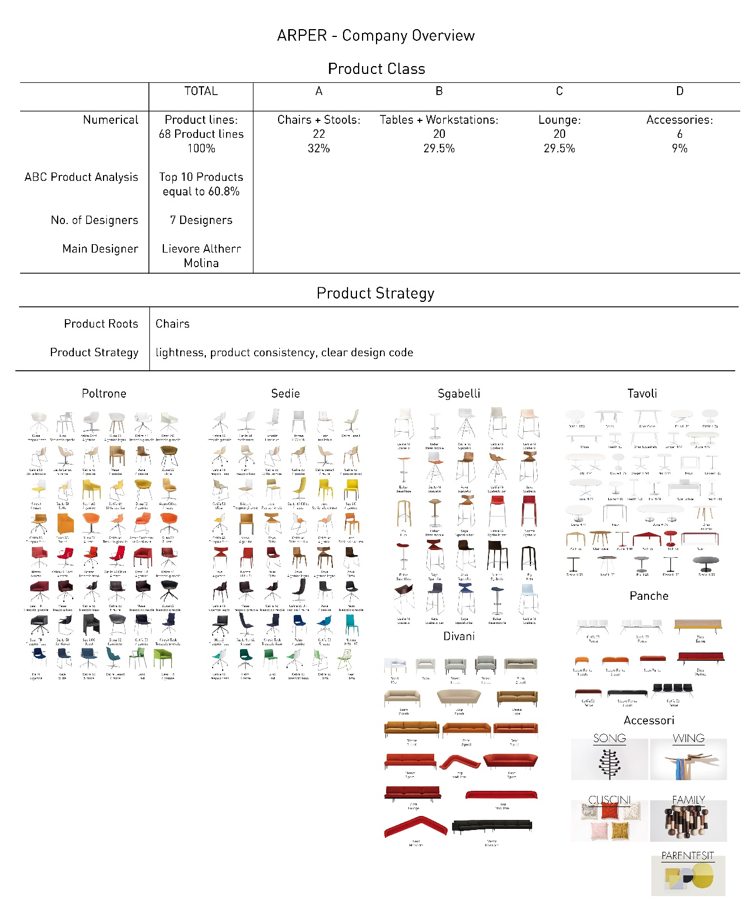
COMPETITIVE ANALYSIS
DIRECT COMPETITORS
PORTFOLIO ARPER

Slide 7
COMPETITIVE ANALYSIS
DIRECT COMPETITORS
BUSINESS MODEL
ARPER
PRODOTTO
DESIGN + PERFORMANCE
BACKWARD INTEGRATION
INSOURCED PRODUCTION
FORWARD INTEGRATION
INSOURCED LOGISTIC + WAREHOUSE
PRODUCT DEVELOPMENT
CONTROLLED
SALES
OUTSOURCED PURCHASE
MARKETING
LOGISTIC
OUTBOUND
INDEPENDENT
SALES

Slide 8
CORSO DI LAUREA MAGISTRALE IN
ECONOMIA AZIENDALE E MANAGEMENT
LESSON 5 - EXERCISE AND FINAL PRESENTATION
Exercise Part 2
In the following you find sets with different information on Arper (www.arper.com), the target company.
Analyze the numbers, calculate missing information and interpret the numbers.
Based on past set of data and on your understanding,
recreate the Arper past product strategy.
Note: all numbers and percentages are disguised.

Slide 9
1. Calculate the missing information
PRODUCT ANALYSIS
PRODUCT MIX
2. Interpret the numbers
Category | Sum of 2013 | Sum of 2013 | Sum of 2014 | Sum of 2014 | Sum of 2015 | Sum of 2015 | CAGR 2013-2015
 | MIO € | In % | MIO € | In % | MIO € | In % | In %
Accessories |  | 3% |  | 3% |  | 4%
Seating |  | 50% |  | 46% |  | 42%
Tables |  | 27% |  | 30% |  | 32%
Upholstery |  | 20% |  | 21% |  | 22%
TOTAL | 115.000.000 | 100% | 122.000.000 | 100% | 129.500.000 | 100%

Slide 10
1. Calculate the missing information
PRODUCT ANALYSIS
PRODUCT PORTFOLIO
2. Interpret the numbers
 |  | 2013 | 2014 | 2015
Evergreens Total
% of total Portfolio |  | 59% | 54% | 49%
Salesbuilder Total
% of total Portfolio |  | 22% | 27% | 30%
Icons Total
% of total Portfolio |  | 15% | 15% | 16%
Low Rotation Total
% of total Portfolio |  | 4% | 4% | 5%
Total |  | 115.000.000 | 122.000.000 | 129.500.000
% of total Portfolio |  | 100% | 100% | 100%
Key:
Evergreen: Products above 5 Mio € yearly Sales with consistent growth for 5 years.
Salesbuilder: Products 2.5-5 Mio € yearly Sales with consistent growth for 3 years.
Icon: Products 1.0-2.5 Mio € yearly Sales.
Low Rotation: Products below 1.0 Mio € yearly Sales.

Slide 11
1. Calculate the missing information
PRODUCT ANALYSIS
PRODUCT PORTFOLIO
2. Interpret the numbers
 |  | 2015
 |  | EVERGREENS |  |  | SALESBUILDER |  |  | ICONS |  |  | TOTAL
 |  | Sales | % on Total Portfolio |  | Sales | % on Total Portfolio |  | Sales | % on Total Portfolio |  | Sales | % on Total Portfolio
Total |  |  | 49% |  |  | 30% |  |  | 16% |  |  | 95%
Category |  | Sales | % on Evergreen Portfolio |  | Sales | % on Salesbuilder Portfolio |  | Sales | % on Icons Portfolio |  | Sales | % on Total Portfolio
Seating |  |  | 80% |  |  | 60% |  |  | 50%
Tables |  |  | 10% |  |  | 35% |  |  | 36%
Upholstery |  |  | 8% |  |  | 4% |  |  | 10%
Accessories |  |  | 2% |  |  | 1% |  |  | 4%
Mature |  |  | 67% |  |  | 70% |  |  | 50%
Growing |  |  | 18% |  |  | 27% |  |  | 45%
Declining |  |  | 15% |  |  | 3% |  |  | 5%

Slide 12
1. Calculate the missing data
PRODUCT ANALYSIS
PRODUCT STRATIFICATION
2. Interpret the numbers
 |  |  | Newness | Extension | Baseline |  | TOTALE
2013 | Sales |  |  |  |  |  | 115.000.000
 | % |  | 10% | 7% | 83% |  | 100%
2014 | Sales |  |  |  |  |  | 122.000.000
 | % |  | 14% | 9% | 77% |  | 100%
2015 | Sales |  |  |  |  |  | 129.500.000
 | % |  | 15% | 10% | 75% |  | 100%
Key:
Baseline = existing products.
Extension = new products based on baseline.
Newness = new products.

Slide 13
1. Calculate the missing data
PRODUCT ANALYSIS
PRODUCT INNOVATION
2009-2015
2. Draw the graph of the Average Sales
3. Interpret the numbers and the graph
AVERAGE SALES BY NEW PRODUCT LAUNCHES
PER NEW YEAR
SALES OF PRODUCTS LAUNCHED
Year | No of Products | Sales 2009-2015 | Average Sales per new launch | Average Sales per year
2009 | 4 | 18.000
2010 | 1 | 5.000
2011 | 1 | 7.500
2012 | 2 | 12.000
2013 | 4 | 19.550
2014 | 7 | 28.060
2015 | 8 | 32.375
7
Average Sales
2009
2010
2011
2012
2013
2014

Slide 14
PRODUCT ANALYSIS
PRODUCT DEVELOPMENT
TIME TO MARKET PER YEAR
1. Calculate the Average Time to Market 2011-2015
TIME TO MARKET
2. Draw the graph of the Time to Market per year
3. Interpret the numbers and the graph
Average Time to Market in 2011: 32 Months
Average Time to Market in 2012: 31.5 Months
Average Time to Market in 2013: 30 Months
Average Time to Market in 2014: 29 Months
Average Time to Market in 2015: 35.5 Months
Time in Months
2011
2012
2013
2014
2015

Slide 15
1. Calculate the missing information
PRODUCT ANALYSIS
MARKETING INVESTMENTS
2. Interpret the numbers
 |  | 2012 | % |  | 2013 | % |  | 2014 | % |  | 2015 | %
Product Development |  |  | 58% |  |  | 55% |  |  | 59% |  |  | 58%
Research & Development |  |  | 42% |  |  | 45% |  |  | 41% |  |  | 42%
TOTAL R&D |  | 2.475.000 | 100% |  | 2.720.000 | 100% |  | 2.950.000 | 100% |  | 3.250.000 | 100%
Consumer/Customer B2B |  |  | 23% |  |  | 20% |  |  | 10% |  |  | 13%
Trade Marketing |  |  | 54% |  |  | 56% |  |  | 61% |  |  | 60%
Sales Support |  |  | 23% |  |  | 24% |  |  | 29% |  |  | 27%
TOTAL MARKETING |  | 7.300.000 | 100% |  | 8.650.000 | 100% |  | 9.500.000 | 100% |  | 10.300.000 | 100%

Slide 16
CORSO DI LAUREA MAGISTRALE IN
ECONOMIA AZIENDALE E MANAGEMENT
LESSON 5 - EXERCISE AND FINAL PRESENTATION
Exercise Part 3
Formulate Arper Product Strategy for the Business Plan 2017-2020,
specify your Strategy in terms of Product Mix, Product Portfolio, Product Stratification, Product Innovation (be specific on Product Class, Time to Market, Brief Definition), Marketing Investments.
Be consistent and be realistic.

Slide 17
PRODUCT ANALYSIS
PRODUCT PORTFOLIO
 | 2015 |  | 2016 |  | 2017 |  | 2018 |  | 2019
 | SALE in € | In % | SALE in € | In % | SALE in € | In % | SALE in € | In % | SALE in € | In %
TOTALE
Seating
Upholstery
Tables
Accessory
New Product Class ?

Slide 18
PRODUCT ANALYSIS
PRODUCT PORTFOLIO
 | 2015 |  | 2016 |  | 2017 |  | 2018 |  | 2019
 | SALE in € | In % | SALE in € | In % | SALE in € | In % | SALE in € | In % | SALE in € | In %
TOTALE
Evergreen
Salesbuilder
Icon

Slide 19
PRODUCT ANALYSIS
PRODUCT PORTFOLIO
 | 2015 |  | 2016 |  | 2017 |  | 2018 |  | 2019
 | SALE in € | In % | SALE in € | In % | SALE in € | In % | SALE in € | In % | SALE in € | In %
TOTALE
Baseline
Extension
Newness

Slide 20
PRODUCT ANALYSIS
PRODUCT PORTFOLIO
 |  | 2015 | 2015 in % | 2017 | 2017 in % | 2019 | 2019 in % | 2020 | 2020 in %
Generale | TOTALE
 | Newness
 | Extension
 | Baseline
Seating | TOTALE
 | Newness
 | Extension
 | Baseline
Upholstery | TOTALE
 | Newness
 | Extension
 | Baseline
Tables | TOTALE
 | Newness
 | Extension
 | Baseline
Accessory | TOTALE
 | Newness
 | Extension
 | Baseline
New Product Class? | TOTALE
 | Newness
 | Extension
 | Baseline

Slide 21
PRODUCT ANALYSIS
PRODUCT INNOVATION
SALES OF NEW PRODUCTS LAUNCHED
AVERAGE SALES BY NEW PRODUCT LAUNCHES PER NEW YEAR
Year | No of Products | Sales 2017-2020 | Average Sales per new launch | Average Sales per year
2017
2018
2019
2020
4
Average Sales
2017
2018
2019
2020

Slide 22
PRODUCT ANALYSIS
MARKETING INVESTMENTS
 |  | 2017 | % |  | 2018 | % |  | 2019 | % |  | 2020 | %
Product Development
Research & Development
TOTAL R&D
Consumer/Customer B2B
Trade Marketing
Sales Support
TOTAL MARKETING

