Slide 1
UNIVERSITÀ CARLO CATTANEO – LIUC
International Financial and Foreign Exchange Markets
Special Topics: BASEL III
Riccardo Gastaldo

Slide 2
AGENDA
The Third Basel Accord
The Framework
The Committee’s response
The Pillars
Liquidity Requirements
Implementation of Basel III
The Criticisms
Conclusions

Slide 3
1. The Third Basel Accord The framework
CAPITAL
LIQUIDITY
Pillar 1
Pillar 2
Pillar 3
Liquidity Coverage Ratio (LCR)
Net Stable Funding Ratio (NSFR)
Credit, Market, Operational and Settlement risk
Capital Adequacy Assessment Process (ICAAP)
Supervisory Review and Evaluation Process (SREP)
Disclosure requirements
CET1 capital
Increase in Quantity and Quality of capital
Risk coverage
Leverage Ratio
Tier capital
Total Capital
Conservation Buffer
Countercyclical Buffer

Slide 4
1. The Third Basel Accord The Committee’s response
In response to pitfalls in the financial regulation system highlighted by the crisis, Basel III was released by the Committee in December 2010 in two documents
Basel III: International framework for liquidity risk measurement, standards and monitoring
Basel III: A global regulatory framework for more resilient banks and banking system
Basel III introduces new measures to reduce risks institutions engage with and mainly focuses on a three Pillars structure.
The framework will become fully effective on 1 January 2019, despite its multi-layered implementation time schedule

Slide 5
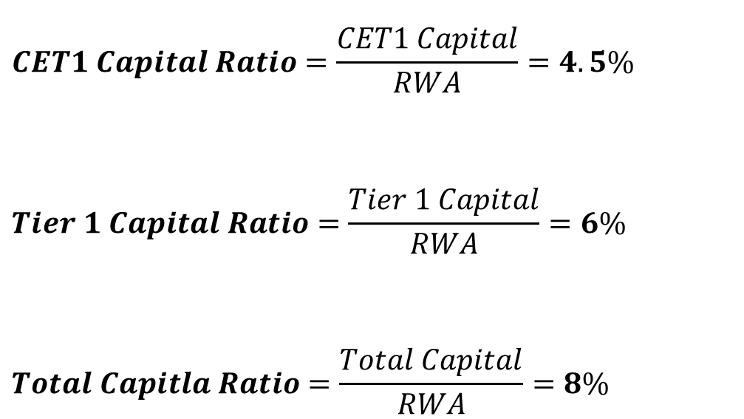
1. The Third Basel Accord Pillar 1 – Capital, Risk coverage and Leverage
With specific reference to capital requirements, financial institutions have to comply with 3 strictly defined capital ratios (we will focus exclusively on the finally-adopted levels)
$$CET1 Capital Ratio=\frac{CET1 Capital}{RWA}=4.5\%$$
$$Tier 1 Capital Ratio=\frac{Tier 1 Capital}{RWA}=6\%$$
$$Total Capitla Ratio=\frac{Total Capital}{RWA}=8\%$$

Slide 6
1. The Third Basel Accord Pillar 1 – The RWA concept
The balance sheet amount of an asset has to be multiplied by the categories’ risk weights to obtain the risk-weighted asset (RWA). Of this RWA, a minimum capital has to be maintained by the bank at all time
$$Capital Ratio ≥\frac{Minimum Capital Requirements}{RWA=Σ(w_{i}∗asset_{i})}$$
Asset Category
Municipal bond
Risk Weight
20%
Amount
€ 10.000
RWA
€ 2.000
Capital Ratio
8%
Minimum Capital Requirements
€ 160

Slide 7
1. The Third Basel Accord Pillar 1 – The Total RWA
𝑅𝑊𝐴 𝐶𝑟𝑒𝑑𝑖𝑡 𝑟𝑖𝑠𝑘: the risk for a lender that the principal or the interests associated with a loan may not be re-payed by the borrower
Standardized Approach: based on external rating agencies’ rating
Internal Rate Based Approach: capital requirements based on institution’s internal measurements
𝑅𝑊𝐴 𝑀𝑎𝑟𝑘𝑒𝑡 𝑟𝑖𝑠𝑘: is the risk of losses in positions arising from movements in market prices
Standardized approach based on weighted coefficient set by the regulator
Value at Risk (VaR) approach which, for a given probability, estimates the maximum potential loss of an investment over a specific period of time.
Basic Indicator Approach: the risk-weighting factor was set by regulators and was to be applied to total gross revenue
Standardized Indicator Approach: as above, but divided by business lines
Internal Measurement Approach: the institution itself defines operational risk capital requirement based on its own risk measurements
𝑅𝑊𝐴 𝑂𝑝𝑒𝑟𝑎𝑡𝑖𝑜𝑛𝑎𝑙 𝑟𝑖𝑠𝑘: is the risk for a company arising from failing business functions, people and procedures
𝑅𝑊𝐴 𝑆𝑒𝑡𝑡𝑙𝑒𝑚𝑒𝑛𝑡 𝑟𝑖𝑠𝑘: is the risk that the counterparty is not able to fulfil its obligations and fails to timely deliver a security or its value in cash, as per a previously defined written agreement
Standardized approach based on weighted coefficient set by the regulator
Value at Risk (VaR) approach which, for a given probability, estimates the maximum potential loss of an investment over a specific period of time.

Slide 8
1. The Third Basel Accord Pillar 1 – CET 1 Capital Ratio
$$CET1 Capital Ratio=\frac{CET1}{RWA}≥4.5\%$$
The Common Equity Tier 1 (CET1) is made up
Common shares issued by the bank
Stock surplus (share premium)
Retained earnings
Accumulated other comprehensive income and other disclosed reserves;
Common shares issued by consolidated subsidiaries of the bank and held by third parties
Regulatory adjustments applied in the calculation of Common Equity Tier 1

Slide 9
1. The Third Basel Accord Pillar 1 – Tier 1 Capital Ratio
$$Tier 1 Capital Ratio=\frac{Tier 1}{RWA}≥6\%$$
The Tier 1 capital is made up
Common Equity Tier 1 capital (4.5%)
Additional Tier 1 capital (1.5%): it is composed by elements that meet the criteria for inclusion in Additional Tier 1 capital (and are not included in Common Equity Tier 1)
In the Tier 1 the predominant form of capital must be common shares and retained earnings

Slide 10
1. The Third Basel Accord Pillar 1 – Total Capital Ratio
$$Total Capital Ratio=\frac{Total Capital}{RWA}≥8\%$$
The Total Regulatory capital is made up
Tier 1 capital (6%)
Tier 2 capital (2%): it is composed by elements that meet the criteria for inclusion in Tier 2 capital (and are not included in Tier 1 capital)
In the Tier 1 the predominant form of capital must be common shares and retained earnings

Slide 11
1. The Third Basel Accord Pillar 1 – Two additional capital buffers
In the aftermath of the recent financial crisis, the Committee decided to push capital requirements even further, by creating two additional countermeasures to avoid banks’ failure.
Hence, the final capital requirement will be given by
Total capital ratio (8%), plus
a mandatory capital conservation buffer
a countercyclical capital buffer

Slide 12
1. The Third Basel Accord Pillar 1 – Capital Conservation Buffer
The Capital Conservation Buffer (CCB), to be met with CET 1 capital, is designed to make the institutions able to absorb losses in periods of financial distress.
By 2019, CCB is expected to account for 2.5% of the RWA exposure
$$Total CET1 Capital (7\%)=CET1 Capital \left(4.5\%\right)+CCB(2.5\%)$$

Slide 13
1. The Third Basel Accord Pillar 1 – Countercyclical Capital Buffer
The rationale behind this buffer is that periods of boom or bust in the economy affect credit growth and other important banking sector’s variables. It takes into consideration the institution’s macro-financial environment to determine if capital requirements are adequate or have to increase.
In case of credit booms, the capital conservation buffer increases as well to protect institutions from risks derived from the excessive credit lent.
On the contrary, in periods of economic burst, the buffer might be reduced to free liquidity and to prevent the contraction of credit supply.
Institutions that operate internationally have to calculate their own countercyclical capital buffer based on the weighted average of buffers in jurisdictions which the institution is exposed to.
The framework allows each National Authority to set the range between 0% and 2.5% of RWA with no mandatory implementation schedule

Slide 14
1. The Third Basel Accord Pillar 1 – The Leverage Ratio and additional measures
The Leverage ratio has been introduced by the Committee to avoid institutions to have an excessive leverage on their balance sheet.
$$Leverage Ratio=\frac{Tier 1 capital}{Total exposure}≥3\%$$
Total exposure is the sum of all risk weighted assets and off-balance sheet item exposures not deducted from Tier 1 capital

Slide 15
1. The Third Basel Accord Pillar 2 – Supervisory Review
This Pillar has the scope
to ensure that banks have adequate capital levels with respect to their risks; and
to encourage financial institutions to integrate their risk management and monitoring techniques.
Supervisory Review is implemented mainly through two processes
Internal Capital Adequacy Assessment Process (ICAAP)
Supervisory Review and Evaluation Process (SREP)
Financial institutions have to identify risks and present solutions to solve them.
The process determines an additional capital charge tailored to each individual bank that an institution has to hold
Basel III increases implementation more widely and increases banks’ top management responsibility

Slide 16
1. The Third Basel Accord Pillar 3 – Market Discipline
Market discipline has been developed to encourage good corporate governance within the banking sector.
It is a composition of information that the institution has to disclose which represented a further supervisory tool available to all market participants.
The targeted result is a scenario where good corporate governance is rewarded by the market, while poor corporate governance is penalised.
In order to improve comparability and consistency of disclosure obligations, Basel III introduces guidelines for documents disclosure
for quantitative information fixed mandatory templates are introduced;
instead, more flexible templates are used for pertinent but not essential information

Slide 17
1. The Third Basel Accord Liquidity Requirements
One of the scopes of the Basel Committee is to ensure the soundness of the overall banking sector, and one way to increase odds in favour of this task’s successful accomplishment is to develop proper liquidity requirements. The results of this mind-set are two liquidity ratios:
Liquidity Coverage Ratio (LCR)
Net Stable Funding Ratio (NSFR)
Short term
Long term

Slide 18
1. The Third Basel Accord Liquidity Requirements – LCR
The Liquidity Coverage Ratio (LCR) requires institutions to hold a buffer of high quality liquid assets to cover the net liquidity outflows faced in a 30-day period in a high level stress scenario
$$Liquidity Coverage Ratio=\frac{High quality liquid assets}{Total net liquidity outflows over a 30 days}>100\%$$
For the numerator, items eligible as liquid assets can be cash, transferable assets with extremely high liquidity and credit quality, and transferable assets that are just of high liquidity and credit quality.
Regarding the denominator, the total net liquidity outflow is calculated as the difference between liquidity inflows and liquidity outflows.
The formula should prevent liquidity crisis that can arise from the mismatch between inflows and outflows in the considered period.

Slide 19
1. The Third Basel Accord Liquidity Requirements – NSFR
The Net Stable Funding Ratio (NSFR) requires banks to present a sound funding structure that must be able to last a high-level stress test over one year period.
$$Net Stable Funding Ratio=\frac{Available Stable Funding}{Required Stable Funding}>100\%$$
The ratio promoted by the Committee requires that available stable funding – thus assets currently funded and possible obligation to fund – are matched, at least at 100% of their value, with sources of stable funding.

Slide 20
2. Implementation of Basel III Implementation
The Financial Crisis highlighted the need for an unbiased and timely enforcement of Basel III.
Regulatory Consistency Assessment Programme (RCAP)
The program monitors the timely implementation of Basel III by confirming the framework transposition into regulation
The program evaluates if jurisdictional regulators have consistently and completely transposed the framework into their legislations
However, the Basel III framework is not a law. Rather, it is conglomerate of international financial standards proposed by supervisors and central banks that requires to be transposed into the national framework through ad hoc laws and regulations

Slide 21
2. Implementation of Basel III Implementation in Europe: the CRD IV
Capital Requirements Directive (2016/36/EU)
Capital Requirements Regulation (575/2013)
CRD IV
Directive: requires national regulators to transpose the law domestically
Regulation: becomes law in in each member state without any further action being required
The mix should reduce all biased situations and leave national regulator with some “legislative room” to intervene
CRD IV enlarges the number of targets by regulating all banks and the entire investment firms’ universe
CRD IV allows instruments other than shares to be qualified as capital
Capital conservation buffer is introduced as suggested by the Basel III framework
Countercyclical capital buffer is left at the national regulator’s discretion
Regarding the LCR, the CRD IV relaxes the definition of high quality liquid assets
CRD IV encourages institutions to develop their own exposure models for the min. cap. requirements
CRD IV introduces a systemic risk buffer that can be implemented for specific institutions

Slide 22
3. The Criticisms The criticisms to Basel III
Risk weighting model
The whole concept is based on historical data and it is hence backward looking
The model encourages banks to expose themselves to asset considered to be risk-free
Countercyclical capital buffer
It is almost impossible to define good and bad times
It is very difficult to determine whether a given capital provision will be sufficient in the future to offset potential losses
Higher capital requirements
Impacts on SMEs, credit to consumers and the overall economy
VaR models
This model tends to underestimate the tail events it is paradoxically supposed to measure
Pillar 2 and 3
The Committee should maybe have presented a more integrated framework, enriched not just of stronger definitions and requirements regarding the capital base, but also of more reliable and transparent practices for the broad banking sector

Slide 23
3. Conclusions A new model: Basel IV
Harmonization of capital requirements’ calculation
IRB Approaches substituted with Standardized Approach
Greater transparency requested
This would allow comparisons between finanancial institutions’ risk profiles and simplify risks’ calculations
The Advanced IRB Approach allows banks for too much discretion in setting their risk parameters. The Committee’s proposal is to set a standardized risk measurement approach
Greater transparency on financial statements and other documents will be required, enhancing the importance of market discipline
Proper implementation is necessary
The Basel Committee should be appointed to coordinate supranational powers in this sector: this is the best solution to develop a sound and symmetric framework able to grant regulators a continuously updated picture of the evolving sector, which will allow them to develop the right response in the right time.

Slide 24
“Standardisation is beneficial. […] When I rent a car anywhere in the world, I can assume that the car will most likely have the first gear on the top left of the gear stick. This facilitates driving but also road safety.”
(Ingves, 2017)

