Slide 1
MEASURING THE IMPACT OF BREXIT
ON BRITISH FINANCIAL INSTITUTIONS
Alessio Mazzotta
Università Carlo Cattaneo – LIUC
21 May 2018

Slide 2
BREXIT IN A NUTSHELL
Brexit to become effective
29th March 2019
Brexit Referendum
23rd June 2016
29th March 2017
Triggering of Art. 50
Lisbon Treaty

Slide 3
THE UK FINANCIAL SECTOR
The financial sector accounts for 11% of the British GDP
26%
41%
Own elaboration from Global Financial Centres Index
The UK share of the total EU Banking Activity
Own elaboration from Global Financial Centres Index
The UK share of the total EU Asset Management Activity

Slide 4
CONSEQUENCES OF THE WITHDRAWAL
1
soft Brexit/
ad hoc agreement
EU Member States
2
hard Brexit

Slide 5
PASSPORTING REGIME
The EU single market in financial services is built on the principle of mutual recognition.
FINANCIAL PASSPORT: system based on a single authorisation by the local regulator
FREEDOM
PROVISION OF SERVICES
ESTABLISHMENT OF A BRANCH

Slide 6
EQUIVALENCE REGIME
Access to EU financial single market is strictly
conditional upon membership within the EU
Member State
Third country
Right
“Privilege”
Permanent access
Risk of revocation
Streamlined authorisation and supervision
Mitigation of market access

Slide 7
EU DIRECTIVES & REGULATIONS
DIRECTIVE
SECTOR
PASSPORTING REGIME
EQUIVALENCE REGIME
CRD
Banking Sector &
Wholesale Finance
Capital Requirement Directive
& Regulation
Art. 17, 33, 39 CRD IV
MiFID
Banking Sector &
Wholesale Finance
Markets in Financial Instruments Directive
& Regulation
Art. 34, 35 MiFID II
Art. 39 MiFID II
Subject to national requirements
UCITS
Asset Management
Undertaking for Collective Investments
in Transferable Securities
Art. 91-96 UCITS V
AIFMD
Asset Management
Alternative Investment Fund Managers Directive
Art. 32, 33 AIFMD
Art. 34-36, 39-42 AIFMD
Subject to national requirements

Slide 8
QUANTITATIVE STUDY
KEY ASSUMPTION
British financial firms have been heavily affected by Brexit, in light of the importance of the sector and the EU Directives
SIMPLE LINEAR REGRESSION MODEL
$$𝔂=α+β𝔁+ε$$
Where:
$𝔂$ represents the FTSE 100 UK
$𝔁$ the mean of the stock price variation of the 9 financial institutions within the sample
(“Banks” & “General Financial“ sector on London Stock Exchange)
$ε$ the abnormal cumulative stock price returns
Higher residuals should show up, where the financial sector is not able to reflect the trend of the market index
Hourly data downloaded from Bloomberg

Slide 9
QUANTITATIVE STUDY
31st May 2016
13th June 2016
24th June 2016
6th July 2016
Brexit -2
Brexit -1
Brexit
“EVENT STUDY” METHODOLOGY
OLS and residual analysis on the full sample
Does Brexit represent an exogenous shock that affects the linearity of the model?
STRUCTURAL BREAK TEST
OLS and residual analysis on the full sample with dummy variable
OLS and residual analysis on the subperiods

Slide 10

OLS & RESIDUAL ANALYSIS – FULL SAMPLE
RESIDUAL PLOT
The model denotes inability of the financial sector to reflect
the trend of the FTSE 100, the closer we get to Brexit
$$R^{2}=77\%$$
Breusch-Pagan-Godfrey test:
Heteroscedastic residuals → Periods marked by uncertainty
tend to be followed by uncertain periods. Higher volatility.
Own elaboration from EViews

Slide 11
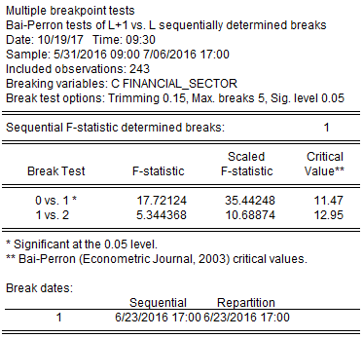
STRUCTURAL BREAK TEST
Bai-Perron test:
Brexit can be considered a fully-fledged exogenous shock
The result of the referendum did cause an unexpected abnormal shift in the OLS model
Own elaboration from EViews

Slide 12
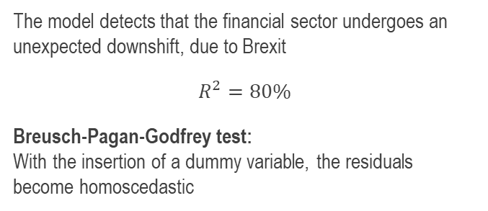
OLS & RESIDUAL ANALYSIS –
FULL SAMPLE WITH DUMMY VARIABLE
RESIDUAL PLOT
The model detects that the financial sector undergoes an unexpected downshift, due to Brexit
$$R^{2}=80\%$$
Breusch-Pagan-Godfrey test:
With the insertion of a dummy variable, the residuals become homoscedastic
Own elaboration from EViews

Slide 13

OLS & RESIDUAL ANALYSIS – SUBPERIODS
31st May 2016
13th June 2016
24th June 2016
6th July 2016
Brexit -2
Brexit -1
Brexit
RESIDUAL PLOT
Mean FTSE 100 – Mean Financial Sector = 0,053%
$$R^{2}=76\%$$
Breusch-Pagan-Godfrey test:
Homoscedastic residuals
The residuals show that the yield of the financial sector tends to mimic that of the market index.
No clear sign of political uncertainty impact.
Own elaboration from EViews

Slide 14

OLS & RESIDUAL ANALYSIS – SUBPERIODS
31st May 2016
13th June 2016
24th June 2016
6th July 2016
Brexit -2
Brexit -1
Brexit
RESIDUAL PLOT
Mean FTSE 100 – Mean Financial Sector = -0,064%
$$R^{2}=85\%$$
Breusch-Pagan-Godfrey test:
Homoscedastic residuals
The residuals show that the yield of the financial sector tends to mimic that of the market index.
Reflection of the positive expectations on the outcome.
Own elaboration from EViews

Slide 15

OLS & RESIDUAL ANALYSIS – SUBPERIODS
31st May 2016
13th June 2016
24th June 2016
6th July 2016
Brexit -2
Brexit -1
Brexit
RESIDUAL PLOT
Mean FTSE 100 – Mean Financial Sector = 0,285%
$$R^{2}=80\%$$
Breusch-Pagan-Godfrey test:
Homoscedastic residuals
The residuals show that the yield of the financial sector
does not reflect that of the market index.
Clear sign of the impact of Brexit on the financial sector.
Own elaboration from EViews

Slide 16
CONCLUSIONS
The adoption of the OLS and the performance of a residual analysis proves successful in the determination of the effect of Brexit on the stock price returns of the financial sector.
With respect to the FTSE 100 UK, financial institutions are affected to a greater extent by Brexit
Political uncertainty is translated in the model as higher residuals that reflect the inability for the financial sector to mimic the trend of the FTSE 100
The result can be interpreted as the fear of forfeiting the passporting rights

