Slide 1
Why do interest rates change?
Luigi Vena
02/26/2018
LIUC – Università Cattaneo

Slide 2
International Financial Markets – 02/26/2018
Today’s Agenda
Debt and Bonds
Changes in interest rates
Supply and demand in the bond market
Yield curve
Spot and forward contracts
Bond pricing
Mishkin, Eakins – ch. 3,4 and 5

Slide 3
International Financial Markets – 02/26/2018
Today’s Agenda
Debt and Bonds
Changes in interest rates
Supply and demand in the bond market
Yield curve
Spot and forward contracts
Bond pricing
Mishkin, Eakins – ch. 3,4 and 5

Slide 4
Where we are…
Present value
The concept of present value (or discounted value) is based on the notion that a “dollar today is worth more than a dollar tomorrow”
The process of computing today’s value of monetary units received in the future is called discounting
The present value permits us to compare the value of two instruments with very different timing of their cash flows
$$PV=FV/(1+i∗t)$$
$$PV=FV/{\left(1+i\right)}^{t}$$
$$PV=FV∗e^{−i∗t}$$
Simple rate
Compound rate
Continuous rate

Slide 5
Debt
If a company wants to finance its business, it can alternatively:
Issue new equity.
Borrow money, promising to make regular interest payment and to repay the principal.

Slide 6
Debt
Who can be the lender?
A financial institution.
A bank
The households.
What type of instruments can be used?
Mortgages
Bonds

Slide 7
Bonds
What are bonds?
Bonds are debt instruments* that represent cash flows payable during a specified time period.
The cash flow they represent are:
Interest payment on the loan;
The redemption of the loan.
*Bonds are portion of a single operation of indebtedness.

Slide 8
Credit instruments
Four types of Credit Market Instruments
Simple loan
Fixed-payment loan
Coupon bond
Discount bond (ZCB)
+ Principal + Interest
0
t
- P
P+I
0
P+I
P+I
…
P+I
…
1
2
…
i
…
t
- P
+ FV + C
0
+ C
+ C
…
+ C
…
1
2
…
i
…
t
- P
+ FV
0
t
- P

Slide 9
Bonds vs shares
Bonds are debt instruments, whereas shares are fraction of equity.
By purchasing equity (shares).
Investor becomes the owner of the corporation.
By purchasing debt (bonds).
Investor becomes a company’s creditor.
While shares are fraction of equity, bonds are fraction of debt (credit).

Slide 10
Bonds vs shares
Bonds are debt, whereas shares are equity.
The primary advantage of being a creditor is that you have a higher claim on assets than shareholders do: that is, in the case of bankruptcy, bondholders will be paid before shareholders.
However, bondholders do not share in the profits if a company does well – they are entitled only to the principal plus interest.

Slide 11
Bonds key features
Maturity: The maturity of a bond refers to the date that the debt will cease to exist.
Term to maturity: The term to maturity of a bond is the number of periods after which the issuer will repay the obligation.

Slide 12
Bonds key features
Face value (a.k.a. Redemption value/ Par value): The face value is the amount that the issuer agrees to repay the bondholder on the maturity date.
Coupon Rate: The coupon rate is the interest rate used to compute the coupon that the issuer agrees to pay each period. It can vary or be fixed.

Slide 13
Focus: T-bill and Money Market
The money market consists of very short term debt securities that usually are highly marketable.
The most marketable securities of the money markets are the US Treasury-Bills (or simply T-bills).
T-bills are issued at initial maturity of 1 month, 3 months, 6 months and 1 year.

Slide 14
Bond categories
With respect to the issuer, bonds can be classified into:
Sovereign governments B;
Local government authorities B;
Supranational bodies B (e.g. the World Bank);
Corporate B

Slide 15
Bond categories
According to the interest payment scheme, bond can be classified into:
ZCB – Zero Coupon Bond
CB – Coupon Bond, in turn classified into:
Fixed income bond which, in all period, pay the same coupon;
Floating Rate Notes which have, for each period, a different interest rate depending on a specific “underlying” interest rate.

Slide 16
Zero Coupon Bond
The Zero Coupon Bond is a debt instruments which grants the lender a profit originated by the difference between:
Issuing Price
Face/Nominal Value
+ Face Value
0
t
- Price

Slide 17
Valuation of a ZCB
Since the interest rate of a Zero Coupon Bond is implicit in the difference between the issuing price and the par value…
EG, the interest rate of a 1Y ZCB.
$$r_{0,1}=\frac{FV}{P}−1$$

Slide 18
Fixed Income Bonds
The fixed income bond grants the owner
the payment of a certain amount of interest each period and
the repayment of the principal at the maturity.
In all periods (e.g. quarters, years…) the interest is computed on the same interest rate which remains fixed over time.

Slide 19
Valuation of Fixed-Income Bonds
Where,
P is the fair price of the bond
C is the coupon
FV is the par (or face) value
r is the interest rate.

Slide 20
Fixed Income Bond
Compute the fair price of the following three bonds:
Interest paid on a yearly basis;
Face value: 100$.
Time to maturity: 3 years
Interest rate, r=5%.
Coupon rate:
7% on annual basis, for the 1st bond
5% on annual basis, for the 2st bond
3% on annual basis, for the 3st bond

Slide 21
Bonds fair price
The fair price of a bond depends on two rate:
Discount rate, r
Coupon rate, c
More precisely, if

Slide 22
Bonds fair price
To discount the different cash flows granted to the bondholder we used the same interest rate, r.
However it is important to know that:
Interest rates may, and usually do, vary over time;
The 1y interest rate differs from the 2y interest rate. That is to say, each maturity has its interest rate.

Slide 23
International Financial Markets – 02/26/2018
Today’s Agenda
Debt and Bonds
Changes in interest rates
Supply and demand in the bond market
Yield curve
Spot and forward contracts
Bond pricing
Mishkin, Eakins – ch. 3,4 and 5

Slide 24
Why do interest rates change?

Slide 25
Why do interest rates change?
We have seen that bond prices determine the level of the interest rates.
Changes in bond prices determine changes in interest rates.
If we explain why bond prices change, we can also explain why interest rates change.

Slide 26
International Financial Markets – 02/26/2018
Today’s Agenda
Debt and Bonds
Changes in interest rates
Supply and demand in the bond market
Yield curve
Spot and forward contracts
Bond pricing
Mishkin, Eakins – ch. 3,4 and 5

Slide 27
Supply and Demand in the Bond Market
Bond prices determine the interest rates levels
Bond prices represent equilibrium condition in the bond market
That is to say, each price is formed when the demand meets the supply.

Slide 28
Supply and Demand in the Bond Market
As every demand curve, the one of the bonds represents the relationship between the demanded quantity and the price when all other economic variables are held constant.
As every supply curve, the one of the bonds represents the relationship between the quantity supplied and the price when all other variables are held constant.

Slide 29
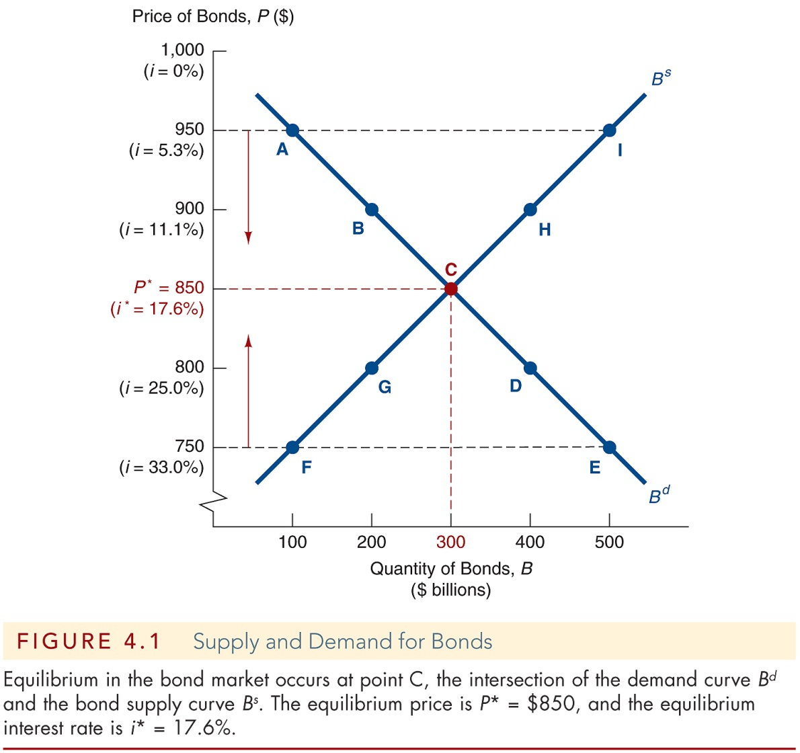
Supply and Demand in the Bond Market
Market equilibrium occurs when the amount that people are willing to buy (demand) equals the amount that people are willing to sell (supply) at a given price.

Slide 30
Determinants of Asset Demand
An asset is a piece of property that is a store of value. An individual who want to purchase an asset must take into account:
Wealth
Expected Return
Risk
Liquidity

Slide 31
Determinants of Assets Demand
Wealth
Should the wealth increase, the demand for asset may increase, due to the more resources available with which to purchase assets.
All else equal, the greater is the wealth the greater will be the quantity demanded for an asset.

Slide 32
Determinants of Assets Demand
Expected Returns
When we make a decision to buy an asset, we are influenced by what we expect the return on that asset to be.
If a Walt Disney bond has a return of 15% half of the time and 5% the other half, its expected return is…

Slide 33
Determinants of Assets Demand
Expected Returns
When we make a decision to buy an asset, we are influenced by what we expect the return on that asset to be.
If a Walt Disney bond has a return of 15% half of the time and 5% the other half, its expected return is… 10%

Slide 34
Determinants of Assets Demand
Expected Returns
You can imagine the expected return as the weighted average of all possible returns.
The weights are the probabilities of occurrence
$$R^{e}=p_{1}∗r_{1}+p_{2}∗r_{2}+…+p_{n}∗r_{n}$$
where $R^{e}$ is the expected return, n the number of possible outcomes, $r_{i}$ the return in the i-th state of nature, and $p_{i}$ the probability of occurrence of the i-th return

Slide 35
Determinants of Assets Demand
Expected Returns
An increase in an asset’s expected return relative to that of an alternative assets, holding everything else unchanged, raises the quantity demanded of the asset. It happens if:
The expected return on the asset increases, while the ones of the other assets remain the same.
The expected return on alternative assets fall while the return on the asset remains constant.

Slide 36
Determinants of Assets Demand
Risk
The degree of risk (or uncertainty) of asset’s returns also affects the demand for the asset.
Consider the two alternative assets:
A – $r_{1}=15\%,p_{1}=50\%;r_{2}=5\%,p_{2}=50\%$
B – $r_{1}=10\%,p_{1}=100\%;$

Slide 37
Determinants of Assets Demand
Risk
A has an expected return of 10%; B has a fixed certain return of 10%.
However, A has uncertainty associated with its returns and, hence, a greater risk than B.
To evaluate the asset’s riskiness, we will use the standard deviation.

Slide 38
Determinants of Assets Demand
Risk
The standard deviation (sd or σ) is a statistical measure that summarize how far are the observation from the mean value.
We compute the sd in the following way:
$$σ=\sqrt{p_{1}∗{\left(r_{1}−R^{e}\right)}^{2}+p_{2}∗{\left(r_{2}−R^{e}\right)}^{2}+…+p_{n}∗{\left(r_{n}−R^{e}\right)}^{2}}$$
The higher the standard deviation, the greater the risk of an asset.

Slide 39
Determinants of Assets Demand
Risk
A risk-averse person prefer less risky assets;
On the contrary, a risk-lover person prefer most risky assets.
The majority of people are risk-averse, especially when evaluating financial decisions.

Slide 40
Determinants of Assets Demand
Risk - Exercise
Consider once again the two investments A and B:
A – $r_{1}=15\%,p_{1}=50\%;r_{2}=5\%,p_{2}=50\%$
B – $r_{1}=10\%,p_{1}=100\%;$
Of the two assets, which is riskier?

Slide 41
Determinants of Assets Demand
Risk
The Expected Return of A is:
$$R_{A}^{e}=50\%∗15\%+50\%∗5\%=10\%$$
Its Standard Deviation is:
$$σ_{A}^{e}=\sqrt{50\%{\left(15\%−10\%\right)}^{2}+50\%(5\%−10\%)^2}$$
$$σ_{A}^{e}=\sqrt{0.25\%}=5\%$$

Slide 42
Determinants of Assets Demand
Risk
The Expected Return of B is:
$$R_{B}^{e}=100\%∗10\%=10\%$$
Its Standard Deviation is:
$$σ_{B}^{e}=\sqrt{100\%(10\%−10\%)^2}$$
$$σ_{B}^{e}=\sqrt{0\%}=0\%$$

Slide 43
Determinants of Assets Demand
Risk
$$σ_{A}^{e}>σ_{B}^{e}→A is riskier than B$$
Holding everything else constant, if an asset’s risk rises relative to that of alternative assets, its quantity demanded will fall.

Slide 44
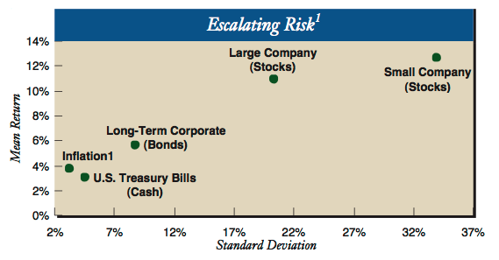
Determinants of Assets Demand
Risk

Slide 45
Determinants of Assets Demand
Liquidity
Another factor that affects the demand for an asset is how quickly it can be converted into cash at low cost.
That is to say, how much the asset is liquid.
All being equal, the more liquid an asset is relative to alternative assets, the more desirable it is, and the greater will be the quantity demanded.

Slide 46
Determinants of Assets Demand
Variable | Change in variable | Change in quantity demanded
Wealth | ↑ | ↑
Expected return relative to other assets | ↑ | ↑
Risk relative to other assets | ↑ | ↓
Liquidity relative to other assets | ↑ | ↑

Slide 47
Shifts in the Demand for Bonds
Wealth
When economy is growing rapidly and wealth is increasing the demanded quantity at each price increases.
As a consequence, the demand curve shifts to the right.
Economy ↑, wealth ↑, Bd ↑, Bd shifts to the right.

Slide 48
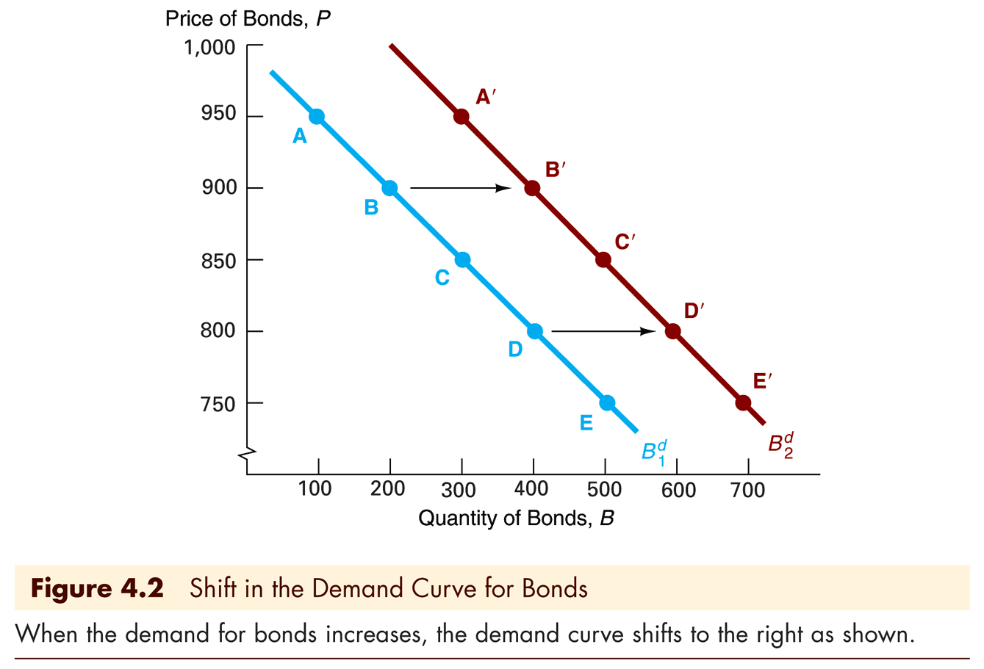
Shifts in the Demand for Bonds
Wealth

Slide 49
Shifts in the Demand for Bonds
Expected Returns
If people begin to think that interest rates would be higher next year than they had originally anticipated, the expected return today on long-term bonds would fall.
Higher expected interest rates in the future:
Lower the expected return for long-term bond
Decrease the demand
Shift the demand curve to the left

Slide 50
Shifts in the Demand for Bonds
Expected Returns
On the contrary lower expected interest rates in the future:
Increase the demand for long-term bonds;
Shift the demand curve to the right.

Slide 51
Shifts in the Demand for Bonds
Risk
An increase (decrease) in the riskiness of bonds causes the demand for bonds to fall (rise) and the demand curve to shift to the left (right).
An increase in the riskiness of alternative assets causes the demand for bonds to rise and the demand curve to shift to the right.

Slide 52
Shifts in the Demand for Bonds
Liquidity
Increased liquidity of bonds results in an increased demand for bonds, and the demand curve shifts to the right.
Increased liquidity of alternative assets lowers the demand for bonds and shifts the demand curve to the left.

Slide 53
Shifts in the Supply of Bonds
Expected Profitability of Investment Opportunities
When economy grows, investment opportunities abound and consequently the supplied quantity of bonds.
In a business cycle expansion (recession), the supply of bonds increases (decreases), and the supply curve shifts to the right (left).

Slide 54
Shifts in the Supply of Bonds
Expected Inflation
More than looking at the nominal interest rate, investors look at the real interest rate.
Real rates are nominal interest rates adjusted by the expected level of prices.
The higher the inflation, the lower the real cost of borrowing money, the higher the supply of bonds.

Slide 55
Shifts in the Supply of Bonds
Government Budget
When the government revenues are less than its expenditure, the treasury must issue new bonds to finance the gap.
Higher government deficits increase the supply of bonds and shift the supply curve to the right.
On the other hand, government surpluses, decrease the supply of bonds and shift the supply curve to the left.

Slide 56
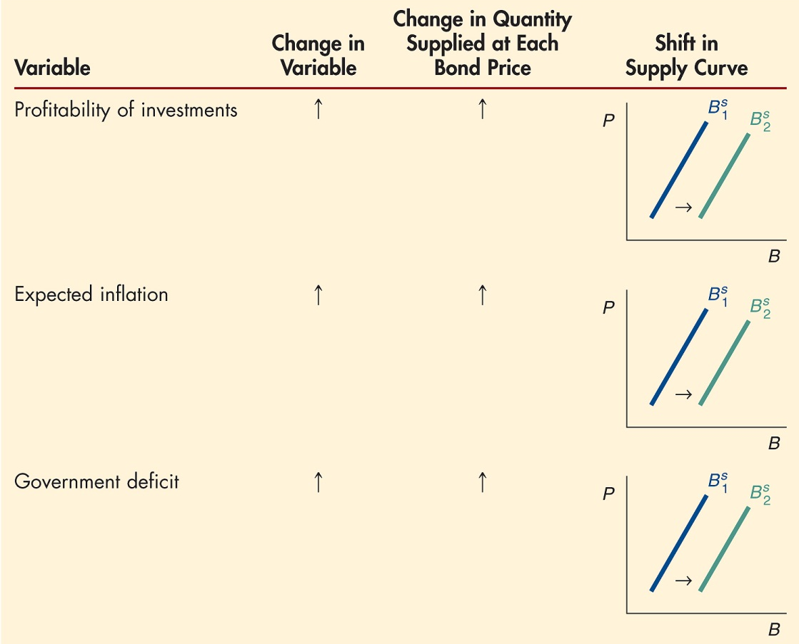
Shifts in the Supply of Bonds

Slide 57
International Financial Markets – 02/26/2018
Today’s Agenda
Debt and Bonds
Changes in interest rates
Supply and demand in the bond market
Yield curve
Spot and forward contracts
Bond pricing
Mishkin, Eakins – ch. 3,4 and 5

Slide 58
Yield Curve
Up to now, we have supposed a unique interest rate, that remains constant over time.
However, it is opportune to recognize that the short term interest rates is different from the long term interest rates.
Indeed, different zero coupon bonds have different prices, according to the various maturity.

Slide 59
Yield Curve
Plotting the different yields against the maturity, we obtain the Yield Curve.
The yield curve shows the different interest rates corresponding to each maturity.
Therefore, it shows the relationship between the short and long term interest rates.

Slide 60
Spot and forward contract
All rates we have considered up to now are computed using spot contract.
A spot contract represents, like the US T-bill, a transaction for immediate delivery.
Indeed, the purchaser of a T-bill is entitled to interest from the settlement date onwards.

Slide 61
Yield curve
In general, the spot rate (on annual basis!) of a spot contract which has
maturity (in years), t
terminal value or face value, x_{t}
price, P=v(0, x_{t})
is the following one:

Slide 62
Yield Curve
Exercise
Let’s consider the following situation:
1y ZCB – Price=98 and Face Value=100
2y ZCB – Price=94 and Face Value=100
The former has a interest rate of (…) indicated with (…) while the latter has a interest rate of (…) indicated with (…).

Slide 63
Yield Curve
Security | Time to Maturity | Face Value | Price | Interest Rate
ZCB | 1m | 100 | 99.9585 | s(0,1)=…
ZCB | 2m | 10 | 9.9876 | s(0,2)=…
ZCB | 3m | 50 | 49.8511 | s(0,3)=…
ZCB | 6m | 65 | 64.3596 | s(0,6)=…
ZCB | 9m | 1 | 0.9781 | s(0,9)=…
ZCB | 12m | 1000 | 956.9378 | s(0,12)=…
Using the data in the table above, graph the term structure of interest rates.

Slide 64
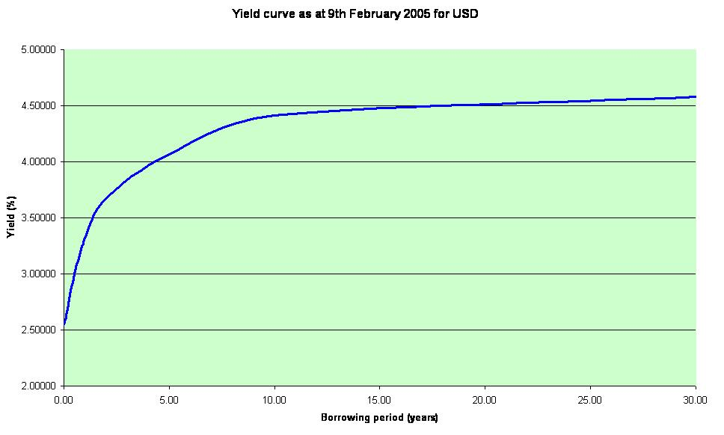
Yield Curve
The zero coupon bond yield curve, as all the other yield curve, plots the spot rates corresponding to the different maturity.

Slide 65
International Financial Markets – 02/26/2018
Today’s Agenda
Debt and Bonds
Changes in interest rates
Supply and demand in the bond market
Yield curve
Spot and forward contracts
Bond pricing
Mishkin, Eakins – ch. 3,4 and 5

Slide 66
Spot and forward contract
Financial markets permits also forward contract.
Unlike the spot contract, the forward one refers to a contract in which the parties to the trade agree today to exchange a security for cash at a future date, but at a price agreed today.
Therefore, as can be inferred from the definition, a forward rate is the interest rate set today which will be applied to a contract at a future date.

Slide 67
Spot and forward contracts
From the spot contracts and the spot rates one can infer the forward rates implicit in the market.
In order to avoid any possibility of arbitrage, the following relation must be respected:

Slide 68
Spot and forward contracts
Therefore f(k, k+i) can be computed using the following relation.
Where f(k, k+i) is the interest rate agreed today for a contract which will last for i periods, from k to k+i.

Slide 69
Spot rate, forward rates and arbitrage
When the relation above mentioned is not satisfied, the market offers a possibility of arbitrage.
An arbitrage is a strategy which ensures non-negative cash flows and, at least, one cash flow strictly positive.
In other words, the arbitrage consists of the simultaneous sell and purchase of different securities, in order to achieve a “free meal”

Slide 70
Spot rate, forward rates and arbitrage
Example.
Suppose that the market offers the following investment opportunity:
A spot contract with maturity k
A spot contract with maturity k+i
A forward contract with settlement date k and maturity k+i.

Slide 71
Spot rate, forward rates and arbitrage
If the spot and forward rates satisfies the following inequality…
…One can
Invest $1 for k+i periods at the spot rate s(0,k+i);
Borrow $1 for k periods at the interest rate s(0,k);
Borrow $[1+s(0,k)]^{k} at the forward rate f(k,k+i), for i periods, from k to k+i.

Slide 72
Spot rate, forward rates and arbitrage
Strategy payouts:
time contracts | 0 | k | k+i
a) | -1 | - | +[1+s(0,k+i)]^{k+i}
b) | 1 | -[1+s(0,k)]^{k} | -
c) | - | +[1+s(0,k)]^{k} | -[1+s(0,k)]^{k}*[1+f(k,k+i)]^{i}
TOTAL | 0 | 0 | >0

Slide 73
Spot rate, forward rates and arbitrage
In word, one must be indifferent between the two following choices:
invest first in a 1Y ZCB and secondly, as the ZCB goes to maturity, reinvest in another 1Y ZCB which features have been decided in 0;
Investing directly in a 2Y ZCB.
If the markets do not respect the preceding relation one can have a free meal and, in other word, implement an arbitrage.

Slide 74
Spot rate, forward rates and arbitrage
Consider the following situation:
1y ZCB – Price=98 and Face Value=100
2y ZCB – Price=94 and Face Value=100
Considering the two spot rates s(0,1)=2.0408% and s(0,2)=3.1421%, there is one and only one forward rates which does not permit any risk free arbitrage.
This forward rate f(1,2)=….

Slide 75
Spot rate, forward rates and arbitrage
Consider again the following spot rates:
s(0,1y)=2.0408% (Spot price=98)
s(0,2y)=3.1421% (Spot price=94)
Suppose that there is a forward contract with the following features:
Forward price = 97.
Face value = 100
Settlement date/period: 1y; Maturity: 2y
Show how one can realize a risk free arbitrage, if any.

Slide 76
International Financial Markets – 02/26/2018
Today’s Agenda
Debt and Bonds
Changes in interest rates
Supply and demand in the bond market
Yield curve
Spot and forward contracts
Bond pricing
Mishkin, Eakins – ch. 3,4 and 5

Slide 77
Bonds pricing……was the formula correct?
When we priced the bond, we used a constant interest rate.
However, as we have just seen, the interest rate may vary over time.
Therefore, exploiting the term structure and the relation between maturities and interest rates we can re-write the bond pricing formula

Slide 78
Bond pricing formula
where:
C is the coupon;
s(0, t) is the spot rate referred to the t^{th} maturirity;
FV is the principal (/face value);
n is the bond maturity.

