Slide 1
Private and Public law lesson 2 The sources of law and their interaction; hierarchy among sources of law

Slide 2
What is a norm? - the subjects to whom it is “addressed”: all citizens? Some of them? Single individuals? Public bodies? No “addressee”?
The sources of law
______________________________

Slide 3
What is a norm? 1. “positività” (in force and effective) 2. “coattività” (enforceable) 3. “esteriorità” (inherent to social life) 4. “generalità e astrattezza” (general, not linked to specific situations/individuals)
The sources of law
______________________________

Slide 4
1. “positività” (in force and effective) - ability to express an existing interest/value among members of the community - the norm has to be effective - if the norm is generally unobserved, this may mean that it does not express a real interest/value of the community - text of the norm – actual content of the norm (as it is applied by Courts and economic players): any conflict?
The sources of law
______________________________

Slide 5
2. “coattività” (enforceable) - Legislator provides for sanctions/fines: the norm has to be applied irrespectively of the individual’s will or intentions - examples: Art. 1516 Civil Code (rights of the purchaser); Art. 624 Criminal Code (theft) - Exception: some norms are not “supported” by sanctions/fines (e.g., norms only setting forth the ultimate aim to be pursued). This does not mean that they are not “effective” or “enforceable”. Example: Art. 4 Constitution (right to work)
The sources of law
______________________________

Slide 6
3. “esteriorità” (inherent to social life; different from rules regarding each private individual only – e.g., moral or religious norms)
The sources of law
______________________________

Slide 7
4. “generalità e astrattezza” (general, regulating categories, not dictated by specific situations/needs of a given individual) - Examples: Art. 58 Constitution ; Art. 575 Criminal Code; Art. 922 Civil Code; Art. 18 Code of Civil Procedure - Exception: “special” norms; exceptional norms (e.g., suspension of procedural terms); “legge-provvedimento” “espropriazione” (compulsory purchase): by operation of law or by means of an administrative decision? Practical implication: different regime concerning challenges
The sources of law
______________________________

Slide 8
Sources of production
[e.g., art. 70 Constitution]
Sources on production
[e.g., art. 72 Constitution]

Slide 9
Institutional sources
(“fonti-atto”)
Factual sources
(“fonti-fatto”)
The Constitutional Court is not competent

Slide 10
Direct sources
Indirect sources

Slide 11
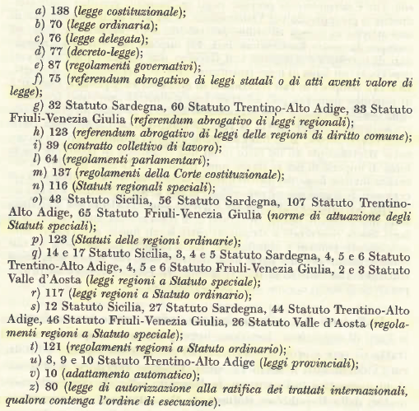
Sources of law in the Italian Constitution
_________________________________

Slide 12
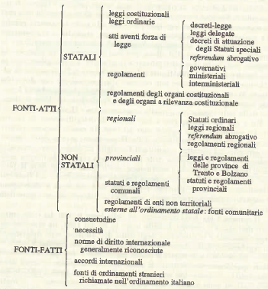
Sources of law in the Italian Constitution
_________________________________

Slide 13
Some remarks on the list of sources: 1- The Constitution is not mentioned: is it a “source”? 2- some sources are regulated by an “external” source 3- some sources are not expressly contemplated by the Constitution (e.g., military orders, EU-law sources, by-laws of non-territorial entities) 4- The Constitution does not contemplate custom (“consuetudini”) – but see art. 1 and 8 of the Pr. to Civil Code - and mechanisms enabling implementation of foreign laws into Italian law 5- the “need” to take a particular action; the “state of need”; “special situations of urgency and need” (art. 77; 13 and 44 of the Constitution)
Sources of law in the Italian Constitution
_________________________________

Slide 14
Regulations: - implementing ordinary laws - supplementing ordinary laws - repealing ordinary laws (based on a previous act of the Parliament) - regulating matters uncovered by ordinary laws
Sources of law in the Italian Constitution
_________________________________
The Constitutional Court is not competent

Slide 15
Internal regulations:
Other sources of law
_________________________________
“riserva di regolamento” costituzionale
Each Chamber of the Parliament
Supreme Council of Magistrates (CSM)
The Constitutional Court
National Council on Economy and Labor (CNEL)
The President of the Republic

Slide 16
Custom (“consuetudine”) 1. “contra legem”; “secundum legem”; “praeter legem” 2. Is “desuetudine” (custom leading to ordinary laws being disregarded) admissible? 3. The main features of “custom”: uniform and constantly repeated behavior by the generality of members of the community + “opinio iuris ac necessitatis” 4. The gathering of custom laws: do “registers” have formal authority? [Art. 9 Pr. to Civil Code: “registered” custom is assumed as existing, unless contrary evidence is provided] 5. Constitutional custom? Supplementing (or amending?) the Constitution; creating new institutions
Other sources of law
_________________________________

Slide 17
Case law 1. the Italian legal system only contemplates “codified” sources of law, but case-law is extremely important 2. example: Art. 923 Civil Code (possession of abandoned goods) 3. What if several norms seem applicable? 4. Is interpretation affected by subjective factors? 5. So, is case law a source of law?
Other sources of law
_________________________________

Slide 18
Case law (follows) 6. Art. 2909 Civil Code: the Court decisions bind all parties, their successor and assigns, as well as any third party involved 7. the role played by the Supreme Court (uniformity in the application of law). Are there binding precedents? 8. May the Judge base his/her decisions on “equità”? (a) the parties so request and the dispute involves disposable rights; (b) the dispute value is lower than a given threshold. If so, may the Judge “create” law?
Other sources of law
_________________________________

Slide 19
National labor agreements 1. Article 39 Constitution: collective agreements entered into by “registered” Unions bind all persons belonging to the relevant category 2. Individual labor agreements bind the relevant parties only 3. Collective agreements may not be in contrast with laws or general regulations (which, in turn, may not regulate matters covered by such agreements in detail). However, in certain matters, the intervention of the legislator is essential (as stated by the Constitutional Court: e.g., minimum wages)
Other sources of law
_________________________________

Slide 20
The opinion of scholars? 1. it is not a source of law 2. It may strongly influence the views taken by Courts and by other “players” (“indirect” application)
Other sources of law
_________________________________

Slide 21
- Hierarchy - Chronology - Segregation of powers
Interaction among sources of law: criteria
_________________________________

Slide 22
General principles: 1. Constitutional laws are preeminent (Art. 2 of the provisions regarding law in general) 2. Without prejudice to point 1, ordinary laws (issued by the Parliament) are preeminent (reserved matters) 3. Government may issue decisions assimilated to ordinary laws (“decreto legislativo” and “decreto-legge”). These are legitimate within the limits set out by ordinary laws
Interaction among sources of law: criteria
_________________________________

Slide 23
1.- Regulations repealing existing norms 2.- Regulations setting forth rules regarding Ministries’ internal organization 3.- Annual measures on deregulation 4.- Regulations implementing EU law into Italian law DEREGULATION PRIVATIZATION DEBUREAUCRATIZATION
Deregulation
_________________________________

