Slide 1
Research assignment RA 9 Impairment Testing
Company_______
Accounting policies/principles
Impairment tests: Goodwill and other intangibles
Impairment tests: Property, plant and equipment

Slide 2
Research assignment RA 9 Impairment Testing
Company_Barclays
^{Impairment testing of goodwill}
During 2016, the Group recognised an impairment charge of nil (2015: £102m). The impairment charge of £102m recognised in 2015 related to Non-Core and the withdrawal of the Bespoke product in Barclays International which was as a result of the recoverable amount of the goodwill relating to these businesses not being supported based on the value in use calculations.
^{Key assumptions}
The key assumptions used for impairment testing are set out below for each significant goodwill balance. Other goodwill of 787m (2015: 1,475m) was allocated to multiple CGUs which are not considered individually significant.
^{Barclays UK}
Goodwill relating to Woolwich in Personal Banking and Business Banking was £3,130m (2015: £3,130m) of the total Barclays UK balance. The carrying value of the CGU has been determined by using net asset value. The recoverable amount of the CGU has been determined using cash flow predictions based on financial budgets approved by management and covering a five-year period, with a terminal growth rate of 2.0 (2015: 2.4 ) applied thereafter. The forecast cash flows have been discounted at a pre-tax rate of 14.6 (2015: 11.4 ). Based on these assumptions, the recoverable amount exceeded the carrying amount including goodwill by £4,130m (2015: £14,097m). A one percentage point change in the discount rate or terminal growth rate would increase or decrease the recoverable amount by £988m (2015: £2,775m) and £615m (2015: £2,109m) respectively. A reduction in the forecast cash flows of 10 per annum would reduce the recoverable amount by 1,293m (2015: 2,789m).
The headroom reflects the changes made to the CGU in Barclays UK as part of the business reorganisation in 2016. The reduction in headroom in 2016 reflects changes in discount rate and future cash flow projections.

Slide 3
Research assignment RA 9 Impairment Testing
Company_L’Oreal
7.3. Impairment tests on intangible assets
^{ACCOUNTING PRINCIPLES}
Goodwill is not amortised. It is tested for impairment at least once a year during the fourth quarter or whenever an adverse event occurs. Adverse events may result among other things from an increase in market interest rates or from a decrease in actual sales or operational profit compared to forecasts.
Impairment tests consist of comparing the carrying amount of assets including goodwill with the recoverable amount of each Cash Generating Unit. A Cash Generating Unit corresponds to one or more worldwide brands. A Cash Generating Unit can contain several brands depending on organisational criteria and particularly when distribution circuits and commercial/management structures are pooled. Recoverable values are determined on the basis of discounted operating cash flow forecasts covering a period of 10 years (the period considered necessary for the strategic positioning of an acquisition) and a terminal value. The cash flows are determined in the currencies of the countries in question and are translated, in the same
way as the net carrying amounts to which they are compared, at the estimated exchange rate for the following year. The discount rate used for these calculations is based on the weighted average cost of capital (WACC), which amounts to 6.8% in 2016, to 6.9% in 2015 and 7.9% in 2014 for amounts in euro, adjusted where appropriate by a country risk premium according to the geographic zones concerned. The discount rates are post-tax rates applied to post-tax cash flows, and result in recoverable amounts identical to those obtained by applying pre-tax rates to pre-tax cash flows. The assumptions adopted in terms of sales growth and terminal values are reasonable and consistent with the available market data (generally 2.5% for Europe and 3% for the rest of the world for terminal values except in specific cases).
The use of discounted cash flow forecasts is preferred in order to determine recoverable amounts, unless details of similar recent transactions are readily available.
Impairment charged against goodwill cannot be reversed.
Impairment tests of Cash Generating Units for which the carrying amount of goodwill and intangible assets with indefinite useful lives is significant, are carried out based on the following data and assumptions:

Slide 4
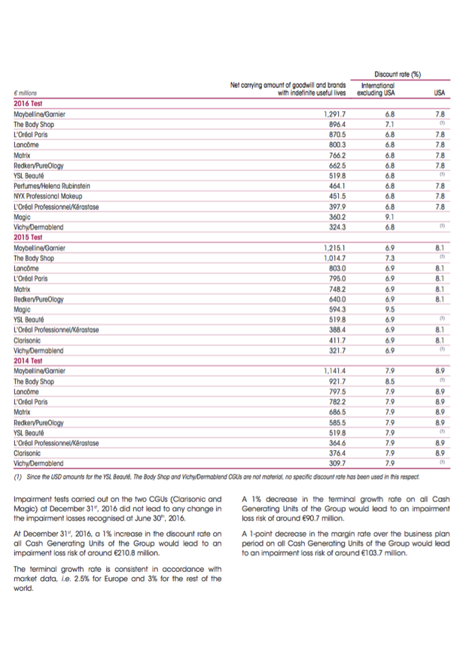
Research assignment RA 9 Impairment Testing
Company_L’Oreal Cont’d

Slide 5
Research assignment RA 9 Impairment Testing
Company_Nestlé
Impairment of property, plant and equipment
Consideration is given at each balance sheet date to determine whether there is any indication of impairment of the carrying amounts of the Group’s property, plant and equipment. Indication could be unfavourable development of a business under competitive pressures or severe economic slowdown in a given market as well as reorganisation of the operations to leverage their scale.
In assessing value in use, the estimated future cash flows are discounted to their present value, based on the time value of money and the risks specific to the country where the assets are located. The risks specific to the asset are included in the determination of the cash flows.
Impairment of property, plant and equipment arises mainly from the plans to optimise industrial manufacturing capacities by closing or selling inefficient production facilities.
Impairment of goodwill and intangible assets
Goodwill and indefinite life intangible assets are tested for impairment at least annually and when there is an indication of impairment. Finite life intangible assets are tested when there is an indication of impairment.
The annual impairment tests are performed at the same time each year and at the cash generating unit (CGU) level. The Group defines its CGU for goodwill impairment testing based on the way that it monitors and derives economic benefits from the acquired goodwill. For indefinite life intangible assets, the Group defines its CGU as
the smallest identifiable group of assets that generates cash inflows that are largely independent of the cash inflows from other assets or groups of assets. The impairment tests are performed by comparing the carrying value of the assets of these CGU with their recoverable amount, based on their value in use, which corresponds to their future projected cash flows discounted at an appropriate pre-tax rate of return. Usually, the cash flows correspond to estimates made by Group Management in financial plans and business strategies covering a period of five years after making adjustments to consider the assets in their current condition. They are then projected to perpetuity using a multiple which corresponds to a steady or declining growth rate. The Group assesses the uncertainty of these estimates by making sensitivity analyses. The discount rate reflects the current assessment of the time value of money and the risks specific to the CGU (essentially country risk). The business risk is included in the determination of the cash flows. Both the cash flows and the discount rates include inflation.
An impairment loss in respect of goodwill is never subsequently reversed.

Slide 6
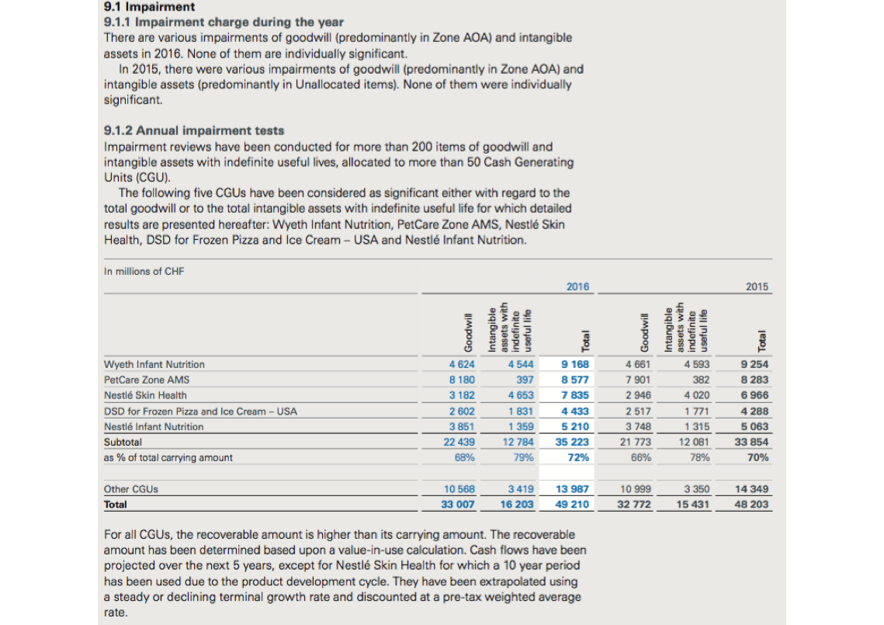
Research assignment RA 9 Impairment Testing
Company_Nestlé

Slide 7
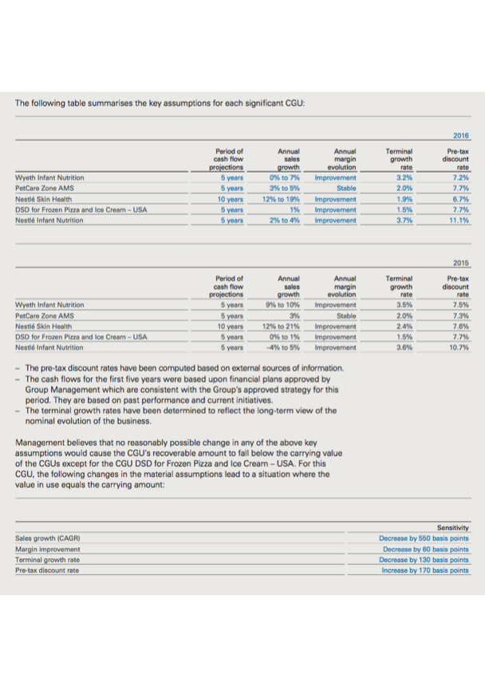
Research assignment RA 9 Impairment Testing
Company_Nestlé

Slide 8
Research assignment RA 9 Impairment Testing
Company_Siemens
Goodwill – Goodwill is not amortized, instead, goodwill is tested for impairment annually, as well as whenever there are events or changes in circumstances (triggering events) which suggest that the carrying amount may not be recoverable. Goodwill is carried at cost less accumulated impairment losses. The goodwill impairment test is performed at the level of a cash-generating unit or a group of cash-generating units, generally represented by a segment and for Siemens Gamesa Renewable Energy one level be- low the segment. This is the lowest level at which goodwill is monitored for internal management purposes.
For the purpose of impairment testing, goodwill acquired in a business combination is allocated to the cash-generating unit or the group of cash-generating units that is expected to benefit from the synergies of the business combination. If the carrying amount of the cash-generating unit or the group of cash-generating units, to which the goodwill is allocated, exceeds its recoverable amount, an impairment loss on goodwill allocated to this cash-generating unit or this group of cash-generating units is recognized. The recoverable amount is the higher of the cash-generating unit’s or the group of cash-generating units’ fair value less costs to sell and its value in use. If either of these val- ues exceeds the carrying amount, it is not always necessary to determine both values. These values are generally determined based on discounted cash flow calculations. Impairment losses on goodwill are not reversed in future periods.
The determination of the recoverable amount of a cash-generating unit or a group of cash-generating units to which goodwill is allocated involves the use of estimates by management. The outcome predicted by these estimates is influenced e.g. by the suc- cessful integration of acquired entities, volatility of capital markets, interest rate developments, foreign exchange rate fluctuations and the outlook on economic trends. In determining recoverable amounts, discounted cash flow calculations use five- year projections that are based on financial forecasts. Cash flow projections take into account past experience and represent management’s best estimate about future developments. Cash flows after the planning period are extrapolated using individual growth rates. Key assumptions on which management has based its determination of fair value less costs to sell and value in use include estimated growth rates and weighted average cost of capital. These estimates, including the methodology used, can
have a material impact on the respective values and ultimately the amount of any goodwill impairment.

Slide 9
Research assignment RA 9 Impairment Testing
Company_Siemens
Impairment of property, plant and equipment and other intangible assets – The Company reviews property, plant and equipment and other intangible assets for impairment whenever events or changes in circumstances indicate that the carrying amount of an asset may not be recoverable. In addition, intangible assets not yet available for use are subject to an annual impairment test. Impairment testing of property, plant and equip ment and other intangible assets involves the use of estimates in determining the assets’ recoverable amount which can have a material impact on the respective values and ultimately the amount of any impairment.

Slide 10
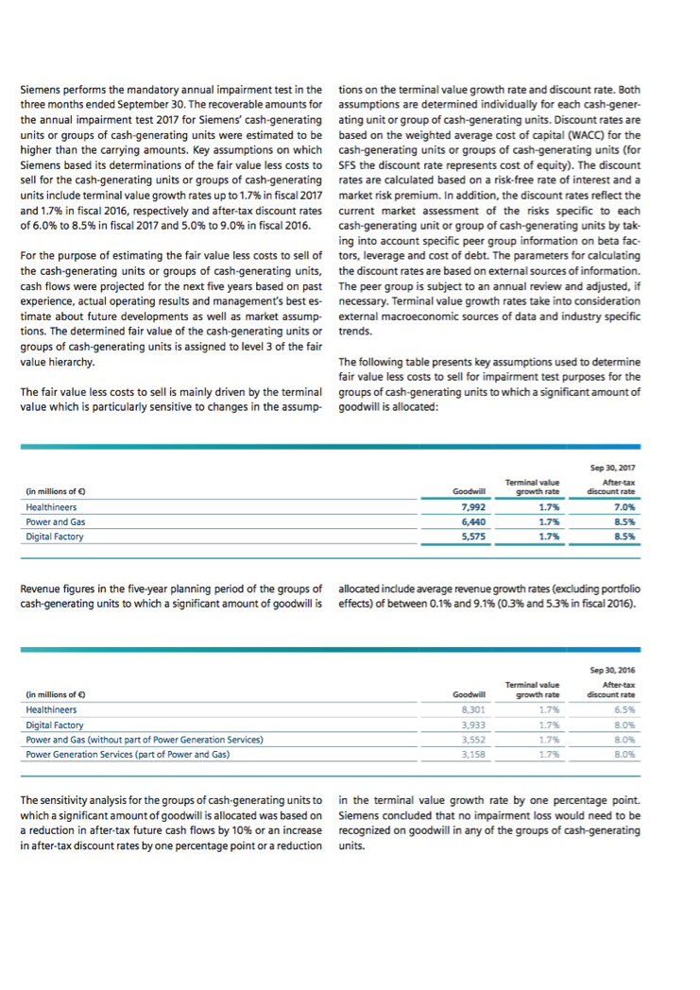
Research assignment RA 9 Impairment Testing
Company_Siemens

Slide 11
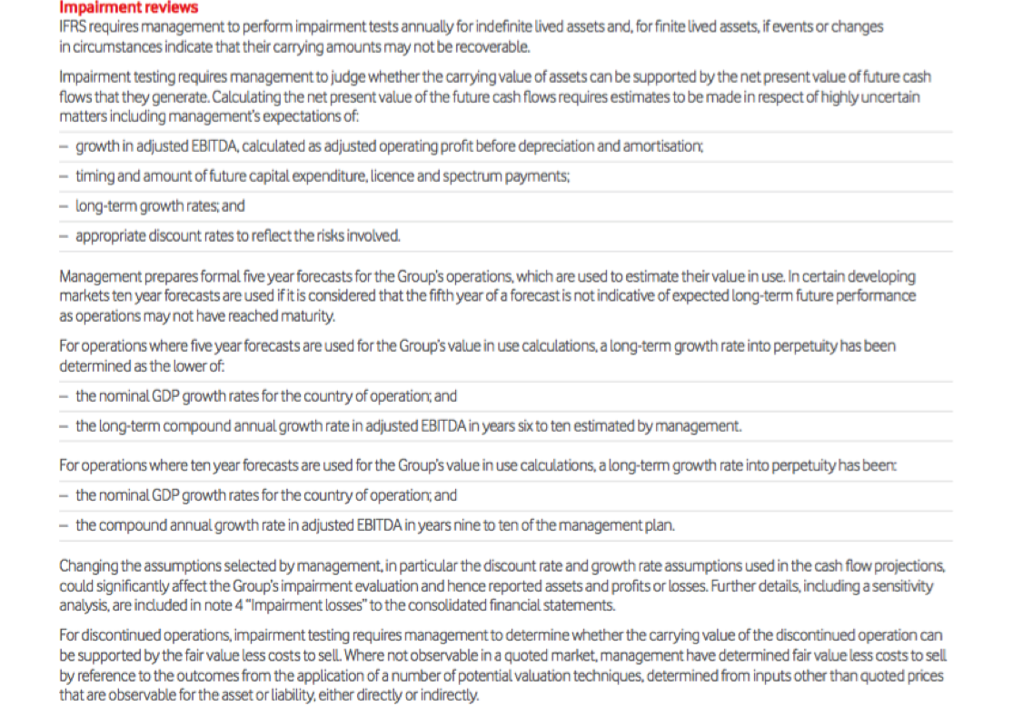
Research assignment RA 9 Impairment Testing
Company_Vodafone

Slide 12
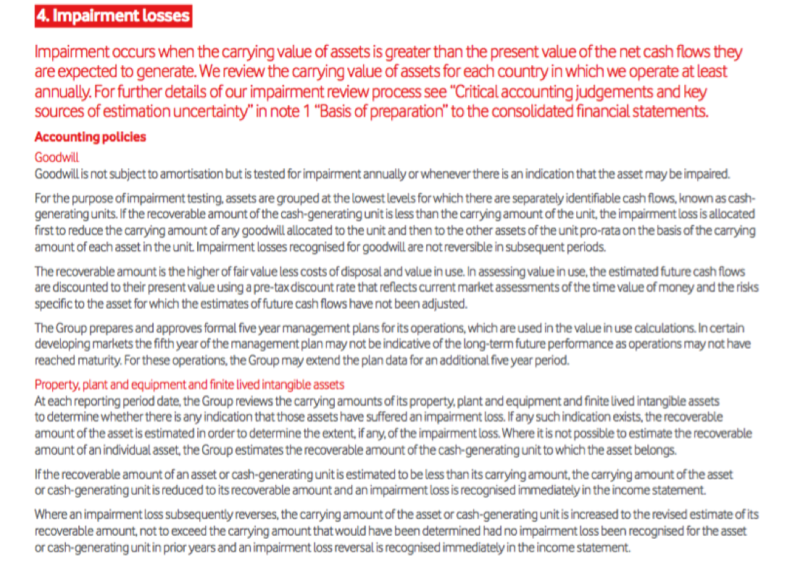
Research assignment RA 9 Impairment Testing
Company_Vodafone

Slide 13
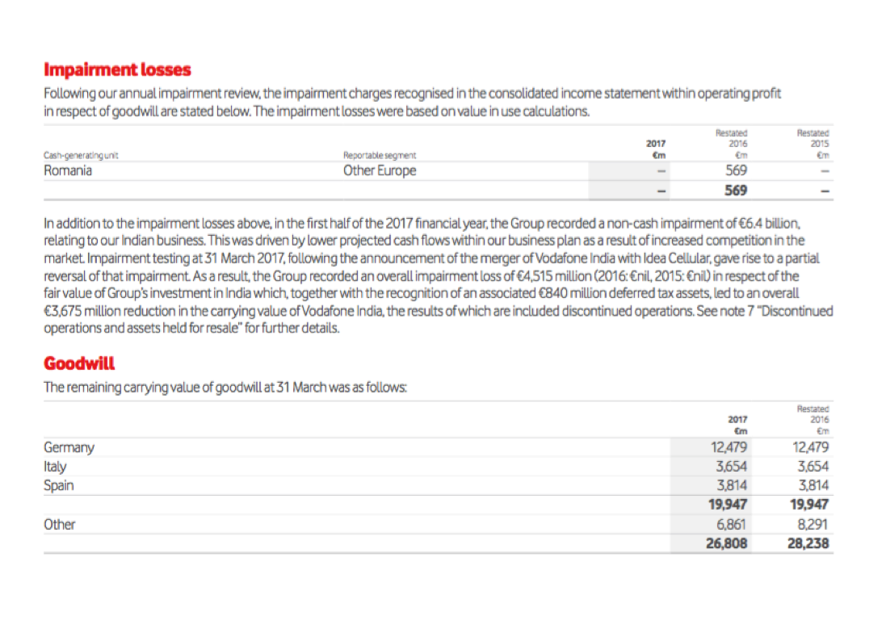
Research assignment RA 9 Impairment Testing
Company_Vodafone

Slide 14
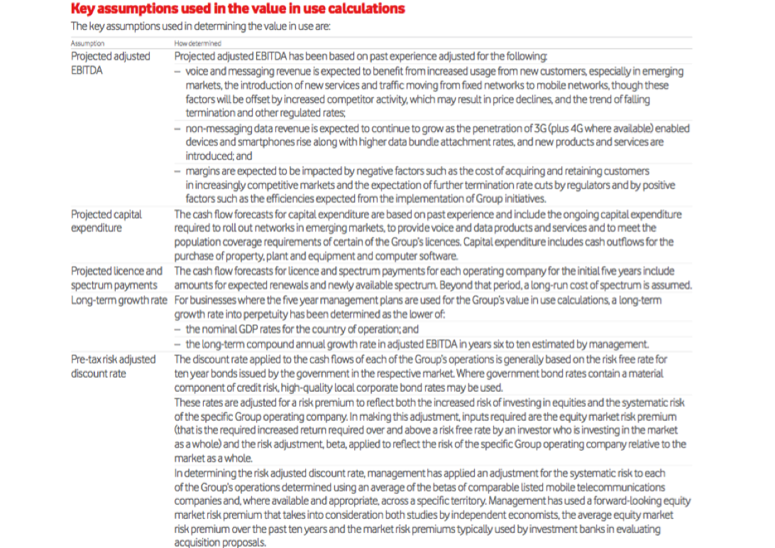
Research assignment RA 9 Impairment Testing
Company_Vodafone

Slide 15
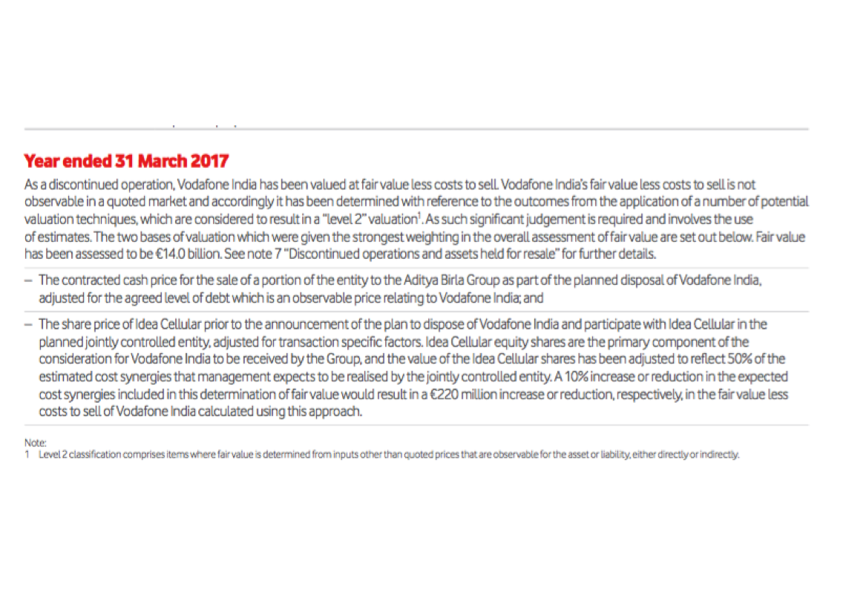
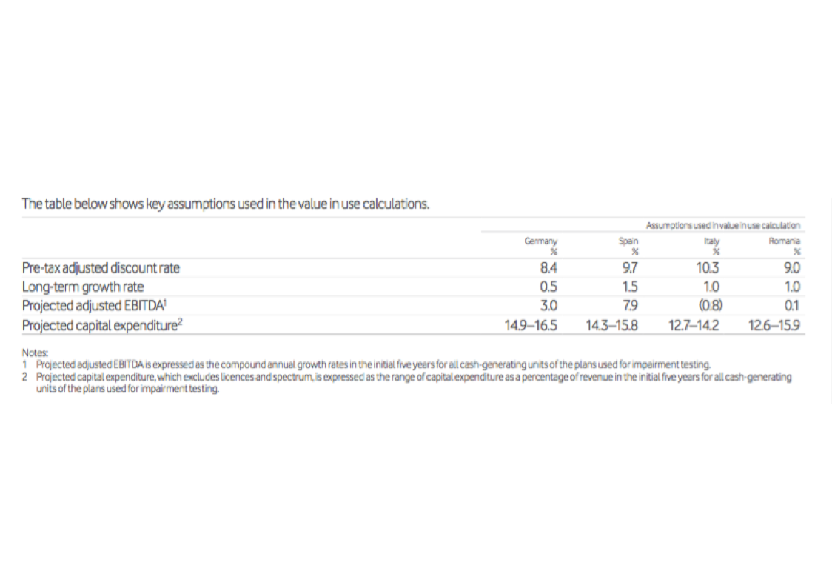
Research assignment RA 9 Impairment Testing
Company_Vodafone

Slide 16
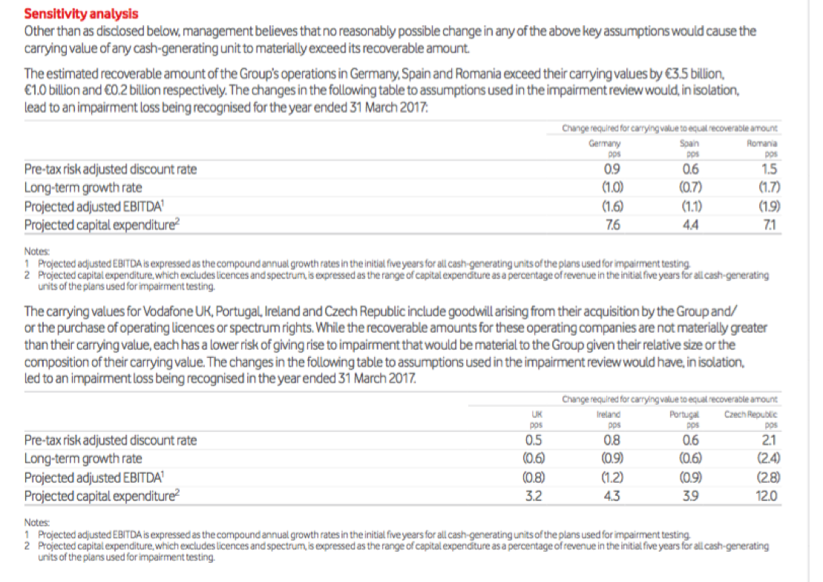
Research assignment RA 9 Impairment Testing
Company_Vodafone

