Slide 1
DECENTRALIZATION
Martina Dal Molin
mdalmolin@liuc.it
AY 2017/2018

Slide 2
Agenda
Introduction
Vertical decentralization
Horizontal decentralization
Five types of decentralization

Slide 3
Introduction
Centralization/ decentralization are common terms in the organizational literature and they have been used in different context
Here centralization/ decentralization are used in relation with the allocation of the decision-making power
Centralized organization = every decision is taken in one part of the organization
Decentralized organization = decision-making power is shared among different part of the organization

Slide 4
Centralization
Centralization ( i.e. every decision is taken by one part of an organization) is the easiest way to coordinate the decision making process:
NEED FOR COORDINATION
THE BOSS DOESN’T HAVE ALL THE REQUIRED INFORMATION
DECENTRALIZATION
DECISION

Slide 5
Decentralization (1/3)
Why decentralization?
Flow of information
Ability to understand information transmitted
To answer to external contextual changes
To motivate people

Slide 6
Decentralization (2/3)
Three meanings of «decentralization»:
Diffusion of formal power along the hierarchical line of authority, i.e. vertical decentralization
Diffusion of informal power, i.e. the control over the decision-making process, of non-managers along, i.e. horizontal decentralization
Physical dispersion of services (e.g. library, printer), i.e. decentralization

Slide 7
Decentralization (3/3)
There are other two types of decentralization
Selective decentralization: decision-making power related to different decision is located in different part of the organization
Parallel decentralization: decision-making power related to different decision is located in only one part of the organization

Slide 8
Decision-making power
What does «decision-making power» actually mean?
INFORMATION
COUNSELLING
CHOICE
AUTHORIZATION
EXECUTION
ACTION
Paterson, 1969

Slide 9
VERTICAL DECENTRALIZATION
AY 2017/2018

Slide 10
Vertical decentralization
It refers to the delegation of power from the strategic apex to the intermediate line
Focus: formal power
Three key questions:
What power should be delegate?
To which organizational unit?
How to coordinate and control the delegated power?

Slide 11
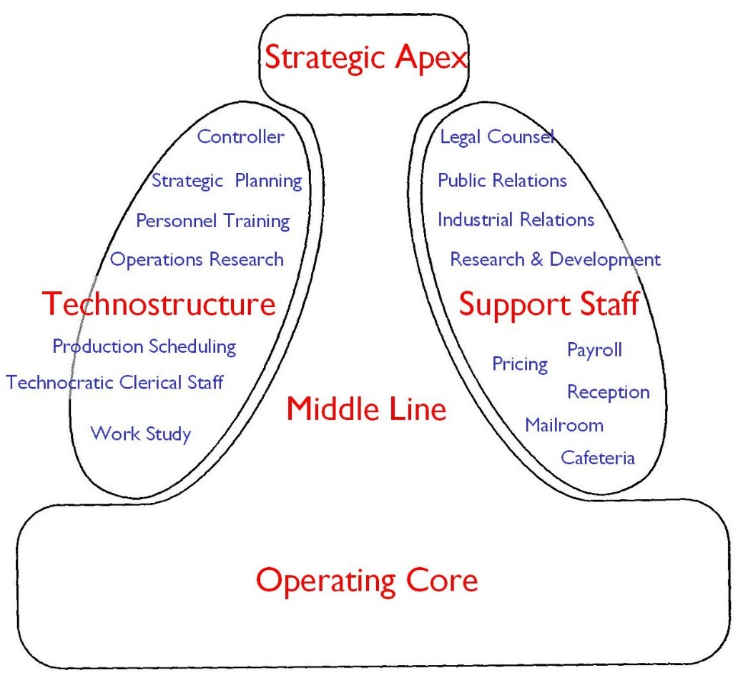
Selective vertical decentralization (1/2)
Work constellation: each constellation is situated, within the organization, where more information are available (to take decision)
FINANCE CONSTELLATION
PRODUCTION
CONSTELLATION
MARKETING
CONSTELLATION

Slide 12
Selective vertical decentralization (2/2)
Functional grouping basis
Interdependencies and, therefore, problem of coordination and control:
Low degree of direct supervision
Process and output standardization
Mutual adjustment

Slide 13
Parallel vertical decentralization
Market grouping basis
Each unit takes decision independently from the others
The strategic apex should control the decision of each unit without reducing their own autonomy
HOW?
Direct supervision
Capabilities standardization
Output standardization
Performance control

Slide 14
HORIZONTAL DECENTRALIZATION
AY 2017/2018

Slide 15
Horizontal decentralization
It refers to the flow of power from managers to «non-managers»
Focus: informal power
The hp according to which fromal power is in the hand of line structure is no longer valid
Continuum of of horizontal decentralization
Power to one person
Power to some analysists
Power to experts
Power to everyone

Slide 16
Power to analysts
The organization is based on «standardization» to coordinate activities
Informal power, therefore, is in the hand of people who design and define standardization
Their power depends on the extension and type of standardization
WHO GIVES POWER TO ANALYSTS?
WORKER, WHOSE WORK IS STANDRIZED
«Power to analysts» is a limited form of horizontal decentralization
«Power to analysts» favor a degree of vertical centralization

Slide 17
Power to experts
Relevance of technical knowledge
Therefore, who has technical knowledge also has informal power
Experts:
Provide advice
Actively take part during the decision-making process
Three situations:
Informal power of experts overlaps the traditional authority structure
Power of experts is combined and matched with formal authority
Power based on technical knowledge is in the hand of workers

Slide 18
Power to everyone
Decentralization is based on the feeling of «being part of the organization»
Democratic organization = an organization in which everyone takes part in the decision making process
Example: voluntary association, private club
PARTICIPATORY MANAGEMENT

Slide 19
5 TYPES of DECENTRALIZATION
AA 2015/2016

Slide 20
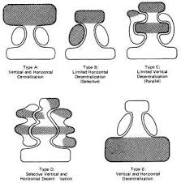
LIMITED HORIZONTAL DECENTRALIZATION
Burocratic organizations based on standardization of processes
Vertical centralization (formal power in the hand of the strategic apex)
Relevance of the technostructure (based on processes strandarization)
VERTICAL AND HORIZONTAL CENTRALIZATION
One person has decision making power
He/She has formal and informal power
He/She takes decision and control their implementation
LIMITED VERTICAL DECENTRALIZATION
Units based on the market
Units managers have the formal power of taking decisions
SELECTIVE HORIZONTAL AND VERTICAL DECENTRALIZATION
Work constellations have power in relation to specific decisions
Constellations select experts
VERTICAL AND HORIZONTAL DECENTRALIZATION
The operating core has alomost all the decision-making power
Technical skills and knowledge of the operating core

