Slide 1
ORGANIZATIONAL STRUCTURES
Martina Dal Molin
mdalmolin@liuc.it
AY 2017/2018

Slide 2
General information
Lessons: from 11/04 to 30/05
Time: 9.00 – 12.00 (20 minutes break)
1° oral exam: 1° June at 9.00
Appointment: write to mdalmolin@liuc.it
La Torre building, first floor, office 1.4

Slide 3
Course structure (1/3)
Topics
Organizational design: the core elements
Coordination mechanisms
The five parts of an organization
The design of the individual positions
The design of the macro-structure
The organizational configurations
The organizational chart
Exercises
Assignment presentation

Slide 4
Course structure (2/3)
What we are going to do:
Frontal lessons
Assignment (individual)
Material:
Slides
Additional material provided by the teacher
Assignment:
Each of view have to chose one scientific article and then:
Ppt presentation (last day of course) (25/05)
Word (Deadline: 30/05)

Slide 5
Course structure: final mark (whole course)
Final mark is composed by
Written test: management and financial accounting 40%
Written test: capital budgeting 30%
Oral exam (whole program) 30%
Average bonus of the 2 assignments (strategy, 1st semester – organization 2nd semester)

Slide 6
Course structure: final mark (partial course)
Part 2 – 2° semester
Written test: capital budgeting 70%
Oral exam (whole program) 30%
Assignment (organization) (bonus 0-2)

Slide 7
ORGANIZATIONAL DESIGN: THE CORE ELEMENTS
AY 2017/2018

Slide 8
Agenda
Organization: some definitions
Organizational dimensions
How to design an organization

Slide 9
Why organization theory?
Why to study organization theory?
Learn from the case of Xerox

Slide 10
Why organization theory?
Why to study organization theory?
It helps us understanding why a company can die or survive
It help us understanding what happened in the past as well well as what might happen in the future
It gives us guidelines on how to manage organizations more effectively

Slide 11
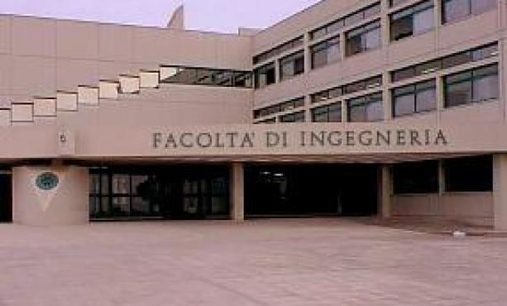
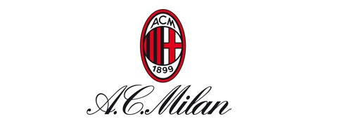
Defining organization (1/2)
Organizations are
Social entities that are goals directed and that are designed as deliberated structure and coordinated activity system and that are linked to the external environment

Slide 12
Defining organization (2/2)
Social entitites, because organizations are made up of people and their mutual relationships;
Goal-directed, because organizations have a mission and goals to be achieved
Designed, because managers organize resourses with the purpose of achieving goals
Linked to the external enviroment, beacuse organizations do not exist in isolation, but they interact with the external enviroment

Slide 13
Organizational dimensions
Organizational dimensions
Structural dimension Contextual dimenion
i.e. The internal characteristics
i.e. Characteristics of the whole organization

Slide 14
Structural dimensions
Formalization, i.e. The amount of written material and documentation that describe behaviour
Specialization, i.e. The degree to which organizational tasks are subdivided into sepratae jobs (extensive vs low)
Hierarchy of authority, that describes who reports to whom and the span of control of each managers
Centralization, i.e. The hierarchical level that has formal decision making power (centralized vs decentralized)
Professionalism, i.e. The level of formal education and training of employes
Personnel ratio, i.e. The deployment of people to various functions and department

Slide 15
Contextual dimensions
Size, i.e. The dimension of the organization and it is typically measured by the n. Of employees
Organizational technology, it refers to the tools, techniques and actions needed to transform inputs into outputs
Environment, it includes all the elements outside the boundary of the organization
Goals and strategy, i.e. The mission and the purpose of the organization
Organization’s culture, i.e. The set of key values and beliefs

Slide 16
Exercise

Slide 17
How to design an organization? (1/2)
Organizational variables MUST be designed and selected following the internal situation and with the external context in which the company works
The parameters for the organizational design should be combined in order to define some ideal configurations.
Literature distinguishes between 5 ideal-type of organizational configurations
Henry Mintzberg

Slide 18
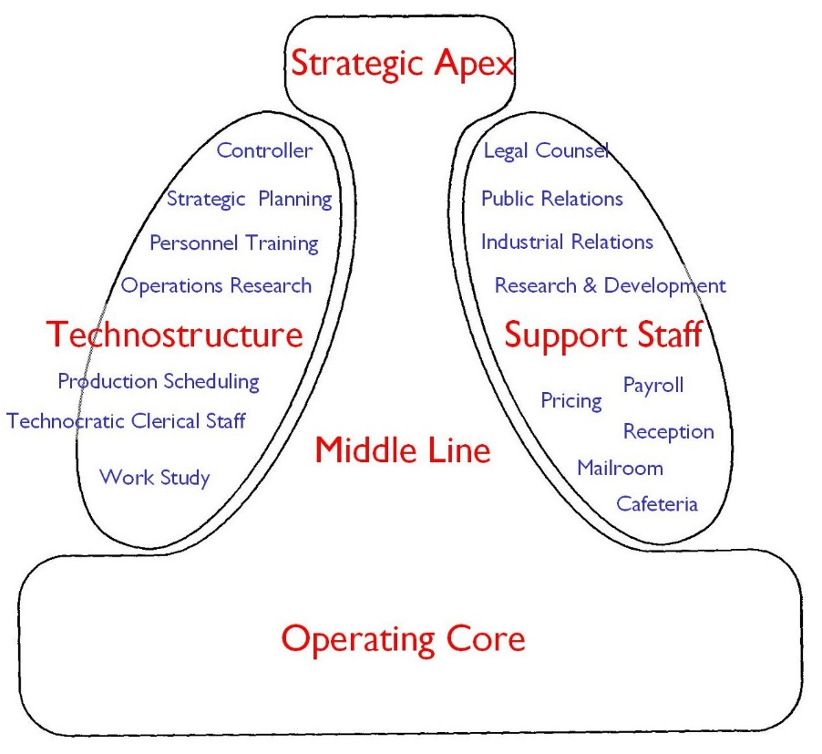
How to design an organization? (2/2)
Which elements or variable should we FIRST consider to design organization?
COORDINATION MECHANISMS
THE (5) PARTS OF AN ORGANIZATION

Slide 19
COORDINATION MECHANISMS
AY 2017/2018

Slide 20
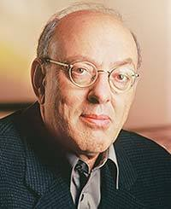
Coordination mechanisms (1/2)
ORGANIZE: what does it mean in your opinion?
The division of labour in different activities
The coordination of these activities

Slide 21
Coordination mechanisms (2/2)

Slide 22
Mutual adjustment (1/2)
MANAGER
CORE ELEMENTS
Coordination is achieved through informal communication
Activities are monitored by who carries out these actvities (i.e. the operator)
Simple
ANALYST
OPERATOR
OPERATOR

Slide 23
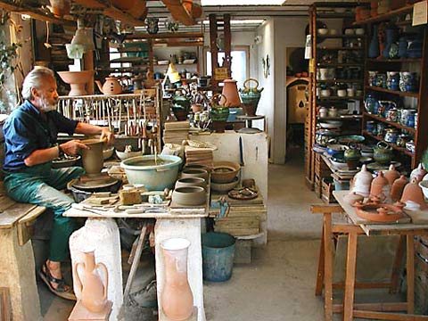
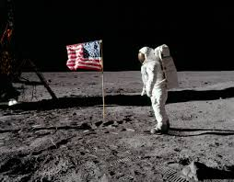
Mutual adjustment (1/2)
In which type of companies do you expect to find this coordination mechanism?
But also…..

Slide 24
Direct supervision (1/2)
MANAGER
CORE ELEMENTS
Coordination is achieved through the direct supervision of the manager
The manager has the responsibility over the others’ activities
ANALYST
OPERATOR
OPERATOR

Slide 25
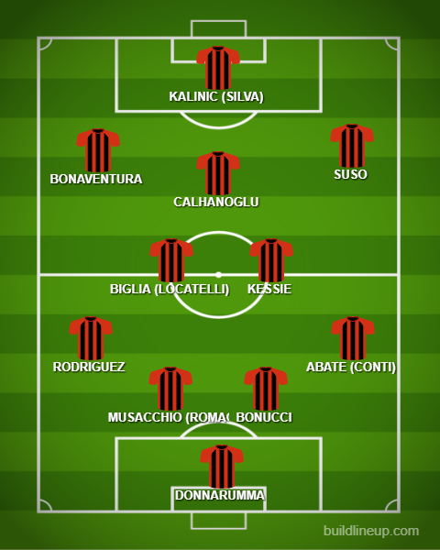
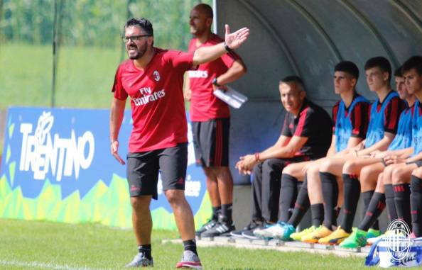
Direct supervision (2/2)
Think about a football team…..

Slide 26
Standardization (1/2)
MANAGER
CORE ELEMENTS
Definition of activities
Three types of standardization:
Input and skills
Work processes
outputs
ANALYST
OPERATOR
OPERATOR
INPUT SKILLS
WORK PROCESSES
OUTPUTS

Slide 27
Standardization (2/2)
….Of WORK PROCESSES
Activities and «content» are specify
….Of OUTPUTS
Final characteristics of the products are defined (e.g. features, dimension, performance)
….Of INPUT SKILLS
Education, skills and capabilities are defined

Slide 28
Summary
MUTUAL ADJUSTMENT
DIRECT SUPERVISION
PROCESSES STANDARDIZ.
OUTPUTS STANDARDIZ.
INPUT SKILLS STANDARDIZ.
MUTUAL ADJUSTMENT
LOW COMPLEXITY
HIGH COMPLEXITY
!!! ORGANIZATIONS USUALLY COMBINE THE FIVE TYPE OF MECHANISMS!!!
Indeed, formal and Informal organization are interconnected

Slide 29
THE FIVE PARTS OF AN ORGANIZATION
AY 2017/2018

Slide 30
The five parts of an organization (1/2)

Slide 31
The five parts of an organization (2/2)
SUPPORT STAFF:
Provision of support services
HIGH COMPLEXITY
TECHNOSTRUCTURE:
The higher complexity of the organization requires standardization
MIDDLE LINE:
Line of authority between the strategic apex and the operating core
STRATEGIC APEX:
Increased dimension of the
More complex division of labour
Direct supervision
OPERATING CORE:
Output production and/or provision of services
Mutual adjustement
LOW COMPLEXITY

Slide 32
Operating core
People directly involved in the production of output/provision of services
Principal functions:
Find input
Trasformation of input in output
Support services (from input to output)
Max standardization
It is the «core» of every organization

Slide 33
Strategic Apex
People who are in charge of monitoring the whole organization and who are responsibile for its results
Principal functions:
Direct supervision
Managing organizational boundaries
Strategy definition
They represent the organizational vision and
mission
Low repetitiveness, complex decision
making, low standardization

Slide 34
Middle line
Middle management and they are responsible for the activities of the operating core
Principal functions:
Collect performance information
Provide performance information to the
strategic apex
Internal boundaries management
Defne internal strategy
Direct supervision

Slide 35
Technostructure
Analysts who define «rule» for the others’ core activities
Principal functions:
To design and plan the others’ work
processes
Three categories
Work analysists
Audit and control analysists
Human Resources analysts

Slide 36
Support Staff
Provision of support services
Provision of SPECIFIC functions without defining
rules for standardization
«small» organization with its own
operating core

Slide 37
How the organization works?
5 perspectives:
Flow of formal authority
Flow of defined and regulated actvities
Flow of informal communication
Work constellation
Ad hoc decision-making process

Slide 38
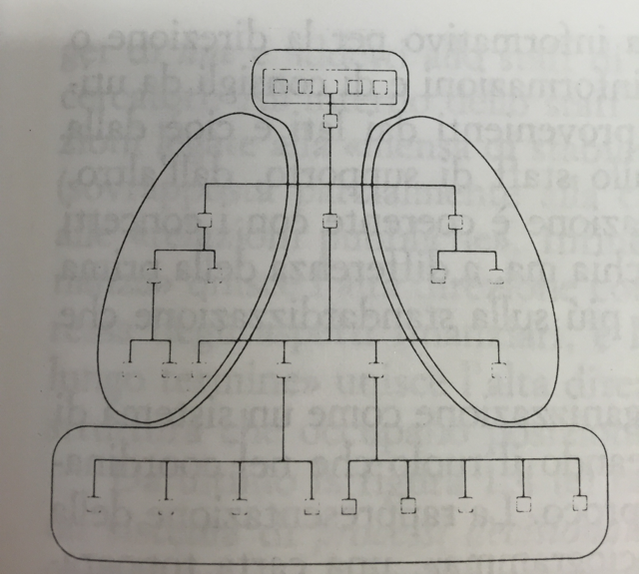
Flow of formal authority
The organization is seen as a system of formal authority
It is represented by the organizational chart
It does not represent the informal flow of power and communication
The organizational chart represent the division of labour:
Which working positions exist
How these positions are grouped to form organizational units
The formal power over organizational units

Slide 39
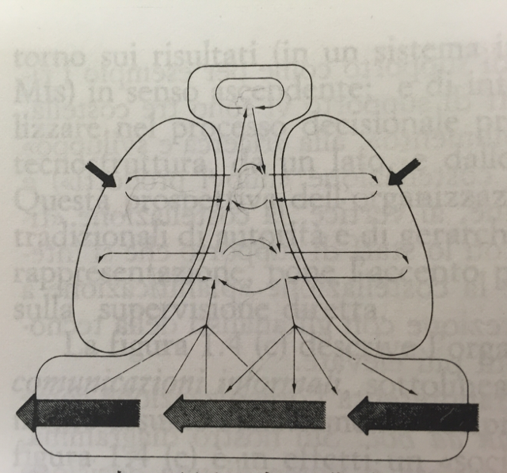
Flow of regulated activities
The organization is seen as a set of rules to monitor the operating core and to provide performance information to the strategic apex
Focus on:
Standardization
Direct supervision

Slide 40
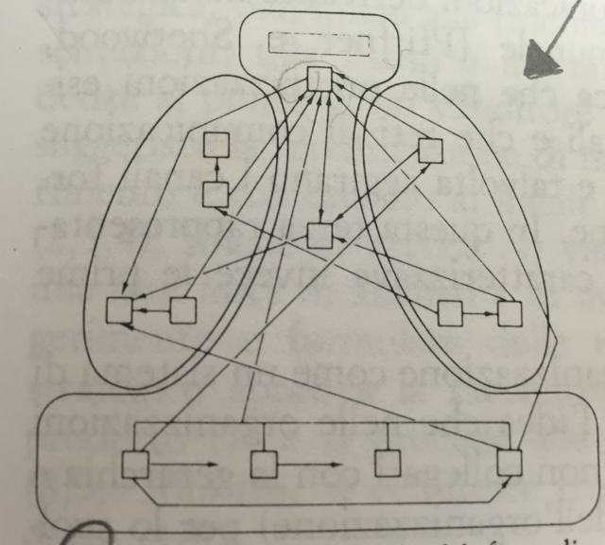
Flow of informal communication
Representation of the real system of communication and power within the organization
It highlights the existence of informal communication flows and «non-official» decision making centres
Focus of mutual adjustement

Slide 41
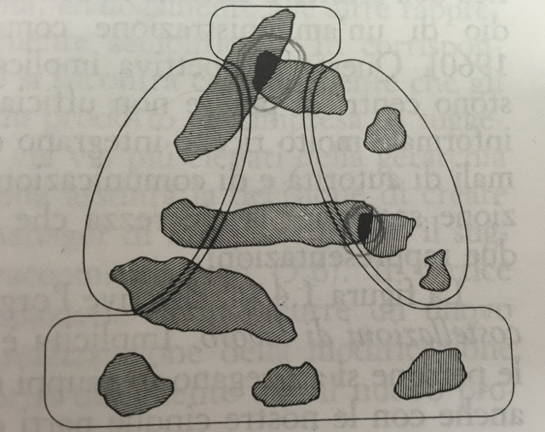
Work constellation
«Work constellation» refers to the creation of groups of people for specific activities
Specific decisions are taken according to the gerarchical position of the constellation

Slide 42
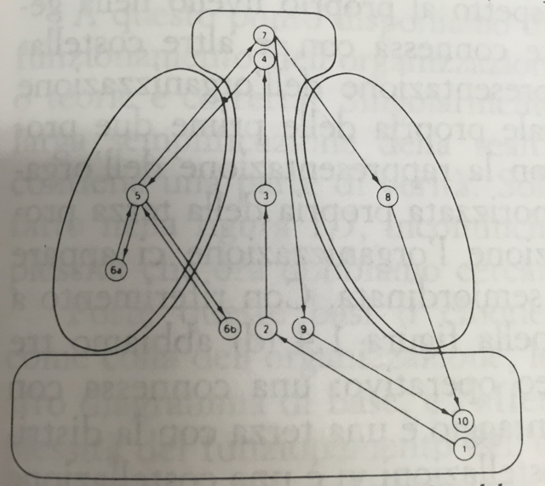
Ad hoc decision-making power
The organization is seen as a set of specific decision-making process

Slide 43
Exercise
Think about empirical example of your life and try to identify the (prevailing) coordination mechanism used to achieve coordination.
Identify the responsbile of the coordination, why a specific coordination mechanism is in used and try to justify the choice.

