Slide 1
ORGANIZATION - ASSIGNMENT
Martina Dal Molin
mdalmolin@liuc.it
AY 2017/2018

Slide 2
You should choose a company and analyze
Checklist | √
A brief overview of the company
Vision and mission statement
Organizational structure (type, characteristics)
Chart of organizational structure
Effectiveness and efficiency of structure (Factors that affecting organizational structure…)
Hierarchy of authority (chain of command, decentralization)
Role of leadership in corporate structure
Analysis and Recommendations

Slide 3
Case-study: Organizational structure of P&G Co.
P&G was created in 1837, Cincinatti, Ohio by William Procter and James Gamble.
In 2014, net sales of the P&G was $ 83,1 billion.
24 of its products have more than billion $ net annual sales, another 20 between 500 million to 1 billion US $.
August 1, 2014 P&G announced itself as a streamlining company by selling off more than 100 brands from its product portfolio, and keeping only 65 brands.
Current President and CEO – David Taylor
Number of employees – 105 000 (2016)
P&G is present at North America, Latin America, Europe, the Middle East, Africa, Asia, Australia, and New Zealand.

Slide 4
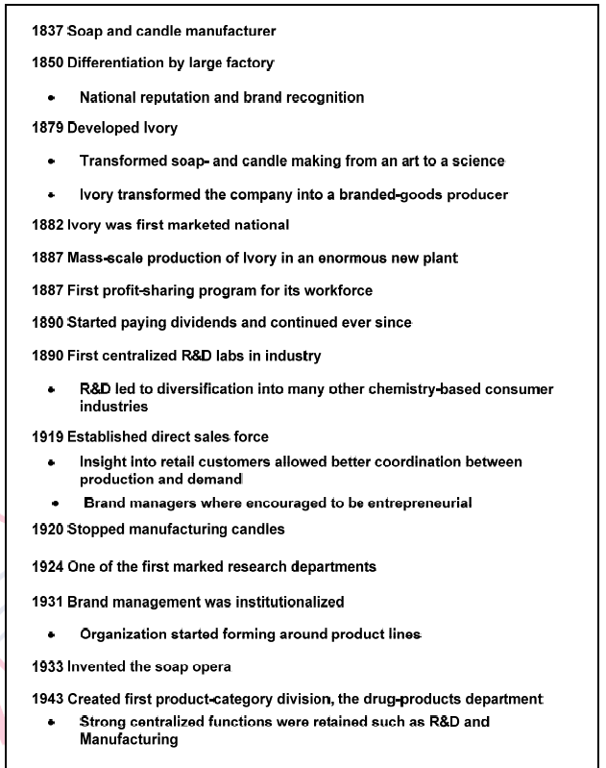
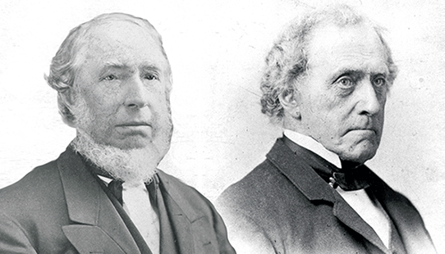
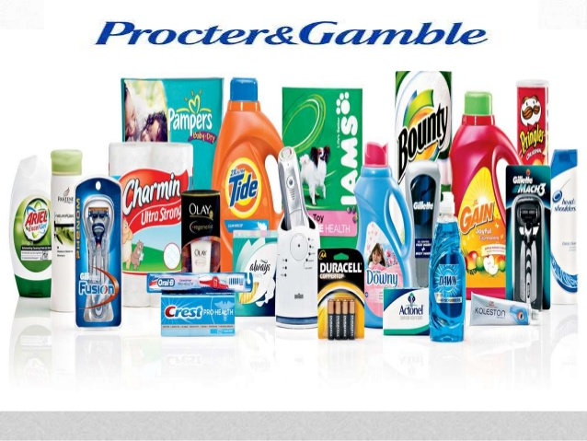
Timeline of P&G

Slide 5
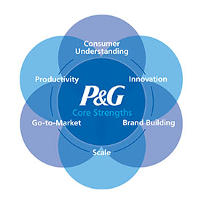
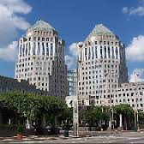

Slide 6
TIMELINE (cont’d)

Slide 7
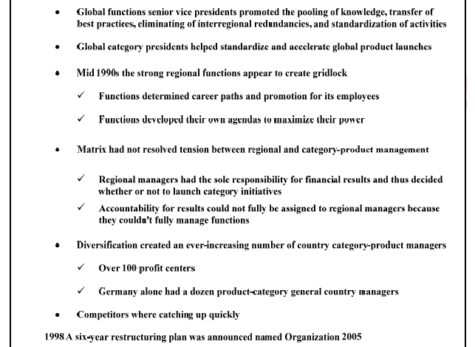
Timeline (cont’d)

Slide 8
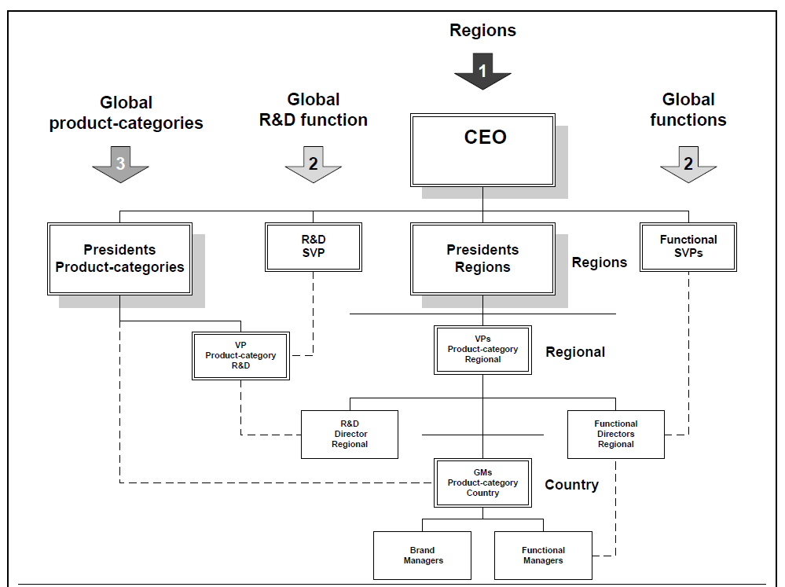
P&G’s matrix structure with three dimensions: regional (1), functional (2)
and product categories (3).

Slide 9
P&G’s Restructuring program (1998): from matrix to hybrid matrix
structure
Durk Jager initiated the restructuring process. The purpose was to achieve $ 900
Million after tax savings by 2004 by voluntary separation of 15000 employees;
eliminating six management layers by reducing from 13 to 7 at a cost of 1,9 billion
US $ over five years.
It was introduced: Global business units with primary responsibility for products;
Market development organizations → markets;
Global business services → managing internal business processes.
2000 – change in the strategy of P&G: Alan Lefly became CEO of the company

Slide 10
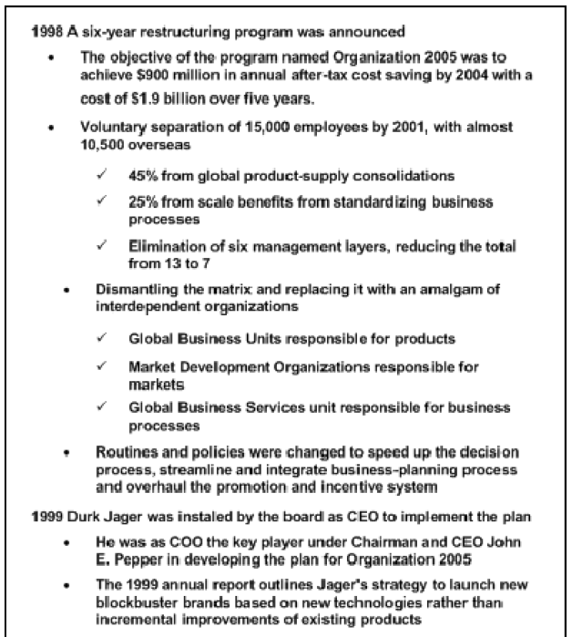

Slide 12
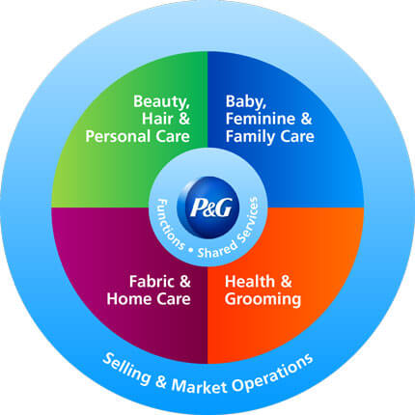
P&G Today:
Global Business Units responsible for developing
overall brand strategy, new product
upgrades and innovations and marketing plans.
Baby, Feminine and Family Care
Beauty
Fabric and Home Care
Health and Grooming
Selling and Market Operations (SMOs) are responsible for developing and executing go-to-market plans at the local level – and includes dedicated retail customer, trade channel and country-specific teams in 6 regions:
Asia Pacific, Europe, Greater China, India, the Middle East and Africa (IMEA)
Latin America, North America.

Slide 13
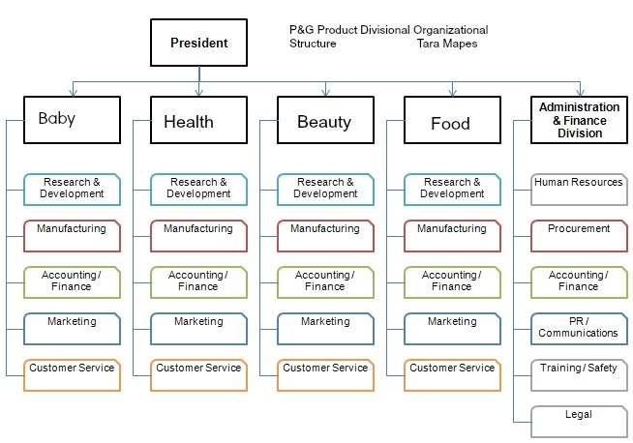

Slide 14
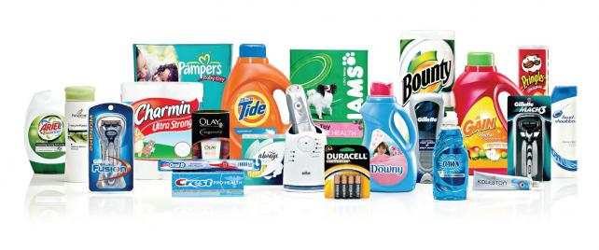
Global Business Services (GBS) provides technology, processes and standard data tools to enable the GBUs and the SMOs to better understand the business and better serve consumers and customers. The GBS organization is responsible for providing world-class solutions at a low cost and with minimal capital investment.

