Slide 1
Management Principles and Human Resources
Martina Dal Molin
mdalmolin@liuc.it
AY 2017/2018

Slide 2
Agenda
Introduction
Business Model
Output Portfolio
BCG Matrix

Slide 3
INTRODUCTION

Slide 4
From Financial Accounting….
Strategy is about…………..
………… being DIFFERENT
COMPETITION
COMPETITIVE ADVANTAGE
PRODUCT or MARKET LEADERSHIP
COMPETENCIES LEADER

Slide 5
Two different focuses
To analyze and to define the company’s strategy, it is necessary what the company is
OUTPUT
Once the nature of the company is clear, is it possible to understand what the company could be
RESOURCES
COMPETENCIES

Slide 6
What the company is (1/3)
To understand what the company is we should look at its output, and specifically at:
Goods and services provided
Clients
Needs the company wants to address
Geographical areas
Competitors (direct, indirect, potential)

Slide 7
What the company is (2/3)
Once competitors have been identified, we should look back at the company, analyzing how good the company is with respect to
Ability to satisfy clients’ needs
Ability of being efficient (production of goods and services)
Bargaining power to clients and suppliers
Ability to maintain competitive advantages or ability to reduce disadvantages
BUT IT IS NOT ENOUGH!!!

Slide 8
What the company is (3/3)
It is necessary to look also at:
“brutality” of internal competition
Trend of the market demand
Power of suppliers
Barriers to new entrance

Slide 9
What the company could be
Basic idea: companies do not have a predetermined future, but they could to strike out and to find new routes
What are the core elements to understand what the company can be?
Features of the top management
“Quality” of HR and ability of the company to attract talents
Role and relevance of R&D
Strength of the brand
Attitude toward entering new geographical area(s)
http://brandfinance.com/press-releases/lego-overtakes-ferrari-as-the-worlds-most-powerful-brand/?utm_source=blog_post&utm_medium=blog_post&utm_campaign=scuola-innovazione-lego
Financial solidity and company’s reputation

Slide 10
THE BUSINESS MODEL

Slide 11
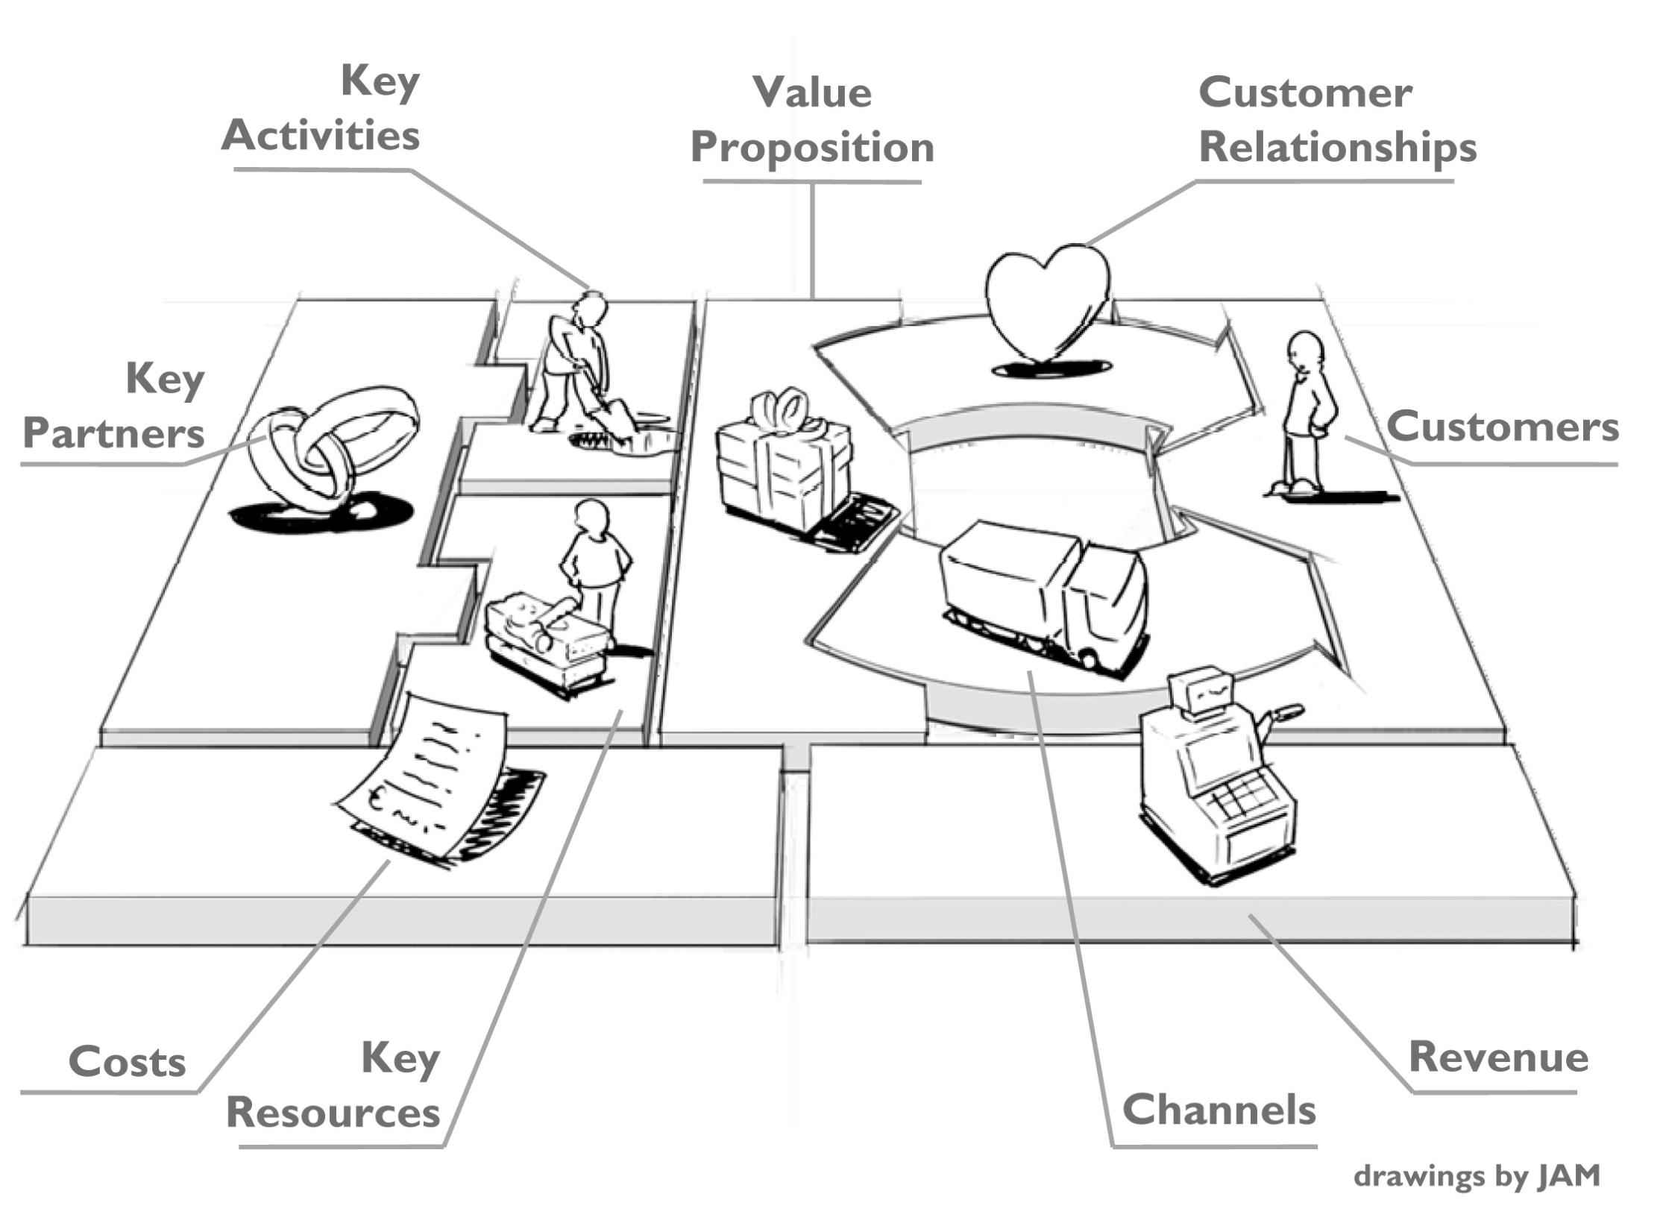

Slide 12
The Business Model
The Business Model allows us to understand the strategic position of the company based on its business idea through which it wants to create value
Basically, the Business Model analyzes:
Products
Clients (final and intermediate clients)
Geo-political area(s)
The more the output portfolio is differentiated, the more the business model is complex

Slide 13
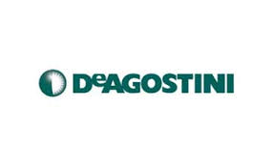
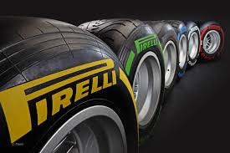
The output portfolio
FOCALIZED OUTPUT PORTFOLIO
DIFFERENTIATED OUTPUT PORTFOLIO

Slide 14
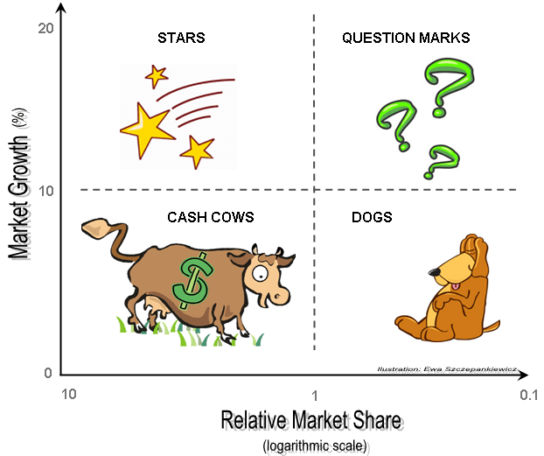
The «optimal» output portfolio: BCG Matrix

Slide 15
The «optimal» output portfolio: BCG Matrix
Dogs: the company has a market share extremely lower compared to that of the leader
Cash Cows: the company is the leader in a market that is decreasing
Stars: the company is the leader is a specific market. With respect to that specific product, the company has the biggest market share. High profitability
Question Marks: The company has a market share lower compared to that of the leader
What is the ideal business portfolio?

Slide 16
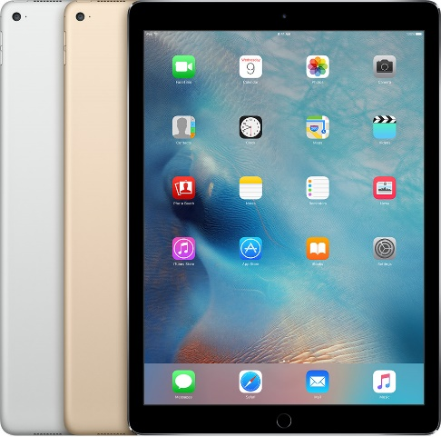
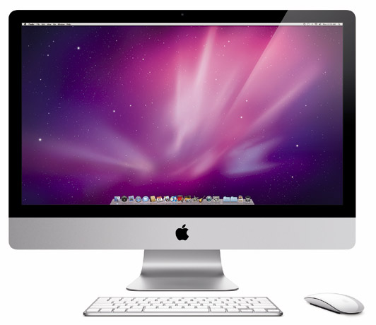
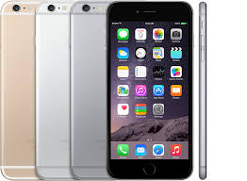
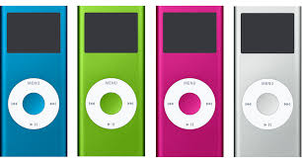
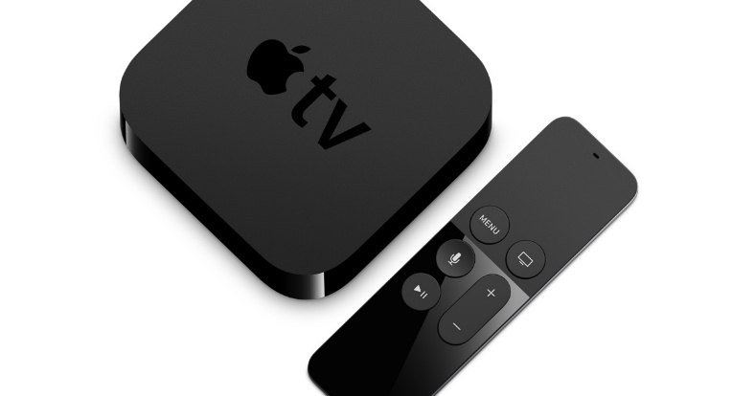
The BCG Matrix: Apple
STARS | QUESTION MARKS
CASH COWS | DOGS

Slide 17
Strategy to go beyond the crise
Notes:
http://brandfinance.com/press-releases/lego-overtakes-ferrari-as-the-worlds-most-powerful-brand/?utm_source=blog_post&utm_medium=blog_post&utm_campaign=scuola-innovazione-lego

Slide 18
LEGO – a short introduction
LEGO was born in 1932 in Billund thanks to a Danish woodworker
“LEGO” is abbreviation for “leg godt”, i.e. play good
The core business of the company are the small colored Atotmatic Binding Bricks
The LEGO is one of the leader on the toys’ market, that is potentially highly able to generate profits, but at the same time is characterized by a strong level of competition
Indeed, also for LEGO, crisis time arrived, starting from 1993 the LEGO slowly growth, arriving in 2003 with a huge deficit
Notes:
http://brandfinance.com/press-releases/lego-overtakes-ferrari-as-the-worlds-most-powerful-brand/?utm_source=blog_post&utm_medium=blog_post&utm_campaign=scuola-innovazione-lego

Slide 19
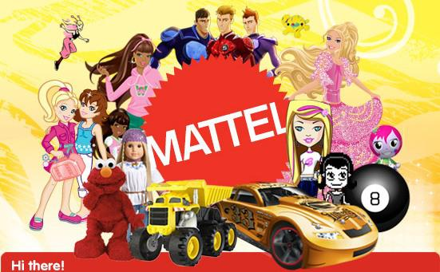
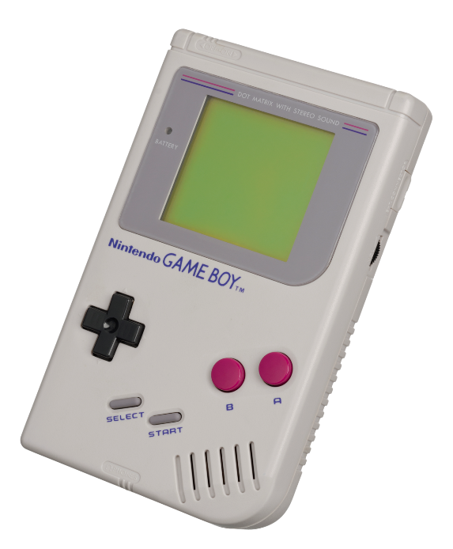
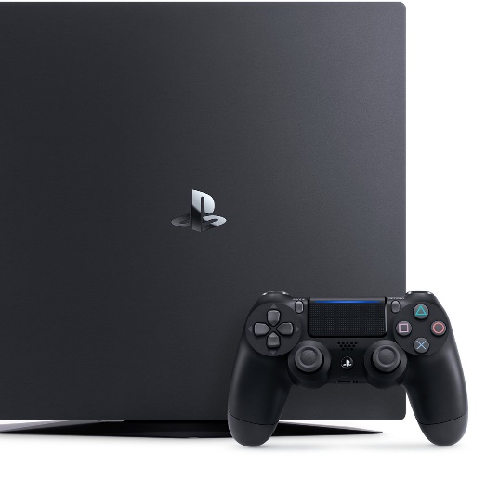
LEGO – the main problems
Non competitive products
Non differentiated products
Technological gap – technological driven toy increased
Notes:
http://brandfinance.com/press-releases/lego-overtakes-ferrari-as-the-worlds-most-powerful-brand/?utm_source=blog_post&utm_medium=blog_post&utm_campaign=scuola-innovazione-lego

Slide 20
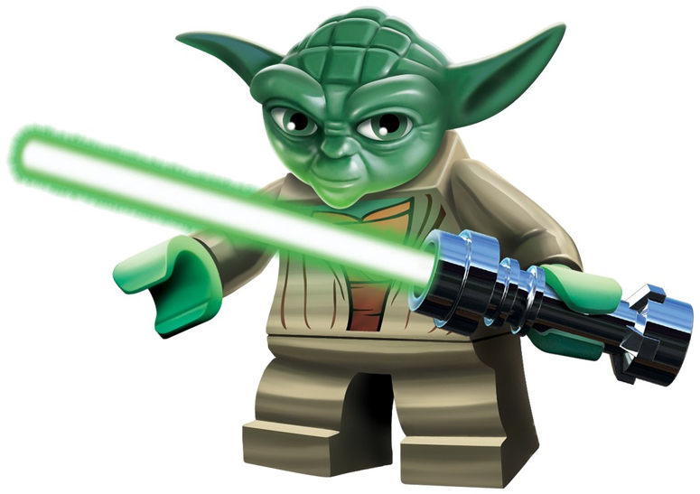
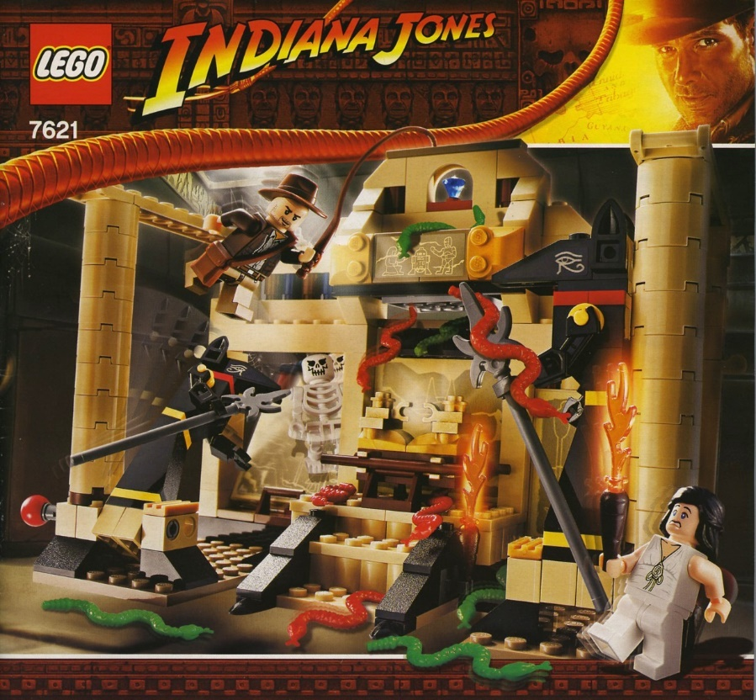
LEGO – The main strategy changes (1/5)
Product differentiation: no more the colored bricks, but…
Notes:
http://brandfinance.com/press-releases/lego-overtakes-ferrari-as-the-worlds-most-powerful-brand/?utm_source=blog_post&utm_medium=blog_post&utm_campaign=scuola-innovazione-lego

Slide 21
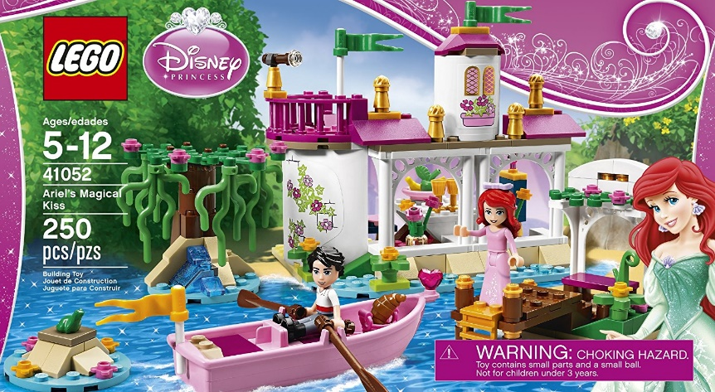
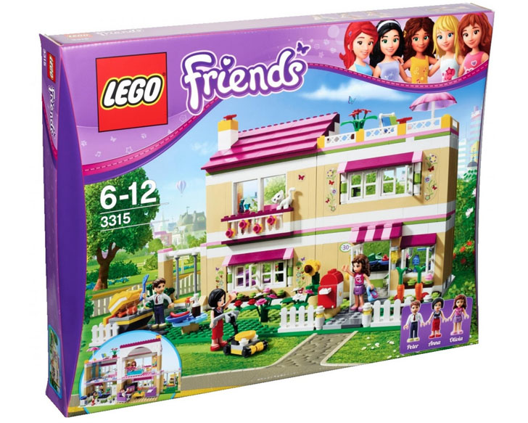
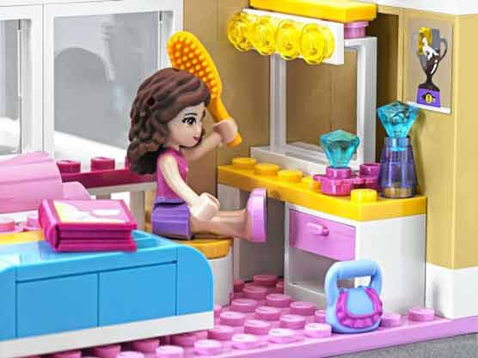
LEGO – The main strategy changes (2/5)
Product differentiation: no more the colored bricks for guys, but…
Notes:
http://brandfinance.com/press-releases/lego-overtakes-ferrari-as-the-worlds-most-powerful-brand/?utm_source=blog_post&utm_medium=blog_post&utm_campaign=scuola-innovazione-lego

Slide 22
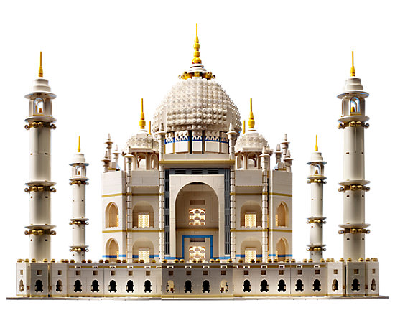
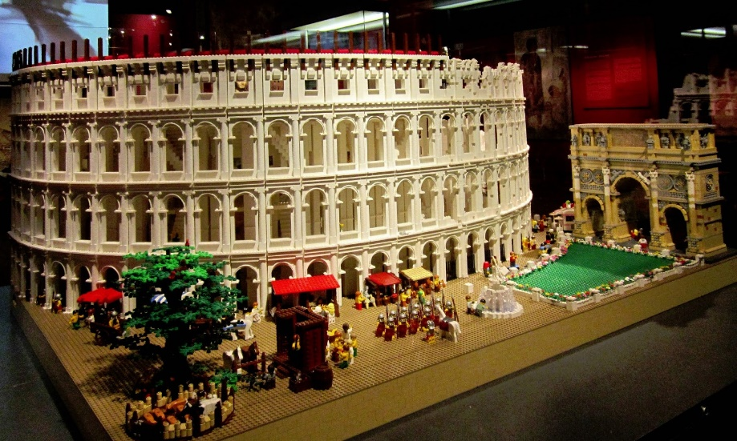
LEGO – The main strategy changes (3/5)
Product differentiation: not only stories, but..
Notes:
http://brandfinance.com/press-releases/lego-overtakes-ferrari-as-the-worlds-most-powerful-brand/?utm_source=blog_post&utm_medium=blog_post&utm_campaign=scuola-innovazione-lego

Slide 23
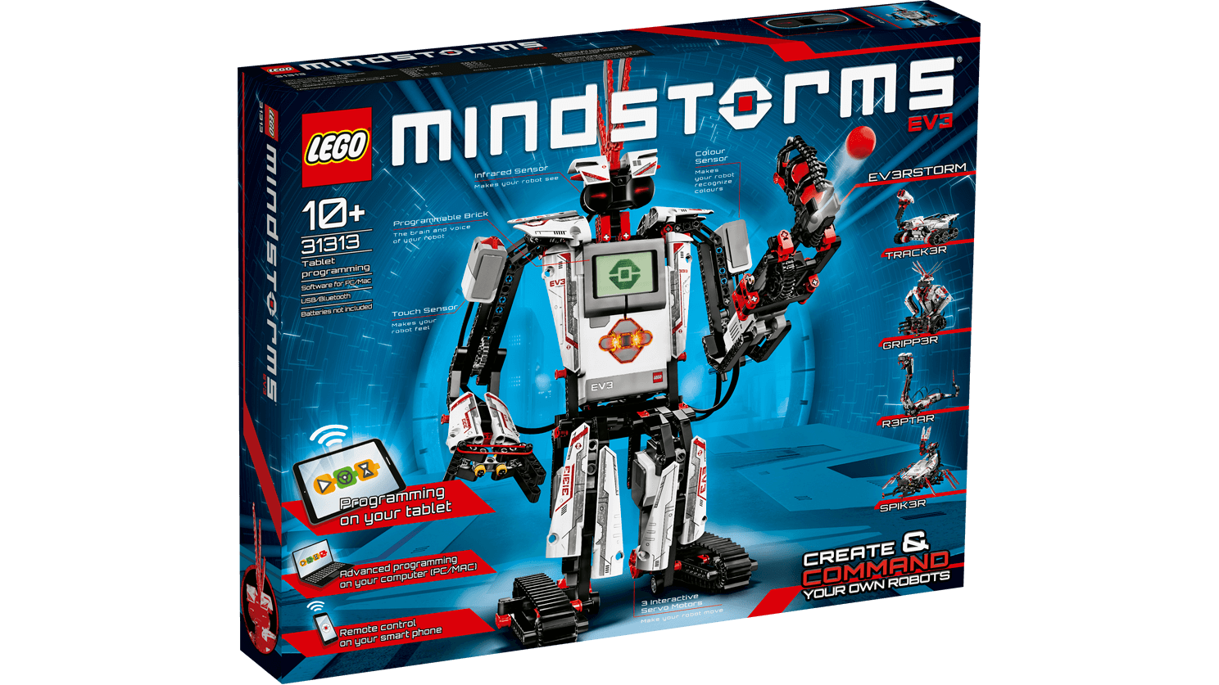
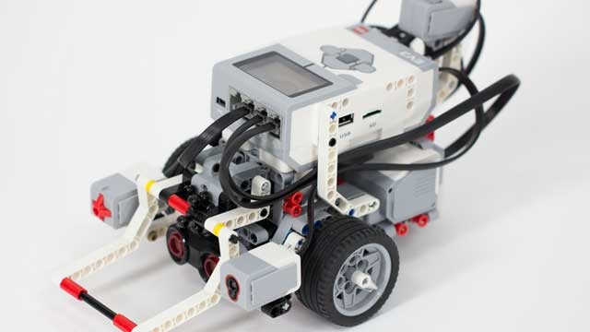
LEGO – The main strategy changes (4/5)
Reducing the technological gap and the relation with clients
Notes:
http://brandfinance.com/press-releases/lego-overtakes-ferrari-as-the-worlds-most-powerful-brand/?utm_source=blog_post&utm_medium=blog_post&utm_campaign=scuola-innovazione-lego

Slide 24
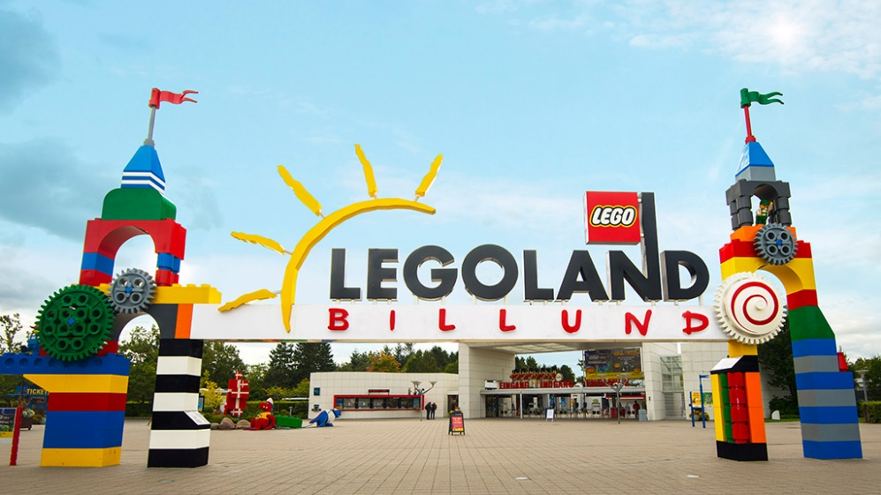
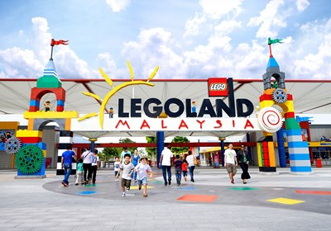
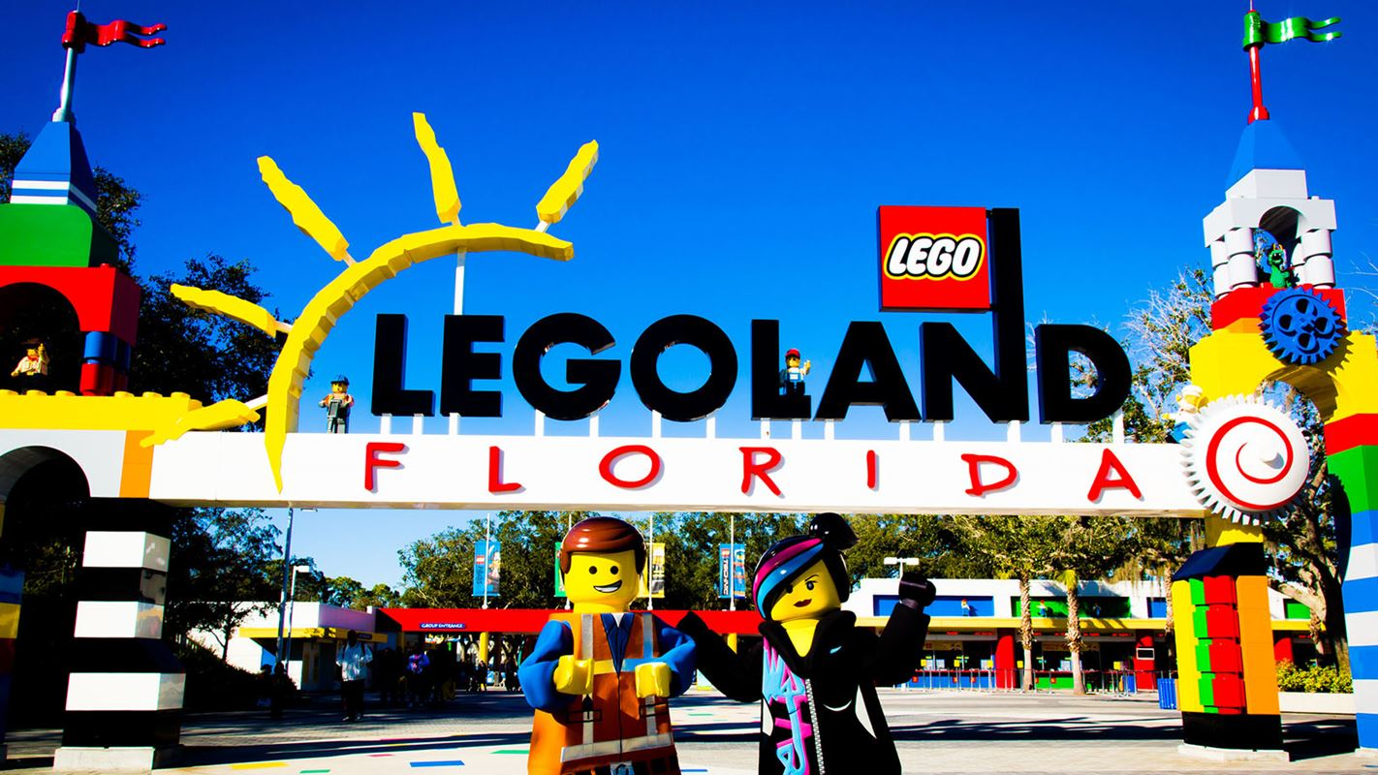
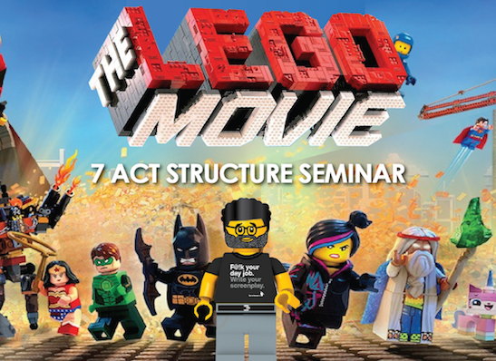
LEGO – The main strategy changes (5/5)
Different channels (from “just imagine” to “play on”)
Notes:
http://brandfinance.com/press-releases/lego-overtakes-ferrari-as-the-worlds-most-powerful-brand/?utm_source=blog_post&utm_medium=blog_post&utm_campaign=scuola-innovazione-lego

Slide 25
LEGO – Some recent data
2009, LEGO is one of the world’s 5 largest toy company
2011, LEGO became the 3 world’s largest toy company
2012, Corporate Management changes from 6 to 22 persons
2013, the Annual Net result id three time that of 2007
2014, main offices open in London, U.S. and China
2015, LEGO products are sold in more than 140 countries
2016, more than 18.000 employees, representing more than 70 nationalities
Notes:
http://brandfinance.com/press-releases/lego-overtakes-ferrari-as-the-worlds-most-powerful-brand/?utm_source=blog_post&utm_medium=blog_post&utm_campaign=scuola-innovazione-lego

Slide 26
Strategy to be different – the food service market
This is the recent story of three guys who wanted to enter the food service market, particularly that of pizza
The food market in Italy is one of the most important market, in which Italians spend around 35% of all their food expenditures
It is characterized by a high competition, and in 2014 there are 4,5 food company every 1.000 inhabitants
Lombardy is the Region in which there is the high number of food service (in 2015, 50.108)
Properly per the high competition, the survival rate is 52% after 5 years
For this reasons entering and surviving is challenging and it requires that restaurant finds their own peculiarities, to differentiate themselves from the others.
Notes:
http://brandfinance.com/press-releases/lego-overtakes-ferrari-as-the-worlds-most-powerful-brand/?utm_source=blog_post&utm_medium=blog_post&utm_campaign=scuola-innovazione-lego

Slide 27
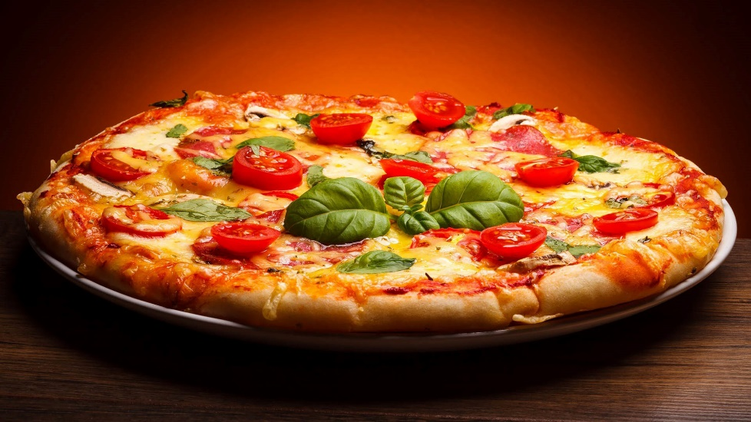
Strategy to be different – the food service market
Products are more or less homogeneous
Low level of products’ differentiation
Perfect information
No barriers to new entrants
Notes:
http://brandfinance.com/press-releases/lego-overtakes-ferrari-as-the-worlds-most-powerful-brand/?utm_source=blog_post&utm_medium=blog_post&utm_campaign=scuola-innovazione-lego

Slide 28
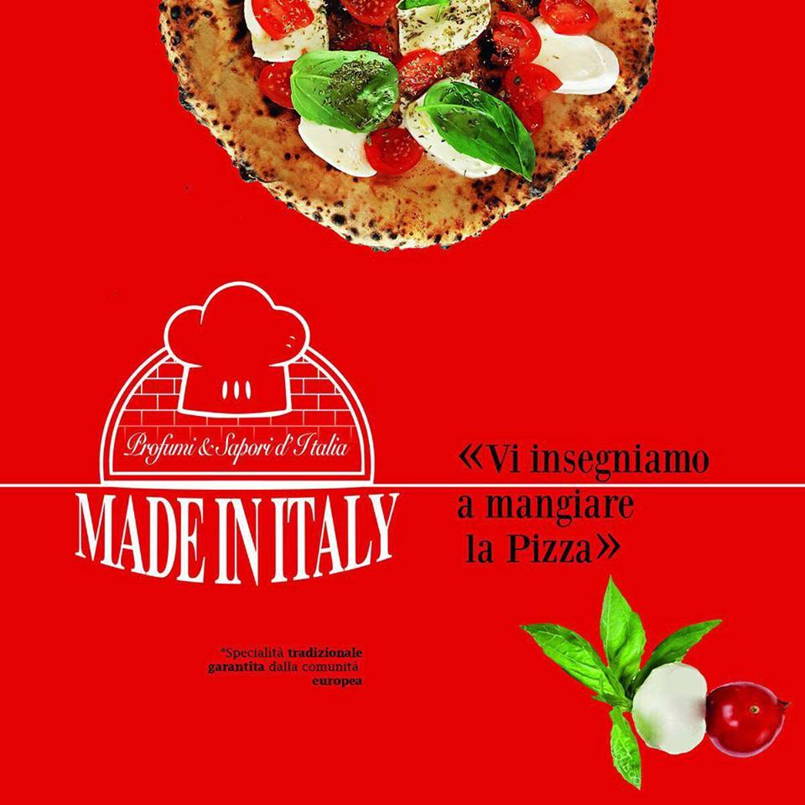
Strategy to be different – the story of three guys
Notes:
http://brandfinance.com/press-releases/lego-overtakes-ferrari-as-the-worlds-most-powerful-brand/?utm_source=blog_post&utm_medium=blog_post&utm_campaign=scuola-innovazione-lego

Slide 29
Strategy to be different – the story of three guys
Core product: not pizza, but the real Naples pizza (i.e. la pizzeria verace)
Controlled raw materials, coming directly from the South of Italy (mozzarella D.O.P., mozzarella fior di latte, pomodorini del Piennolo del Vesuvio)
All the raw material are “Made in Italy”
A particular type of oven, directly chosen and bought from the South of Italy
Ability of differentiate a popular product, i.e. pizza, and to make it unique
Notes:
http://brandfinance.com/press-releases/lego-overtakes-ferrari-as-the-worlds-most-powerful-brand/?utm_source=blog_post&utm_medium=blog_post&utm_campaign=scuola-innovazione-lego

Slide 30
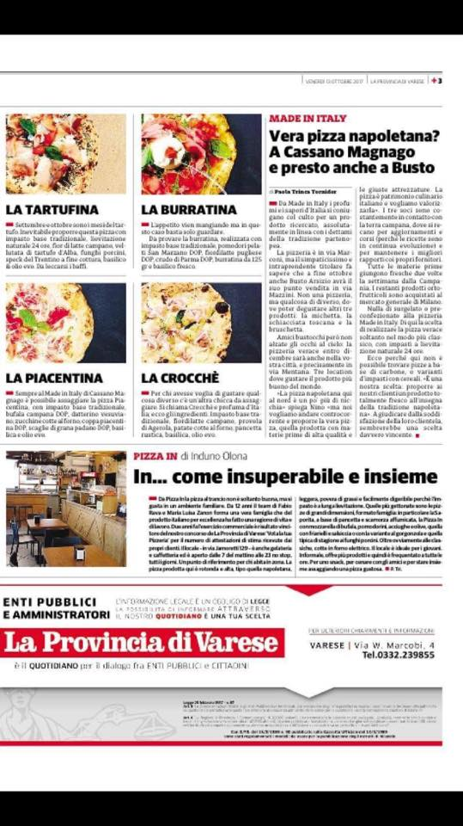
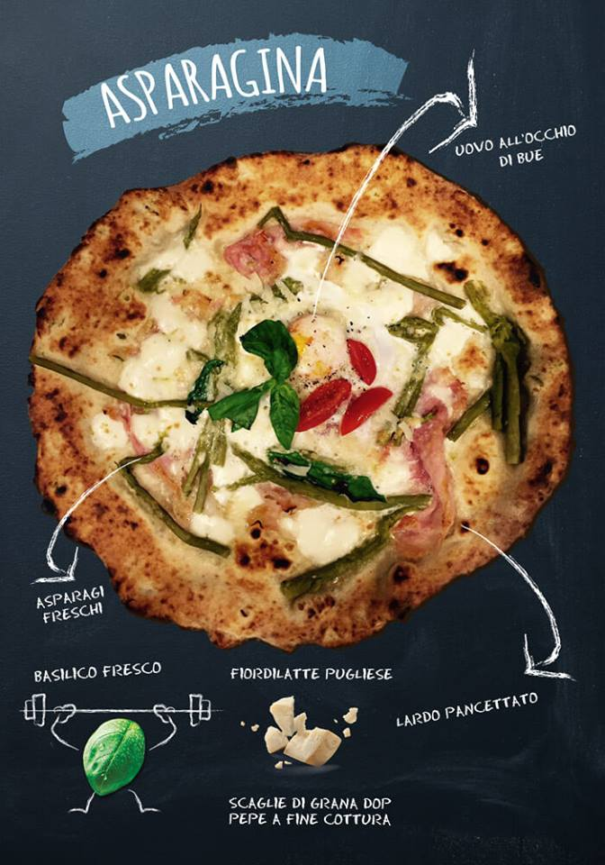
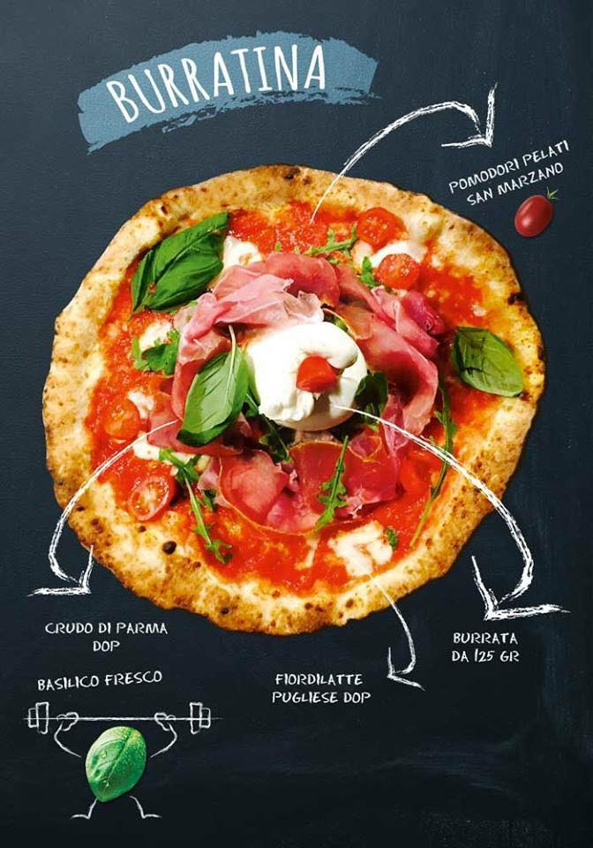
Strategy to be different – the story of three guys
Ability of differentiate a popular product, i.e. pizza, and to make it unique
Notes:
http://brandfinance.com/press-releases/lego-overtakes-ferrari-as-the-worlds-most-powerful-brand/?utm_source=blog_post&utm_medium=blog_post&utm_campaign=scuola-innovazione-lego

Slide 31
Strategy to be different – the story of three guys
Trust relationship with customers:
“ I come from Campania and I can say to have eaten one of the best pizza in my life”
“A lot of pizzerias try to replicate the real Naples’ pizza, but only few people are actually able. Here the pizza is that of Naples and I come from there!”
“The quality of ingredients is more than excellent….”
“It is the best pizza I have ever eat. Moreover also the owners are very friendly”
Notes:
http://brandfinance.com/press-releases/lego-overtakes-ferrari-as-the-worlds-most-powerful-brand/?utm_source=blog_post&utm_medium=blog_post&utm_campaign=scuola-innovazione-lego

Slide 32
STRATEGY ANALYSIS

Slide 33
Strategy Analysis (1/2)
External Environment Analysis
PEST – PESTLE
Political, Economic, Social, Technological, Legal, Environment
Porter’s 5 forces
The threat of new entry
The threat of substitutes
The bargaining power of buyer
The bargaining power of supplier
The intensity of rivalry
Competitor analysis
Notes:
http://brandfinance.com/press-releases/lego-overtakes-ferrari-as-the-worlds-most-powerful-brand/?utm_source=blog_post&utm_medium=blog_post&utm_campaign=scuola-innovazione-lego

Slide 34
Strategy Analysis (2/2)
Internal Analysis
Resources analysis
Human
Organizational
Financial
Competencies analysis
Stakeholders analysis
Leadership analysis
SWOT Analysis
Strenghts
Weaknesses
Oppotunities
Threats
Notes:
http://brandfinance.com/press-releases/lego-overtakes-ferrari-as-the-worlds-most-powerful-brand/?utm_source=blog_post&utm_medium=blog_post&utm_campaign=scuola-innovazione-lego

Slide 35
THE CASE of RYANAIR

Slide 36
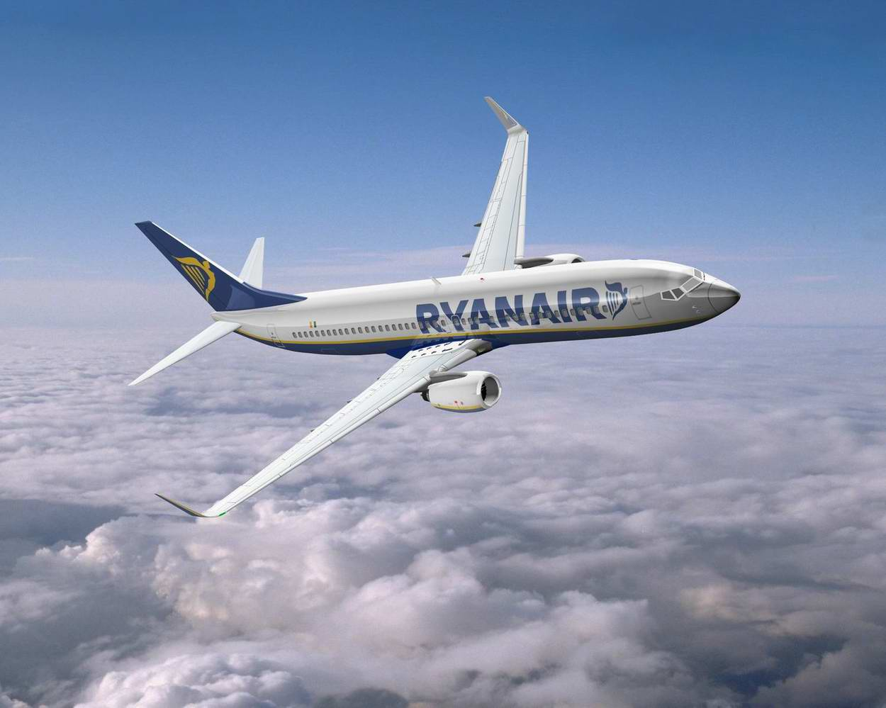
Introduction
Was set up by the Ryan family with a share capital of just £1, and a staff of 25 in 1985 by Tony Ryan.
First route was launched with daily flights on a 15-seater Bandeirante aircraft, operating daily from Waterford in the southeast of Ireland to London Gatwick.
Ryanair was the 1st airline introducing budget airline model in Europe.
“Europe’s only ultra low-cost carrier”.

Slide 37
Summary of Ryanair history

Slide 38
Ryanair in pills
Mission
Ryanair aims to offer low fares that generate increased passenger traffic while maintaining a continuous focus on cost commitment and operating efficiencies.
Vision
To firmly establish itself as Europe’s leading low-fares scheduled passenger airline through continued improvements and expanded offerings of its low-fares service.
Values
Ryanair is committed to bring customers the lowest fares and most on-time flights out in comparison to all competitors. Most importantly are safety issues, punctuality, near-perfect baggage handling, and the green policy.
Goals
Ryanair plans to increase efficiency and lower costs even further in comparison to industry rivals. The company wants to become the 2nd largest international airline.

Slide 39
External analysis – PESTLE (1/4)
Political- EU policy regulations affects strategy and operations of Ryanair:
EU regulation setting a ceiling on flying hours in order to prevent pilot’s fatigue → hiring more pilots;
EU regulation on refunding passengers for delayed and cancelled flights;
Air Travel tax (3 euro per passenger) and Carbon Tax (10-20 euro per tonne).
Uncertainties related to BREXIT
Economic
Ryanair saves cost by operating over secondary airports→ avoiding airport charges and extra costs.
Even during the crises period, Ryanair has shown its ability to be a leading budget airline with generating profit.
Fluctuations in fuel price may affect on operating costs and price of low fares.
GDP growth rate, unemployment rate, inflation, exchange rate may influence on overall performance of Ryanair.
A possible decline related to BREXIT

Slide 41
External analysis – PESTLE (3/4)
Social
customers perceive Ryanair’s customer service poor. Poor working conditions cause legal and safety issues.
lifestyle changes that characterise Generation Y travellers able to afford multiple short-trips each year
Technological – Ryanair was able to demonstrate how to make use of modern technology in order to save the costs.
Internet technology is widely used for online booking, online check-in and marketing strategies.
Generation Y travellers have the desire to remain constantly connected with their social environment, which suggests that airlines need to adopt a different digital communication strategy to reach out to their target audience
Legal – Ryanair is involved in few legal battles with Stansted and Dublin airports for departure duties.
Poor working conditions might be an issue of labor law.
Environmental – according to EU regulation on environmental awareness, additional fees are applied if the CO2 limit is exceeded.
growing distress regarding low-cost airlines contribution to carbon emissions

Slide 42
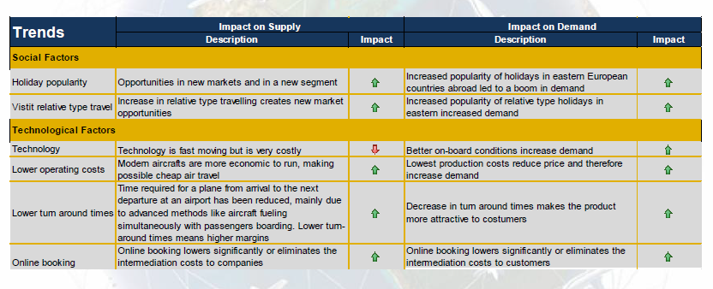

Slide 43
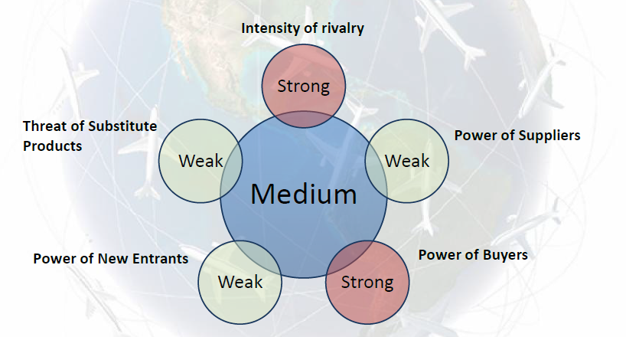
External analysis – Porter’s 5 forces
there are a lot of competitors trying to imitate Ryanair’s cost-leadership strategy. The budget airline industry has a potential to grow, as the market share of budget airline is 30% of the whole airline industry.
railway networks, sea transport and car rental service can substitute airline industry. But taking into account the price of these services, the threat of substitutes is low/weak.
INTENSITY OF RIVALRY
customers may switch to another airline if they aren’t satisfied with Ryanair’s services. No additional expenses are required for this. So, customers have strong power of bargaining.
THREATS OF SUBSTITUTE PRODUCTS
POWER OF BUYERS
very hard for other competitors enter the market due to the high capital requirements. Besides, access to distribution channels is required. Threat of new entrants is low/weak.
is high, because there are only two manufacturers competing in the aircraft industry. Supplier switching cost is also high. Boeing was Ryanair’s traditional supplier.
POWER OF NEW ENTRANTS
POWER OF SUPPLIERS

Slide 44
External analysis – Competitors’ analysis
Europe has 21 different low-cost airlines in 16 countries.
Ryanair competes with most traditional and low-cost airlines such as EasyJet, Norwegian Air Shuttle, Air Berlin, Wizz Air and etc.
Skytrax evaluated Ryanair with rating of 2 (from 1 to 5 based on customer satisfaction) making the company the worst among competitirs.
Dimension by number of routes operated

Slide 45
Internal analysis – Resources analysis

Slide 46
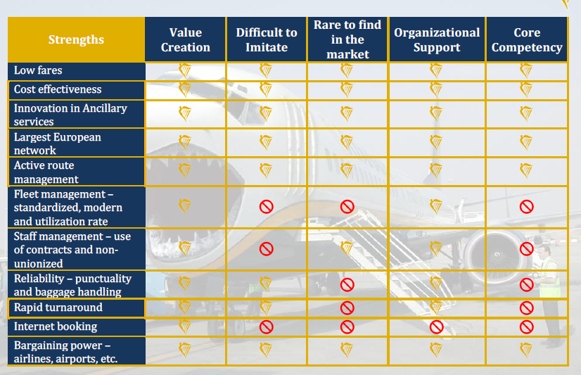
Internal analysis – Stakeholders’ analysis

Slide 47
Internal analysis – Competencies’ analysis
Capital market stakeholders:
Since 2006 Ryanair made an effort take over the state-owned Aer Lingus airline. The strategy made totally sense, the merger will allow Ryanair to increase its market share significantly: 80% of all flights between Ireland and other European countries will be operated by Ryanair in the future. Besides, it should help Ryanair to focus on long-haul flights that correspond with its prospective strategy plans. Until 2012 three bids were unsuccessful, as European Comission and Aer Lingus rejected it in order avoid Ryanair’s monopoly in European market of airlines.
Product market stakeholders:
British Airline Pilot Association (BALPA) challenge Ryanair’s business culture and don’t except poor working conditions.

Slide 48
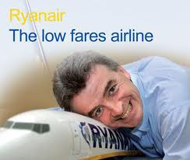
Internal analysis – Leadership analysis
Michael O’Leary is an extraordinary figure and key personality in Ryanair’s management.
Strong Leadership style;
Innovation abilities;
Maintaining Core Competencies and effective Organizational Culture;
Skillful promoter;
Developing Human and Social Capital

Slide 49
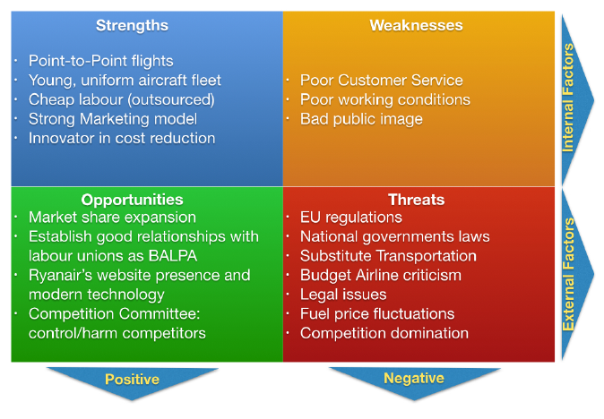
Internal analysis – SWOT analysis

Slide 50
ASSIGNMENT

Slide 51
Assigment: what you gave to do
Group of 3-4 students
Choose a company
For the company you choose you have to provide:
External analysis
Internal analysis
Provide
A ppt presentation (6 December) about 20 minutes/group
A word description (individual – deadline 11 december) about 4/5 pages
Where to find information:
Description given by the teacher
Google
Publications (typically carried out by consultancy group)

Slide 52
Assigment: list of companies
Zara
Starbucks
Apple
Nestle
Dell
KFC
Google
Ikea
Walt Disney
Mc Donald

