Slide 1
Lecture of April 17, 2019
Prof. Giuseppe Schlitzer
THE INTERNATIONAL MONETARY
& FINANCIAL SYSTEM
IN HISTORICAL PERSPECTIVE

Slide 2
Three phases of globalization
1820-1913
1944-1973
1973 onwards
2

Slide 3
Three phases of globalization
1820-1913 First phase of globalization (Prof. Helg, RPE)
Starts with the industrial revolution in the UK which spreads all over the world
London was the financial center of the world and the UK
Innovations like steam power, sea and rail transports contributed to economic & financial integration and to economic growth
3

Slide 4
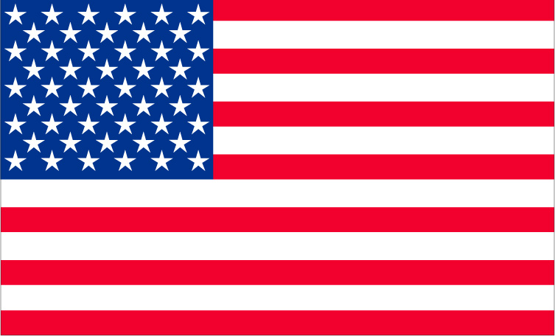
Three phases of globalization
Apex in 1870-1913 (Gold standard)
In 1870-71, when Germany adopts gold as the reference metal, historians place the start of the "gold standard".
Monetary regimes were based on precious metals, typically silver and gold.
The value of money was given by the content of precious metal
* Hence needed 4.87 US dollars to obtain 1 pound
US$=23.22
UK£=113 grains of gold
Exchange rate
113/23.22= 4.87*
4

Slide 5
Three phases of globalization
Before 1870 there was no clear-cut rule.
Some countries were on the gold std (UK, Portugal), others on the silver std (Germany, Austria, Netherlands, Russia, Sweden); other adopted bimetallism, (e.g. USA, France, Italy, Belgium).
Under the gold std (basically, a system of fixed exchange rates) there was a period of exceptional growth & financial stability (historians are re-visiting this)
The 1913 peak in world export equalled only in 1970
!!Banknotes!!
countries were committed to assure "full convertibility" of fiat money at any moment
5

Slide 6
Three phases of globalization
1914-1944 - Interwar period
WWI puts an end to the golden era of the gold std
Countries start to rely on beggar-thy- neighbour policies to gain a competitive advantage
Competitive devaluations become the norm
Bilateral agreements prevail on multilateral/regional agreements
Some countries impose banknotes circulation by law without committing to full convertibility
Widespread use of restrictions on commercial & financial cross-border flows
Hyperinflation in some countries
6

Slide 7
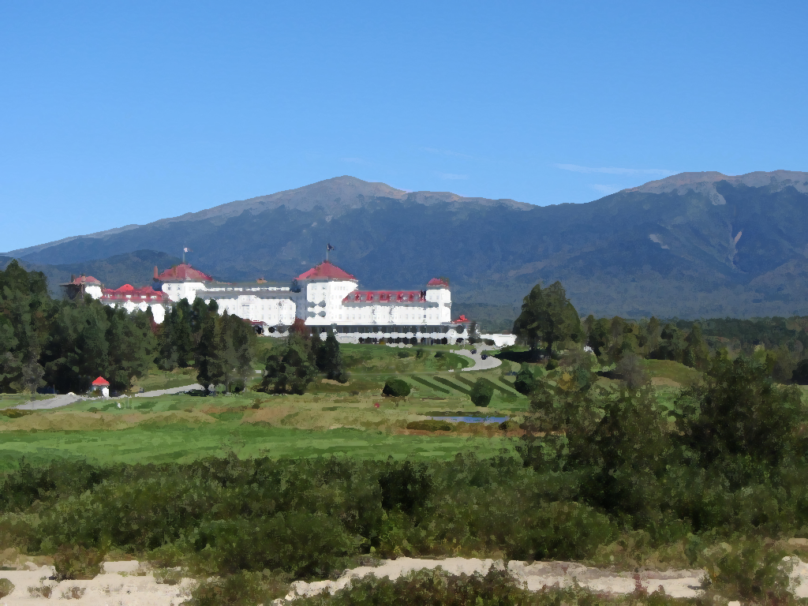
Three phases of globalization
1944 - Bretton Woods Conference
In May 1944 the US invite 44 other countries to a conference with the aim to establish a "new economic order" (Germany, Italy & Japan not invited).
The IMF, WB and (later on) the WTO are established.
Currencies are placed on a "dollar std" so called "Bretton Woods System" of "fixed but adjustable" exchange rates.
7

Slide 8
Three phases of globalization
2) 1944-1973 - II Phase of globalisation
The reconstruction after the war and the BW economic order foster a new era of growth and financial stability.
Inflation is low and is not yet an objective of monetary policies (at least not for all CBs)
Trade and financial flows become more open (back to globalisation)
The US $ becomes the world reference currency
3) 1973-nowaday - III Phase of globalisation
This is a very extended period that can in principle be subdivided in more subperiods.
For instance, there is evidence that after 1989 (break of Berlin wall) world integration has accelerated.
8

Slide 9
The concept of stability - A digression
When we classify historical periods we use the concept of "stability" to determine whether that period was economically good or bad.
But what do we mean by "stability"?
There are basically 3 definitions of "stability":
1) Stability in (domestic) prices hence inflation
You want prices to be as stable as possible since this helps domestic transactions
2) Stability in exchange rates
You want ex-rates to be stable or even fixed since they also are prices and stability facilitates international transactions.
3) Financial stability
Stability in financial markets, mostly the banking system. A "stable" banking system is one that is not prone to crisis, defaults, deposit runs...
9

Slide 10
The concept of stability - A digression
The three concepts of stability interact with each other.
Inflation is relevant for financial transaction. For instance it is important to value a debt in "real" terms. In fact inflation reduces the real value of a debt, hence helping debtors. It is also relevant to determine nominal/real interest rates.
Domestic prices & the exchange rate interact in several guises. Devaluations may be inflationary, but also inflation spirals may cause devaluations.
It is relevant to know whether a debt is denominated in domestic or foreign currency. In many financial crisis, there was lot of debt denominated in a foreign currency (L£ & the US$). When the country devalues the nominal value of the debt may become unsustainable.
1
3
1
2
2
3
10

Slide 11
Bretton Woods and its legacy
When 45 nations gathered in 1944 in Bretton Woods (New Hampshire, USA) their aim was to establish the foundations for a new economic order.
1) To re-activate the process of (global) growth and employment creation, they were convinced that trade & financial integration was essential.
Bretton Woods can be read as the start of the re-globalization process, the so called II phase of globalization.
The IMF, WB and GATT/WTO can be seen as all having the same objective: global integration!
2) Founding fathers had in mind the gold standard era, when exchange rates were fixed and full convertibility was assured.
Hence they tried to replicate the gold standard mechanism with the BW system of Exchange rates.
11

Slide 12
Bretton Woods system of exchange rates
Par values with the US $
35 US$ = 1 ounce of gold
Full convertibility of the US $ in gold hence a gold-dollar standard
Grid system of ±1% around par value
Two devices were added which made the system more "flexible" than the pure gold standard
Par values were "adjustable" in case of a fundamental disequilibrium in the BoP (but the Statute of the IMF gave no definition of this). To change the par value, the member would consult the IMF. If the Δɛ<10% the IMF could not oppose, otherwise the IMF advice was more binding and sanctions were imposed in case the member would not abide.
Capital restrictions were allowed (J.M.Keynes was in favor of capital restrictions that he tought could limit speculative flows, so called "hot money")
12

Slide 13
Impossible trinity
You cannot have at the same time:
free capital movements (cross-border flows)
an autonomous monetary policy
a fixed exchange rate
We know that monetary policy is not autonomous in fine tuning the cycle when there is a peg and capital flows are free to move in and out of the country. In fact monetary policy is "targeted" to the peg.
Therefore, if you want both (i) a fixed exchange rate and (ii) an autonomous m.p. you have to introduce
This is what was done in BW: capital restrictions were allowed (although not recommended) in order to allow members to adjust more freely m.p. to support the economic cycle.
CAPITAL RESTRICTIONS
13

Slide 14
Fall of the Bretton Woods System 1971-73
By the end of the 50s and throughout the 60s the system was characterized by wide BoPs disequilibria.
The US, also due to the Vietnam war, had a large BoP deficit, whereas Germany and Japan had BoP surpluses. As a consequence a huge amount of US$ began accumulating outside the US:
In 1971 US President Nixon declares the unconvertibility of the US$.
The dollar was initially devalued by 8% (38$ per 1 gold ounce).
By the spring of 1973 the system is definitely over.
In 1970 official reserves in $ (held by non US central banks) had reached $40 billions whereas US gold reserves were only $11 billions
CAUSES: adjustments of par values were rare and thus insufficient to cope with the large and persistent BoP imbalances
14

Slide 15
Differences between "Gold Std" and "Dollar Std"
In the GS you have n countries & n exchange rates vis-à-vis gold. No country has a privileged position, hence the system is perfectly symmetric.
In the DS you have n-1 exchange rates via-à-vis the reference currency and the pivot country has no need to intervene. The US have seignorage and a privileged position since their monetaty policy is more autonomous.
The Gold-Dollar Std established with BW lies in-between the pure GS and the $Std System
15

Slide 16
Differences between "Gold Std" and "Dollar Std"
Who determines global monetary conditions?
In the GS this hinges on gold stocks of reserves owned by the central banks
Monetary policy is not autonomous
The global stock of gold varies depending on the discovery of gold mines
There can be disparities among countries depending on their natural endowment of gold
In the $ Std it is the US that determine global monetary conditions
There will be downward pressures on the US$ thereby pushing US exports.
DISADVANTAGES
16

Slide 17
Fixed Exchange Rates
GOLD STD.
Symmetric
There can be differences in the endowments of gold which can change through the BoP
Money supply is given and changes with new discoveries of gold
Can be deflationary
DOLLAR STD.
Asymmetric since one country has a privileged position (seigniorage) and determines monetary conditions
Differences in the stock of reserve currencies that can change through BoP
Can be inflationary
17

Slide 18
Differences between "Gold Std" and "Dollar Std"
When the US was providing the international liquidity through its BoP deficits, at the end of the '60s, they were accused of "exporting inflation" abroad (especially by the Germans).
France was also very critical of US policies and accused the US of an "exorbitant privilege" (Charles de Gaulle).
Role of anchor in monetary policy
1) A rule on the growth of monetary aggregates
2) Inflation targeting
18

Slide 19
Architecture of the Bretton Woods System
INTERNATIONAL MONETARY FUND
Coordination of economic policies
Financing of BoP for short term
BW System of Exchange Rates till 1973
Remove exchange rate restrictions on trade
WORLD BANK
Financing the process of reconstruction after the war
Financing (long term) for developing economies
GATT/WTO (1995)
Remove barriers to trade (no financing)
Based on a "quota" system
Can issue bonds but has never done this
Draws money from the market issuing bonds
+
"quotas"
19

Slide 20
Architecture of the Bretton Woods System
The difference in the resource mechanism between International Monetary Fund and World Bank was used to justify the fact that the President of the WB had to be an American (and the head of the IMF an European).
Since the WB had to tap financial market, it was said that an American banker would reassure the markets. Indeed the story is much more complex.
20

Slide 21
The International Monetary Fund
A universal organization of 189 members whose main functions are:
Coordination of economic policies and surveillance (the primary function of the IMF)
Short term financing
IMF financing is aimed at corretting policies that have led to a disequilibrium in the BoP or level of reserve/exchange rate.
They are provided under "conditionality" that is under the condition that the adjustment program agreed with the authorities is implemented.
Multilateral surveillance (WEO, GFSR, etc)
Regional surveillance
Surveillance on members' economic policies (Art.IV)
21

Slide 22
The International Monetary Fund
Financing is normally devolved in "tranches" so that the IMF can verifiy each time whether there has been progress in the economic program. If not, financing can be post-poned or even interrupted.
Conditionality is quantified through "performance criteria" (for instance: reduce budget deficit to 3% by end year) that may concern macroeconomic policies as well as structural policies.
22

Slide 23
The International Monetary Fund
Things to keep in mind
1) The resources of the Fund are limited (total quotas amount at $360 billions) thus, although the Fund can rely on extra resources (GAB & NAB, also limited at $34 billions) it must be used on a "rotative basis" as in a cooperative system.
2) The interest rate payed on IMF loans is an average of market rates but it is normally lower than the rate that the country would pay on the market (given the situation of difficulty).
3) IMf financing normally covers only 9-15% of a country's financing need. Its role is more in terms of a "catalyst" for additional public and private financing.
23

Slide 24
The International Monetary Fund
Main financing facilities - A
1) Stand-by Arrangement (SBA)
The traditional IMF financing tool for temporary problems that lasts normally 1-2 years (repayments within 5 years).
*Normally up to 200% of a member quote and not more than 600% cumulatively.
2) Extended facility/arrangement
Aimed at supporting programs to solve longer term, structural problems (repayments within 10 years).
*Same as SBA
24

Slide 25
The International Monetary Fund
Main financing facilities - B
3) Flexible Credit Line & Precautionary Credit Line
Used on a precautionary basis to avoid "domino" effects.
*No formal limits and no conditionality
4) Special facility (ad hoc): oil facility, Y2K facility
SPECIAL DRAWING RIGHTS (SDR)
New liquidity that the Fund can "allocate" to its members in case of global liquidity needs. But it's only 3% of global reserves.
25

Slide 26
Governance of the IMF
Board of Governors (189)
Approve decisions concerning membership quotas, SDR allocations
International Monetary & Financial Commitee (24)
"Strategic" decisional body of the Fund
Organised around 24 constituencies
Board of Directors (24)
Discharges the daily business meeting 2-3 times x week
Ex Directors are employees of the Fund & reside in Washington D.C.
Managing Director (C.Lagarde)
The MD is the most important role in IMF governance and the one who sets the "direction" of IMF policies
26

Slide 27
The International Monetary Fund
Quotas & Fund resources
The liquidity available to the IMF is made of the "quotas" that the members pay to the Fund. Quotas are proportional to each member economic size (GDP, export-import flows, stock of international reserves...). They are revisited every 5 years. The last quota revision (January 2016) brought the "Fund" to $652 billions. The largest member of the IMF is the United States, with a current quota (as of March 2017) of SDR82.99 billion (about US$113 billion), and the smallest member is Tuvalu, with a quota of SDR2.5 million (about US$3.4 million).
The Fund can count on extra resources made available by members on a voluntary basis. Through the NAB & GAB it can draw another $588 billions (up to). Other liquidity can be made available by countries on a bilateral basis (Japan).
27

Slide 28
The International Monetary Fund
Quotas & Fund resources - 2
Not all the "Fund" is really available for financial purposes since:
it serves also to cover the costs for the ordinary functioning of the organization;
not all currencies are usable for financing.
Quotas determine also the relative (voting) power of each member. The formula is:
Under the last reform basic votes will rise to 750, in order to give more voice to small countries.
250 BASIC VOTES
+
1 VOTE FOR EACH 100.000 SDR
28

Slide 29
The International Monetary Fund
Main quotas*:
USA | 17,46%
JAPAN | 6,48%
CHINA | 6,41%
GERMANY | 5,60%
FRANCE | 4,24%
UNITED KINGDOM | 4,24%
ITALY | 3,17%
INDIA | 2,76%
RUSSIA | 2,71%
Source: IMF, 2019
*Last Update: April 11, 2019
29

Slide 30
The Theory of Optimum Currency Areas
(Levi, ch. 11, pp. 254-6)
What Is an Optimum Currency Area?
It is a region where it is best (optimal) to have a single currency.
Optimality depends on degree of economic integration:
Trade in goods and services
Factor mobility
A fixed exchange rate area will best serve the economic interests of each of its members if the degree of output and factor trade among them is high.
30

Slide 31
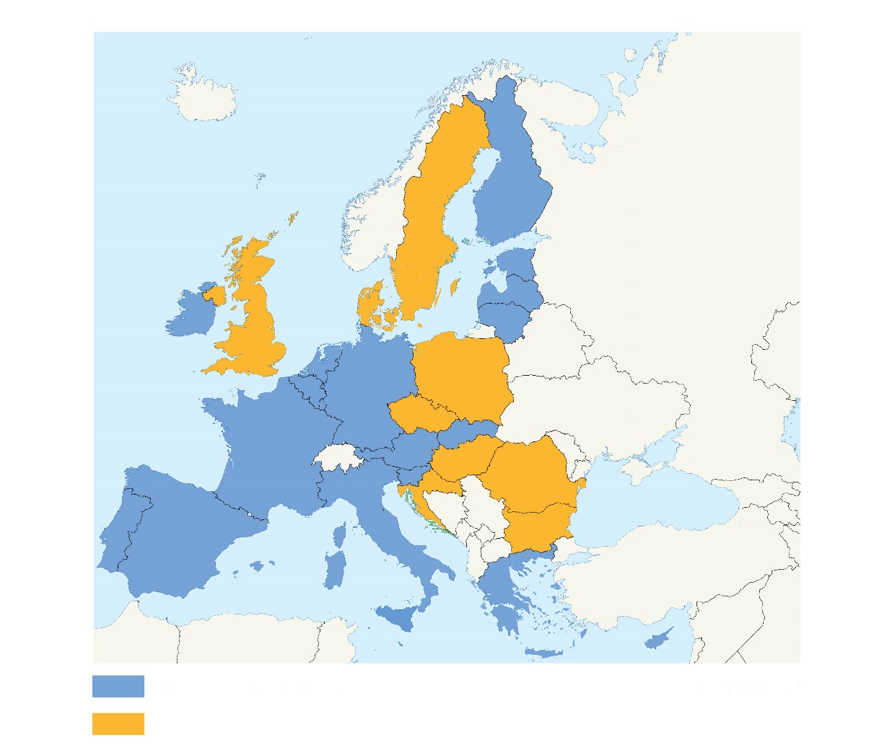
The Euro (€) - a single currency for Europeans
No fluctuation risk and foreign exchange cost
More choice and stable prices for consumers
Closer economic cooperation between EU countries
EU countries using the euro
EU countries not using the euro
31

Slide 32
The Road to the European Monetary Union - EMU
The three stages of monetary union
Stage One: July 1, 1990 The complete elimination of capital controls among the Member States and increased cooperation between their central banks.
Stage Two: January 1, 1994
The real beginning of the transition to EMU with the establishment of the European Monetary Institute (EMI).
EMI = precursor of the European Central Bank, charged with co-ordinating monetary policy and preparation for the single currency.
Stage Three: January 1, 1999
Eleven countries fixed their exchange rates.
The national currencies of the eleven were replaced by the euro.
The ECB took over responsibility for monetary policy in the euro area.
32

Slide 33
The Road to the European Monetary Union - EMU
The eurozone
Today 19 countries are part of EMU and an even larger number of nations adopted the euro as their official currency.
* Liechtenstein uses the Swiss franc
EMU Members
Belgium, Germany, Ireland, Greece, Spain, France, Italy, Cyprus, Luxembourg, Malta, The Netherlands, Austria, Portugal, Slovenia, Slovakia, Finland, Estonia, Latvia, Lithuania
Non-euro area Member States
Bulgaria, Czech Republic, Hungary, Poland, Romania, Sweden, Croatia
Member States with an opt-out
United Kingdom,
Denmark
Non EU Member States adopting the euro*
Andorra, Monaco,
San Marino, Vatican City
33

Slide 34
The Road to the European Monetary Union - EMU
The Maastricht criteria
The euro "convergence" criteria (also known as the Maastricht criteria) are the criteria which European Union member states are required to meet to enter the third stage of the Economic and Monetary Union (EMU) and adopt the euro as their currency.
Convergence concerns "fundamental" economic variables such as inflation, debt/deficit and interest rates.
The idea is that the more "homogeneous" are the members of EMU, the greater will be the sustainability of the euro.
34

Slide 35
The Road to the European Monetary Union - EMU
The Maastricht criteria
1. HICP inflation (12-months average of yearly rates): Shall not exceed the HICP reference value which is calculated by the end of the last month with available data as the unweighted arithmetic average of the similar HICP inflation rates in the 3 EU member states with the lowest HICP inflation plus 1.5 percentage points
2. Government budget deficit: < 3%
3. Government debt-to-GDP ratio must not exceed 60% at the end of the preceding fiscal year or if the debt-to-GDP ratio exceeds the 60% limit, the ratio shall at least be found to have "sufficiently diminished and must be approaching the reference value at a satisfactory pace
4. Exchange rate stability: Applicant countries should not have devalued the central rate of their euro pegged currency during the previous two years, and for the same period the currency stability shall be deemed to have been stable without "severe tensions"
5. Long-term interest rates Shall be no more than 2.0 percentage points higher, than the unweighted arithmetic average of the similar 10-year government bond yields in the 3 EU member states with the lowest HICP inflation
35

Slide 36
Was EMU a bad idea from the start?
PROS
Monetary: A firm nominal anchor to end inflation among Mediterranean countries.
Trade: To promote EU economic integration.
Political: To improve cohesion.
CONS
Monetary: Loss of ability by each to respond to local conditions by adjusting money supply, interest rate, or exchange rate
Political: (according to M.Friedman): Could lead to conflict.
36

Slide 37
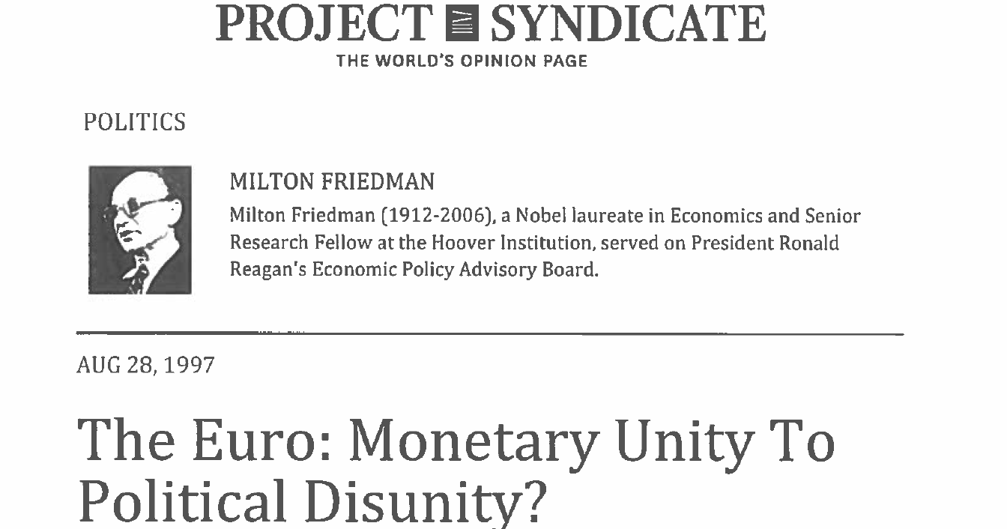
Was EMU a bad idea from the start?
Milton Friedman:
"...Europe's common market exemplifies a situation that is unfavorable to a common currency. It is composed of separate nations, whose residents speak different languages, have different customs......
........
"....Despite being a free trade area, goods move less freely than in the United States, and so does capital"...
37

Slide 38
Optimum Currency Areas: Europe Vs USA
We can use comparative analysis to see if Europe performs as well as or better than the United States (viewed as a common currency zone) on each of the OCA criteria, which would lend indirect support to the economic logic of the euro:
Trade integration
Labor mobility
Fiscal transfers
38

Slide 39
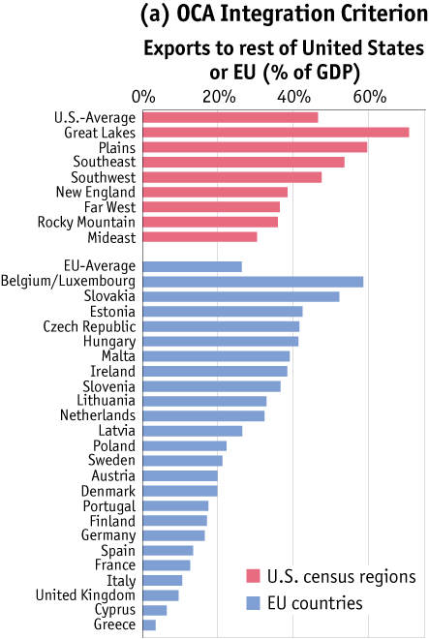
Europe Vs. the United States - Trade flows
Most economists believe that the United States is much more likely to satisfy the OCA criteria than the EU. Why?
Data in panel (a) show that interregional trade in the United States rises to levels much higher than those seen among EU countries.
Source: HBS
39

Slide 40
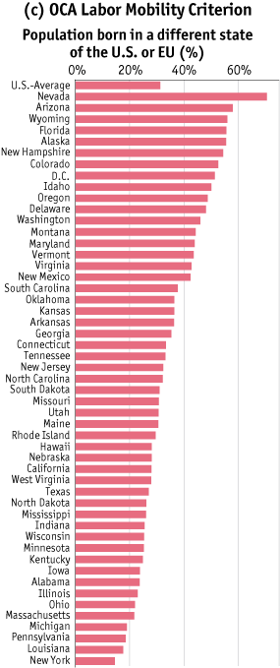
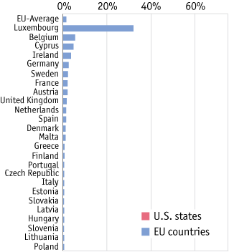
Europe Vs. the United States - Labor mobility
(b)
Labor in Europe is much less mobile between states than it is in the United States. The flow of people between regions is also larger in the United States than in the EU.
Labor markets in Europe are generally less flexible, and differences in unemployment across EU regions tend to be larger and more persistent than they are across the individual states of the United States. In short, the labor market adjustment mechanism is weaker in Europe. On this test, Europe is far behind the United States.
Source: HBS
Data in panel (b) show that U.S. labor markets are highly integrated compared with those of the EU.
40

Slide 41
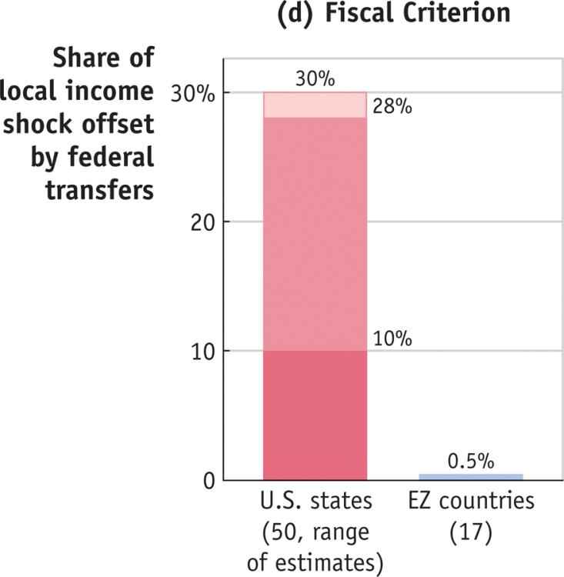
Europe Vs. the United States - Fiscal transfers
(c)
Fiscal Transfers Stabilizing transfers, whereby substantial taxing and spending authority are given to the central authority, exist in the United but not in the EU.
Data in panel (c) show that interstate fiscal stabilizers are large in the United States, but essentially nonexistent in the EZ.
Source: HBS
41

Slide 42
Europe Vs. the United States - Federal budget
The annual EU budget is €157 bn (2017 figures) – a large sum in absolute terms, but only about 1% of the EU GDP. In 2017 Us federal spending averaged 21% GDP
EU vs. USA - Federal budget as a percentage of gdp - 2017
Source:
www.usgovernmentspending.com, 2018
https://europa.eu 2018
42

Slide 43
Europe Vs. the United States
Summary
On the simple OCA criteria, the EU falls short of the United States as a successful optimum currency area.
Goods market integration is a little bit weaker, fiscal transfers are negligible, and labor mobility is very low. At best, economic shocks in the EU are fairly symmetric, but this fact alone gives only limited support for a currency union given the shortcomings in other areas.
Most economists think there are still costs involved when a country sacrifices monetary autonomy.
On balance, economists tend to believe that the EU, and the current Eurozone within it, were not an optimum currency area in the 1990s and that nothing much has happened yet to alter that judgment.
43

