Slide 1
Lecture of May 27, 2019
Prof. Giuseppe Schlitzer
World Economy after 1973

Slide 2
INDEX
1. Monetary policy in a Fiat money economy
2. Recent financial crises (80s, 90s & Argentina's default)
3. Main causes of financial crises
4. 2007-2012 Economic & financial crises
4.1 Phase I Subprime loans crisis
4.2 Phase II European sovereign debt crisis
5. Consequences of Greece/Italy leaving the eurozone
6. Quantitative Easing
2

Slide 3
End of Bretton Woods System of Exchange Rates
1973
1973
First oil shock
Inflation becomes main objective of CBs
No way to re-establish a world wide system of fixed exchange rates.
The world is set on a "system" of "free" exchange rates (or a "non system")
Policy-makers concentrate, especially after II oil shock (1979), on inflation (price stability) more than on exchange rates (stability)
3

Slide 4
In Europe an area of exchange rate stability is created after 1971:
1973
The ‘snake’ (joint float against the US$)
1972
1979
ERM-The European Exchange Monetary System*
1979
1999
The EURO*
1999
* Levi, 216-218 & 246 (Euro)
4

Slide 5
Exchange Rate Arrangements, 2009-2018
(Percent of IMF members as of April 30 each year)*
Exchange Rate Arrangement | 2009 | 2010 | 2011 | 2012 | 2013 | 2014 | 2015 | 2016 | 2017 | 2018
HARD PEGS | 12,2 | 13,2 | 13,2 | 13,2 | 13,1 | 13,1 | 12,6 | 13,0 | 12,5 | 12,5
No separate legal tender | 5,3 | 6,3 | 6,8 | 6,8 | 6,8 | 6,8 | 6,8 | 7,3 | 6,8 | 6,8
Currency board | 6,9 | 6,9 | 6,3 | 6,3 | 6,3 | 6,3 | 5,8 | 5,7 | 5,7 | 5,7
SOFT PEGS | 34,6 | 39,7 | 43,2 | 39,5 | 42,9 | 43,5 | 47,1 | 39,6 | 42,2 | 46,4
Conventional peg | 22,3 | 23,3 | 22,6 | 22,6 | 23,6 | 23,0 | 23,0 | 22,9 | 22,4 | 22,4
Stabilized arrangement | 6,9 | 12,7 | 12,1 | 8,4 | 9,9 | 11,0 | 11,5 | 9,4 | 12,5 | 14,1
Crawling peg | 2,7 | 1,6 | 1,6 | 1,6 | 1,0 | 1,0 | 1,6 | 1,6 | 1,6 | 1,6
Crawl-like arrangement | 0,5 | 1,1 | 6,3 | 6,3 | 7,9 | 7,9 | 10,5 | 5,2 | 5,2 | 7,8
Pegged exchange rate within horizontal bands | 2,1 | 1,1 | 0,5 | 0,5 | 0,5 | 0,5 | 0,5 | 0,5 | 0,5 | 0,5
FLOATING | 42,0 | 36,0 | 34,7 | 34,7 | 34,0 | 34,0 | 35,1 | 37,0 | 35,9 | 34,4
Floating | 24,5 | 20,1 | 18,9 | 18,4 | 18,3 | 18,8 | 19,4 | 20,8 | 19,8 | 18,2
Free floating | 17,6 | 15,9 | 15,8 | 16,3 | 15,7 | 15,2 | 15,7 | 16,1 | 16,1 | 16,1
OTHER MANAGED ARRANGEMENT | 11,2 | 11,1 | 8,9 | 12,6 | 9,9 | 9,4 | 5,2 | 10,4 | 9,4 | 6,8
Euro Area
China
*Includes 188 member countries and three territories: Aruba (Netherlands) Curaçao and St.Maarten (Netherlands), and Hong Kong SAR (China)
5

Slide 6
Monetary policy in a "fiat money" economy
Once in 1973 gold was definitly abandoned, monetary policy has been in search of an "anchor" ever since. In fact, if the anchoring to gold was per se contractionary, in a fiat money economy the risk is that monetary policy is inflationary.
One easy solution for a monetary anchor is to chose a fixed exchange rate, which however reduces the autonomy of monetary policy, as was shown in previous classes. After 1973, as we know, several countries adopted a flexible exchange rate.
Under a flexible ex. rate, there are normally two ways to anchor monetary policy.
1
Set a rule for the growth of monetary aggregates
2
Target inflation directly
6

Slide 7
Set a rule for the growth of monetary aggregates
This is the approach that started essentially in the FED under Paul Volcker at the end of 70s. It concentrates on money (M1, M2, M3) and credit aggregates.
The basic logic is that money & credit growth should go hand in hand with real growth. In other words, they should accompany the process of economic activity without being either deflationary or inflationary. There can be several versions of this approach. For instance, Milton Friedman proposed that a constant, small expansion of money supply was the only wise policy. For more than a decade CBs in advanced economies and the IMF have followed this approach to regulate money supply. However during the 90s it became clear that monetary & credit aggregates had become difficult to control due to financial innovation.
MV=PQ
7

Slide 8
Target inflation directly
As monetary aggregates became too unstable to control, CBs started to size inflation directly. This means to set their objective/target in terms of consumer price growth or price stability.
For instance, the ECB, is required by statute to contain inflation (in the eurozone) under 2%. To set an inflation target does not mean that you forget about money supply & interest rates, but only that these become your "tools" to achieve the required objective in terms of price growth.
The FED also states regularly its desired inflation target, that is normally expressed as a range, usually 1,5-2%.
8

Slide 9
Target inflation directly - second part
Clearly the more precise is the inflation target (both in quantitative terms and in terms of the time period required to reach the target) the less autonomy has monetary policy to target other objectives, such as growth & employment.
By contrast, the more discretion you have in setting the inflation target, the more you may be subject to the criticism that your action was inflationary.
The FED, for instance, pursues by statute two objectives:
i) Supporting growth & employment
ii) Fighting inflation
That's probably why the FED is often accused to be too "accommodative" and the ECB too "restrictive"
9

Slide 10
Current issues in monetary policy
As was said, in the current globalised economy, inflation is much less of a problem than in the past. Not only inflation has gone down dramatically but also oil & raw material price increases are less inflationary than in the past.
Therefore, during an expansionary phase, inflation shows up in asset prices (real estates & stock exchanges) more than in consumer goods.
This new phenomenon has put in difficulty monetary policies based on inflation targeting. CBs (like the FED) are often accused of being late in tightening money supply since the growth in asset prices is proof of an inflationary process.
CBs reply that their target is price inflation, that they have no mechanisms to size asset prices, and that they do not want to be responsible for a stock market or house market crash.
10

Slide 11
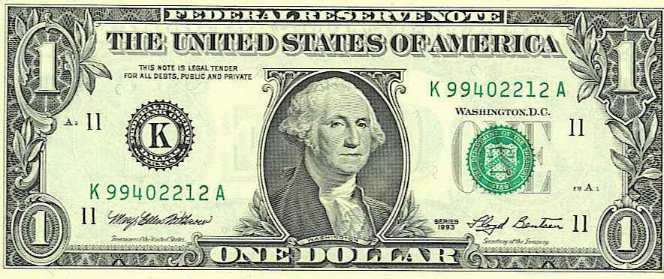
Historic inflation by country
INFLATION %
Source: IMF
11

Slide 12
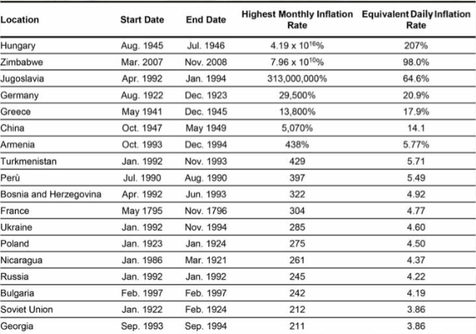
The Hyperinflation Table
Source: IMF
12

Slide 13
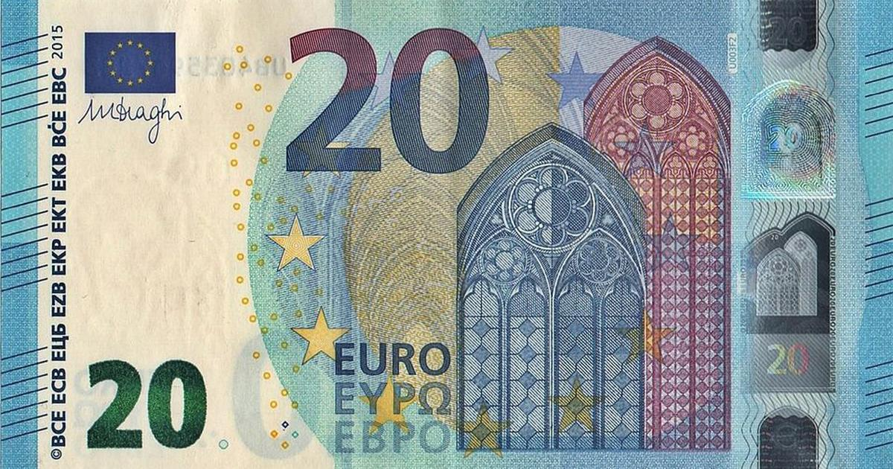
Historic inflation in the Euro-Area
INFLATION %
Source: IMF
11

Slide 14
Financial crises in the post Bretton Woods era
Several episodes of financial/exchange rate instability/BoPs imbalances (with domino effects):
1982 - LA debt crisis
1992 - ERM crisis
1994/95 - Mexican crisis
1997-99 Asian financial crisis
2001 Argentina's exchange rate & banking crisis
2007 Current economic & financial crisis (Great Crisis)
14

Slide 15
Financial crises in the post Bretton Woods era
1982 - LA debt crisis
Large exposure of industrialized countries' banks to developing nations (similarities with current European financial crisis - Greece)
Little awareness that governments can default on their obligations
Paul Volcker change in monetary policy leading to a substantial rise in (world) interest rates
Levi, 240-42
Levi, 240-42
15

Slide 16
Financial crises in the post Bretton Woods era
1992 - ERM crisis
In september 1992 British Pound was pushed to abandon the system. It was followed by the Italian Lira. A year later the ERM was the facto dead.
High German interest rates to counteract fiscal expansion after re-unification put the ERM under stress and may have triggered the crisis
16

Slide 17
Financial crises in the post Bretton Woods era
1994-95 - Mexican crisis
Mexico was under a fixed exchange rate regime with the peso pegged to the US$
A lax fiscal policy, insufficient $ reserves and raising lack of confidence in the banking system led to the abandonment of the peg
A domino effect onto several emerging market could subside only after an IMF led support financial package was agreed
17

Slide 18
Financial crises in the post Bretton Woods era
1997-99 Asian financial crisis
A crisis of vast propotions on which thousands of pages have been written in the economic literature
Surprising since it touched the "Asian Tigers" which were a "model" of economic growth
Causes not in sovereign debt but in private debt and badley regulated domestic banking systems
Levi, 243
Levi, 243
18

Slide 19
Financial crises in the post Bretton Woods era
2001 Argentina's exchange rate & banking crisis
Currency board since 1991 to fight inflation
By the end of 2001-early 2002 the currency board broke down
Causes are debated: fiscal laxity was one of the reasons but an overvalued currency which contributed to low growth also played a role
The case of Argentina interesting not for the domino effect (which was very limited) but for demostrating how difficult it is to defend fixed exchange rates.
Levi, 245
Fixed exchange rate (peg to US$)
ΔMs=ΔR
Levi, 245
19

Slide 20
Financial crises in the post Bretton Woods era
2007 Current economic & financial crisis (Great Crisis)
20

Slide 21
Causes of financial crises
Although financial crises differ from one another, economists and economic historians study their common features with the aim to learn from past episodes of instability and avoid the same mistakes in the future.
In recent crisis episodes, inflation is less of a problem than in the past since globalization has reduced prices/inflation worldwide.
Financial crises are often due to a combination of several factors that normally involve the exchange rate, especially when it is fixed, the BoP and/or the level of reserves, and the financial/banking system.
In particular, it is recurrent to have a situation in which the banking system is fragile, the BoP is in deficit (initially in the current account) or reserves are limited, the exchange rate is pegged and overvalued, and a devaluation is likely. When this situation persists sooner or later speculation will attack the peg and cause a devaluation, with all its consequences.
21

Slide 22
Causes of financial crises
Normally, however, the exchange rate, the BoP and the fragility of the domestic banking system are symptoms of deeper problems. These may be weaknesses in the productive system (growth & exports are too low), problems in functioning of some markets (protections and restrictions of transactions are widespread) or "governance" hurdles concerning banks or firms.
Bad economic policies are also often the cause of financial crises, as in the case of a prolonged lax fiscal policy.
A note of Exchange Rate Instability
While in the past flexible exchange rate were considered source of instability, nowadays it seems that fixed exchange rates are the real source for concern. When the peg is wrong (currency is overvalued) and/or a devaluation is largely expected, this become "sel-fulfilling". Speculation in the end succeeds in causing the peg to break-down. Paradoxically, it happens that fixed rates are unstable!
22

Slide 23
2007-2012 Economic & Financial Crisis
1. Considered the most severe worldwide crisis since the Great depression, and in fact it is named "The Great Crisis".
2. Largely unexpected
Although several international institutions had sent warnings that the growth process was accumulating imbalances (especially in BoPs), they did not forsee the crisis. None could believe that a serious financial crisis would develop in the most advanced system of the world, the US. If a crisis occurs - most of us thought - then it would come from emerging markets or a fall in the $.
3. If in the first years the center of the crisis were the US, in the last 2-3 years it has become Europe (sovereign debt crisis).
23

Slide 24
2007-2012 Economic & Financial Crisis
4. From financial the crisis has rapidly muted in a real crisis, with sharp falls in GDPs (mostly in Europe: in 2009 Ireland -5%, UK -2.8%, Germany -2.3%).
5. Main Features
Although the Great Crisis differs in several respects from past crisis episodes, it seems to replicate the normal/canonic pattern:
Imbalances accumulate and spread out in the system during the expansionary phase.
Prices/asset values rise exaggeratedly as in a classical boom episode.
Monetary policy tightens, prices & asset values start to fall and imbalances come to the fore causing a break of the system.
24

Slide 25
2007-2012 Economic & Financial Crisis
As regards inflation, monetary policy typically targets consumer inflation (that is: inflation in the price of goods & services) but in more recent episodes of financial instability inflation shows up in the form of:
Stock price inflation
Stock price inflation
Real estate prices
Oil & raw materials valuation
Oil & raw materials valuations
25

Slide 26
How the crisis develops
A complete TIMELINE of the Great Crisis can be found in the website of the FED of St.Louis. Here only the main events and factors underlying the crisis.
Ist PHASE 2007-2009 The (mostly US) subprime loans crisis
A real estate boom, in quantities & prices, had characterized the years 2004-2006;
Subprime loans (mortgages to individual with a very poor credit rating) contribute to the boom;
SL offered at low rates for the first years, but the rates would rapidly rise subsequently;
Fraudolent behaviour on the part of financial "agents" contributed to the spread of subprime loans
26

Slide 27
How the crisis develops
Serious defaults in banking systems worldwide:
- Northern Rock in the UK (nationalized in february 2008)
- Bear Stearn defaults in march 2008 (merges with JP Morgan)
- Merryl Lynch merges with Bank of America (September 2008)
- Lehman Brothers defaults and the panic spreads across the markets
- AIG is saved by US financial authorities
- Authorities around the world have to intervene in support of major financial institutions (Fortis, UBS, Hypo Real Estate, Royal Bank of Scotland, Dexia....)
- Between September & October 2008 the S&P 500 falls by 26%
27

Slide 28
How the crisis develops
- The interbank market (an essential channel for liquidity through the banking system) is literally frozen due to a widespread leak of confidence in the system
- In 2009 financial markets stabilize, due to the intervention of the authorities, but GDPs around the world sustain dramatic falls
End of Ist part of the Crisis
28

Slide 29
Things to keep in mind
Subprime Loans were assembled in packages called CDO (Collateralized Debt Obligations) and were sold by one bank to the others in order to diversify risk
Rating agencies assigned high ratings to CDOs which were supposed to diversify risk
There is a clear responsibility in US and international supervisory authorities in having overlooked the risk that was accumulating in the system
In this respect, the case of US investment banks, which were subject to a lax supervision, is worth mentioning.
29

Slide 30
II PHASE 2010-2012 The (European) Sovereign debt crisis and Greece
First Eurozone crisis since its creation in 1999;
At the end of 2009 Greece enters into serious economic difficulties, after a period of rapid growth (5.6% in 2006);
- The new government (Papandreu) reveals that the public deficit in 2009 would be 12.7%, the triple of what claimed by the previous administration;
- GDP falls by 2% and the economy enters into recession;
Serious repercussions across Europe, especially Spain, Portugal and Italy
- Spreads explode
- Ratings on sovereign debts are cut
2010-2011
2010-2011
30

Slide 31
May 2010 - Support Plan by 110 billion euros in support of Greece by EU & IMF
The crisis continues affecting the European banking system. European banks are in fact full of severeign bonds
The easy and massive financing by ECB is used to buy new sovereign bonds, which aggravates the problem
- Banks are required to raise more capital and this reduces credit to the economy. The recession worsens
The economic & financial crisis in Europe continues throughout 2012 with an increasing risk of Greece and later of Italy leaving the euro.
31

Slide 32
Critical questions
Is the crisis due to:
Public finances out of control?
Structural weaknesses in the regulatory framework?
Competitiveness gap among european economies (which cannot be adjusted through exchange rates)?
All 3 factors have played a role, but is probably more important than is normally believed, especially for Greece, Spain, Italy & Portugal
1
2
3
3
32

Slide 33
Critical questions
What if Greece (or Italy) exits the euro zone?
Getting back to the dracma could allow an exchange rate adjustment that would support exports & growth;
However, as Greece debt is denominated in euro, the cost of the debt would rise dramatically
Domino effects on other countries are possible and are the reason why European authorities will continue support Greece, it they do not want to put at risk the monetary union
Defaulting on the debt will be unavoidable
33

Slide 34
What is Quantitative Easing
The European Central Bank has announced action aimed at stimulating the troubled eurozone economy in the face of deflation and recession.
Unlike central banks in the United States and Britain, the ECB has so far resisted implementing a programme of buying government bonds. That is the process known as quantitative easing.
Governments and central banks like there to be "just enough" growth in an economy - not too much that could lead to inflation getting out of control, but not too little that there is stagnation. Their aim is the so-called "Goldilocks economy" - not too hot, but not too cold.
One of the main tools they have to control growth is raising or lowering interest rates. Lower interest rates encourage people or companies to spend money, rather than save.
But when interest rates are almost at zero, central banks need to adopt different tactics - such as pumping money directly into the economy.
This process is known as Quantitative Easing or QE.
34

Slide 35
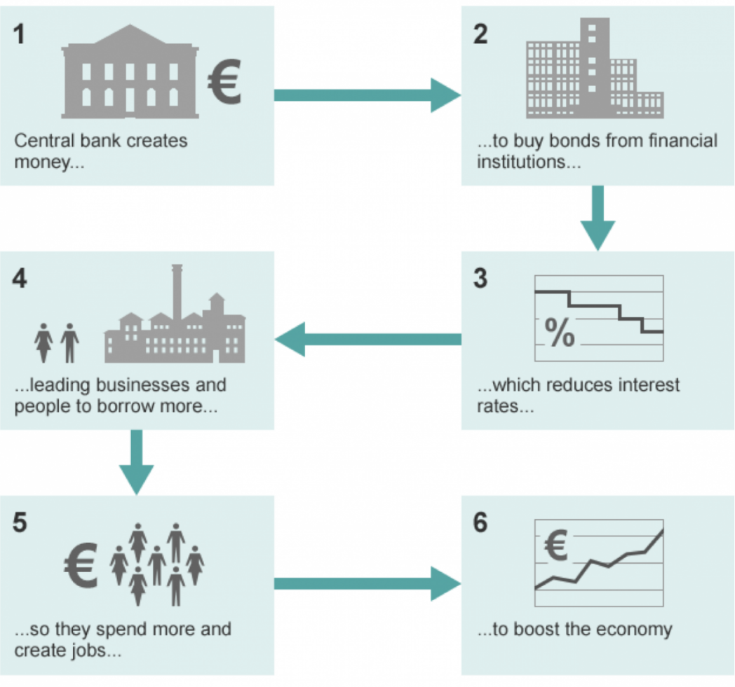
How Quantitative Easing works
Quantative easing: the theory
The central bank buys assets, usually government bonds, with money it has "printed" - or created electronically these days. It then uses this money to buy bonds from investors such as banks or pension funds using this "new" money, which increases the amount of cash in the financial system, encouraging financial institutions to lend more to businesses and individuals. This in turn should allow them to invest and spend more, hopefully increasing growth.
35

