Slide 1
Term Structure
A. Caggia, M. Armanini
Financial Investments & Pricing
2015/2016

Slide 2
SPOT vs. FORWARD
SPOT RATE (S_{t}): is the annual interest rate that can be locked today for the next t years.
FORWARD Rate(F_{t}): is the annual interest rate that can be extrapolated today from the market and applied to a future period starting in t years from now.

Slide 3
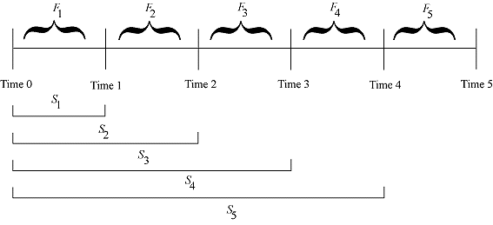
SPOT vs. FORWARD Rates (continued)

Slide 4
Term Structure
The term structure of interest rates (risk free) shows the existing relationship between spot rates (also “Zero Rates”) and the time to maturity of (risk free) bonds
To calculate the zero rates from the price of coupon bonds we use the Bootstrapping: this is a recursive method to calculate zero rates from market prices, maturity after maturity

Slide 5
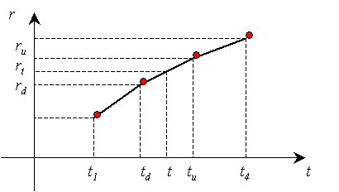
Linear assumption
Note that conventionally we calculate spot rates on the curve using the linear assumption between known rates
So to find r_{t} when both r_{d} and r_{u} are known we assume a linear relationship

Slide 6
Yield Curve
Show the relationship between IRR (o YTM) and residual life of the assets.
Upward Sloped
Foresee raising interest rates
Yield to Maturity
Flat
Expactations of future rates at same level than current ones
Foresee lower interest rates
Downward Sloped
Maturity

Slide 7
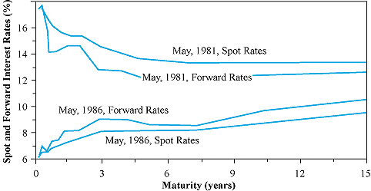
Yield Curve (http://www.smartmoney.com/Investing/Bonds/The-Living-Yield-Curve-7923/)

Slide 8
Modeling on Expectations (Fisher, 1896; Lutz, 1940)
Assume that an investor should expect to earn the same from equivalent strategies.
Suggest that spot rates reflect market expectations of forward rates.

Slide 9
Liquidity Premium (Hicks, 1946)
Assume that investors demand a yield premium to compensate for investing on longer maturities.
Investors are risk adverse and prefer short term investments to longer ones, as the formers are more liquid than the latters.
To attract investors then the long date assets have to bear an higher yield than the short dated ones.

Slide 10
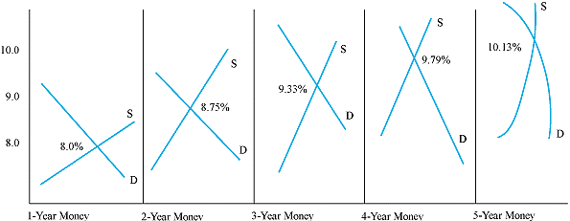
Market Segmentation (Culbertson, 1957; Modigliani – Sutch, 1966)
Explain the term structure of yield as a series of preference zones for maturities chosen by certain investors.

Slide 11
Credit Risk
Moody’s S & P Fitch D & P Brief Definition
Investment Grade - High Creditworthiness
Aaa AAA AAA AAA Gilt edge, prime, maximum safety
Aa1 AA+ AA+ AA+
Aa2 AA AA AA Very high grade, high quality
Aa3 AA- AA- AA-
A1 A+ A+ A+
A2 A A A Upper medium grade
A3 A- A- A-
Baa1 BBB+ BBB+ BBB+
Baa2 BBB BBB BBB Lower medium grade
Baa3 BBB- BBB- BBB-
Distinctly Speculative - Low Creditworthiness
Ba1 BB+ BB+ BB+
Ba2 BB BB BB Low grade, speculative
Ba3 BB- BB- BB-
B1 B+ B+ B+
B2 B B B Highly speculative
B3 B- B- B-
Predominantly Speculative - Substantial Risk or in Default
CCC+
Caa CCC CCC CCC Substantial risk, in poor standing
CCC-
Ca CC CC May be in default, extremely speculative
C C C Even more speculative than those above
CI Income bonds - no interest being paid
DDD
DD DD Default
D D

Slide 12
Credit Risk

