Slide 1
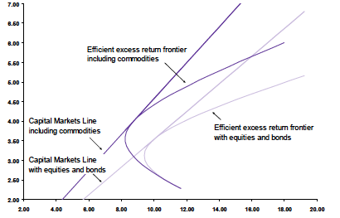
Commodities as an asset class
M.Armanini \ A. Caggia
FIP 2015/2016

Slide 2
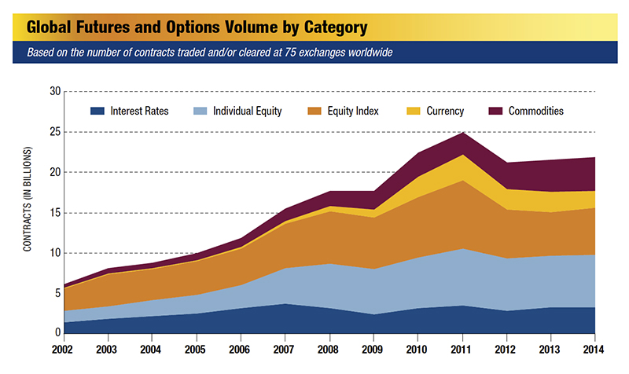
Market size also grew

Slide 3
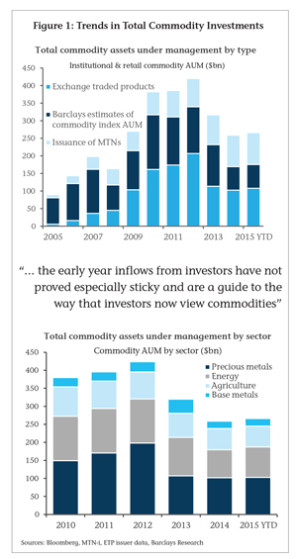

Slide 4
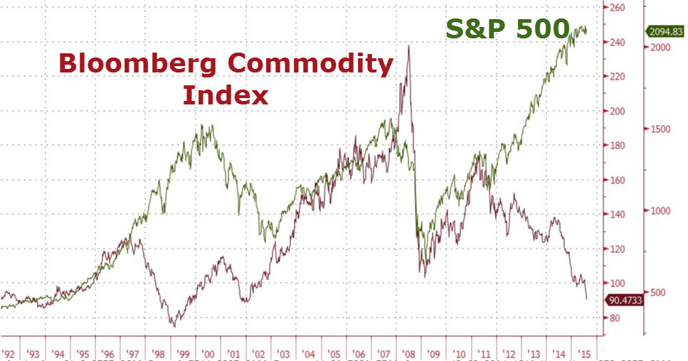

Slide 5
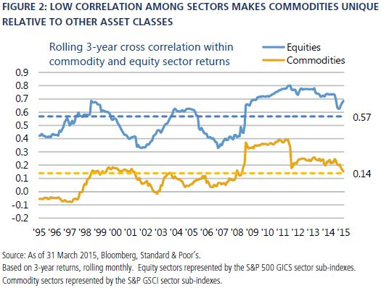

Slide 6
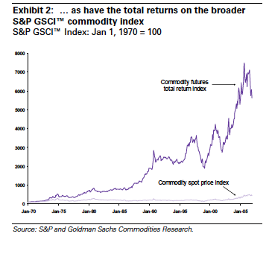
Physical and Futures Market

Slide 7
Look at the different curve shapes

Slide 8
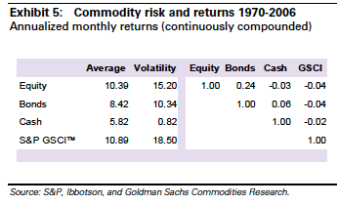

Slide 9
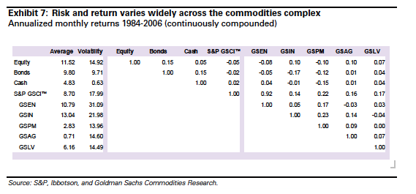
Energy
Industrial metals
Precious Metals
Agricolture
Livestock

Slide 10
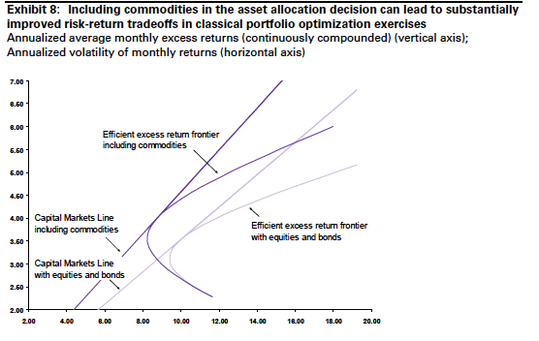
Portfolio allocation

Slide 11
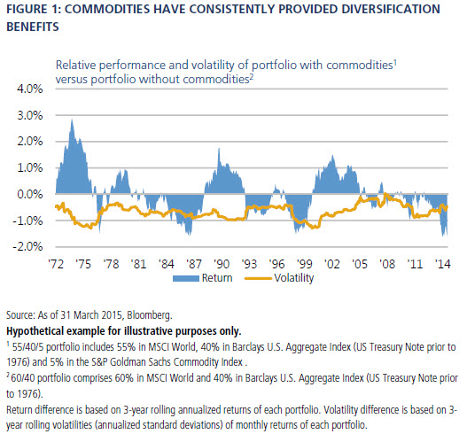

Slide 14
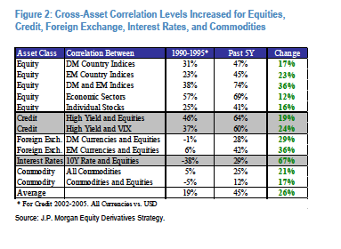

Slide 15
http://www.cmegroup.com/education/fundamental-analysis.html

