Slide 1
Capital Asset Pricing Model
M.Armanini \ A. Caggia
FIP 2015/16

Slide 2
Market Portfolio (Refresh)
Optimal Porfolio
Tangent to the efficient frontier: Capital Allocation Line
Sharpe Ratio is constant on the line
RM-RF/STDM Sharpe Ratio or price of Risk

Slide 3
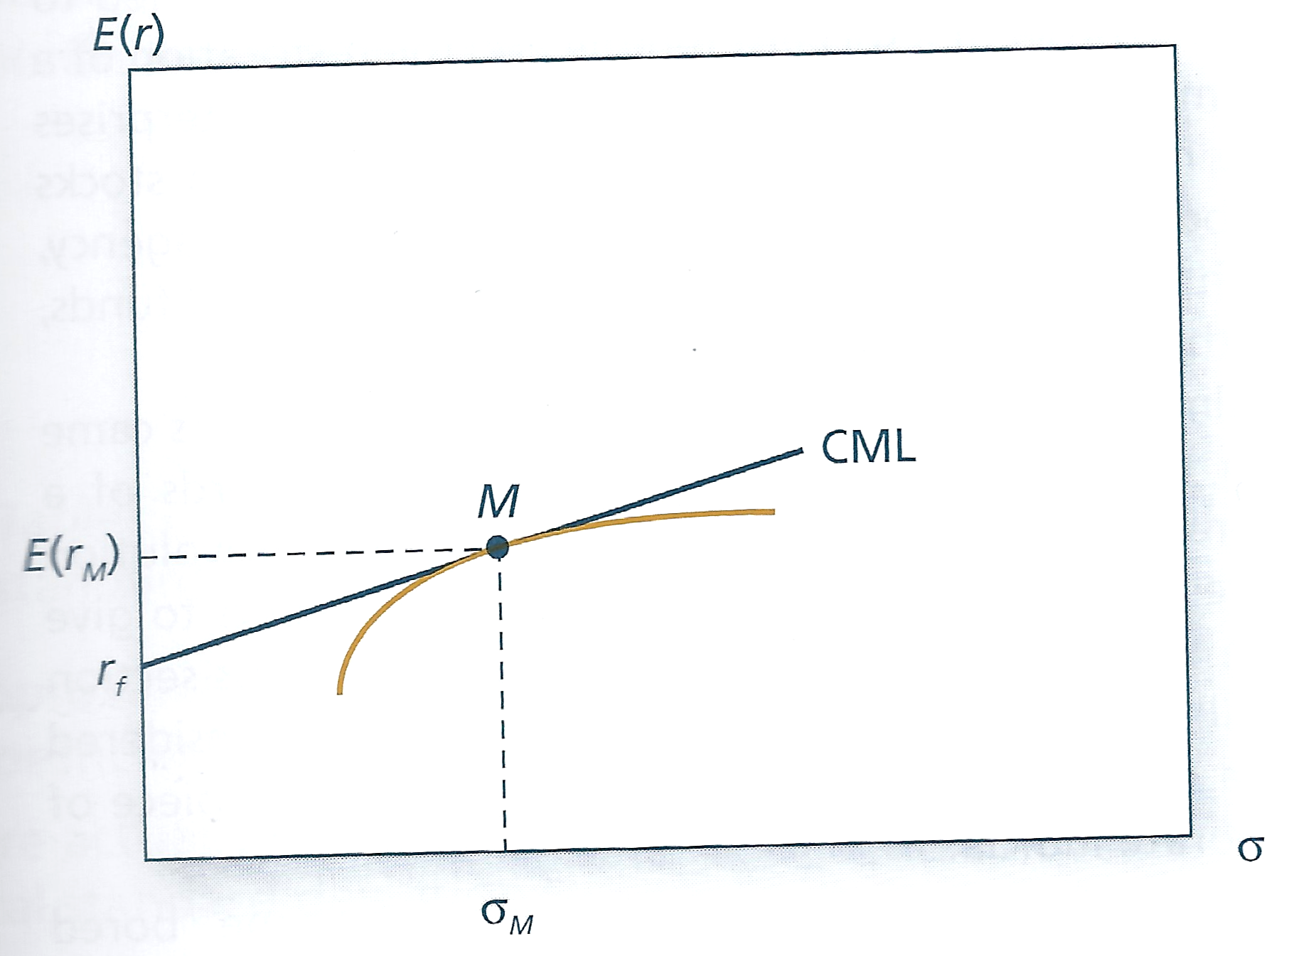
Capital Market line

Slide 4
Now Move to Individual Securities
Contribution to market portfolio
Contribution to market return R=w_{i} E (r_{i})
Contribution to market Variance Var=w_{i} cov(r_{i},r_{m})
All component in the market porfolio contribute with the same risk reward ratio (r_{i}-r_{f})/cov(r_{i},r_{m})=(r_{m}-r_{f})/var r_{m}
So:
r_{i}=r_{f}-+ (r_{m}-r_{f} ) cov(r_{i},r_{m})/var
Where cov(r_{i},r_{m})/var r_{m} = beta
So r_{i}-r_{f}/r_{m}-r_{f} = beta

Slide 5
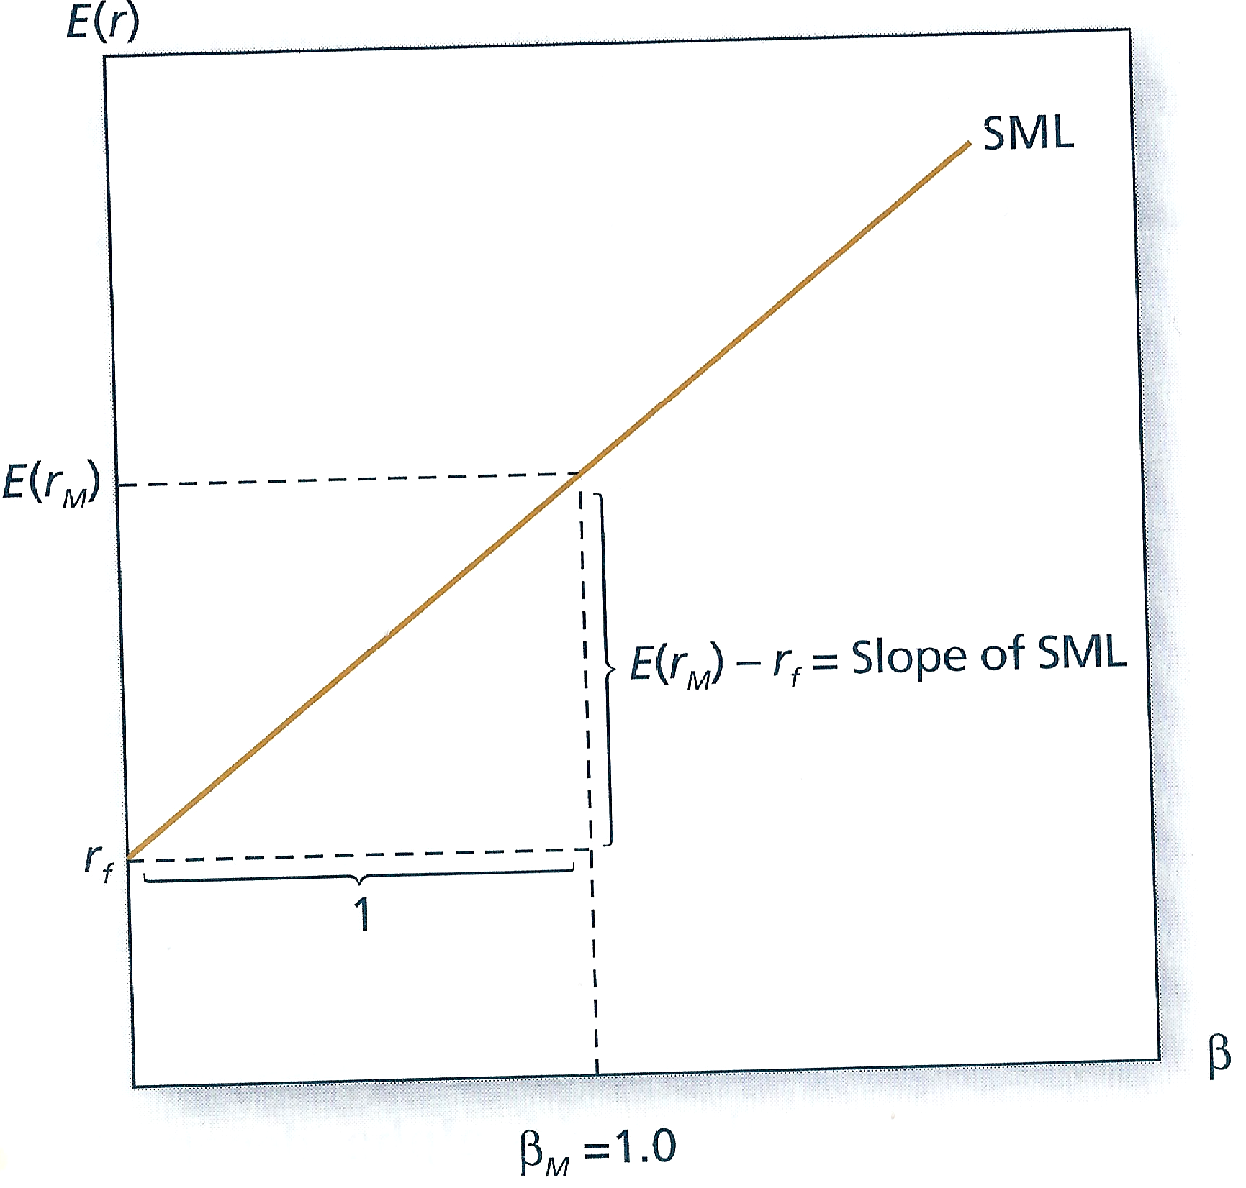
Security Market Line
Slope r_{m}-r_{f}

Slide 6
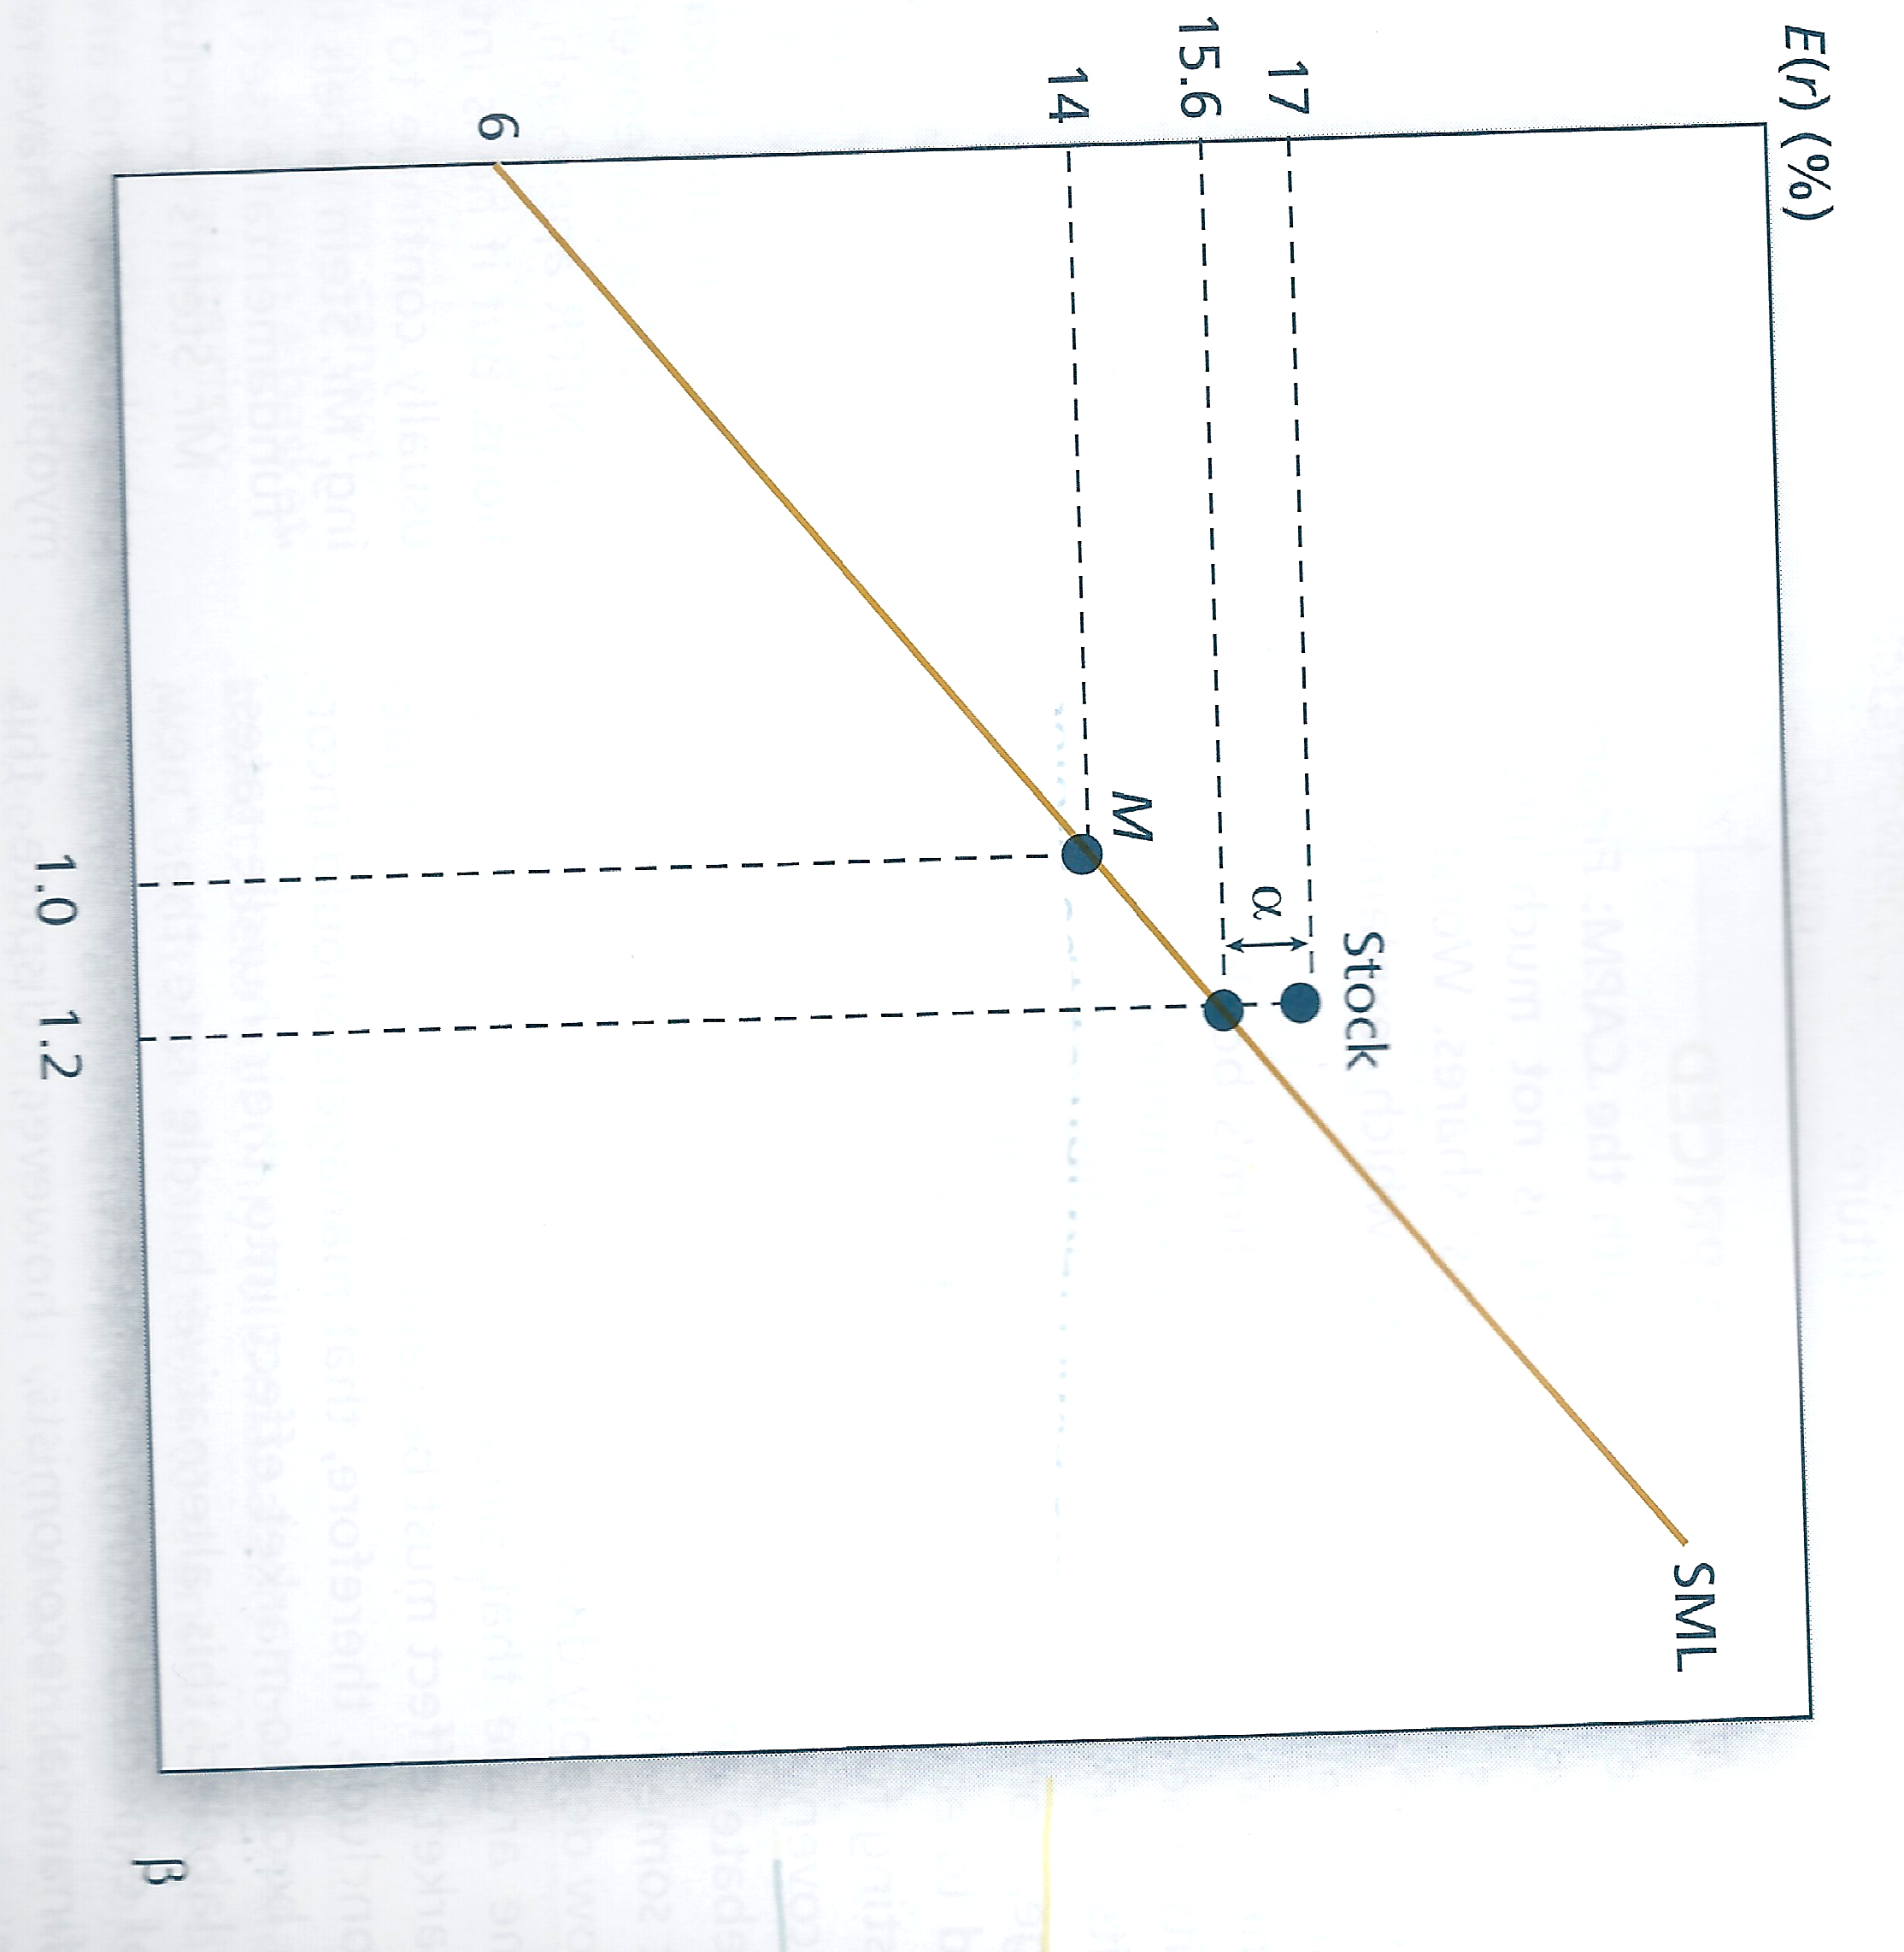
Look for Alfa

Slide 7
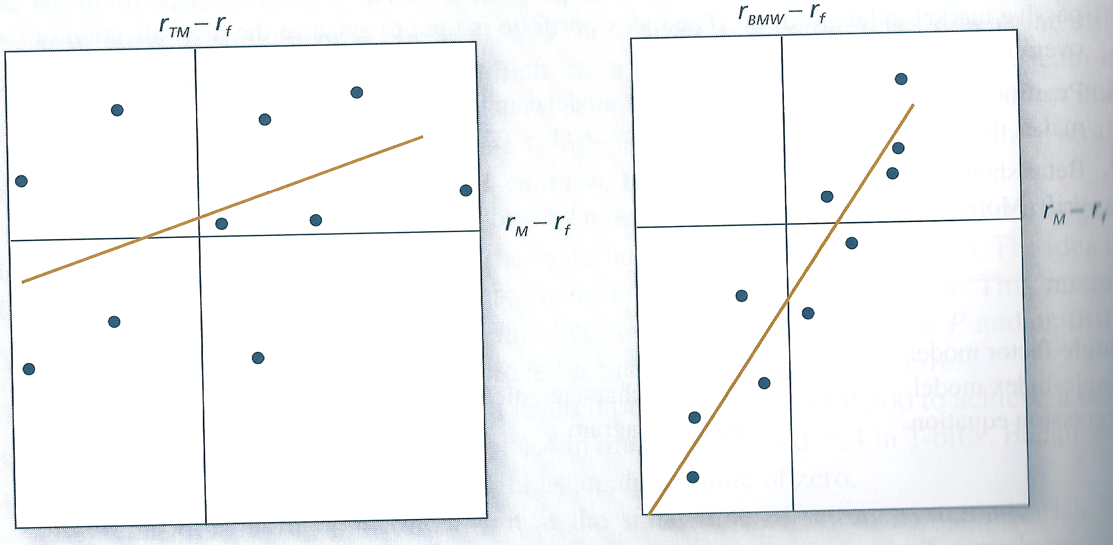
Beta as a function of Risk Premia
Beta is the slope of the regression line

