Slide 1
Part II – Lecture III
Central Banking and the
Conduct of Monetary Policy

Slide 2
Chapter 9
Central Banks
and the
Federal Reserve System

Slide 3
Chapter Preview
Central banks are the government authorities in charge of monetary policy.
U.S., the central bank is the Federal Reserve System (FED)
Europe: the European Central Bank (ECB)
Although we typically hear about central banks in connection with interest rates, their actions also affect credit, the money supply, and inflation (just to name a few areas).

Slide 4
Chapter Preview
We examine the role of government authorities over the money supply.
We focus primarily on the role of the U.S. Federal Reserve System, but also examine similar organizations in other nations.
Topics include:
  Origins of the Federal Reserve System
  Structure of the Federal Reserve System
  How Independent is the Fed?
  Should the Fed Be Independent?
  Structure and Independence of the European Central Banks
  Structure and Independence of other Foreign Central Banks

Slide 5
Origins of the Federal
Reserve System
Fear of centralized power and distrust of moneyed interests guided central bank activities in the 19th century.
The First Bank of the U.S. was disbanded in 1811.
The Second Bank of the U.S. was disbanded in 1836 when President Andrew Jackson vetoed its renewal.
As a result, banking panics became regular events, absent a lender of last resort, culminating in the panic of 1907.
Widespread bank failures and depositor losses convinced the U.S. that a central bank was needed.

Slide 6
Federal Reserve Act of 1913
Fear of a “central authority” was rampant—people worried that powerful Wall Street interests would manipulate the system.
Questions arose as to whether such a monetary authority would be private or a government institution.
The Federal Reserve Act of 1913 was a compromise that created the Federal Reserve System, including elaborate checks and balances.

Slide 7
Inside the Fed: The Political Genius of the Funders of the FRS
The founders decided against concentrating the federal banking system in NYC or D.C. in order to maintain public support for the idea, increasing its effectiveness.
The 12 branches are spread across the country to make sure all regions of the country are represented in policy deliberations.
The banks are quasi-private institutions, promoting a concern with regional issues.

Slide 8
Structure of the Federal Reserve System
Design was intended to diffuse power along the following dimensions:
  Regions of the U.S.
  Government and private sector interests
  Needs of bankers, businesses, and the public
The system as it exists now includes:
  Twelve Federal Reserve Banks
  Board of Governors (BOG) of the Federal Reserve System
  Federal Open Market Committee (FOMC)
  Federal Advisory Council
  Member Banks (around 2,000)

Slide 9
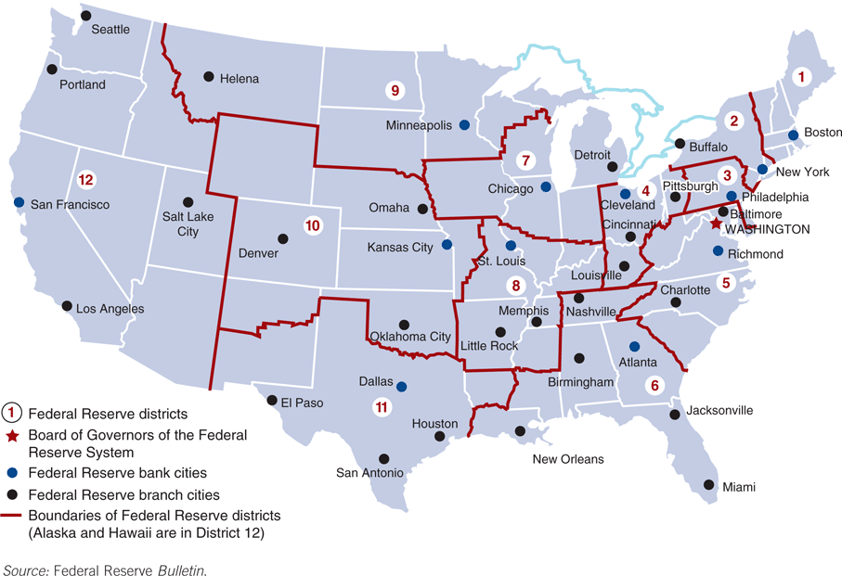
Federal Reserve Banks
Figure 9.2 Federal Reserve System

Slide 10
Structure of the Federal Reserve System
The next slide outlines the relationships of these entities to one another and to the three policy tools of the Fed:
Open market operations
Discount rate
Reserve requirements

Slide 11
Federal Reserve Bank Functions: General
MONETARY POLICY ADMINISTRATION
Clear checks
Issue new currency and remove damaged currency
Administer and make discount loans to banks in their districts
RESEARCH
Collect and examine data on local business conditions
Conduct research related to monetary policy
STABILITY & CONTROL
Evaluate bank mergers and expansions
Perform bank examinations

Slide 12
Chairman of the
Federal Reserve System
Spokesperson for the entire Federal Reserve System, and supervises the Board’s staff
Negotiates, as needed, with Congress and the President of the United States
With these, the chairman has effective control over the system, even though he doesn’t have legal authority to exercise control over the system and its member banks.

Slide 13
The FRB of New York
The New York Fed is responsible for oversight of some of the largest financial institutions headquartered in Manhattan and the surrounding area.
The New York Fed houses the open market desk.
All of the Feds open market operations (discussed in a bit) are directed through this trading desk.

Slide 14
Federal Open Market Committee
Make decisions regarding open market operations, to influence the monetary base.
Open market operations are the most important tool that the Fed has for controlling the money supply (along with reserve requirements and the discount rate)
All actions are directed the Federal Reserve Bank of New York, where securities are bough / sold as required.

Slide 15
Inside the Fed:
FOMC Meeting
Meet eight times each year (about every
six weeks)
Important agenda items include
  Reports on open market operations (foreign and domestic)
  National economic forecasts are presented
  Discussion of monetary policy and directives, including views of each member
  Formal policy directive made
  Post-meeting announcements, as needed

Slide 16
How Independent is the Fed?
A broad question of policy for the Federal Reserve Systems is how free the Fed is from presidential and congressional pressure in pursuing its goals.
  Instrument Independence: the ability of the central bank to set monetary policy instruments.
  Goal Independence: the ability of the central bank to set the goals of monetary policy.
Evidence suggests that the Fed is free along both dimensions.

Slide 17
How Independent is the Fed?
Other Evidence
The Fed usually generates revenue in excess of its expenses, so it is not typically under appropriations pressure.
However, Congress can enact legislation to gain control of the Fed, a threat wielded as needed. For example, the House Concurrent Resolution 133 requires the Fed to announce its objective growth rate for the money supply.
Presidential appointment clearly sets the direction of the Fed.

Slide 18
Should the Fed Be Independent?
Every few years, the question arises in Congress as to whether the independence of the Fed should be reduced in some fashion. This is usually motivated by politicians who disagree with current Fed policy.
Arguments can be made both ways, as we outline next.

Slide 19
Case for Independence
The strongest argument for independence is the view that political pressure will tend to add an inflationary bias to monetary policy.
This stems from short-sighted goals of politicians.
For example, in the short-run, high money growth does lead to lower interest rates. In the long-run, however, this also leads to higher inflation.

Slide 20
Case for Independence (cont.)
The notion of the political business cycle stems from the previous argument.
  Expansionary monetary policy leads to lower unemployment and lower interest rates—a good idea just before elections.
  Post-election, this policy leads to higher inflation, and therefore, higher interest rates—effects that hopefully disappear (or are forgotten) by the next election.

Slide 21
Case for Independence (cont.)
Other arguments include:
  The Treasury may seek to finance the government through bonds purchased by the Fed. This may lead to an inflationary bias.
  Politicians have repeatedly shown an inability to make hard choices for the good of the economy that may adversely affect their own well-being.
  Its independence allows the Fed to pursue policies that are politically unpopular, yet in the best interest of the public.

Slide 22
Case Against Independence
Some view Fed independence as “undemocratic”—an elite group controlling an important aspect of the economy but accountable in few ways.
If this argument seems unfounded, then ask why we don’t let the other aspects of the country be controlled by an elite few. Are military issues, for example, any less complex?
Indeed, we hold the President and Congress accountable for the state of the economy, yet they have little control over one of the most important tools to direct the economy.

Slide 23
Case Against Independence (cont.)
Further, the Fed has not always been successful in the past. It has made mistakes during the Great Depression and inflationary periods in the 1960s and 1970s.
Lastly, the Fed can succumb to political pressure regardless of any state of independence. This pressure may be worse with few checks and balances in place.

Slide 24
Explaining Central Bank Behavior
Two competing theories try to explain the observed behavior of central banks:
  Public Interest View: the central bank serves the public interest.
  Theory of Bureaucratic Behavior: the central bank will seek to maximize its own welfare.
The Fed often fights to maintain autonomy while avoid conflict with Congressional power groups. These seem to favor the latter theory, but this view is probably too extreme.

Slide 25
Inside the Fed:
Fed’s Communication Strategy
The Fed generally likes to keep its actions hidden—not transparent—to avoid conflicts with Congress and other politicians.
For example, in the past, the Fed didn’t announce the results of the FOMC meetings.

Slide 26
Inside the Fed: Fed’s Communication Strategy (cont.)
Has made changes toward more transparency over the years:
1994 - began to reveal the FOMC directives immediately after each FOMC meeting
1999 - began to announce the “bias” toward which direction monetary policy was likely to go
2002 - the Fed started to report the roll call for the FOMC meeting votes
2004 – moved up the release date of the minutes of FOMC meetings
today: it announces also the interest rate forecasts!

Slide 27
Inside the Fed: Fed’s Communication Strategy (cont.)
Each chairman, of course, adds changes to this view:
In 2007, Bernanke extended the forecast horizon for FOMC projections from 2 years to 3 years.
FOMC publishes these projects quarterly (instead of twice a year).
The Chairman now also gives a press conference after FOMC meetings in January, April, June, and November.

Slide 28
Structure and Independence of the European Central Bank
Founded (as it currently exists) in 1999 by a treaty between the European Central Bank (ECB) and the European System of Central Banks (ESCB).
The ECB is housed in Frankfurt, Germany.
Executive board consists of the president, vice president, and four members, all serving eight-year terms.
The policy group consists of the executive board and governors from the 17 member countries central banks.

Slide 29
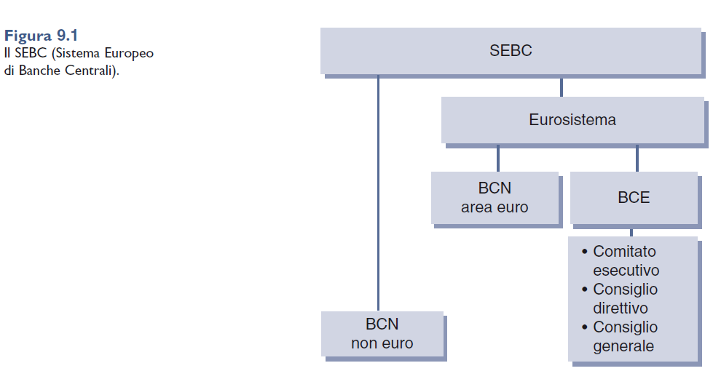
The system

Slide 31
I compiti fondamentali dell’Eurosistema sono i seguenti:
      definizione e attuazione della politica monetaria dell’area euro
      svolgimento degli interventi sul mercato dei cambi
      gestione delle riserve ufficiali degli Stati membri
      promozione del regolare funzionamento dei sistemi di pagamento

Slide 32
The European Central Bank
The ECB is the most instrument and goal independent central bank in the world. It was given independence in the Maastricht Treaty, and that policy can only be changed by amending the treaty.
The treaty set the ECB’s long-term goal as price stability, so it’s not entirely free to pursue its own goals.

Slide 33
Structure and Independence of Other Foreign Central Banks
Unlike the United States, central banks of other industrial countries consist of one central bank that is owned by the government. Here, we examine the structure and independence of important foreign central banks:
Bank of England
Bank of Japan

Slide 34
Bank of England
Founded in 1694
The “Court” consists of the governor, two deputy governors (five-year terms), and 16 nonexecutive directors (three-year terms).
The Monetary Policy committee compares with the U.S. FOMC, consisting of the governor, deputy governors, two other central bank officials, plus four outside economic experts.
The Bank was the least independent of the central banks, until 1997, when it was granted authority to set interest rates.
The government can step in under “extreme” circumstances, but has never done so yet.

Slide 35
Bank of Japan (Nippon Ginko)
Founded in 1882
The Policy Board sets monetary policy, and consists of the governor, two vice governors, and six outside members. All serve five-year terms.
The Bank of Japan Law (1998) gave the Bank considerable instrument and goal independence.

Slide 36
Bank of Japan (Nippon Ginko)
Recently, Ministry of Finance lost its authority to oversee many operations of the Bank of Japan.
In a recent episode, the new Abe government put pressure on the Bank of Japan to adopt a 2% inflation target against the wishes of its current Governor.
Governor resigned! May suggest that the Bank of Japan’s independence is limited.

Slide 37
Trend toward Independence
In recent years, we have seen a remarkable trend toward increasing independence. The Fed used to be substantially more independent than other central banks, but this has changed with the formation of the ECB and changes at other central banks. This trend should continue.

