Slide 1
Part 2 – Lecture IV Conduct of Monetary Policy:
Tools, Goals, Strategy, and
Tactics

Slide 2
Chapter Preview
“Monetary policy” refers to the management of the money supply.
The theories guiding the Federal Reserve are complex and often controversial.
We are affected by this policy, and a basic understanding of how it works is, therefore, important.

Slide 3
Chapter Preview
The Federal Reserve’s Balance Sheet
The Market for Reserves and the Federal Funds Rate
Conventional Monetary Policy Tools
Reserve Requirements
Nonconventional Monetary Policy Tools and Quantitative Easing
Monetary Policy Tools of the ECB
The Price Stability Goal and the Nominal Anchor

Slide 4
Chapter Preview (cont.)
Other Goals of Monetary Policy
Should Price Stability be the Primary Goal of Monetary Policy?
Inflation Targeting
Central Banks’ Responses to Asset-Price Bubbles: Lessons from the Global Financial Crisis
Tactics: Choosing the Policy Instrument

Slide 5
The Federal Reserve’s Balance Sheet
The conduct of monetary policy by the Federal Reserve involves actions that affect its balance sheet. This is a simplified version of its balance sheet, which we will use to illustrate the effects of Fed actions.

Slide 6
The Federal Reserve’s Balance Sheet: Liabilities
The monetary liabilities of the Fed include:
Currency in circulation: the physical currency in the hands of the public.
Reserves: All bank deposits with the Fed. The Fed sets the required reserve ratio. Any reserves deposited with the Fed beyond this amount are excess reserves.
The sum of these two items is the monetary base.

Slide 7
The Federal Reserve’s Balance Sheet: Assets
The monetary assets of the Fed include:
Government securities: U.S. Treasury bills and bonds that the Federal Reserve has purchased in the open market.
Loans to financial institutions: Loans to member banks at the current discount rate. The loans are referred to as borrowings from the Fed or borrowed reserves.

Slide 8
Open Market Operations
In the next two slides, we will examine the impact of open market operations conducted through primary dealers. As suggested in the last slide, we will show the following:
Purchase of bonds increases the money supply
Making discount loans increases the money supply
Naturally, the Fed can decrease the money supply by reversing these transactions.

Slide 9
The Federal Reserve Balance Sheet
Open Market Purchase from Primary Dealer
Result R ↑ $100, MB $100

Slide 10
Conventional Monetary Policy Tools
We further examine each of the tools in turn to see how the Fed uses them in practice and how useful each tools is.

Slide 11
Reserve Requirements
Reserve Requirements are requirements put on financial institutions to hold liquid (vault) cash again checkable deposits.
Everyone subject to the same rule for checkable deposits:
3% of first $48.3M, 10% above $48.3M
Fed can change the 10%
Rarely used as a tool
Raising causes liquidity problems for banks
Makes liquidity management unnecessarily difficult

Slide 12
Tools of Monetary Policy: Open Market Operations
Open Market Operations
Dynamic: Change reserves and monetary base
Defensive: Offset factors affecting reserves, typically uses repos
Advantages of Open Market Operations
Fed has complete control
Flexible and precise
Easily reversed
Implemented quickly

Slide 13
Inside the Fed: A Day at the Trading Desk
The trading desk typically uses two types of transactions to implement their strategy:
Repurchase agreements: the Fed purchases securities, but agrees to sell them back within about 15 days. So, the desired effect is reversed when the Fed sells the securities back—good for taking defense strategies that will reverse.
Matched sale-purchase transaction: essentially a reverse repo, where the Fed sells securities, but agrees to buy them back.

Slide 14
Tools of Monetary Policy: Discount Policy
The Fed’s discount loans, through the discount window, are:
Primary Credit: Healthy banks borrow as they wish from the primary credit facility or standing lending facility.
Secondary Credit: Given to troubled banks experiencing liquidity problems.
Seasonal Credit: Designed for small, regional banks that have seasonal patterns of deposits.

Slide 15
Tools of Monetary Policy: Discount Policy
Lender of Last Resort Function
To prevent banking panics
Example: Continental Illinois
Really needed? What about the FDIC?
Problem 1: FDIC only has about 1% of deposits in the insurance trust
Problem 2: over $1.1 trillion are large deposits not insured by the FDIC

Slide 16
Tools of Monetary Policy: Discount Policy
Lender of Last Resort Function
Can also help avoid panics
Ex: Market crash in 1987 and terrorist attacks in 2001 - bad events, but no real panic in our financial system
But there are costs!
Banks and other financial institutions may take on more risk (moral hazard) knowing the Fed will come to the rescue

Slide 17
Inside the Fed
The Global Financial Crisis tested the Fed’s ability to act as a lender of last resort.
The next two slides detail some of the Fed’s efforts during this period to provide liquidity to the banking system.
Nonconventional Monetary Policy Tools and Quantitative Easing

Slide 18
Inside the Fed
Fed Lending Facilities During the Global Financial Crisis
Nonconventional Monetary Policy Tools and Quantitative Easing

Slide 19
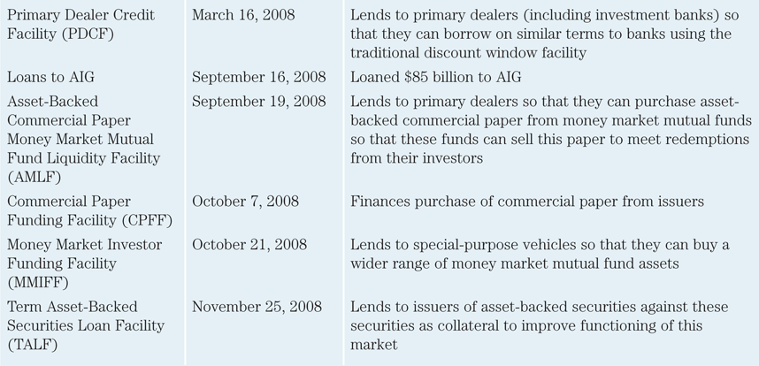
Inside the Fed
Fed Lending Facilities During the Global Financial Crisis (cont.)
Nonconventional Monetary Policy Tools and Quantitative Easing

Slide 20
Fed Stabilization
The Global Financial Crisis challenged the Fed’s ability to stabilize the economy:
Financial system seized
Zero-lower-bound problem – could take rates below zero
The problems called for the use of nonconventional tools.
Nonconventional Monetary Policy Tools and Quantitative Easing

Slide 21
Liquidity Provisions
Discount windows expansion – discount rate lowered several times.
Term auction facility – another loan facility, offering another $400 billion to institutions.
New lending programs – included lending to Investm Banks, and lending to promote purchase of asset-backed securities.
Nonconventional Monetary Policy Tools and Quantitative Easing

Slide 22
Asset Purchases (Quantitative Easing)
Nov 2008 – QE1 established, purchasing $1.25 trillion in MBSs.
Nov 2010 – QE2, Fed purchases $600 billion in Treasuries, lower long-term rates.
Sept 2012 – QE3, Fed commits to buying $40 billion in MBSs each month.
Nonconventional Monetary Policy Tools and Quantitative Easing

Slide 23
Quantitative Easing v. Credit Easing
QE programs dramatically increases the Fed’s balance sheet.
Power force to stimulate the economy, but perhaps also lead to inflation?
Nonconventional Monetary Policy Tools and Quantitative Easing

Slide 24
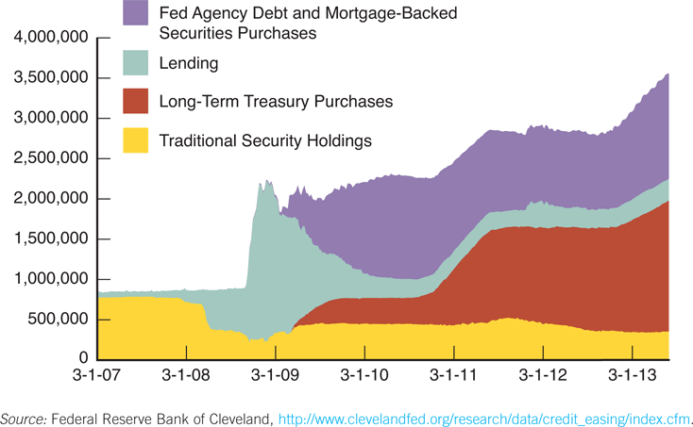
Nonconventional Tools and Quantitative Easing
Figure 10.7 The Expansion of the Federal Reserve’s Balance Sheet During and After the Global Financial Crisis

Slide 25
Quantitative Easing vs. Credit Easing
Quantitative Easing v. Credit Easing
However, short-term rate is already near zero – not clear further action helps.
Banks are not lending
Money supply did not expand
Nonconventional Monetary Policy Tools and Quantitative Easing

Slide 26
Quantitative Easing vs. Credit Easing
Fed Chairman Ben Bernanke argues that the Fed has been engaged in credit easing, actions to impact credit markets.
How does this work?
Nonconventional Monetary Policy Tools and Quantitative Easing

Slide 27
Quantitative Easing vs. Credit Easing
Liquidity can help unfreeze markets that have seized.
Asset purchases can lower rates on those assets, focusing on specific markets.
Nonconventional Monetary Policy Tools and Quantitative Easing

Slide 28
Management of Expectations: Commitment to Future Policy Actions
By committing to maintain short-term rates near zero, future short-term rates should also be zero, meaning long-term rates fall.
This is known as management of expectations.
Fed started this policy in late 2008, committing to hold rates low through mid-2015.
Long rates fell.
Nonconventional Monetary Policy Tools and Quantitative Easing

Slide 29
Management of Expectations: Commitment to Future Policy Actions
Commitment to low fed funds rate is conditional, predicated on weak economy.
Could make an unconditional commitment to keep rates low, regardless of the economy.
Nonconventional Monetary Policy Tools and Quantitative Easing

Slide 30
Management of Expectations: Commitment to Future Policy Actions
However, unconditional commitments can be tough, especially if circumstances change. Becomes a credibility problem.
2003 experience confirmed this – Fed’s unconditional commitment of low rates needed to change.
Nonconventional Monetary Policy Tools and Quantitative Easing

Slide 31
Monetary Policy Tools of the European Central Bank
ECB policy signals by
setting a target financing rate,
which establishes the overnight cash rate.
The EBC has tools to implement its intended policy:
open market operations,
lending to banks,
reserve requirements.

Slide 32
ECB Open Market Operations
Like the Fed, open market operations are the primary tool to implement the policy.
The ECB primarily uses main refinancing operations (like repos) via a bid system from its credit institutions.
Operations are decentralized—carried out by each nation’s central bank.
Also engage in long-term refinancing operations,

Slide 33
ECB Lending to Banks
Like the Fed, the ECB lends to its member banks via its marginal lending facility.
Banks can borrow at the marginal lending rate, which is 100 basis points above the target lending rate.
Also has the deposit facility. This provides a floor for the overnight market interest rate.

Slide 34
ECB Reserve Requirements
Like the Fed, ECB requires banks to hold 2% of checkable deposits, plus a minimum reserve requirement.
The ECB does pay interest on reserves

Slide 35
Price Stability Goal & the Nominal Anchor
Policymakers have come to recognize the social and economic costs of inflation.
Price stability, therefore, has become a primary focus.
High inflation seems to create uncertainty, hampering economic growth.
Indeed, hyperinflation has proven damaging to countries experiencing it.

Slide 36
Price Stability Goal & the Nominal Anchor
Policymakers must establish a nominal anchor which defines price stability. For example, “maintaining an inflation rate between 1% and 2%” might be an anchor.
An anchor also helps avoid the time-inconsistency problem.

Slide 37
Price Stability Goal & the Nominal Anchor
The time-inconsistency problem is the idea that day-by-day policy decisions lead to poor long-run outcomes.
Policymakers are tempted in the short-run to pursue expansionary policies to boost output. However, just the opposite usually happens.
Central banks will have better inflation control by avoiding surprise expansionary policies.
A nominal anchor helps avoid short-run decisions.

Slide 38
Other Goals of Monetary Policy
Goals
High employment
Want demand = supply, or natural rate of unemployment
Economic growth (natural rate of output)
Stability of financial markets
Interest-rate stability
Foreign exchange market stability
Goals often in conflict

Slide 39
Should Price Stability be the Primary Goal?
Price stability is not inconsistent with the other goals in the long-run.
However, there are short-run trade-offs.
An increase in interest rates will help prevent inflation, but increases unemployment in the short-run.

Slide 40
Should Price Stability be the Primary Goal?
The ECB uses a hierarchical mandate, placing the goal of price stability above all other goals.
The Fed uses a dual mandate, where “maximizing employment, stable prices, and moderate long-term interest rates” are all given equal importance.

Slide 41
Should Price Stability be the Primary Goal?
Which is better?
Dual mandate can lead to increased employment and output, but also increases long-run inflation.
Hierarchical mandate can lead to over-emphasis on inflation alone - even in the short-run.
Answer? It depends. Both help the central bank focus on long-run price stability.

Slide 42
Should Central Banks’ Respond to Asset-Price Bubbles? Lessons from the Global Financial Crisis
Asset pricing bubbles occur when
asset’s prices climb above fundamental values
… then fall back to the fundamental value (or below) quite rapidly

Slide 43
Should Central Banks Respond to Asset-Price Bubbles?
What should central banks do about pricing bubbles?
Should response be different from inflation and employment goals?
Should response minimize damage when bubble bursts?
Clean-up after bubble bursts?

Slide 44
Should Central Banks Respond to Asset-Price Bubbles?
To help answer this, we first must define the types of pricing bubbles.
Credit-driven bubble: created when easy credit terms spill over into asset prices. And as asset prices increase, further lending is encouraged.
Very dangerous when the bubble ends - the downward spiral can be more damaging than the asset bubble.

Slide 45
Should Central Banks Respond to Asset-Price Bubbles?
To help answer this, we first must define the types of pricing bubbles.
Optimism-driven bubble: driven by overly optimistic expectations of asset pricing. Ex., the tech bubble of the late-1990s.
These bubbles are less dangerous, as the impact on the financial system is limited. Resulting wealth transfers are not good for the economy.

Slide 46
Should Central Banks Respond?
The “Greenspan” doctrine for why the answer is no:
Bubbles are difficult to identify
Rate changes may do nothing
Rates are a blunt instrument - affect many asset prices in the economy

Slide 47
Should Central Banks Respond?
The “Greenspan” doctrine for why the answer is no:
Resulting slow economy, unemployment, etc., may be worse than the bubble.
Policy reactions after the bubble bursts may keep damage at a reasonable level.

Slide 48
Should Central Banks Respond?
The global financial crisis suggests the answer is yes:
Suggests leaning against credit-driven bubbles.
Seems easy to identify, but what policies are most effective?

Slide 49
Macroprudential Regulation
Macroprudential regulation may be the answer
Increase disclosure requirements and capital requirements, prompt corrective action, monitoring risk-management procedures, and close supervision.
For example, countercyclical capital requirements would dampen credit-booms. As asset prices increase, increase required capital.

Slide 50
Monetary policy
Low interest rates may be the “risk-taking channel of monetary policy”
Asset managers search for high yield
Asset demand may increase
Lenders consider riskier projects
Perhaps just use macroprudential policies?

Slide 51
Monetary policy
Macroprudential policies can be more difficult to enact:
Subject to political pressure
Can impact bottom line of firms
Institutions are good at finding ways around regulation
Best policy is not clear.

