Slide 1
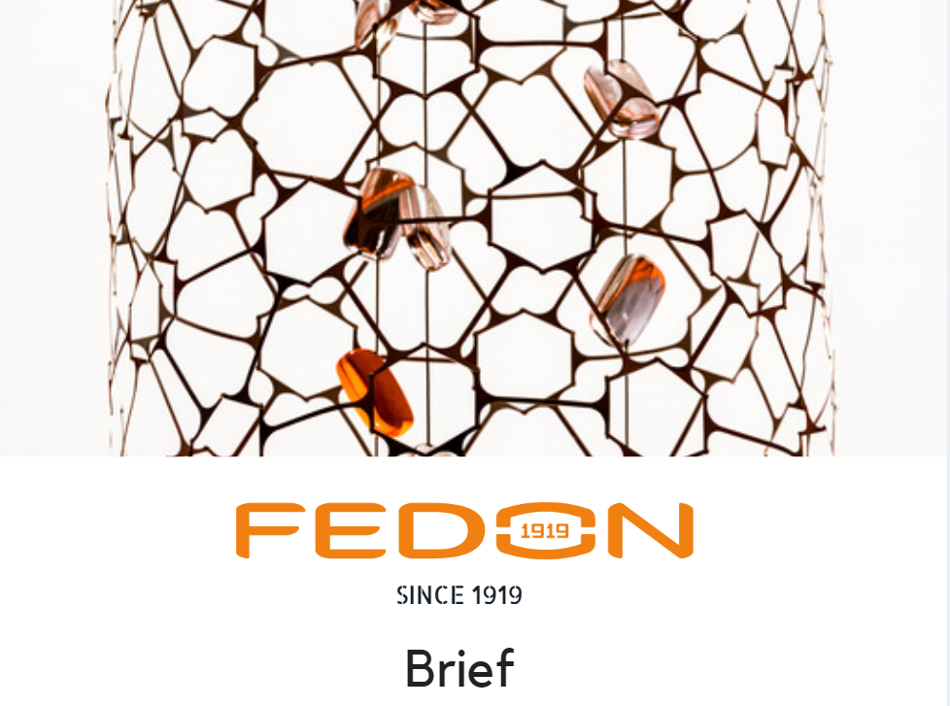

Slide 2
THE BEGINNING
In the past eyeglass cases were sold through the opticians' retail network.
In some countries (i.e. Italy) opticians were giving cases as a gift when selling frames, in some others they were able to sell them (i.e. Germany).
In the 80s the big fashion brands entered the eyewear market.
It was starting the production of eyeglasses under licence.
The need of "branded” eyeglass cases to hold “branded” frames was a consequence.
Since then, the Client of cases manufacturers was no longer the optician but the eyewear manufacturers who, not having a specific know-how, turned to Fedon asking assistance to design cases able to satisfy the needs of the Brands.
A trilateral cooperation brand- eyeglass manufacturer – Fedon.

Slide 3
THE EVOLUTION
Over time, the eyewear manufacturers began to filter the contact between the Brand and Fedon by inserting a person who acted as a “trait d'union”.
The person had sensitivity to design in order to be able to interact with both the Brand and Fedon.

Slide 4
AS IS
Today the eyewear manufacturer has modified its behavior once more, and dedicate:
a resource with sensitivity for design to the relationship with the Brand, and
a Buyer (with less sensitivity to design and Brand Equity issues) to the relationship with Fedon.
The direct connection between Fedon and the brand has been broken.
The Buyers have economic targets and filter creative proposals mainly privileging the ones falling into a predefined cost range, underestimating design and image content.
In this phase, the respect of the brand's value (Brand Equity) can be overshadowed.
Often Brands ask eyewear manufacturers to ensure compliance with the main ethical and corporate social responsibility rules.
As a ripple effect, the request is turned to Fedon.

Slide 5
REMARKS
While on the one hand there is a trend that tend to turn eyeglass cases into commodities decreasing their added value, on the other hand Brand needs are underestimated.
Issues such:
Brand Equity creation
The integration of the eyeglass cases in Marketing & Communication strategies
are somehow “forgotten”.
An interesting remark is that the communication value of cases is paradoxically greater than the one of frames. Cases have bigger dimensions and can be recognized in distance while frames communicate the brand only at short distance. Furthermore cases are used with high frequency, especially by women during the summer (sunglasses).

Slide 6
TARGETS
In this scenario, Fedon's goal it would be:
to rebuild a win-win-win relationship with Brands, in full cooperation with its Clients (eyewear manufacturers), and
To directly promote its cases to Brands of its non client eyewear manufacturers.
A direct relationship with Brands will allow to promote creative projects and will transmit the added value of the eyeglass case in terms of design and sustainability. Moreover it will allow to underline the strong communication values of eyeglass cases towards consumers.
Brands could become able to "distinguish" Fedon eyeglass cases from others more basic and possibly ask them to the eyewear manufacturers (push action).

Slide 7
THE CHALLENGE
Design a marketing strategy with the goal of convincing Brands of the creative and communication values of Fedon cases.
Measure (qualitatively and/or quantitatively) the real importance of compliance issues for the final consumer and for the brands (difference between declared and real care).
The eyeglass case is perhaps the only packaging with repeated use.
We would like to carry out a benchmark with products with similar functions and comparing at the same time sustainability values.
Then prepare at least two real creative solutions for the repeated use of cases, designing how to communicate them to final consumers.
Define in which way and how much the eyeglass case affects the overall eyewear value perceived by the consumer. Then define a communication strategy aimed at increasing the perceived value of the Branded eyeglass cases by the final consumer.

