Slide 1

ORGANIZATIONAL STRUCTURES
Martina Dal Molin
mdalmolin@liuc.it
AY 2018/2019

Slide 2
Course structure (1/3)
Topics
Organizational design: the core elements
Coordination mechanisms
The five parts of an organization
The design of the individual positions
The design of the macro-structure
The organizational configurations
The organizational chart
Assignment presentation

Slide 3
ORGANIZATIONAL DESIGN: THE CORE ELEMENTS
AY 2018/2019

Slide 4
Agenda
Organization: some definitions
Organizational dimensions
How to design an organization

Slide 5


Why organization theory?
Why do we study organization theory?

Slide 6
Why organization theory?
Why to study organization theory?
It helps us understanding why a company can die or survive
It help us understanding what happened in the past as well well as what might happen in the future
It gives us guidelines on how to manage organizations more effectively

Slide 7


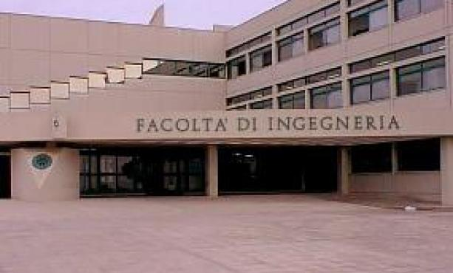
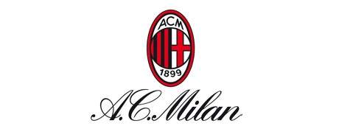
Defining organization (1/2)
Organizations are
Social entities that are goals directed and that are designed as deliberated structure and coordinated activity system and that are linked to the external environment

Slide 8
Defining organization (2/2)
Social entitites, because organizations are made up of people and their mutual relationships;
Goal-directed, because organizations have a mission and goals to be achieved
Designed, because managers organize resourses with the purpose of achieving goals
Linked to the external enviroment, beacuse organizations do not exist in isolation, but they interact with the external enviroment

Slide 9
Organizational dimensions
Organizational dimensions
Structural dimension Contextual dimension
i.e. The internal characteristics
i.e. Characteristics of the whole organization

Slide 10
Structural dimensions
Formalization, i.e. The amount of written material and documentation that describe behaviour
Specialization, i.e. The degree to which organizational tasks are subdivided into sepratae jobs (extensive vs low)
Hierarchy of authority, that describes who reports to whom and the span of control of each managers
Centralization, i.e. The hierarchical level that has formal decision making power (centralized vs decentralized)
Professionalism, i.e. The level of formal education and training of employes
Personnel ratio, i.e. The deployment of people to various functions and department

Slide 11
Contextual dimensions
Size, i.e. The dimension of the organization and it is typically measured by the n. Of employees
Organizational technology, it refers to the tools, techniques and actions needed to transform inputs into outputs
Environment, it includes all the elements outside the boundary of the organization
Goals and strategy, i.e. The mission and the purpose of the organization
Organization’s culture, i.e. The set of key values and beliefs

Slide 12
Miss Raku and her pottery laboratory (1/2)
Because of the high number of clients, Miss Raku and Miss Bisque were not able to develop alone all the products. At the beginning three new assistants were hired. Then other two. At that time, infomal communication was not enough: Miss Raku had to devote much more time to clients and Miss Bisque has to prepare pottery vases and to coordinate the work of assistants.
Miss Raku then hired Miss Bisque, who wanted to learn pottery art. Miss Bisque had two tasks: weighing the clay and preparing paints. Miss Raku carried out all the other remainign activities. To coordinate their activities, they infomally communicate
Miss Raku developed a pottery laboratory in the basement of her house. Alone she was able to to carry out several activities: clay kneading, shaping the vases, cooking the vases

Slide 13
Miss Raku and her pottery laboratory (2/2)
What does the story of Miss Raku tell us?
Organization can be defines as the way in which the labor division is defined and, therefore, how the different activities are mutually coordinated

Slide 14
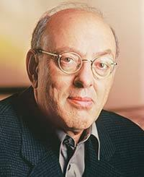
How to design an organization? (1/2)
Organizational variables MUST be designed and selected following the internal situation and with the external context in which the organization works
The parameters for the organizational design should be combined in order to define some ideal configurations.
Literature distinguishes among 5 ideal-type of organizational configurations
Henry Mintzberg

Slide 15
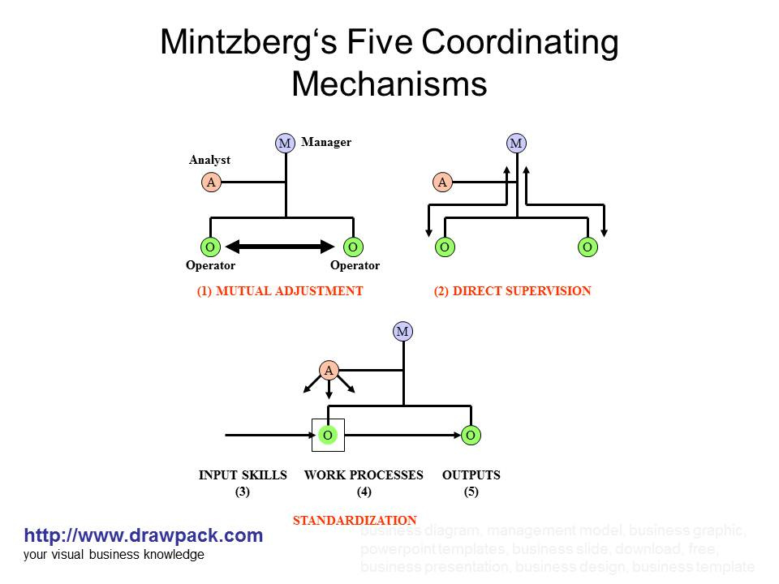
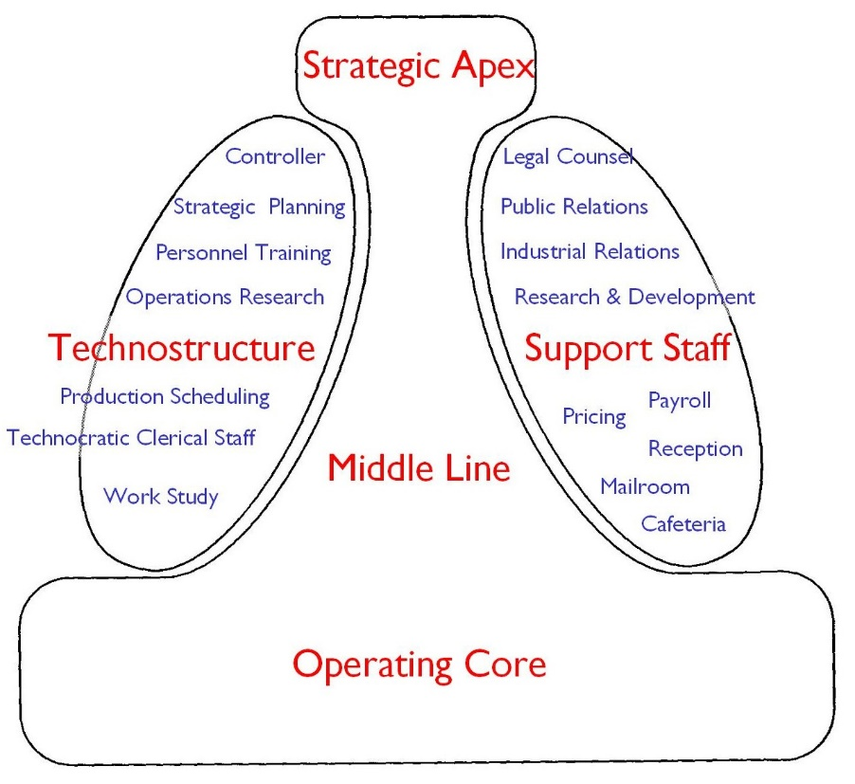
How to design an organization? (2/2)
Which elements or variable should we FIRST consider to design organization?
COORDINATION MECHANISMS
THE (5) PARTS OF AN ORGANIZATION

Slide 16
COORDINATION MECHANISMS
AY 2018/2019

Slide 17
Coordination mechanisms (1/2)
ORGANIZE: what does it mean in your opinion?
The division of labour in different activities
The coordination of these activities

Slide 18
Coordination mechanisms (2/2)

Slide 19
Mutual adjustment (1/2)
MANAGER
CORE ELEMENTS
Coordination is achieved through informal communication
Activities are monitored by who carries out these actvities (i.e. the operator)
Simple
ANALYST
OPERATOR
OPERATOR

Slide 20

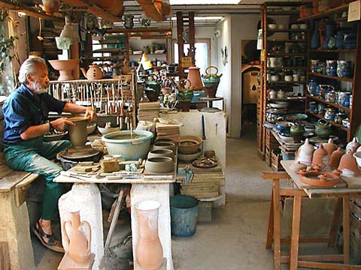


Mutual adjustment (1/2)
In which type of companies do you expect to find this coordination mechanism?
But also…..

Slide 21
Direct supervision (1/2)
MANAGER
CORE ELEMENTS
Coordination is achieved through the direct supervision of the manager
The manager has the responsibility over the others’ activities
The manager gives order and controls the others’ activities and results
ANALYST
OPERATOR
OPERATOR

Slide 22
Direct supervision (2/2)
Think about a football team…..

Slide 23
Standardization (1/2)
MANAGER
CORE ELEMENTS
Definition of activities
Three types of standardization:
  Input and skills
  Work processes
  outputs
ANALYST
OPERATOR
OPERATOR
INPUT SKILLS
WORK PROCESSES
OUTPUTS

Slide 24
Standardization (2/2)
….Of WORK PROCESSES
Activities and «content» are specify
….Of OUTPUTS
Final characteristics of the products are defined (e.g. features, dimension, performance)
….Of INPUT SKILLS
Education, skills and capabilities are defined

Slide 25
Summary
MUTUAL ADJUSTMENT
DIRECT SUPERVISION
PROCESSES STANDARDIZ.
OUTPUTS STANDARDIZ.
INPUT SKILLS STANDARDIZ.
MUTUAL ADJUSTMENT
LOW COMPLEXITY
HIGH COMPLEXITY
!!! ORGANIZATIONS USUALLY COMBINE THE FIVE TYPE OF MECHANISMS!!!
Indeed, formal and Informal organization are interconnected

Slide 26
THE FIVE PARTS OF AN ORGANIZATION
AY 2017/2018

Slide 27

The five parts of an organization (1/2)

Slide 28
The five parts of an organization (2/2)
SUPPORT STAFF:
Provision of support services
HIGH COMPLEXITY
TECHNOSTRUCTURE:
The higher complexity of the organization requires standardization
MIDDLE LINE:
Line of authority between the strategic apex and the operating core
STRATEGIC APEX:
Increased dimension of the
More complex division of labour
Direct supervision
OPERATING CORE:
Output production and/or provision of services
Mutual adjustement
LOW COMPLEXITY

Slide 29

Operating core
People directly involved in the production of output/provision of services
Principal functions:
  Find input
  Trasformation of input in output
  Support services (from input to output)
Max standardization
It is the «heart» of every organization

Slide 30
Strategic Apex
People who are in charge of monitoring the whole organization and who are responsibile for its results
Principal functions:
  Direct supervision
  Managing organizational boundaries
  Strategy definition
They represent the organizational vision and
mission
Low repetitiveness, complex decision
making, low standardization
Mutual adjustment among managers

Slide 31
Middle line
Middle management and they are responsible for the activities of the operating core
Principal functions:
  Collect performance information
  Provide performance information to the
  strategic apex
  Internal boundaries management
  Define internal strategy
Direct supervision

Slide 32
Technostructure
Analysts who define «rules» for the others’ activities
Principal functions:
  To design and plan the others’ work
  processes
Three categories
  Work analysists (std of process)
  Audit and control analysists (std of output)
  Human Resources analysts (std of input)

Slide 33
Support Staff
Provision of support services
Provision of SPECIFIC functions without defining
rules for standardization
«small» organization with its own
operating core

Slide 34
The functioning of an organization
5 perspectives:
  Flow of formal authority
  Flow of defined and regulated actvities
  Flow of informal communication
  Work constellation
  Ad hoc decision-making process

Slide 35
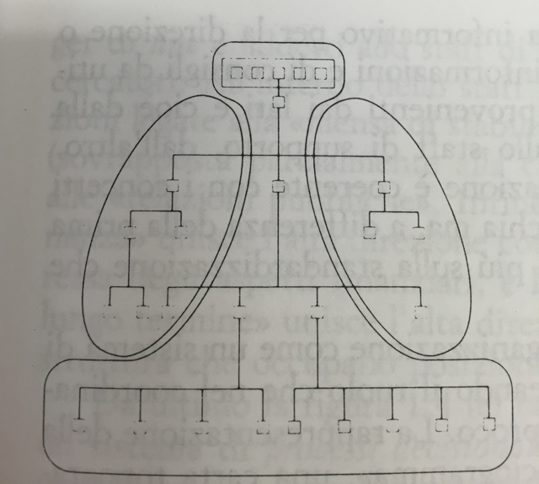
Flow of formal authority
The organization is seen as a system of formal authority
It is represented by the organizational chart
It does not represent the informal flow of power and communication
The organizational chart represent the division of labour:
  Which working/individual positions
  How these positions are grouped to form organizational units
  The formal power over organizational units

Slide 36
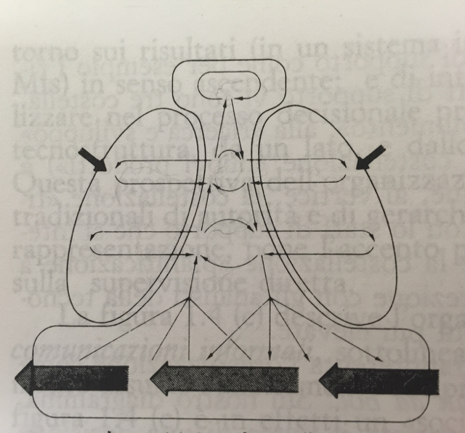
Flow of regulated activities
The organization is seen as a set of rules to monitor the operating core and to provide performance information to the strategic apex
Focus on:
  Standardization
  Direct supervision

Slide 37
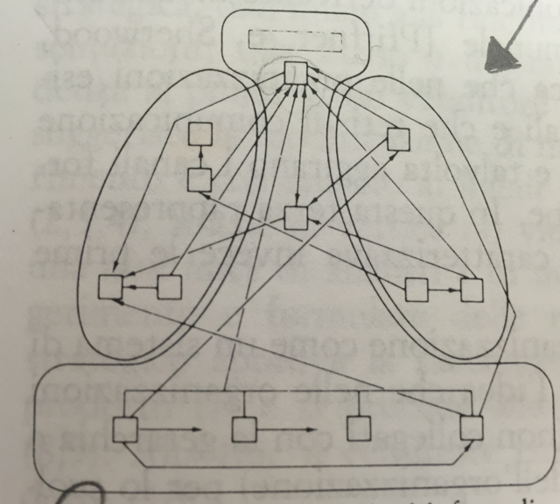
Flow of informal communication
Representation of the real system of communication and power within the organization
It highlights the existence of informal communication flows and «non-official» decision making centres
Focus of mutual adjustement

Slide 38
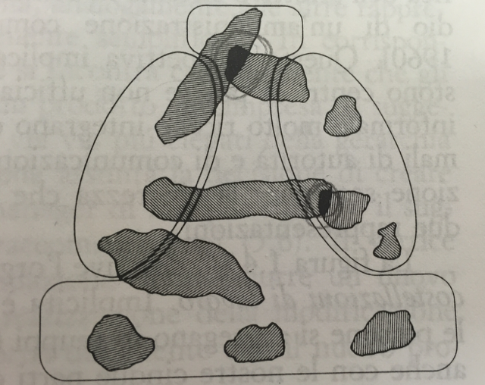
Work constellation
«Work constellation» refers to the creation of groups of people for specific activities
Specific decisions are taken according to the gerarchical position of the constellation

Slide 39
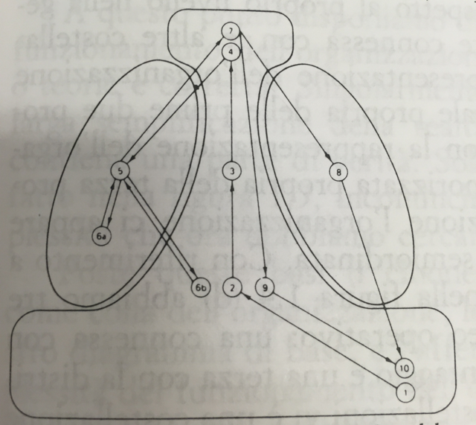
Ad hoc decision-making power
The organization is seen as a set of specific decision-making process

Slide 40
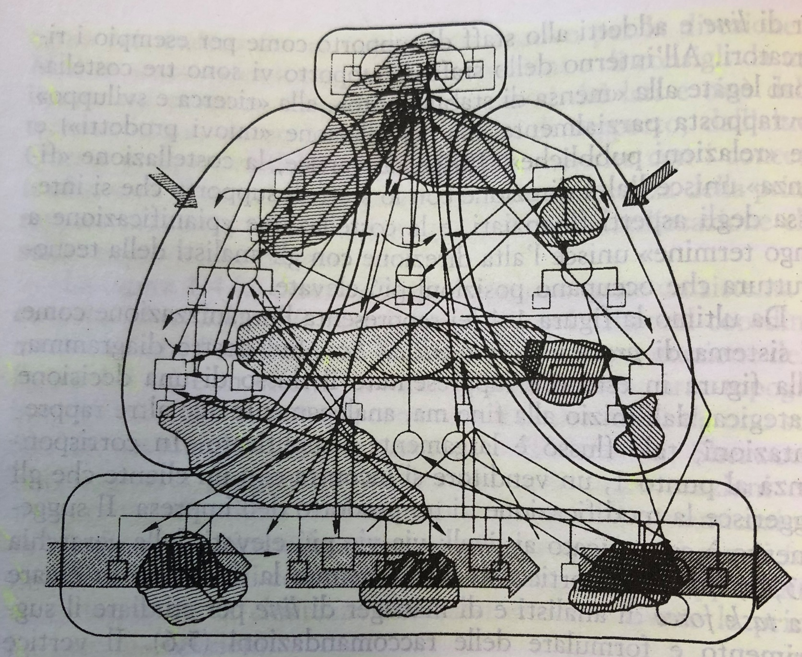
How do organizations really work?

Slide 41
The parameters of organizational design
Decision-making system
Side-markers connection
Macro-structure
Individual position

Slide 42
Exercise
Identify the five parts of the organization in the case of Liuc University

