Slide 1
THE DESIGN OF INDIVIDUAL POSITIONS
Martina Dal Molin
mdalmolin@liuc.it
AY 2018/2019

Slide 2
Agenda
Introduction
Specialization of tasks
Formalization of the behaviour
Training and indoctrination

Slide 3
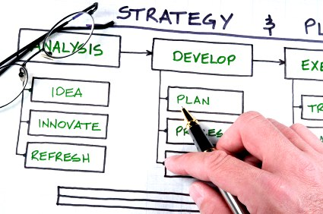
Introduction
What do you mean by «DESIGN»?

Slide 4
The design of an organization
Ability to modify a system
To modify some organizational core elements (e.g. coordination mechanisms) that affect:
the division of labour
Coordination mechanisms
Modification of the organizational functioning rules

Slide 5
Example of key questions
How many activities should be related to a work position?
How to standardize the output?
How to standardize an activity?
PARAMETERS of ORGANIZATIONAL DESIGN
Which abilities and skills are required for a specific position?
How many organizational units are required?
Which mechanisms to facilitate the mutual adjustement?
How many decision making power for managers?

Slide 6
The parameters of organizational design
Decision-making system
Side-markers connection
Macro-structure
Individual position

Slide 7
The parameters of organizational design
Individual position
Specialization of tasks
Labour division
Formalization of behaviour
Standardization of processes
Regulated flow system
Training and indoctrination
Standardization of skills

Slide 8
The parameters of organizational design
Macrostructure
Units creation
Direct supervision
Division of labour
Formal authority, informal communication, labour constellation
Units dimension
System of informal communication
Direct supervision
Control

Slide 9
The parameters of organizational design
Side marker connections
Planning and control
Output standardization
Regulated flow system
Connection mechanisms
Mutual adjustment
Informal communication, work constellation, ad hoc decision-makign processes

Slide 10
The parameters of organizational design
Decision-making system
Vertical decentralization
Division of labour
Formal authority, labour constellation, ad hoc decision-making processes
Horizontal decentralization
Division of labour
Informal communication, work constellation, ad hoc decision-makign processes

Slide 11
THE DESIGN of INDIVIDUAL POSITION
AY 2018/2019

Slide 12
Individual position
Individual position
Specialization of tasks
Formalization of behaviour
Training and indoctrination

Slide 13
Specialization of tasks
Two dimensions
Extent of control
Depth of control
Horizontal specialization vs horizontal task enlargement
Vertical specialization vs vertical task enlargement

Slide 14
Horizontal specialization (1/2)
“One man draws out the wire, another straights it, a third cuts it, a fourth points it, a fifth grinds it at the top for receiving, the head; to make the head requires two or three distinct operations; to put it on is a peculiar business, to whiten the pins is another; it is even a trade by itself to put them into the paper; and the important business of making a pin is, in this manner, divided into about eighteen distinct operations, which, in some manufactories, are all performed by distinct hands, though in others the same man will sometimes perform two or three of them” (Adam Smith, 1910, p. 8)

Slide 15
Horizontal specialization (2/2)
The most popular form of labour division
To improve productivity:
Higher ability in specific operations
Time savings
New method and machinery development
It increases labour repetitiveness, and, in turn, also labour standardization increases
Focus oh the «human-side», favoring learning
Adaptation between workers and activities

Slide 16
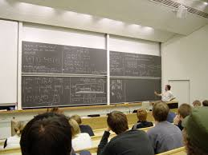
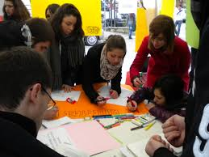
Vertical specialization
Separation between execution and monitoring activities
It is used to define how an activity has to be executed
It is used when activities are highly specialized
Who is in charge of monitoring activities executed?
Managers, throuh direct supervision
Analysists, through standardization

Slide 17
Tasks enlargement
Tasks’ specialization lead to problems of
Communication
Coordination
Motivation (operating core)
How to deal with these problems?
TASKS ENLARGMENT
The worker carries out activities and has control over them
The worker carries out different activities related to the output
Horizontally
Vertically

Slide 18
Tasks specialization within the organization
HORIZONTAL SPECIALIZATION
High
Low
Not-qualified job
(operating core and support staff)
Low managerial positions
High
VERTICAL
SPECIALIZATION
Professional job (operating core and support staff)
All managerial positions
Low

Slide 19
Individual position
Individual position
Specialization of tasks
Formalization of behaviour
Training and indoctrination

Slide 20
Formalization of behaviour (1/3)
Standardization of processes to decrease workers’ discretionality
Processes could be standardized:
By describing the details the activities
By specifying the work processes
Through rules
In all of the three cases the behaviour is formalized and regulated

Slide 21
Formalization of behaviour (2/3)
Why companies use the formalization of behavior?
To coordinate activities
To improve efficiency
To ensure an impartial behaviour with respect to clients
Criticalities:
Resistance to change
Increase of absenteeism, turnover and strikes

Slide 22
Individual position
Individual position
Specialization of tasks
Formalization of behaviour
Training and indoctrination

Slide 23
Training and indoctrination
Definition of required skills and capabilities to carry out a specific activity
Definition of recruitment procedures or the definition of training program to develop these skills and capabilities
Training
Learning and teaching
Key role for professional activities
Standardization of skills
Indoctrination
The process of socialization of people working in an organization
It starts before the recruitment and it continues during the working relationship
It is particularly relevant when activities are highly variables

Slide 24
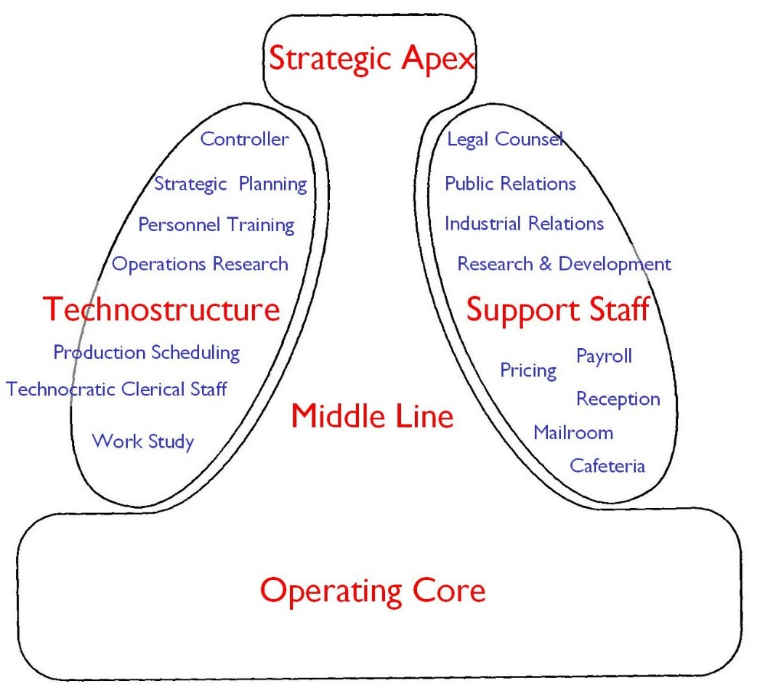
Specialization, formalization of behaviour and Training and indoctrination

