Slide 1
THE DESIGN OF THE MACROSTRUCTURE
Martina Dal Molin
mdalmolin@liuc.it
AY 2018/2019

Slide 2
The parameters of organizational design
Decision-making system
Side-markers connection
Macro-structure
Individual position

Slide 3
Agenda
Introduction
Units grouping
Units’ dimension

Slide 4
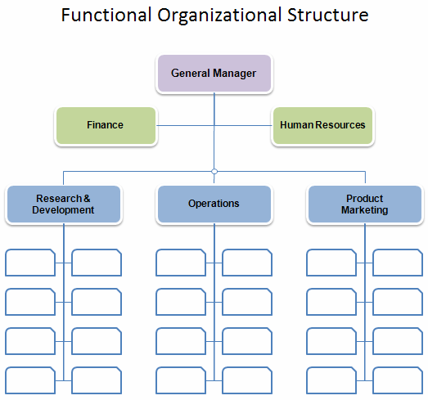
Introduction (1/2)
Individual positions are defined according to specialization, formalization, training and indoctrination.
How to group these individual positions?
What should be the dimension of these units?

Slide 5
Introduction (2/2)
The process of creating units has two effects on the organzation:
- formal authority
- hierarchy
It is a progressive process – bottom up:
Organizational mission and objectives tasks and activities to be accomplished tasks are translated into positions (top-down)
Individual positions are organized into units (i.e. the macrostructure) (bottom-up)
Allocation of the decision-making power

Slide 6
UNITS GROUPING
AY 2018/2019

Slide 7
Units grouping (1/2)
The creation of units favors the introduction of coordination inside the organization:
COMMON SUPERVISION
COMMON RESOURCES
COMMON PERFORMANCE INDICATORS
MUTUAL ADJUSTEMENT

Slide 8
Units grouping (2/2)
WHICH COORDINATION MECHANISMS?
DIRECT SUPERVISION
OUTPUT STANDARDIZATION
MUTUAL ADJUSTEMENT

Slide 9
How to group: basis for units
There are six methods to create or group organizational units:
Knowledge, ability and skills
Work processes and functions
Time
Output
Clients
Geographical positions

Slide 10
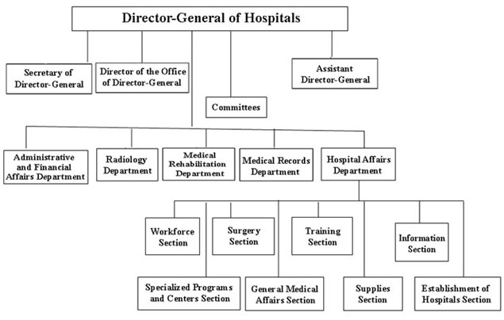
Knowledge ability and skills
ABILITIES AND SKILLS OF PEOPLE

Slide 11
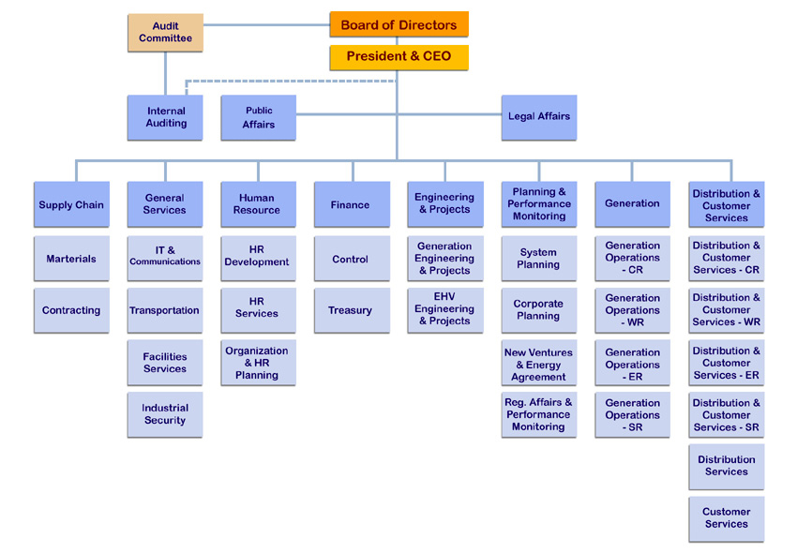
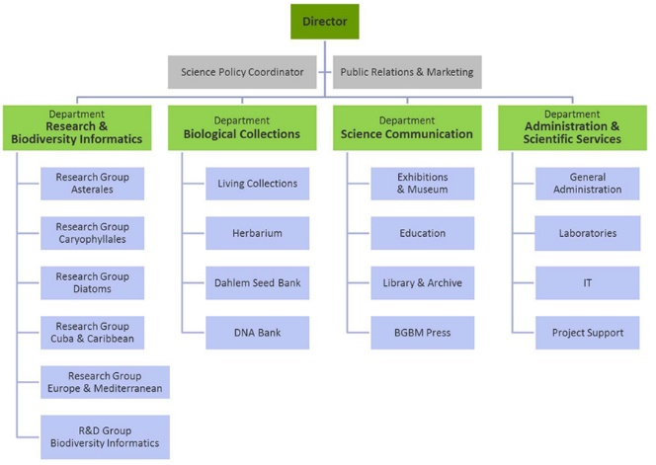
Work processes and functions
PROCESS OR ACTIVITIES CARRIED OUT BY PEOPLE

Slide 12
Time
WHEN THE ACTIVITY ID CARRIED OUT

Slide 13
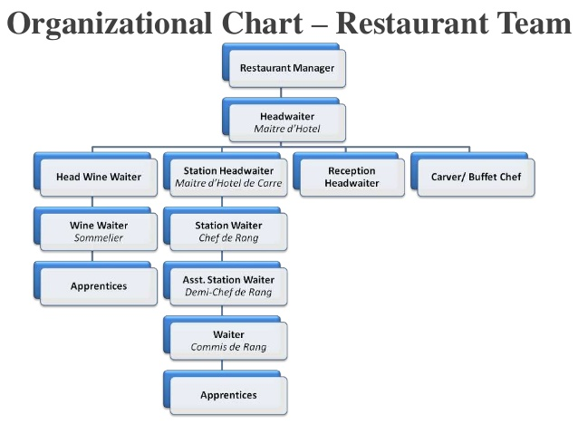
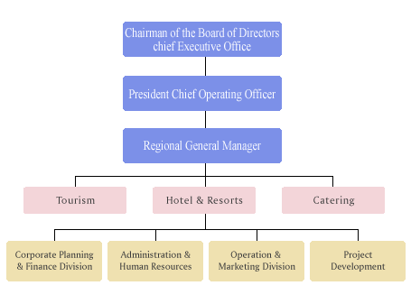
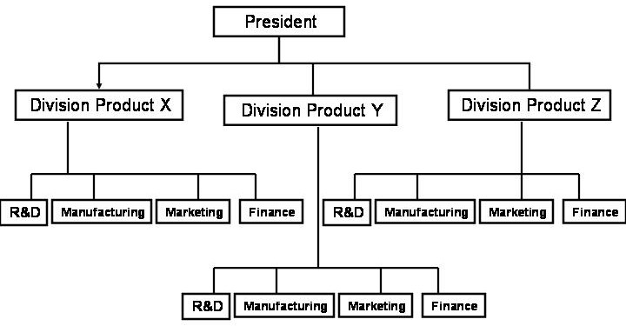
Output
OUTPUT OR SERVICES PROVIDED BY EACH UNIT

Slide 14
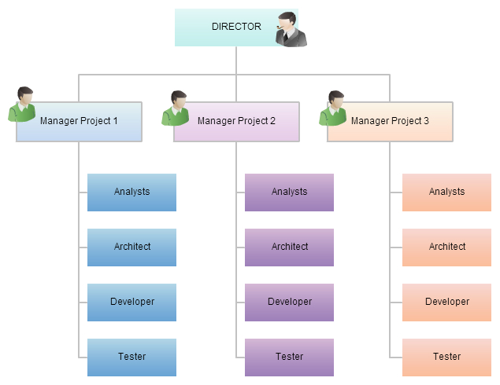
Clients
TYPE(S) OF CLIENT

Slide 15
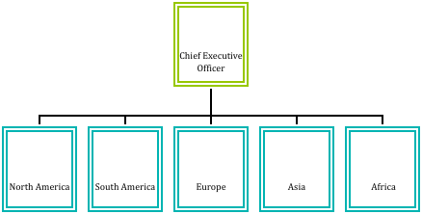
Geographical location
GEOGRAPHICAL LOCATION IN WHICH THE ORGANIZATION WORKS

Slide 16
Units grouping: two macro-categories
There are six methods to create or group organizational units:
Knowledge, ability and skills
Work processes and functions
Time
Output
Clients
Geographical positions
FUNCTIONAL GROUPING
MARKET GROUPING

Slide 17
Market grouping and functional grouping
FUNCTIONAL GROUPING
MARKET GROUPING
Functions, knowledge, processes used by the organization to realize products and to deliver services
Characteristics of the markets in which the organization works

Slide 18
Functional grouping
Focus on:
Work flow processes interdependencies
Economies of scale
Weaknesses
Focus on processes and not on organizational objectives
Need to find a coordination mechanism
Burocracy:
High fomalization
More structured strategic apex
Strong hierarchy

Slide 19
Market grouping
Focus on:
(more or less) independent units
Mutual adjustment and direct supervision are «inside» each unit
Less formalization
Coordination between specialized functions
Fexibility
Weaknesses
Higher need for resources
Not able to use economies of scale

Slide 20
DEFINING UNITS’ DIMENSION
AY 2018/2019

Slide 21
Stating the problem
Addressing the problem of the dimension means answering the following questions:
How many positions should be grouped?
How many people should be controlled by the same manager?
How should be the extent of mangers’ control?
Which form should the organization have? Vertical or flt and enlarged?
IT IS NOT ONLY A PROBLEM OF CONTROL, BECAUSE OTHER FACTORS AFFECT THE CHOICE OF THE UNITS’ DIMENSION

Slide 22
Functional grouping
The 5 coordination mechanisms are, more or less, interchangeable
therefore
Variations on units’ dimension by looking at the coordination mechanisms employed
Two propositions

Slide 23
Proposition 1: Standardization
«The higher is the standardization, the higher is the dimension of the unit»
If processes are standardized, less managerial direct supervision is required and, therefore, the unit could be bigger
If capabilities are standardized, and the higher is the training of workers, less managerial direct supervision is required and, therefore, the unit could be bigger
If outputs are standardized, less managerial direct supervision is required with respect to the outputs control and, therefore, the unit could be bigger

Slide 24
Proposition 2: Mutual adjustment
«The higher is the mutual adjustment, the lower is the dimension of the unit»
If tasks are interdependent, workers need frequent contacts with the manager, who must have time to control workers and to speak with workers
If tasks are interdependent and they need mutual adjustement, workers should establish face-to-face contact

Slide 25
Higher units’ dimension
Which factors favor a higher units’ dimension?
Standardization
Similarity of tasks and activities
Need for autonomy for workers

Slide 26
Lower units’ dimension
Which factors favor a lower units’ dimension?
Need for direct supervision
Need for mutual adjustment
The manager has control over different activities
Workers need help and counselling from the manager frequently

