Slide 1
Strategy Analysis and organization design
Martina Dal Molin
mdalmolin@liuc.it
AY 2018/2019

Slide 2
A basic framework for strategy analysis
THE ENVIRONMENT
Competitors
Customers
Supplier
THE COMPANY
Goals and values
Resources and capabilities
Structure and systems
STRATEGY
Strategy may be seen as the way in which a company allocates its resources to achieve its goals

Slide 3
Strategy formulation (1/4)
Success = creating value for owners – focus on financial performance
Focusing on financial performance is it enough to develop strategy?
Is it not sufficient in creating links among the different part of the organization and of the organization with the external environment
Developing a sense of mission to the pursuit of profit is one of the main challenge for strategic management
AY 2018/2019

Slide 4
Strategy formulation (2/4)
1° step in strategy formulation: appraising the current performance of an organization
2° step: diagnosing the source of any performance problems
3° step: implementing corrective actions
4° step: implementing performance standard to drive organization performance and to monitor the related achievement over a period of time
5° step: translating corporate performance standards into more specific goals down all the level of the organization
AY 2018/2019

Slide 5
Strategy formulation (3/4)
It is necessary to link the overall goal of value maximization to strategic and operational target to be sure that the achievement of financial goal in not at the expense of long-term strategic position of the company
BALANCED SCORECARD
AY 2018/2019

Slide 6
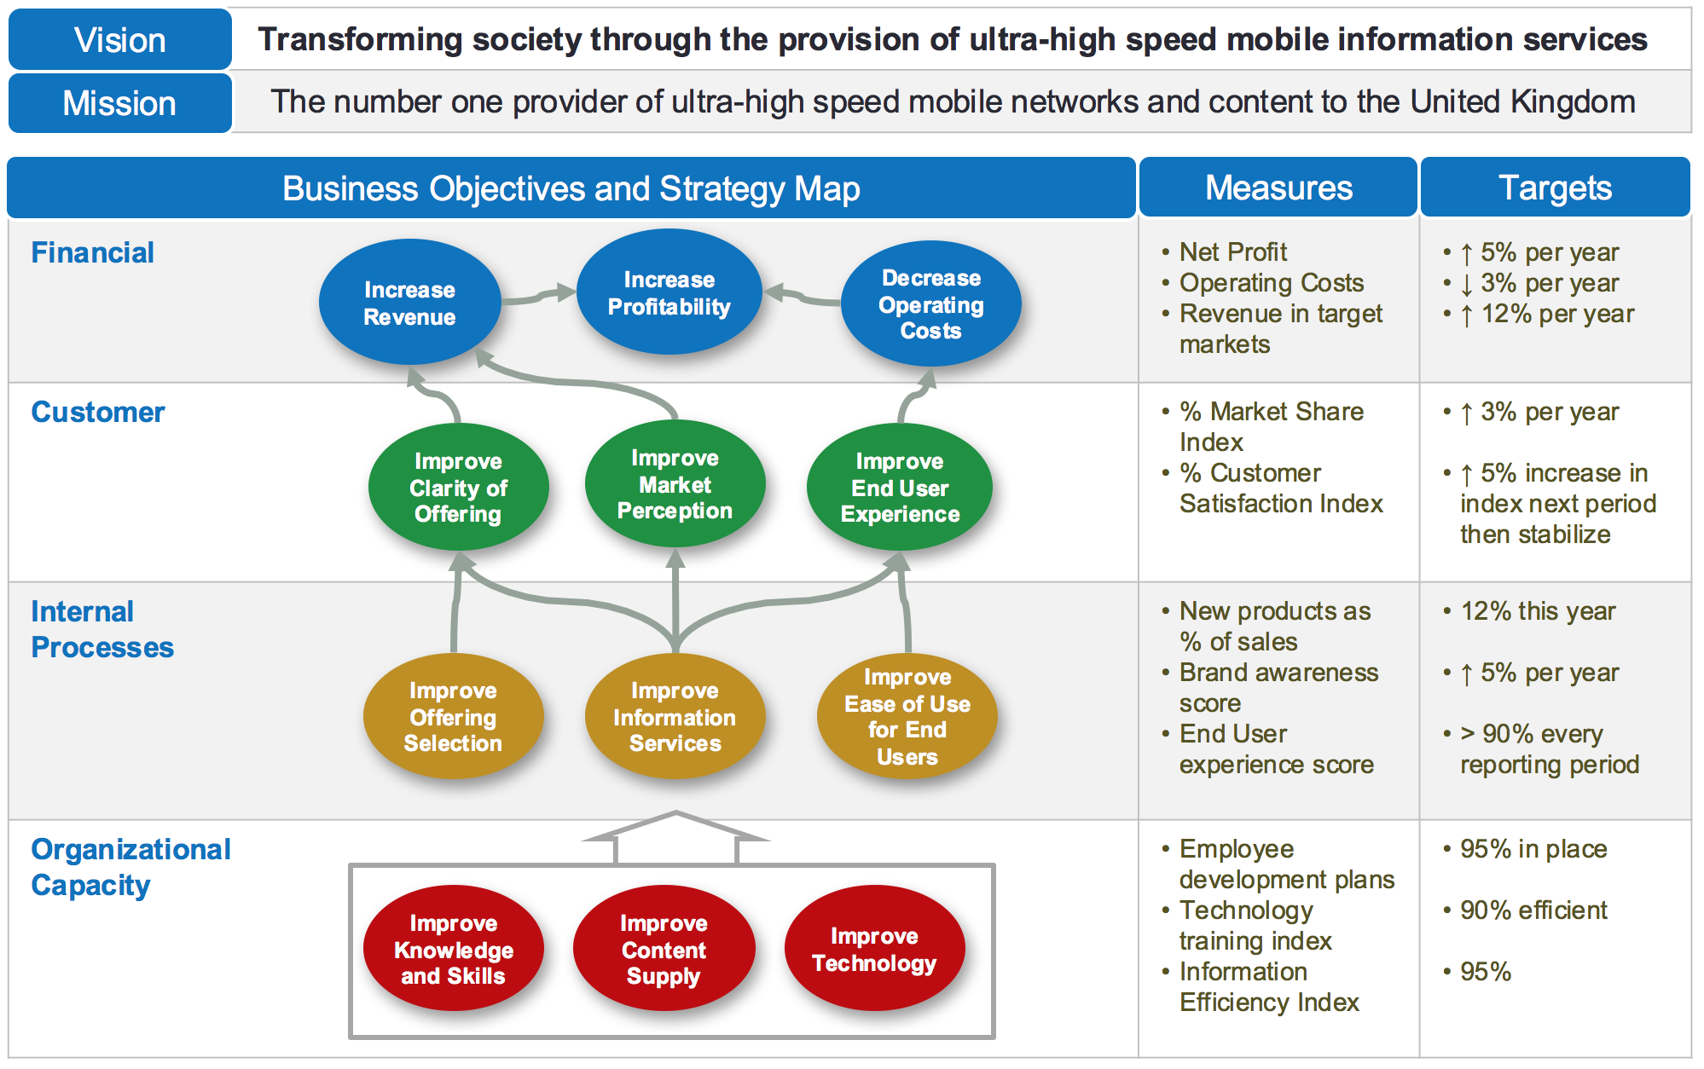
Strategy formulation (4/4)
AY 2018/2019

Slide 7
Requirements of performance measures: 4 questions to be answered
How do we look to shareholders?
How do customers see us?
What must we excel at?
Can we continue to improve and create value?
AY 2018/2019

Slide 8
Values, Vision, Mission
The dedication of solely to profit is unlikely to provide the motivation needed to ensure the success of a business
All companies have organizational VALUES that create a sense «being part of», of who they are, what they represent, what they want to achieve and how they intend to achieve it
VISION is an articulation of what the company whises to become or where it seeks to go
MISSION is related to the corporate purpose and it generally defines the area of business
AY 2018/2019

Slide 9
Vision
Vision is a picture of what the firm wants to be and, in broad terms, what it wants to ultimately achieve
a vision statement points the firm in the direction of where it would eventually like to be in the years to come
Vision is “big picture” thinking with passion that helps people feel what they are supposed to be doing in the organization
As a firm’s most important and prominent strategic leader, the CEO is responsible for working with others to form the firm’s vision. Experience shows that the most effective vision statement results when the CEO involves a host of stakeholders (e.g., other top-level managers, employees working in different parts of the organization, suppliers, and customers) to develop it.
AY 2018/2019

Slide 10
Mission
A mission specifies the business or businesses in which the firm intends to compete and the customers it intends to serve
The firm’s mission is more concrete than its vision. However, like the vision, a mission should establish a firm’s individuality and should be inspiring and relevant to all stakeholders
The mission deals more directly with product markets and customers, and middle- and first-level managers and other employees have more direct contact with customers and the markets in which they are served
Vision and mission are critical aspects of the strategic inputs it requires to engage in strategic actions as the foundation for achieving strategic competitiveness and earning above-average returns.
AY 2018/2019

Slide 11
Vision and Mission Statement: some examples
“Our mission is to be one of the world’s leading producers and providers of entertainment and information. Using our portfolio of brands to differentiate our content, services and consumer products, we seek to develop the most creative, innovative and profitable entertainment experiences and related products in the world”
Walt Disney
AY 2018/2019

Slide 12
Vision and Mission Statement: some examples
“To be our customers' favorite place and way to eat and drink”
Mc Donald
AY 2018/2019

Slide 13
Vision and Mission Statement: some examples
“To create a better everyday life for the many people”, this is the IKEA vision. Our business idea is “to offer a wide range of well-designed, functional home furnishing products at prices so low that as many people as possible will be able to afford them”
Ikea
AY 2018/2019

Slide 14
Vision and Mission Statement: some examples
“Bring the world closer together”
Facebook
AY 2018/2019

Slide 15
Vision and Mission Statement: some examples
“Looking good should do good too. That's what our sustainability is all about — making sure our customers wear our products with pride, and staying conscious of all our actions.”
H&M
AY 2018/2019

Slide 16
Why and to whom mission and vision are relevant?
STAKEHOLDERS
Stakeholders are the individuals and groups who can affect the firm’s vision and mission, are affected by the strategic outcomes achieved, and have enforceable claims on the firm’s performance
Stakeholders continue to support an organization when its performance meets or exceeds their expectations
AY 2018/2019

Slide 17
Classification of stakeholders
To manage the different objectives
MARKET STAKEHOLDERS
PRODUCT MARKET STAKEHOLDERS
ORGANIZATIONAL STAKEHOLDERS
all of a firm’s employees, including both nonmanagerial and managerial personnel
shareholders and the major suppliers of a firm’s capital
the firm’s primary customers, suppliers, host communities, and unions representing the workforce

Slide 18
Stakeholders and related expectations
Capital market stakeholders – they expect a firm to preserve and enhance the wealth they have entrusted to it. The returns they expect are commensurate with the degree of risk accepted with those investments (i.e., lower returns are expected with low-risk investments while higher returns are expected with high-risk investments).
Product market stakeholders – they are satisfied when a firm’s profit margin reflects at least a balance between the returns to capital market stakeholders (i.e., the returns lenders and shareholders will accept and still retain their interests in the firm) and the returns in which they share.
Organizational stakeholders – they expect the firm to provide a dynamic, stimulating, and rewarding work environment. As employees, we are usually satisfied working for a company that is growing and actively developing our skills, especially those skills required to be effective team members and to meet or exceed global work standards.
AY 2018/2019

Slide 19
Exercise
AY 2018/2019

