Slide 1
Strategy Analysis and organization design
Martina Dal Molin
mdalmolin@liuc.it
AY 2018/2019

Slide 2
Canvas Business Model and BCG Matrix
AY 2018/2019

Slide 3
Canvas Business Model
The Business Model allows us to understand the strategic position of the company based on its business idea
It is a strategic tool for “business design”
The more the output portfolio is differentiated, the more the business model is complex

Slide 4
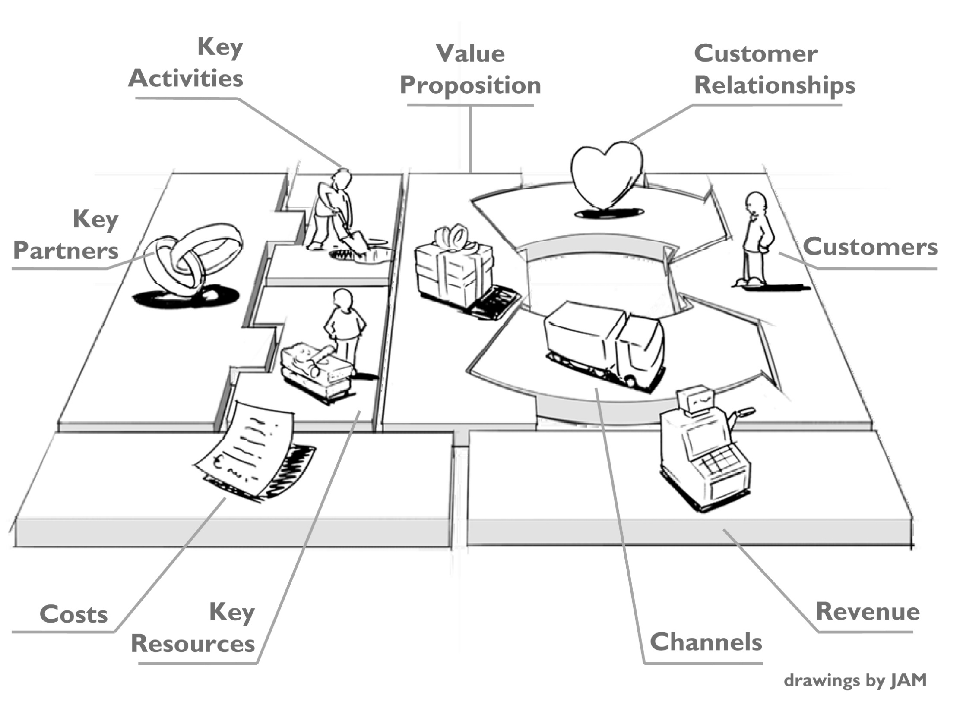

Slide 5
«CUSTOMERS»:
It describes the segments of clients who would buy the products
It is possibile to identify homogeneous groups of client based on thei needs and behaviour (i.e. different needs – different values)
Different clients, different channels of communication
Different clients, different «reveneues» generated

Slide 6
«VALUE PROPOSITION»:
Products or services representing a need or value for a specific group of customer
«Why should clients buy our product?»
Some examples: introducing an innovation (e.g. smartphone), improving existing products, lowering the price, improving products’ design or performance

Slide 7
«CHANNELS»:
«How is it possibile to catch up segment of clients?»
Typically, direct of indirect clients or both

Slide 8
«CUSTOMER RELATIONSHIPS»:
Personal assistance
Self-service (indirect relationship with clients)
Automatic services (e.g. on line banking)
Community

Slide 9
«REVENUES»:
How to define a sustainable business model?
Typically related to the payment system: «single price», «distributed and stable fees», «registration fee», leasing, licenses, …..

Slide 10
«KEY RESOURCES»:
What resources do we need to make our business work?
Physical resources (e.g. stores), intangible (e.g. know-how, copyright, patents, ..)
Human resources and capabilities (e.g. specific skills)
Financial

Slide 11
«KEY ACTIVITIES»:
i.e. strategic activities that must be implemented/realized to make your business work
Productive activities (e.g. for manufacturing companies)
Problem-solving activities (e.g. in case of company focused on the provision of services
Network/platform development

Slide 12
«KEY PARTNERS»:
i.e. fundamental suppliers and other partners to make the business work
Why we need partners? Some ideas:
To create alliances, reducing competition
To generate economies of scales
To make a more efficient use of resources
To attract new clients

Slide 13
«COSTS»:
It is the last item of the Canvas to be defined
It refers to the whole structure of costs:
Fixed costs
Variable costs
Economies of scales
Low cost vs high costs

Slide 14
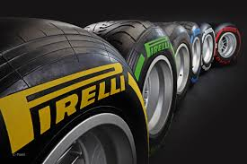
The output portfolio
FOCALIZED OUTPUT PORTFOLIO
DIFFERENTIATED OUTPUT PORTFOLIO

Slide 15
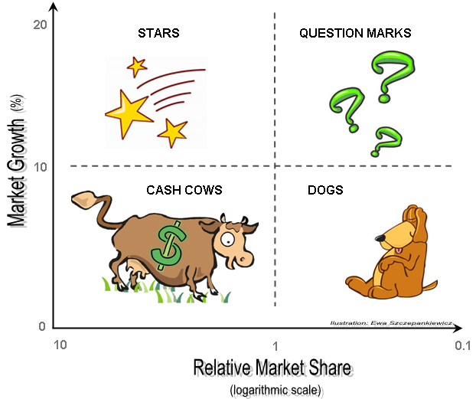
The «optimal» output portfolio: BCG Matrix
High market share compared to that of the leader
High market growth
Low market share compared to that of the leader
High market growth
low market share compared to that of the leader
Low market growth
High market share compared to that of the leader
Low market growth

Slide 16
The «optimal» output portfolio: BCG Matrix
Aim: to support the identification of the optimal output portfolio
Which implications for strategic decision?
Question mark
Investment strategy to transform question mark into star
Disinvestment strategy
Star
The company has competitive advantage and these products need particular attention and they must be protected by the attacks of competitors
Cash Cow
They ensure liquidity to the company and low need for investment
Dog
They are considered as an “obstruction” for the company
Disinvestment strategy or investment strategy to change it

Slide 17
EXERCISE
Choose a company (e.g. Facebook, Twitter, H&M, Fiat) and apply the Canvas Business Model
AY 2018/2019

