Slide 1
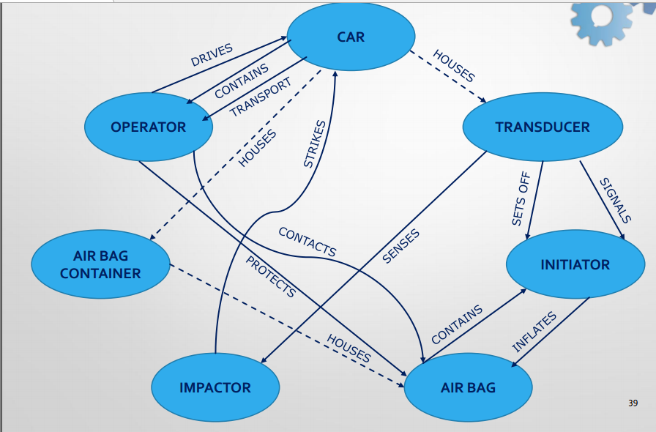
Title of the product (Company)
Team Presentation
Business Intelligence
TRIZ
Your text would go here.
Your text would go here.
Your text would go here.
Your text would go here.
Product Presentation
Your text would go here.
Technological Intelligence
Price & Place
Your text would go here.
Your text would go here.
Team Name
Your text would go here.

