Slide 1
3. Il contesto in cui saremo chiamati a «vivere»
Prof. Dipak R. Pant

Slide 2
3. Il contesto in cui saremo chiamati a crescere
‘Sustainability’, the term and the meanings
English: to sustain (v.) - from Middle Age English sustenen - from old French sustenir (v.) – from old Italian – sustinēre (v.) from Latin sub (“below”) + tenere (“to hold”) - subtenere = “holding from below”
(Mexican Spanish: Sostén = bra (n. Eng.) / reggiseno (n. Ital.)
sus·tain'a·bil'i·ty (n.), sus·tain'a·ble (adj.), sus·tain'er (n.), sus·tain'ment (n.)
To keep in existence; to maintain.
To supply with necessities or nourishment; provide for.
To support from below; keep from falling or sinking.
To support the spirits, vitality, or resolution of; encourage.
To bear up; withstand., to experience or suffer.
To prove or corroborate; confirm.
To keep up competently.
Conceptual implications of the etymology:
‘Sustainability’ is NOT natural (automatic).
CONSCIOUS and MEASURED EFFORTS are required to sustain any system.
‘Sustainability’ is NOT perfection; it is a dynamic quest to preclude the disruption/discontinuity of a system.
Sustainable economy:
Controlled transformation and management of change in an economic system, with maximum concern for the needs of present with minimization of the costs and burdens for future.

Slide 3
3. Il contesto in cui saremo chiamati a crescere
‘Sustainability’, the triple bottom-line concept
Economic and financial viability
Sustainability
Social and human security
Environmental and landscape quality

Slide 4
3. Il contesto in cui saremo chiamati a crescere
Institutionalization of ‘sustainability’
The Report of the UN-sponsored Brundtland Commission.The Report was welcomed by the adopted by General Assembly of the United Nations in its resolution 42/187[4] and published as Our Common Future by Oxford University Press in 1987 : “Sustainable development meets the needs of the present without compromising the ability of future generations to meet their own needs”.
In 1999, Global Reporting Initiative, Amsterdam-based international NGO, had promoted “the triple E bottom-line” in its Sustainability Reporting Guidelines.
In 2001, the EU’s European Commission issued a Green Paper in which it provided a charter for sustainable development that emphasized on the optimal mediation of the economic, environmental and social needs.
This became the essential basis for all political and economic discourse on ‘sustainability’ and ‘sustainable development’.
‘Sustainability’ is defined as having “triple E bottom-line”:
Environment (natural resources, ecosystems)
Economy (productivity, prosperity)
Equity (fair distribution of income and opportunities, social justice).

Slide 5
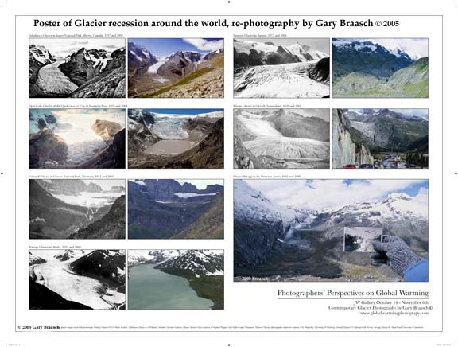
3. Il contesto in cui saremo chiamati a crescere
How ‘sustainability’ became such an urgent and important issue in the recent years: the perception of climate change and looming disasters.

Slide 6
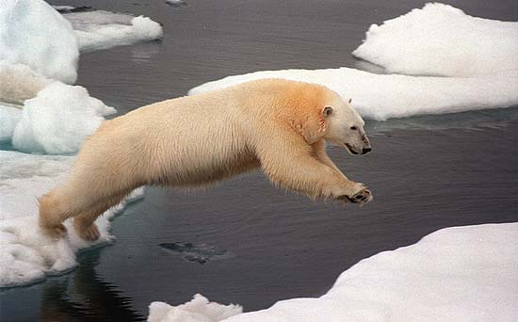
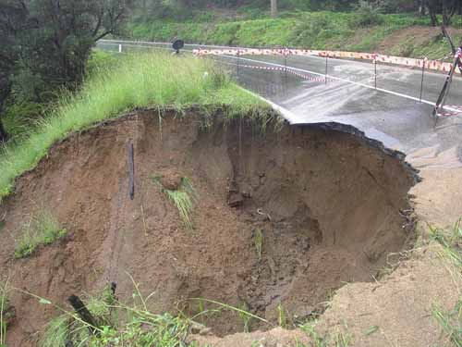
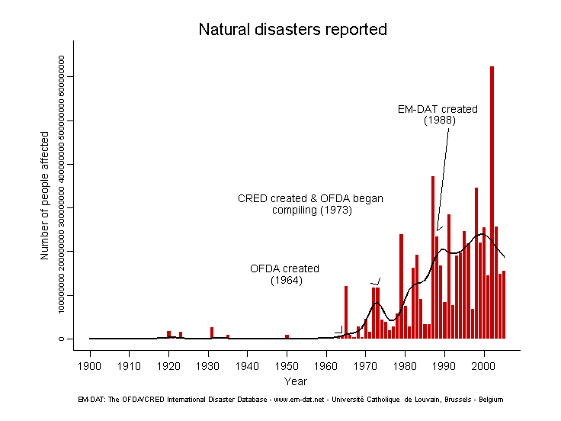
Climate uncertainity and environmental change pose serious threat to:
Eco-systems and landscapes
Resource-base
Human security
Infrastructures
Global order and peace
Source: The OFDA/CRED International Disaster Database, 2007

Slide 7
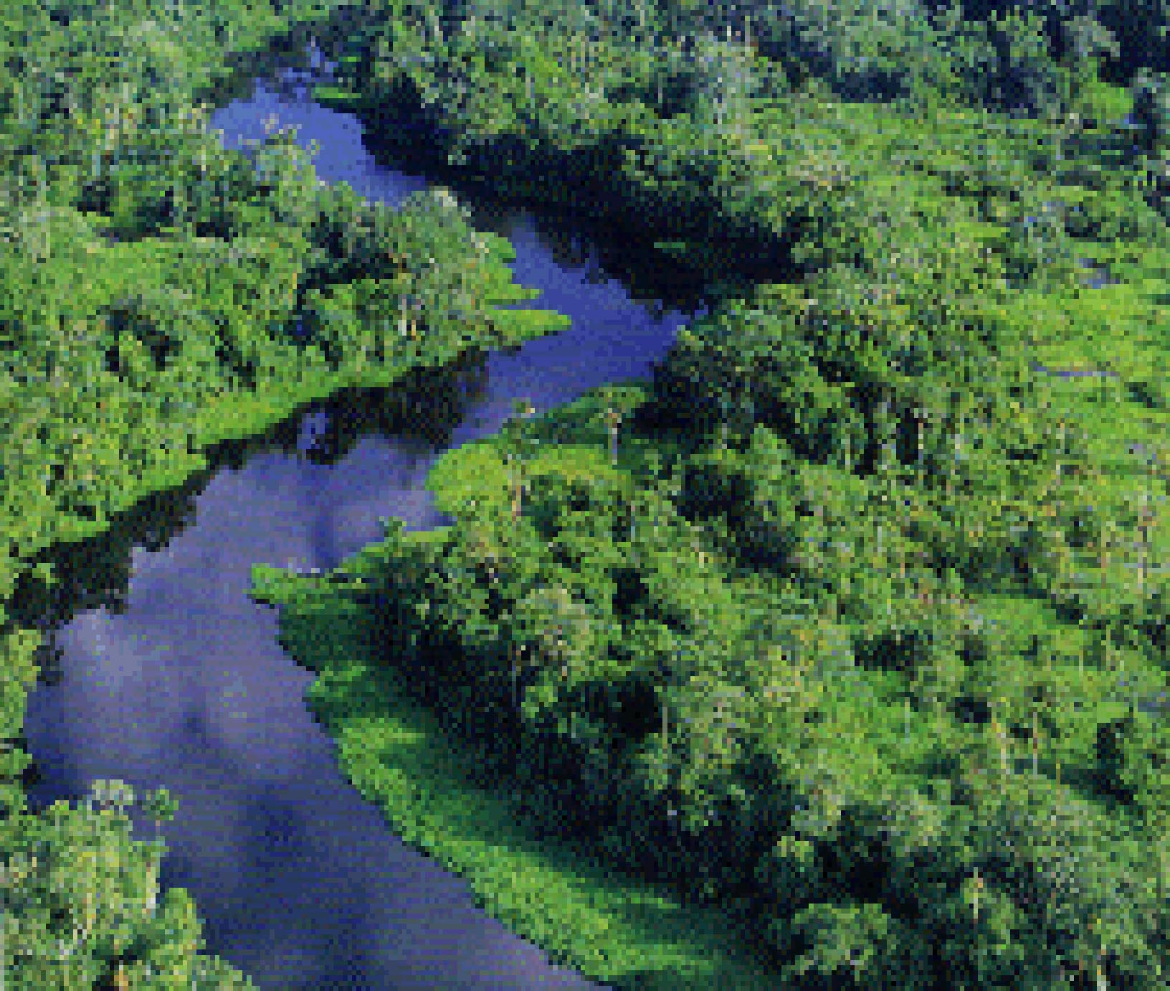
Reality experience: frequency and intensity of rapid and
discontinuous changes in weather/climate.
Climate science: nothing certain (!?!?)
Climate uncertainty and environmental change, what are the options?
Only two real options are available
Being serious about the reduction of human vulnerability - principle of precaution, preventive measures to control the risk and contain the damage, fostering collective resilience.
Choosing durability, fairness and beauty – strive for sustainability

Slide 8
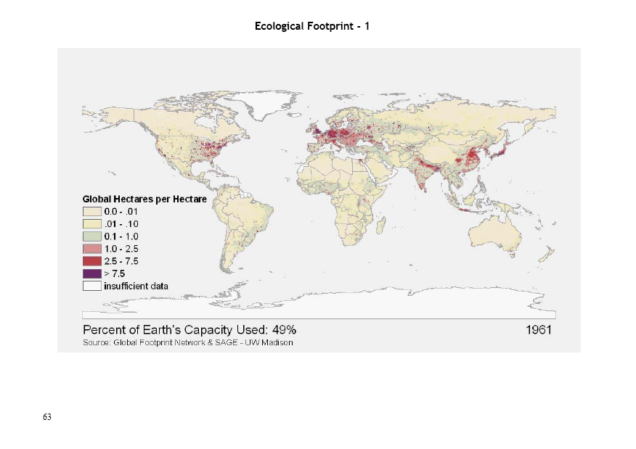

Slide 9
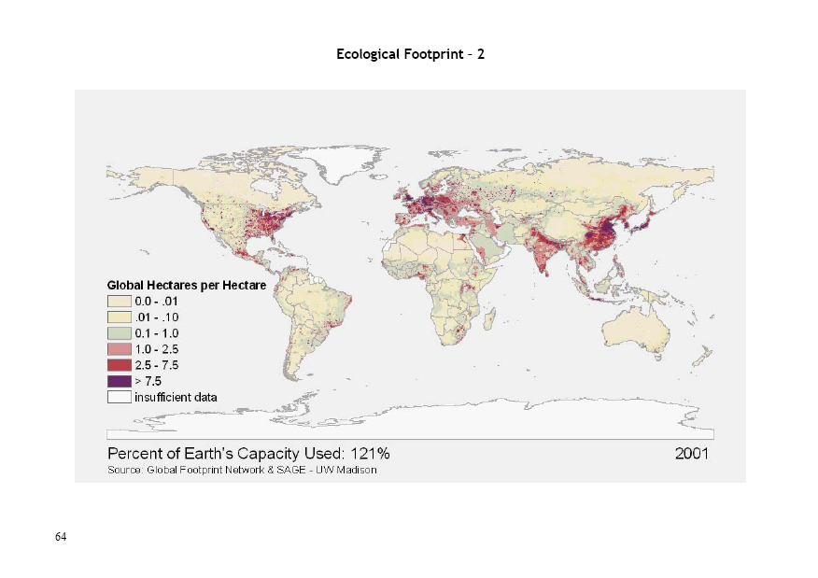

Slide 10
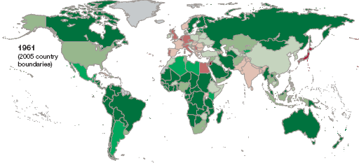
Ecological creditors and debtors, 1961 - 2005
Source: Global Footprint Network, 2009

Slide 11
The factors determing sustainability/un-sustainability
Human (socio-economic) and environmental impact
Environmental impact per unit of resource used
Number of people
Resource use per person
=
X
X
Population size and density
Livelihoods and businesses, afflunece, values and norms, regulation/compliance, life-style, consumption
Policy, Technology, Management

Slide 12
Relationship between “sustainability” and profit margin
Sustainable products and processes
Sustainable Corporation
Convergence of all stakeholders to ‘sustainability’
Reduced costs of waste management
Higher resources productivity
Reduced liability costs
Higher market share due to the ethical preference of stakeholders and clients
Economies of scale advantages
Lower costs
Increased value
Better market share
Higher revenues
Higher profit margins

Slide 13
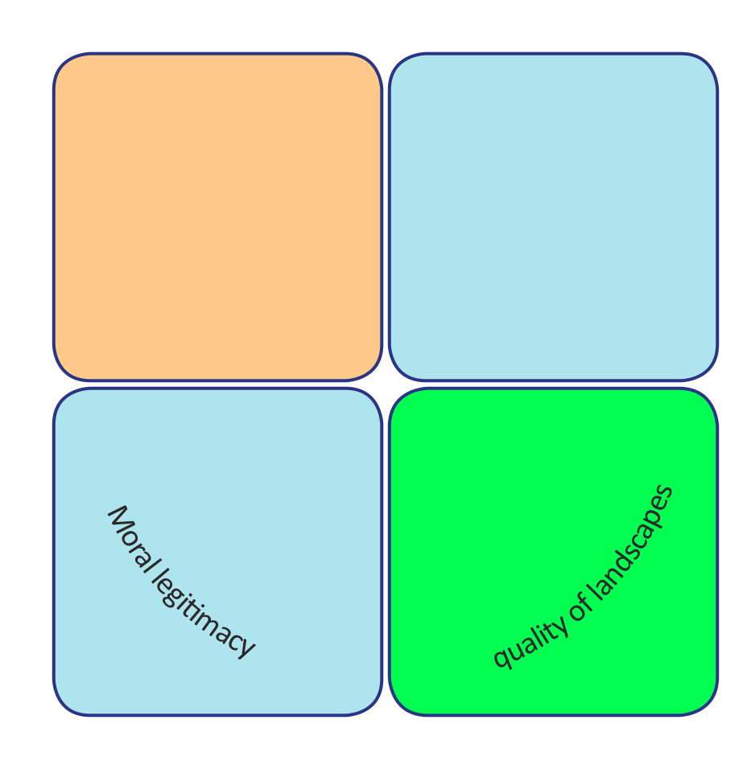
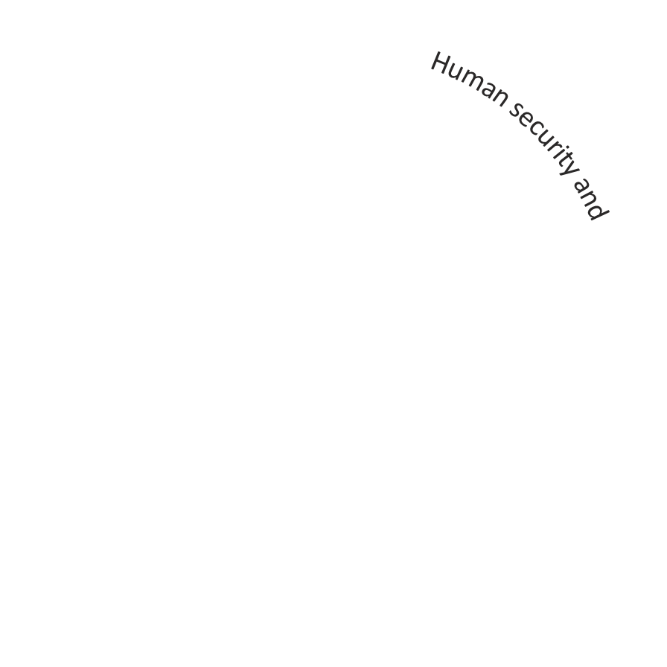
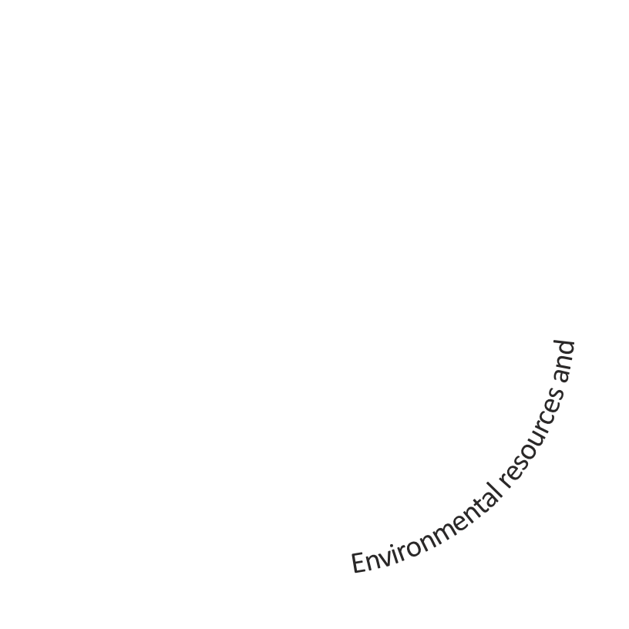
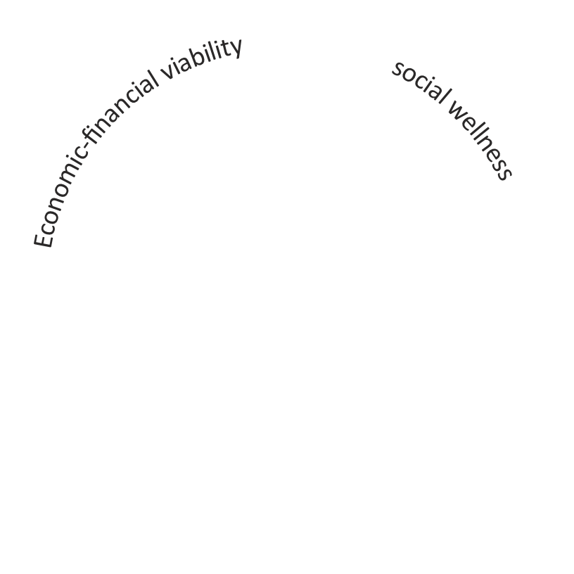

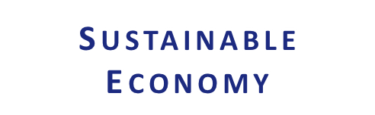
‘Sustainability’, the integral concept

Slide 14
