Slide 1
Asset Classes and Financial Instruments
2
Bodie, Kane, and Marcus
Essentials of Investments Eleventh Edition

Slide 2
2.1 Asset Classes
Asset Classes
Fixed Income
Equity
Derivatives

Slide 3
2.1 Fixed Income: Money Markets
Asset Classes
Equity
Derivatives
Fixed Income
Money Markets
Capital Markets

Slide 4
2.1 The Money Market
Subsector of the fixed-income market
Short-term
Liquid
Low risk
Often have large denominations

Slide 5
2.1 The Money Market: Treasury Bills
 | Treasury Bills
Issuer: | Federal Government
Denomination: | Commonly $10,000; $1,000
Maturity: | 4, 13, 26 or 52 Weeks
Liquidity: | High
Default Risk: | None
Interest Type: | Discount
Taxation: | Owed: Federal; Exempt: State, Local

Slide 6
2.1 The Money Market: Treasury Bills

Slide 7
2.1 The Money Market: Treasury Bills
Bank Discount Rate (T-bill quotes)
Example: 90-day T-bill, P = $9,875
− P
x
r
=
$10,000
360
$10,000 = Par
BD
$10,000
n
r_{BD} = bank discount rate
P = market price of the T-bill
n = number of days to maturity
$10,000
-
$9,875
360
r
=
×
=
5%
BD
90
$10,000

Slide 8
2.1 The Money Market: Certificates of Deposit (CDs)
 | Certificates of Deposit
Issuer: | Depository Institutions
Denomination: | Any, $100,000 or more marketable
Maturity: | Varies, Typically 14-day Minimum
Liquidity: | High for CDs <3 months, if marketable
Default Risk: | First $250,000 FDIC insured
Interest Type: | Add on
Taxation: | Owed: Federal, State, Local

Slide 9
Figure 2.2 Spreads on CDs and Treasury Bills

Slide 10
2.1 The Money Market: Commercial Paper
 | Certificates of Deposit
Issuer: | Large creditworthy corps.; financial institutions
Denomination: | Minimum $100,000
Maturity: | Maximum 270 days, usually 1-2 months
Liquidity: | CP < 3 months liquid if marketable
Default Risk: | Unsecured, rated, mostly high quality
Interest Type: | Discount
Taxation: | Owed: Federal, State, Local
New Innovation: Asset-backed commercial paper

Slide 11
2.1 The Money Market: Instruments
Bankers’ Acceptances
Purchaser authorizes a bank to pay a seller for goods at later date (time draft)
When purchaser’s bank “accepts” draft, it becomes contingent liability of the bank ( and marketable)
Eurodollars
Dollar-denominated time deposits held outside U.S.
Pay higher interest rate than U.S. deposits

Slide 12
2.1 The Money Market: Instruments
Federal Funds
Trading in reserves held at the Federal Reserve *
Key interest rate for economy
LIBOR (London Interbank Offer Rate)
Rate at which large banks in London (and elsewhere) lend to each other
Base rate for many loans and derivatives
* Depository institutions must maintain deposits with Federal Reserve Bank

Slide 13
2.1 The Money Market: Repurchase Agreements
Repurchase Agreements (RPs)
Short-term sale of securities + promise to repurchase at higher price
RP is a collateralized loan
Many RPs are overnight
“Term” RPs may have a 1-month maturity
Reverse RPs
Lending money; obtaining security title as collateral
“Haircuts” may be required
Notes:
Think: What is the collateral of an RP?

Slide 14
2.1 The Money Market: Brokers’ Calls
Brokers’ Calls
Call money rate applies for investors buying stock on margin
Loan may be “called in” by broker

Slide 15
2.1 The Money Market: Credit Crisis
MMMF and the Credit Crisis of 2008
2005-2008: Money market mutual funds (MMMFs) grew 88%
MMMFs had their own crisis in 2008: Lehman Brothers
Reserve Primary Fund “broke the buck”
Run on money market funds ensued
U.S. Treasury temporarily offered to insure all money funds

Slide 16
2.1 The Money Market: Instrument Yields
Yields on money market instruments not always directly comparable
Factors influencing “quoted” yields
Par value vs. investment value
360 vs. 365 days assumed in a year (366 leap year)
Simple vs. compound interest

Slide 17
2.1 The Money Market: Bond Equivalent Yield
Bond Equivalent Yield
Can’t compare T-bill directly to bond
360 vs. 365 days
Return is figured in par vs. price paid
Adjust bank discount rate to make it comparable

Slide 18
2.1 The Money Market: Bond Equivalent Yield
Bond Equivalent Yield
Example Using Sample T-Bill
P = price of the T-bill
n = number of days to maturity
r_{BD} = 5%
P
10,000
−
×
365
r
=
BEY
P
n
10,000
−
9,875
×
365
r
=
BEY
9,875
90
r_{BEY} = .0127 × 4.0556 = .0513 = 5.13%

Slide 19
2.1 The Money Market: Effective Annual Yield
Effective Annual Yield
Example Using Sample T-Bill
Compare:
r_{BD} = 5%
r_{BEY} = 5.13%
r_{EAY} = 5.23%
r_{EAY} =
P = price of the T-bill
n = number of days to maturity
r_{EAY} =
r_{EAY} = 5.23%

Slide 20
2.1 The Money Market: Instrument Yield
Money Market Instrument | Instrument Yield
Treasury Bills | Discount
Certificates of Deposit | Bond Equivalent Yield
Commercial Paper | Discount
Bankers’ Acceptances | Discount
Eurodollars | Bond Equivalent Yield
Federal Funds | Bond Equivalent Yield
Repurchase Agreements | Discount
Reverse RPs | Discount

Slide 21
2.2 Fixed Income: Capital (Bond) Markets
Asset Classes
Equity
Derivatives
Fixed Income
Money Markets
Capital Markets

Slide 22
2.2 The Bond Market
Capital Market—Fixed-Income Instruments
Government Issues—U.S. Treasury Bonds and Notes
Bonds vs. notes
Denomination
Interest type
Risk? Taxation?
Treasury Inflation Protected Securities (TIPS)
Principal adjusted for changes in the Consumer Price Index
Marked with a trailing “i” in quote sheets

Slide 23
Figure 2.3 Listing of Treasury Issues

Slide 24
2.2 The Bond Market: Agency Issues
Agency issues (federal government)
Most are home-mortgage-related: FNMA, FHLMC, GNMA, Federal Home Loan Banks
Risks of these securities?
Implied backing by the government
In September 2008, federal government took over FNMA and FHLMC

Slide 25
2.2 The Bond Market: Municipal Bonds
Municipal bonds
Issuer?
Differ from treasuries and agencies?
Risk?
G.O. vs. revenue
Industrial development
Taxation?
r_{tax exempt} = r_{taxable} x (1 – Tax rate)
r = Interest rate

Slide 26
Table 2.2 Equivalent Taxable Yields
 | Tax-Exempt Yield
Marginal Tax Rate | 1% | 2% | 3% | 4% | 5%
20% | 1.25% | 2.50% | 3.75% | 5.00% | 6.25%
30 | 1.43 | 2.86 | 4.29 | 5.71 | 7.14
40 | 1.67 | 3.33 | 5.00 | 6.67 | 8.33
50 | 2.00 | 4.00 | 6.00 | 8.00 | 10.00
r_{tax exempt} = r_{taxable} x (1 – Tax rate)

Slide 27
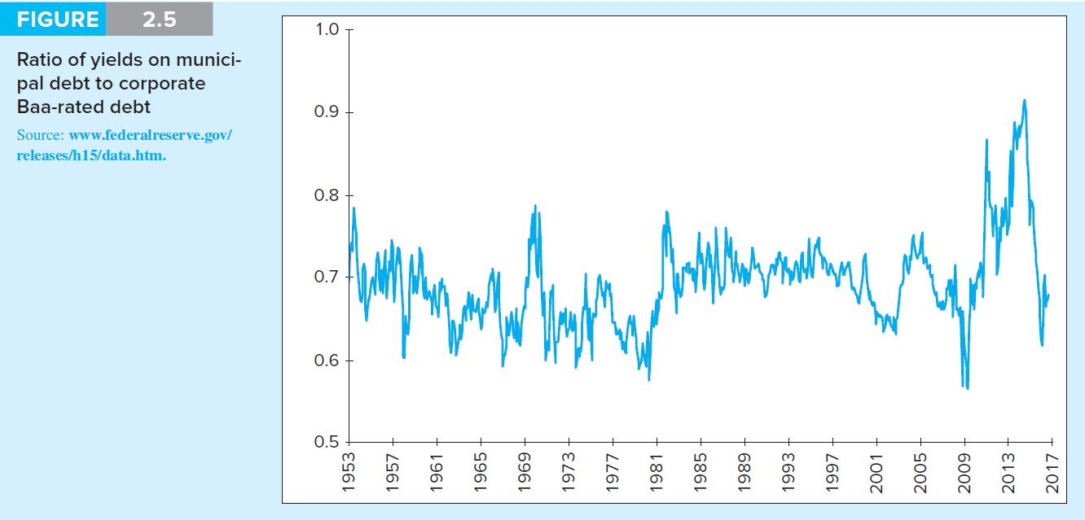
Figure 2.5 Yield Ratio: Tax-Exempt to Taxable Bonds

Slide 28
2.2 The Bond Market: Private Issue
Corporate Bonds
Investment grade vs. speculative grade
Mortgage-Backed Securities
Backed by pool of mortgages with “pass-through” of monthly payments; covers defaults
Collateral
Traditionally all mortgages conform, since 2006 Alt-A and subprime mortgages are included in pools
Private banks purchased and sold pools of subprime mortgages
Issuers assumed housing prices would continue to rise

Slide 29
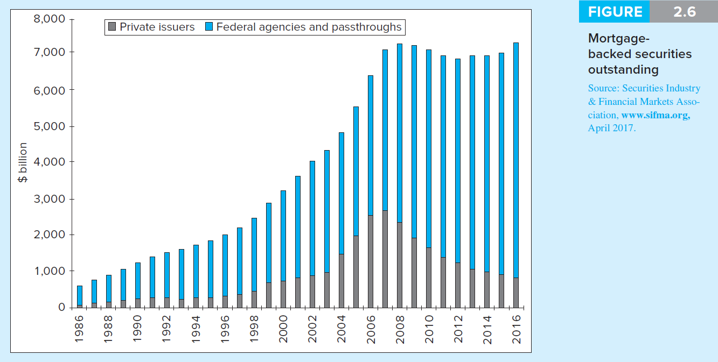
Figure 2.6 Mortgage-Backed Securities Outstanding

Slide 30
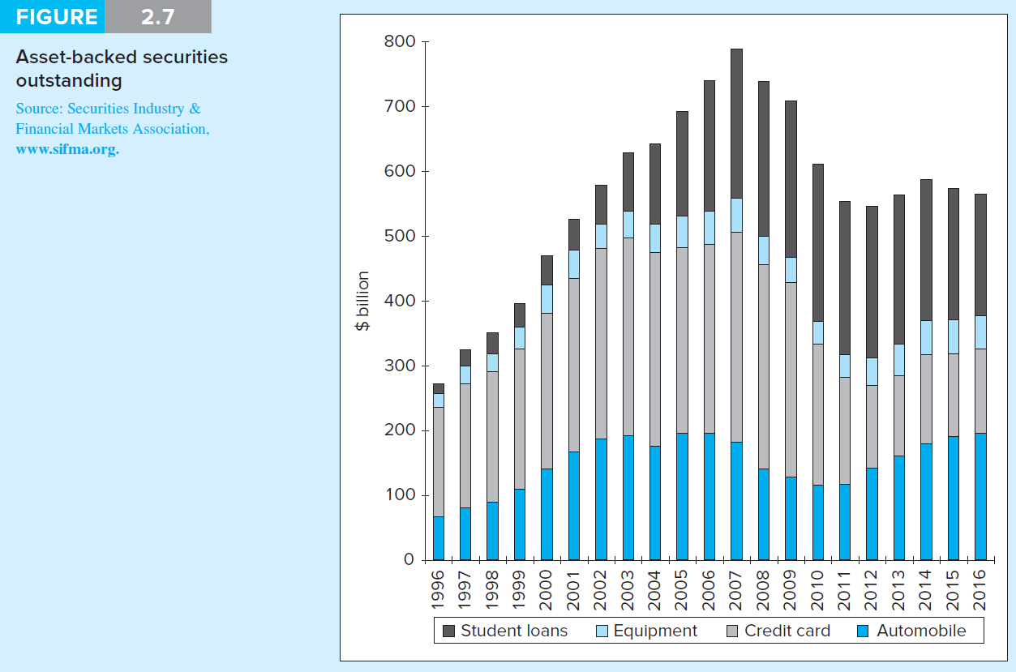
Figure 2.7 Asset-Backed Securities Outstanding

Slide 31
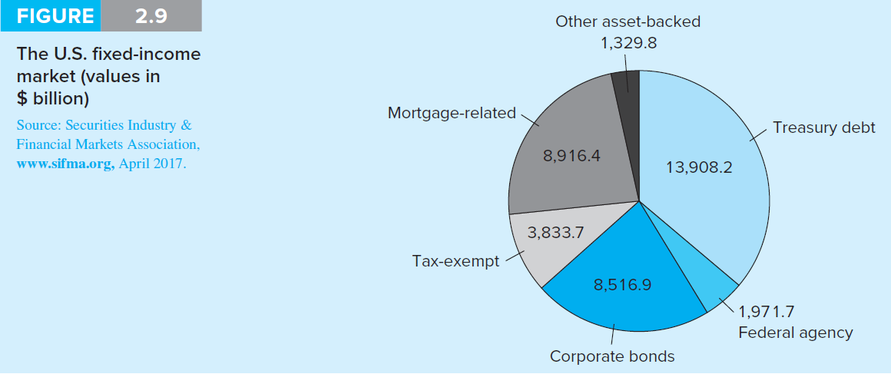
Figure 2.9 The U.S. Fixed-Income Market

Slide 32
2.3 Equity
Asset Classes
Equity
Derivatives
Fixed Income
Money Markets
Capital Markets

Slide 33
2.3 Equity Securities: Instruments
Depository receipts
American Depositary Receipts (ADRs), also called American Depositary Shares (ADSs)
Certificates traded in the U.S. representing ownership in foreign security

Slide 34
2.3 Equity Securities: Instruments
Equity Securities
Common stock
Residual claim
Limited liability
Preferred stock
Priority over common
Fixed dividends: Limited gains
Nonvoting
Tax treatment: Corporate tax exclusions on 70% of dividends earned

Slide 35
2.3 Equity Securities: Instruments
Equity Securities
Common stock
Residual claim
Limited liability
Preferred stock
Priority over common
Fixed dividends: Limited gains
Nonvoting
Tax treatment: Corporate tax exclusions on 70% of dividends earned

Slide 36
2.3 Equity Securities: Returns
Capital gains and dividend yields
Buy a share of stock for $50, hold for 1 year, collect $1 dividend, and sell stock for $54 What were dividend yield, capital gain yield, and total return?

Slide 37
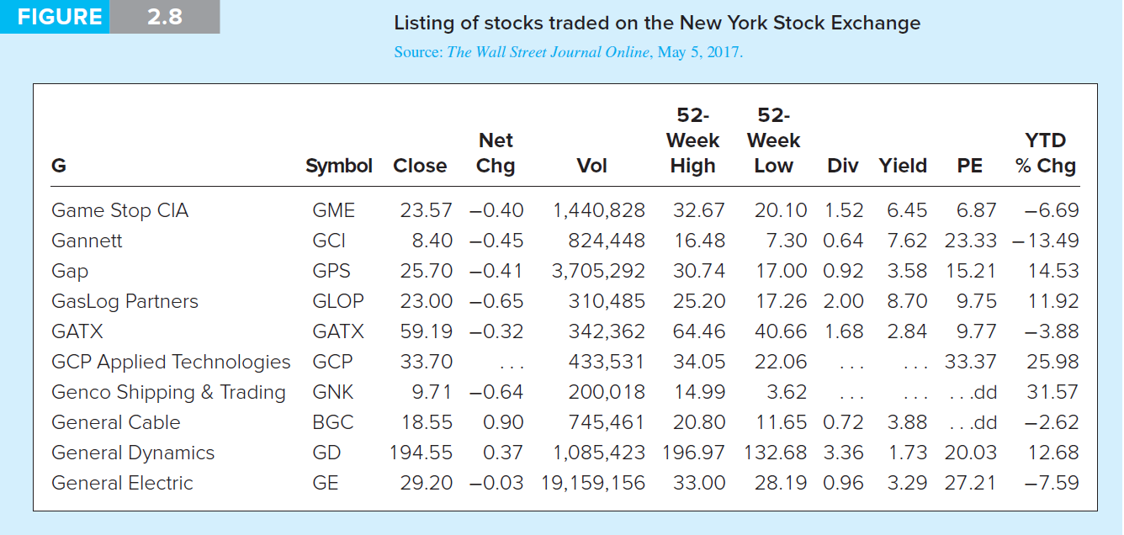
Figure 2.8 Listing of stocks traded on NYSE

Slide 38
2.4 Stock and Bond Market Indexes
Uses
Track average returns
Compare performance of managers
Base of derivatives
Factors in constructing/using index
Representative?
Broad/narrow?
How is it constructed?

Slide 39
2.4 Stock and Bond Market Indexes
Constructing Market Indexes
Weighting schemes
Price-weighted average:
Add prices and divide by “divisor”
Market value-weighted index:
Return = weighted average of returns of each security proportional to market value
Equally weighted index:
Computed from simple average of returns

Slide 40
2.4 Stock and Bond Market Indexes
Construction of Indexes
How are stocks weighted?
Price weighted (DJIA)
Market value weighted (S&P 500, NASDAQ)
Equally weighted (Value Line Index)
How much money do you put in each stock in the index?

Slide 41
2.4 Stock and Bond Market Indexes
Construction of Indexes
How are stocks weighted?
Price weighted (DJIA)
Market value weighted (S&P 500, NASDAQ)
Equally weighted (Value Line Index)
How much money do you put in each stock in the index?

Slide 42
2.5 Derivative Markets
Derivative Asset/Contingent Claim
Security with payoff that depends on the price of other securities
Call Option
Right to buy an asset at a specified price on or before a specified expiration date
Put Option
Right to sell an asset at a specified exercise price on or before a specified expiration date

Slide 43
Figure 2.10 Stock Options on Apple

Slide 44
2.5 Derivative Markets: Call Option
Call Options on Apple
The right to buy 100 shares at a strike price of $135 using the May contract costs:
Is this contract “in the money”?
When should you buy this contract?
When should you write it?

Slide 45
2.5 Derivative Markets: Put Option
Put Options on Apple
The right to buy 100 shares at a strike price of $135 using the May contract costs:
Is this contract “in the money?”
Why do the two option prices (Call and Put) differ?

Slide 46
2.5 Derivative Markets
Futures Contracts
Purchaser (long) buys specified quantity at contract expiration for set price
Contract seller (short) delivers underlying commodity at contract expiration for agreed-upon price

Slide 47
Figure 2.11 Futures Contracts

Slide 48
2.5 Derivative Markets
Options
Basic Positions
Call (Buy/Sell?)
Put (Buy/Sell?)
Terms
Exercise price
Expiration date
Futures
Basic Positions
Long (Buy/Sell?)
Short (Buy/Sell?)
Terms
Delivery date
Deliverable item

