Slide 1
3
Security Markets
Bodie, Kane, and Marcus
Essentials of Investments Eleventh Edition

Slide 2
3.1 How Firms Issue Securities: Primary vs. Secondary
Primary | Secondary
New Issue Created/Sold | Current owner sells to another party
Issuer Receives Proceeds from Sale | Issuer Does Not Receive Proceeds from Sale

Slide 3
3.1 How Firms Issue Securities: Private vs. Public
 | Privately Held | Publicly Traded
Definition | Ownership help by a small group of investors | Securities sold to the general public; investors to trade shares
Shareholders | Up to 2000 shareholders | Unlimited number
Financial Statements | Fewer obligations to release financial statements to public | Obligated to release financial statements to the public
Primary Offering | Sold Directly to a Small group of Investors | Sold to the Public (often with an Underwriter)

Slide 4
3.1 How Firms Issue Securities: IPO
Publicly Traded Companies
Initial public offering: First sale of stock by a formerly private company
Underwriters: Purchase securities from issuing company and resell them
Prospectus: Description of firm and security being issued

Slide 5
3.1 How Firms Issue Securities
Initial Public Offerings
Issuer and underwriter put on “road show”
Purpose: Bookbuilding and pricing
Underpricing
Post-initial sale returns average 10% or more—“winner’s curse”
Easier to market issue → costly to issuing firm
Notes:
5

Slide 6
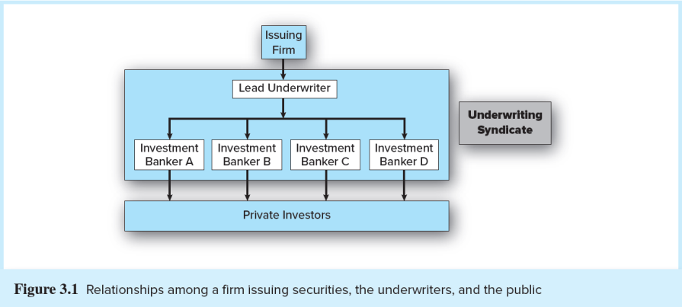
Figure 3.1 Relationship among a Firm Issuing Securities, the Underwriters, and the Public

Slide 7
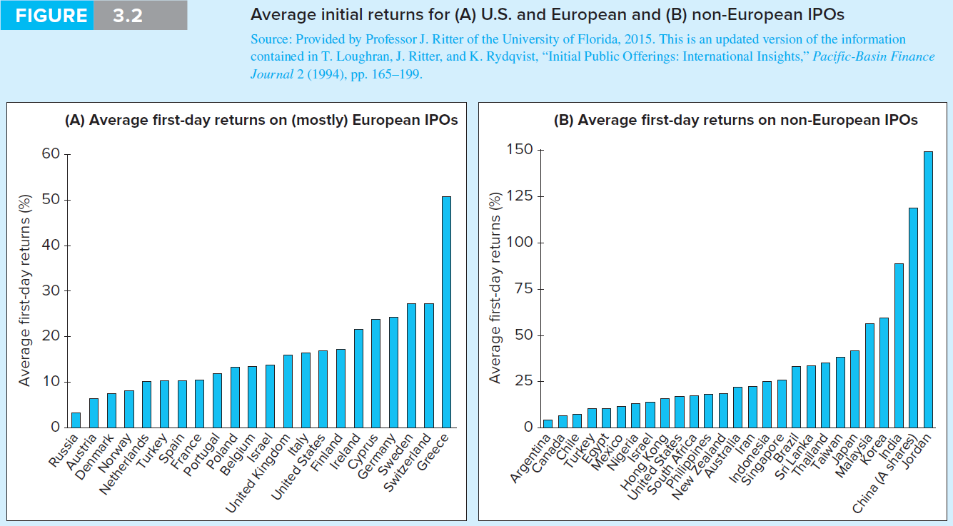
Figure 3.2 Average First-Day Returns

Slide 8
3.1 How Firms Issue Securities: Shelf Registration
SEC Rule 415
Security is preregistered
Offered at any time within the next two years
24-hour notice: Any or all of preregistered amount may be offered
Introduced in 1982
Why would a firm use Rule 415?

Slide 9
3.2 How Securities Are Traded: Financial Markets
Overall purpose: Facilitate low-cost investment
Bring together buyers and sellers at low cost
Provide adequate liquidity
Minimize time to trade
Promotes price continuity
Set and update prices of financial assets
Reduce information costs associated with investing
Notes:
9

Slide 10
3.2 How Securities Are Traded: Market Types
Direct Search Markets
Buyers and sellers locate one another on their own
Brokered Markets
Third-party assistance in locating buyer or seller
Dealer Markets
Third party acts as intermediate buyer/seller
Auction Markets
Brokers and dealers trade in one location
Trading is more or less continuous

Slide 11
3.2 How Securities Are Traded: Order Types
Market order:
Execute immediately at best price
Bid price: price at which dealer will buy security
Ask price: price at which dealer will sell security
Price-contingent order:
Limit buy/sell order: specifies price at which investor will buy/sell
Stop order: not to be executed until price point hit

Slide 12
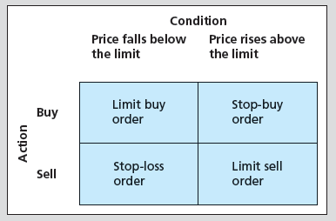
3.2 How Securities are Traded: Price-Contingent Orders

Slide 13
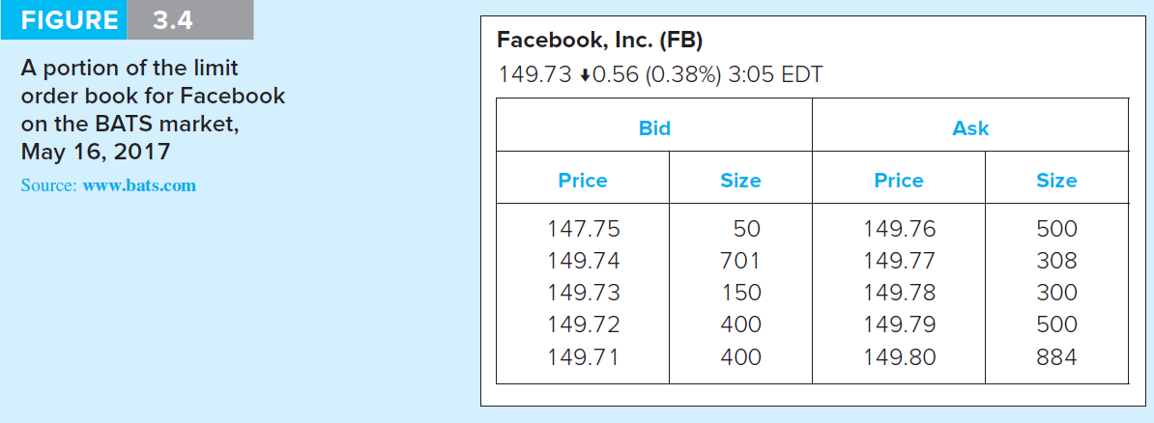
Figure 3.4 Limit Order

Slide 14
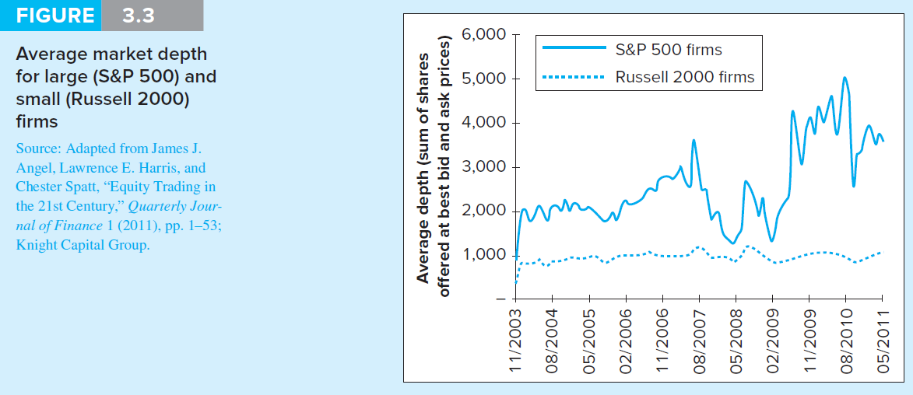
Figure 3.3 Market Orders: Average Market Depth

Slide 15
3.2 How Securities Are Traded
Trading Mechanisms
Dealer markets
Over-the-counter (OTC) market: Informal network of brokers/dealers who negotiate securities sales
NASDAQ stock market: Computer-linked price quotation system for OTC market
Electronic communication networks (ECNs)
Computer networks that allow direct trading
Specialist markets
Specialist: Makes market in shares of one or more firms; maintains “fair and orderly market” by dealing personally

Slide 16
3.3 Rise of Electronic Trading: Timeline of Market Changes
1969: Instinet (first ECN) established
1975: Fixed commissions on NYSE eliminated
Congress amends Securities and Exchange Act to create National Market System (NMS)
1994: NASDAQ scandal
SEC institutes new order-handling rules
NASDAQ integrates ECN quotes into display
SEC adopts Regulation Alternative Trading Systems, giving ECNs ability to register as stock exchanges

Slide 17
3.3 Rise of Electronic Trading: Timeline of Market Changes
1997: SEC drops minimum tick size from 1/8 to 1/16 of $1
2000: National Association of Securities Dealers splits from NASDAQ
2001: Minimum tick size $.01
2006: NYSE acquires Archipelago Exchanges and renames it NYSE Arca
SEC adopts Regulation NMS, requiring exchanges to honor quotes of other exchanges

Slide 18
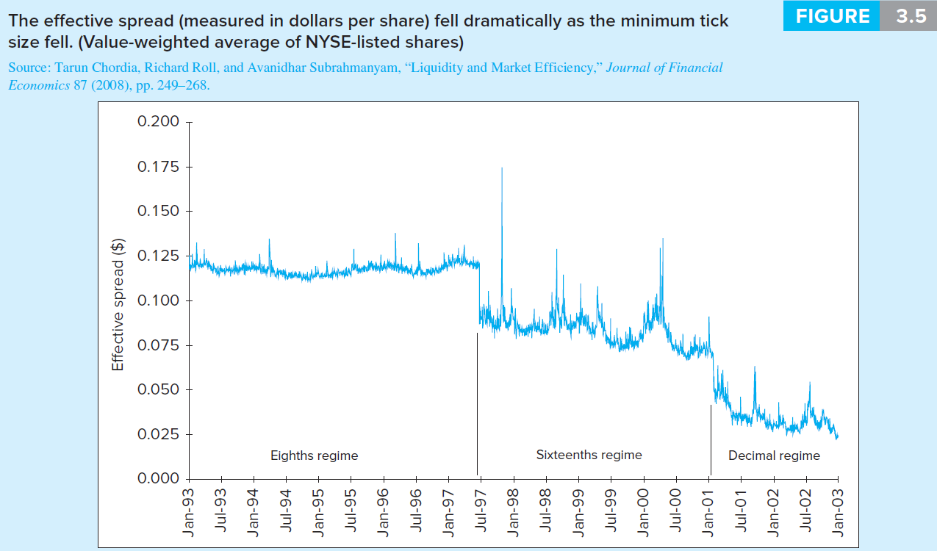
Figure 3.5 Effective Spread vs. Minimum Tick Size

Slide 19
3.4 U.S. Markets
NASDAQ
Approximately 3,000 firms
New York Stock Exchange (NYSE)
Stock exchanges: Secondary markets where already-issued securities are bought and sold
NYSE is largest U.S. Stock exchange
ECNs
Latency: Time it takes to accept, process, and deliver a trading order

Slide 20
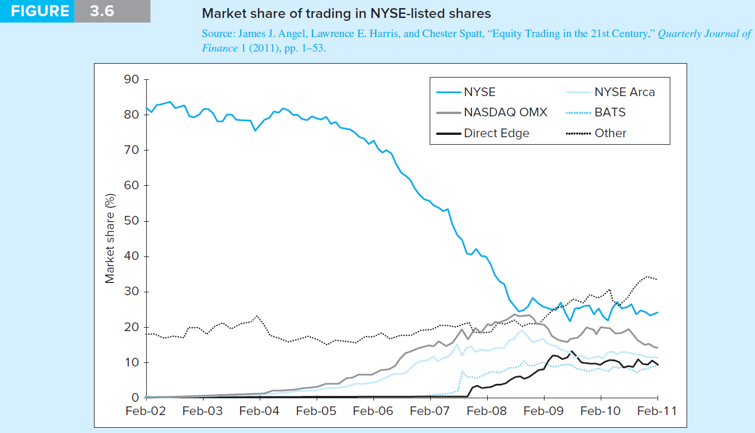
Figure 3.6 Market Share of Trading in NYSE-Listed Shares

Slide 21
3.5 New Trading Strategies
Algorithmic Trading
Use of computer programs to make rapid trading decisions
High-frequency trading: Computer programs make very rapid trading decisions for very small profits

Slide 22
3.5 New Trading Strategies
Dark Pools
ECNs where participants can buy/sell large blocks of securities anonymously
Blocks: Transactions of at least 10,000 shares

Slide 23
3.6 Globalization of Stock Markets
Moving to automated electronic trading
Current trends will eventually result in 24-hour global markets
Moving toward market consolidation

Slide 24
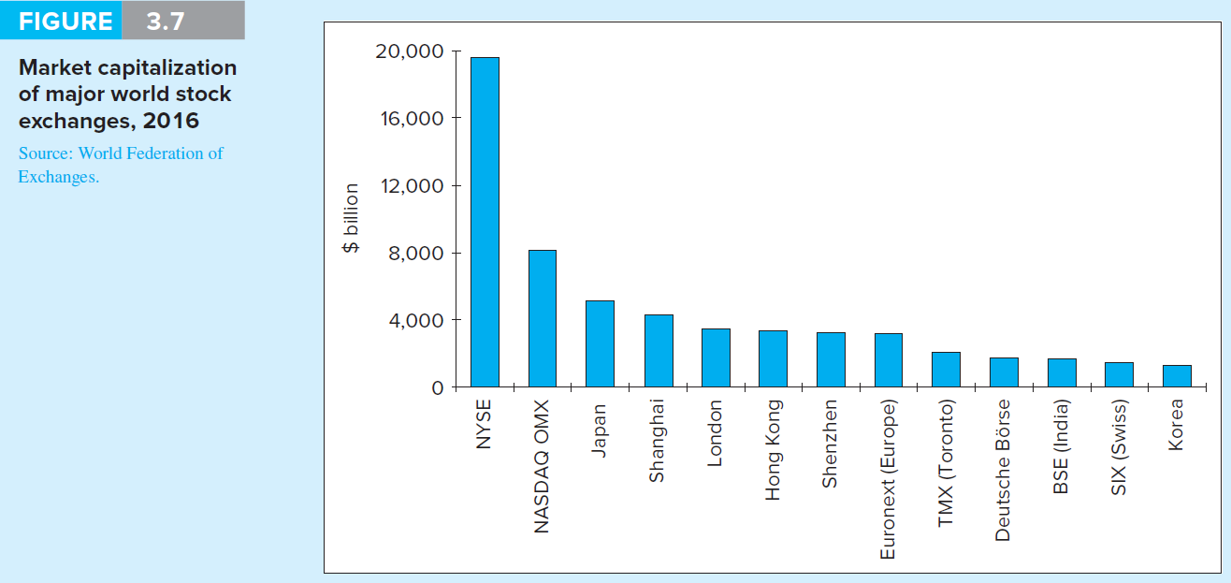
Figure 3.7 Market Capitalization of World Stock Exchanges, 2016

Slide 25
3.7 Trading Costs
Commission: Fee paid to broker for making transaction
Spread: Cost of trading with dealer
Bid: Price at which dealer will buy from you
Ask: Price at which dealer will sell to you
Combination: On some trades both are paid

Slide 26
3.8 Buying on Margin
Margin: Describes securities purchased with money borrowed in part from broker
Net worth of investor's account
Initial Margin Requirement (IMR)
Minimum set by Federal Reserve under Regulation T, currently 50% for stocks
Minimum % initial investor equity
1 − IMR = Maximum % amount investor can borrow

Slide 27
3.8 Buying on Margin
Equity
Position value – Borrowing + Additional cash
Maintenance Margin Requirement (MMR)
Minimum amount equity can be before additional funds must be put into account
Exchanges mandate minimum 25%
Margin Call
Notification from broker that you must put up additional funds or have position liquidated

Slide 28
3.8 Buying on Margin
If Equity / Market value ≤ MMR, then margin call occurs
Solve for market value
A margin call will occur when:

Slide 29
3.8 Buying on Margin
Margin Trading: Initial Conditions
X Corp: Stock price = $70
50%: Initial margin
40%: Maintenance margin
1000 shares purchased
Initial Position
Stock | $70,000 | Borrowed | $35,000
 |  | Equity | $35,000

Slide 30
3.8 Buying on Margin
Stock price falls to $60 per share
Position value – Borrowing + Additional cash
Margin %: $25,000/$60,000 = 41.67%
How far can price fall before margin call?
Market value = $35,000/(1 – .40) = $58,333
New Position
Stock | $60,000 | Borrowed | $35,000
 |  | Equity | $25,000

Slide 31
3.8 Buying on Margin
With 1,000 shares, stock price for margin call is $58,333/1,000 = $58.33
Margin % = $23,333/$58,333 = 40%
To restore initial margin requirement, equity = ½ x $58,333 = $29,167
New Position
Stock | $60,000 | Borrowed | $35,000
 |  | Equity | $23,333

Slide 32
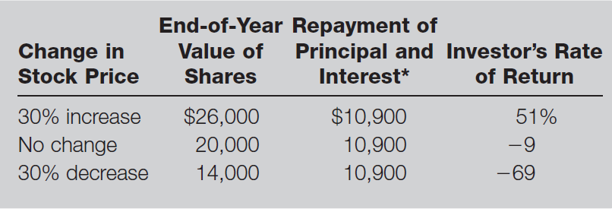
Table 3.1 Illustration of Buying Stock on Margin

Slide 33
3.9 Short Sales
Sale of shares not owned by investor but borrowed through broker
Mechanics
Borrow stock from broker; must post margin
Broker sells stock, and deposits proceeds/margin in margin account
Covering or closing out position: Buy stock; broker returns title to original party

Slide 34
3.9 Short Sales
Required initial margin: Usually 50%
More for low-priced stocks
Liable for any cash flows
Dividend on stock
Zero tick, uptick rule
Eliminated by SEC in July 2007

Slide 35
3.9 Short Sales: Example
Sell 100 short shares of stock at $60 per share
$6,000 must be pledged to broker
Pledge 50% margin, or $3,000
Now there is $9,000 in margin account
Short sale equity = Total margin account – Market value

Slide 36
3.9 Short Sales
Example
Maintenance margin for short sale of stock with price > $16.75 is 30% market value
30% x $6,000 = $1,800
You have $1,200 excess margin
What price for margin call?

Slide 37
3.9 Short Sales: Example, Margin Call
When equity ≤ (.30 x Market value)
Equity = Total margin account – Market value
When Market value = Total margin account / (1 + MMR)
Market value = $9,000/(1 + 0.30) = $6,923
Price for margin call: $6,293/100 shares = $69.23

Slide 38
3.9 Short Sales: Example, Continued
If this occurs:
Equity = $9,000 − $6,923 = $2,077
Equity as % market value = $2,077/$6,923 = 30%
To restore 50% initial margin:
($6,923/2) − $2,077 = $1,384.50

Slide 39
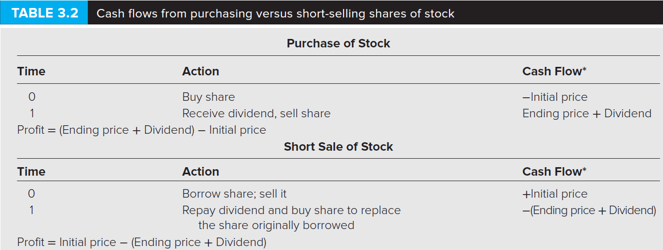
Table 3.2 Cash Flows from Purchasing vs. Short-Selling
*Note: A negative cash flow implies a cash outflow.

Slide 40
3.10 Regulation of Securities Markets
Self-Regulation
The Sarbanes-Oxley Act
Insider Trading
Inside information: Nonpublic knowledge about a corporation possessed by officers, major owners, etc., with privileged access to information

