Slide 1
6
Efficient Diversification
Bodie, Kane, and Marcus
Essentials of Investments Eleventh Edition

Slide 2
6.1 Diversification and Portfolio Risk
Market/Systematic/Nondiversifiable Risk
Risk factors common to whole economy
Unique/Firm-Specific/Nonsystematic/ Diversifiable Risk
Risk that can be eliminated by diversification

Slide 3
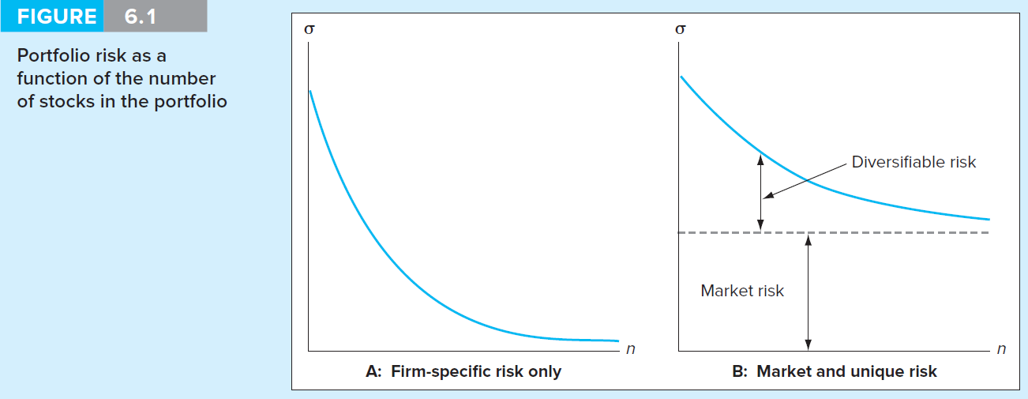
Figure 6.1 Risk as Function of Number of Stocks in Portfolio

Slide 4
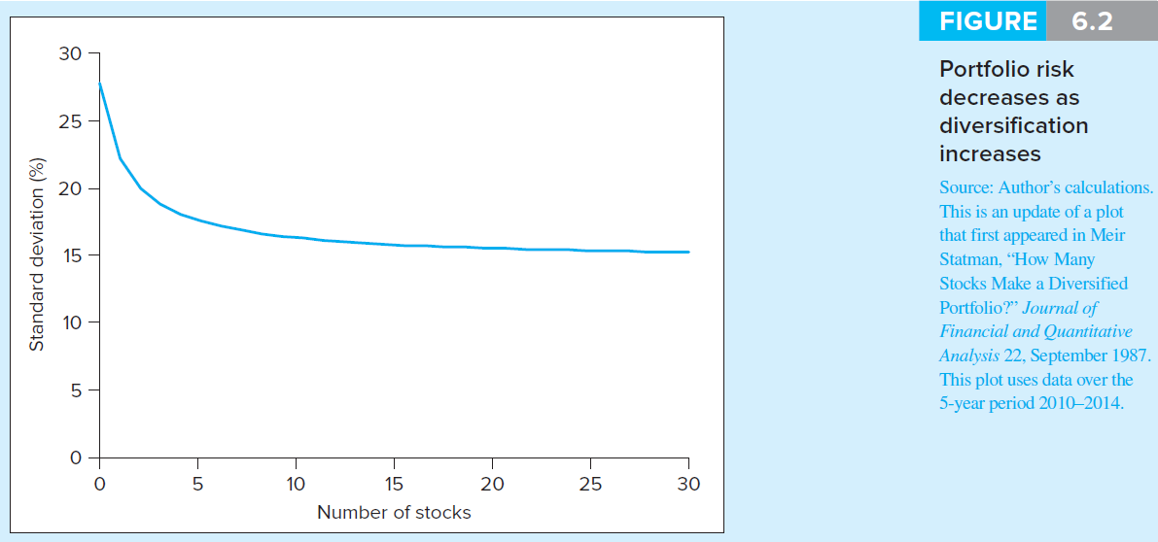
Figure 6.2 Risk versus Diversification

Slide 5
6.2 Asset Allocation with Two Risky Assets
Covariance and Correlation
Portfolio risk depends on covariance between returns of assets
Expected return on two-security portfolio

Slide 6
6.2 Asset Allocation with Two Risky Assets
Covariance Calculations
Correlation Coefficient

Slide 7
Spreadsheet 6.1 Capital Market Expectations

Slide 8
Spreadsheet 6.2 Variance of Returns

Slide 9
Spreadsheet 6.3 Portfolio Performance

Slide 10
Spreadsheet 6.4 Return Covariance

Slide 11
6.2 Asset Allocation with Two Risky Assets
Using Historical Data
Variability/covariability change slowly over time
Use realized returns to estimate
Cannot estimate averages precisely
Focus for risk on deviations of returns from average value

Slide 12
6.2 Asset Allocation with Two Risky Assets
RoR: Weighted average of returns on components, with investment proportions as weights
ERR: Weighted average of expected returns on components, with portfolio proportions as weights
Variance of RoR:

Slide 13
6.2 Asset Allocation with Two Risky Assets
Risk-Return Trade-Off
Investment opportunity set
Available portfolio risk-return combinations
Mean-Variance Criterion
If E(r_{A}) ≥ E(r_{B}) and σ_{A} ≤ σ_{B}
Portfolio A dominates portfolio B

Slide 14
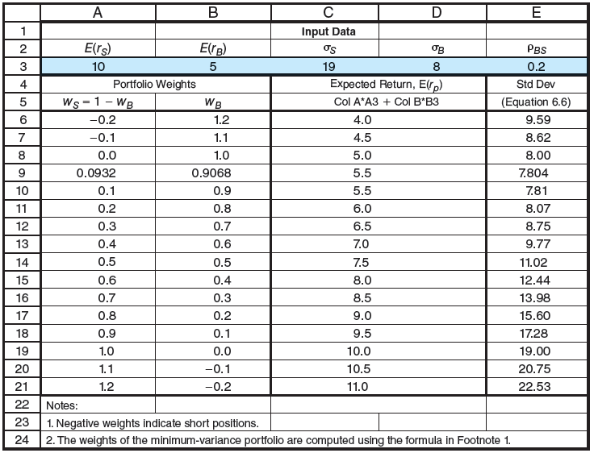
Spreadsheet 6.5 Investment Opportunity Set

Slide 15
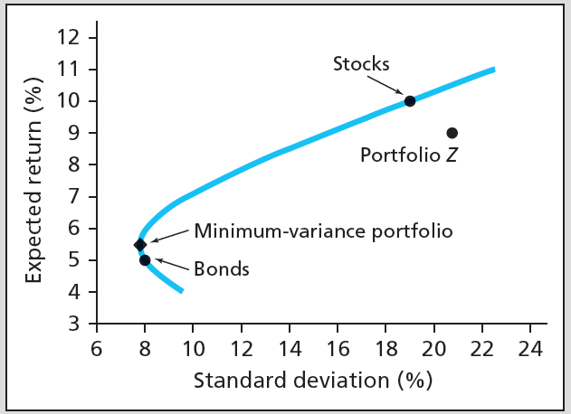
Figure 6.3 Investment Opportunity Set

Slide 16
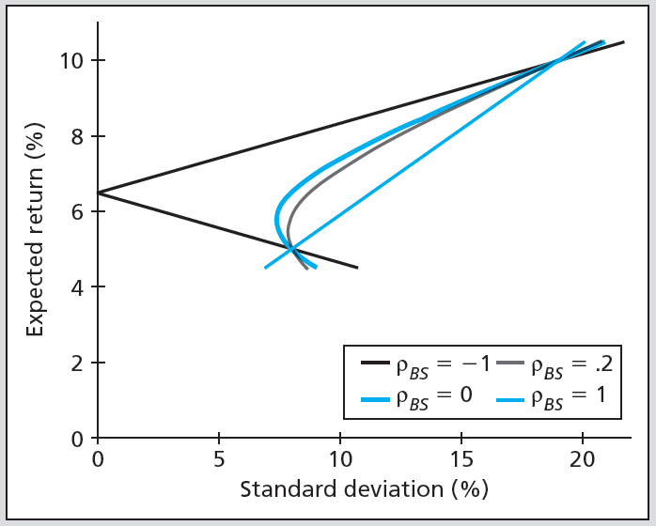
Figure 6.4 Opportunity Sets: Various Correlation Coefficients

Slide 17
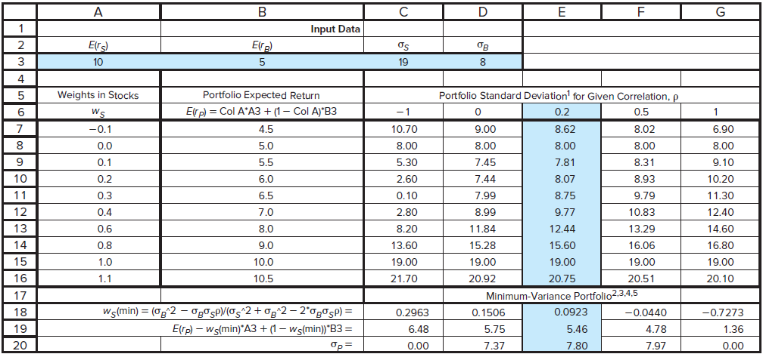
Spreadsheet 6.6 Opportunity Set -Various Correlation Coefficients

Slide 18
6.3 The Optimal Risky Portfolio with a Risk-Free Asset
Slope of CAL is Sharpe Ratio of Risky Portfolio
Optimal Risky Portfolio
Best combination of risky and safe assets to form portfolio

Slide 19
6.3 The Optimal Risky Portfolio with a Risk-Free Asset
Calculating Optimal Risky Portfolio
Two risky assets

Slide 20
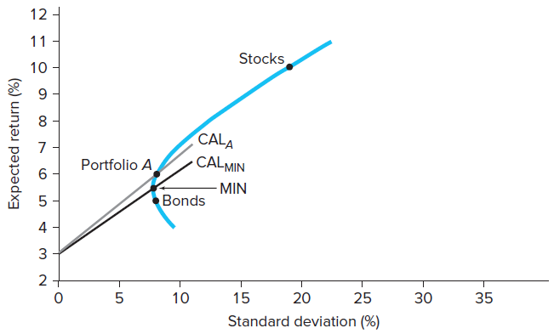
Figure 6.5 Two Capital Allocation Lines

Slide 21
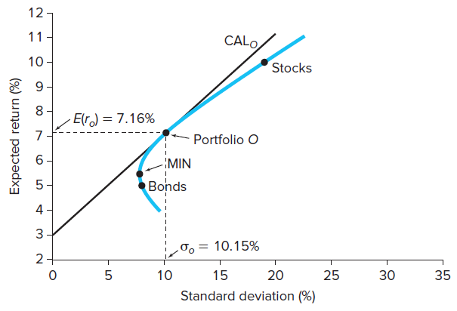
Figure 6.6 Bond, Stock and T-Bill Optimal Allocation

Slide 22
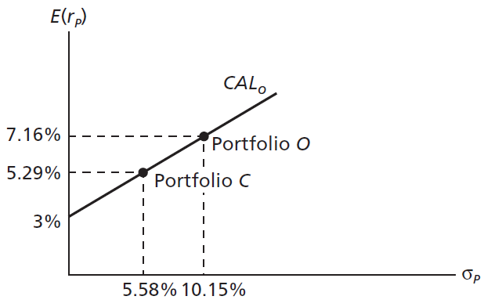
Figure 6.7 The Complete Portfolio

Slide 23
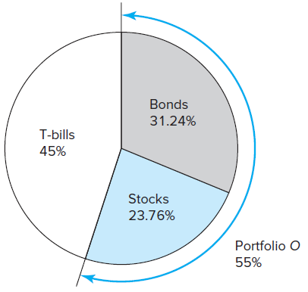
Figure 6.8 Portfolio Composition: Asset Allocation Solution

Slide 24
6.4 Efficient Diversification with Many Risky Assets
Efficient Frontier of Risky Assets
Graph representing set of portfolios that maximizes expected return at each level of portfolio risk
Three methods
Maximize risk premium for any level standard deviation
Minimize standard deviation for any level risk premium
Maximize Sharpe ratio for any standard deviation or risk premium

Slide 25
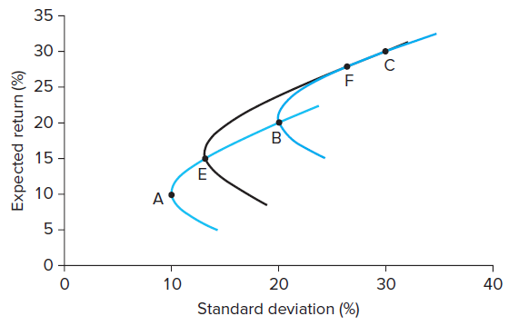
Figure 6.9 Portfolios Constructed with Three Stocks

Slide 26
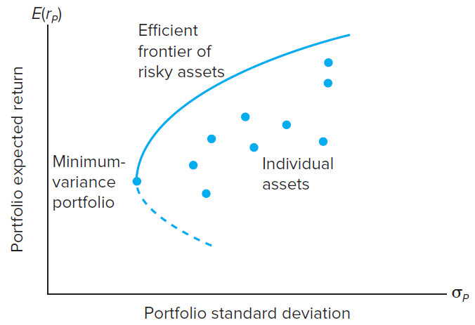
Figure 6.10 Efficient Frontier: Risky and Individual Assets

Slide 27
6.4 Efficient Diversification with Many Risky Assets
Choosing Optimal Risky Portfolio
Optimal portfolio CAL tangent to efficient frontier
Separation Property implies portfolio choice, separated into two tasks
Determination of optimal risky portfolio
Personal choice of best mix of risky portfolio and risk-free asset

Slide 28
6.4 Efficient Diversification with Many Risky Assets
Optimal Risky Portfolio: Illustration
Efficiently diversified global portfolio using stock market indices of six countries
Standard deviation and correlation estimated from historical data
Risk premium forecast generated from fundamental analysis

Slide 29
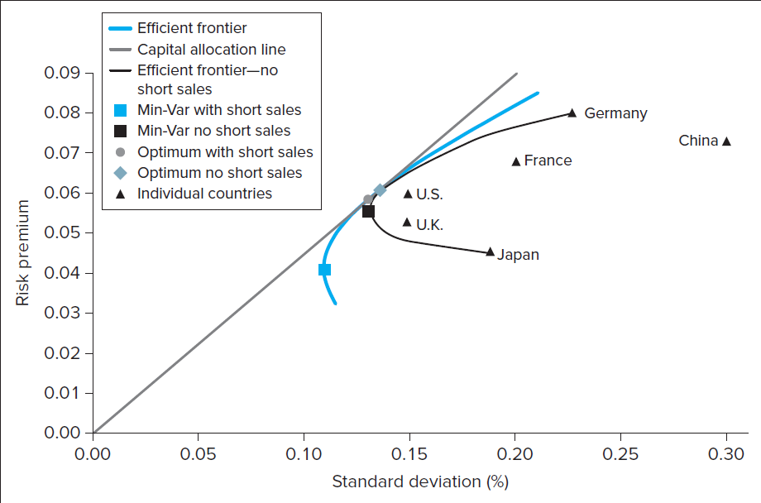
Figure 6.11 Efficient Frontiers/CAL: Table 6.1

Slide 30
6.5 A Single-Index Stock Market
Index model
Relates stock returns to returns on broad market index & firm-specific factors
Excess return
RoR in excess of risk-free rate
Beta
Sensitivity of security’s returns to market factor
Firm-specific or residual risk
Component of return variance independent of market factor
Alpha
Stock’s expected return beyond that induced by market index

Slide 31
6.5 A Single-Index Stock Market
Excess Return
$R_{i}=β_{i}R_{M}+α_{i}+e_{i}$
Where:
${β_{i}R}_{M}$: component of return due to movements in overall market
$β_{i}$: security’s responsiveness to market
$α_{i}$: stock’s expected excess return if market factor is neutral, i.e. market-index excess return is zero
$e_{i}$: Component attributable to unexpected events relevant only to this security (firm-specific)

Slide 32
6.5 A Single-Index Stock Market
Statistical and Graphical Representation of Single-Index Model
Security Characteristic Line (SCL)
Plot of security’s predicted excess return from excess return of market
Algebraic representation of regression line

Slide 33
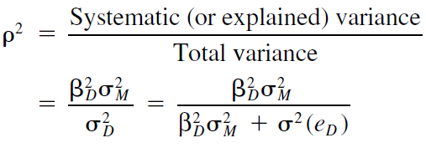
6.5 A Single-Index Stock Market
Statistical and Graphical Representation of Single-Index Model
Ratio of systematic variance to total variance

Slide 34
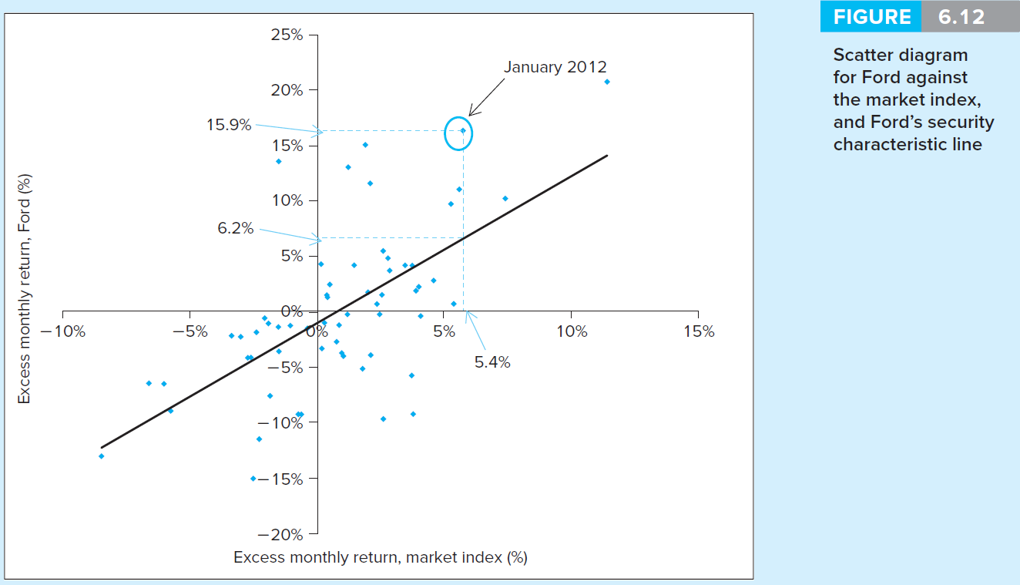
Figure 6.12 Scatter Diagram for Ford

Slide 35
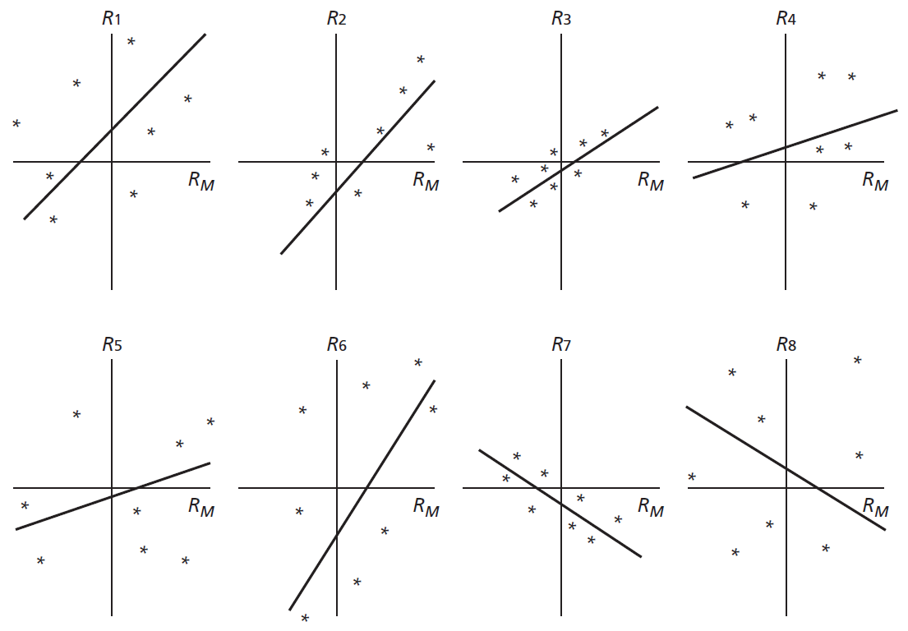
Figure 6.13 Various Scatter Diagrams

Slide 36
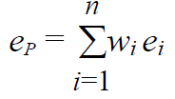
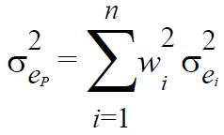
6.5 A Single-Index Stock Market
Diversification in Single-Index Security Market
In portfolio of n securities with weights
In securities with nonsystematic risk
Nonsystematic portion of portfolio return
Portfolio nonsystematic variance

Slide 37
6.5 A Single-Index Stock Market
Using Security Analysis with Index Model
Information ratio
Ratio of alpha to standard deviation of residual
Active portfolio
Portfolio formed by optimally combining analyzed stocks

Slide 38
6.6 Risk of Long-Term Investments
Why the Unending Confusion?
Vast majority of financial advisers believe stocks are less risky if held for long run
Risk premium grows at rate of horizon, T
Standard deviation grows at √T
Sharpe ratio, $S_{1}√T$, grows with investment horizon

Slide 39
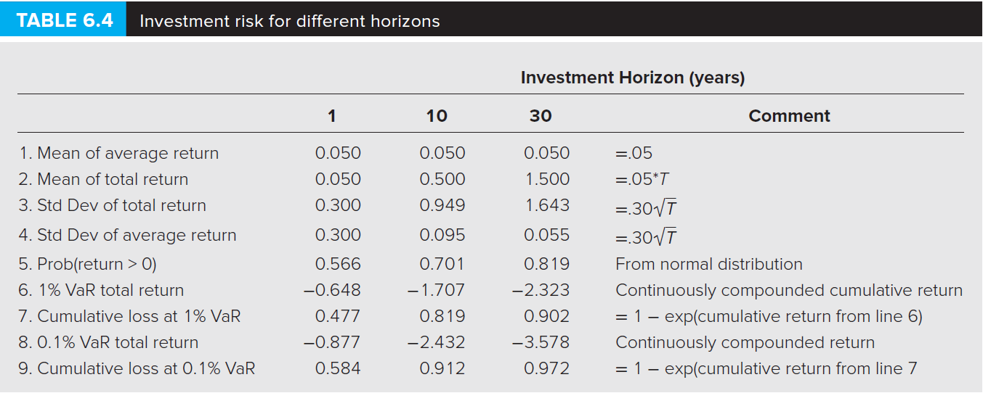
Table 6.4 Investment Risk for Different Horizons

