Slide 1
7
CAPM and APT
Bodie, Kane, and Marcus
Essentials of Investments Eleventh Edition

Slide 2
7.1 The Capital Asset Pricing Model
Capital Asset Pricing Model (CAPM)
Security’s required rate of return relates to systematic risk measured by beta
$E\left(r_{M}\right)−r_{f}=Ao_{M}^{2}$
Market Portfolio (M)
Each security held in proportion to market value

Slide 3
7.1 The Capital Asset Pricing Model: Assumptions
Market Assumptions | Investor Assumptions
All investors are price takers | Investors plan for the same (single-period) horizon
All information relevant to security analysis is free and publicly available. | Investors are efficient users of analytical methods → investors have homogeneous expectations.
All securities are publicly owned and traded. | Investors are rational, mean-variance optimizers.
No taxes on investment returns.
No transaction costs.
Lending and borrowing at the same risk-free rate are unlimited.

Slide 4
7.1 The Capital Asset Pricing Model
Hypothetical Equilibrium
All investors choose to hold market portfolio
Market portfolio is on efficient frontier, optimal risky portfolio

Slide 5
7.1 The Capital Asset Pricing Model
Hypothetical Equilibrium
Risk premium on market portfolio is proportional to variance of market portfolio and investor’s risk aversion
Risk premium on individual assets
Proportional to risk premium on market portfolio
Proportional to beta coefficient of security on market portfolio

Slide 6
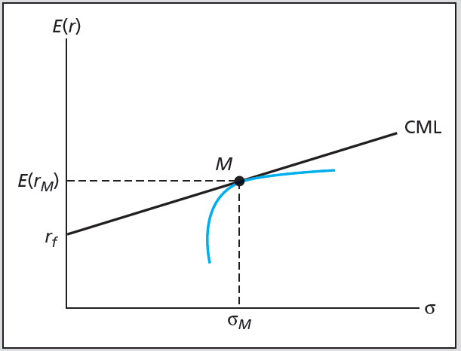
Figure 7.1 Efficient Frontier and Capital Market Line

Slide 7
7.1 The Capital Asset Pricing Model
Passive Strategy is Efficient
Mutual fund theorem: All investors desire same portfolio of risky assets, can be satisfied by single mutual fund composed of that portfolio
If passive strategy is costless and efficient, why follow active strategy?
If no one does security analysis, what brings about efficiency of market portfolio?

Slide 8
7.1 The Capital Asset Pricing Model
Risk Premium of Market Portfolio
Demand drives prices, lowers expected rate of return/risk premiums
When premiums fall, investors move funds into risk-free asset
Equilibrium risk premium of market portfolio proportional to
Risk of market
Risk aversion of average investor

Slide 9
7.1 The Capital Asset Pricing Model
Expected Returns on Individual Securities
Expected return-beta relationship
Implication of CAPM that security risk premiums (expected excess returns) will be proportional to beta
$E\left(r_{D}\right)=r_{f}+β_{D}[E\left(r_{M}\right)−r_{f}]$

Slide 10
7.1 The Capital Asset Pricing Model
The Security Market Line (SML)
Represents expected return-beta relationship of CAPM
Graphs individual asset risk premiums as function of asset risk
Alpha
Abnormal rate of return on security in excess of that predicted by equilibrium model (CAPM)

Slide 11
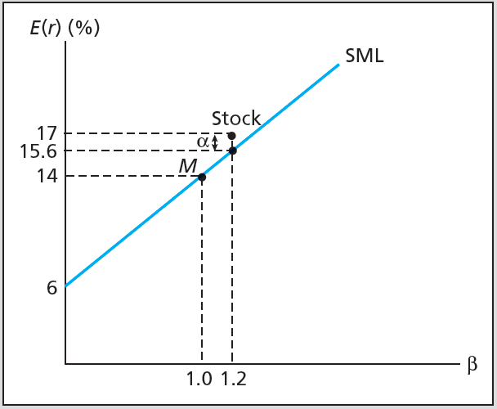
Figure 7.2 The SML and a Positive-Alpha Stock

Slide 12
7.1 The Capital Asset Pricing Model
Applications of CAPM
Use SML as benchmark for fair return on risky asset
SML provides “hurdle rate” for internal projects

Slide 13
7.2 CAPM and Index Models
Index Model, Realized Returns, Mean-Beta Equation
$r_{it}−r_{ft}=α_{i}+β_{i}\left(r_{Mt}−r_{ft}\right)+e_{it}$
$r_{it}$: HPR
i: Asset
t: Period
$α_{i}$: Intercept of security characteristic line
$β_{i}$: Slope of security characteristic line
$r_{M}$: Index return
$e_{it}$: Firm-specific effects
$E\left(r_{it}\right)−r_{ft}=α_{i}+β_{i}[E\left(r_{Mt}\right)−r_{ft}]$

Slide 14
7.2 CAPM and Index Models
Estimating Index Model
$R_{Gt}=α_{G}+β_{G}R_{Mt}+e_{Gt}$
$R_{G}=r_{G}−r_{f}$, excess return
Residual = Actual return $−$ Predicted return for Google
${e_{Gt}=R}_{Gt}−(α_{G}+β_{G}R_{Mt})$

Slide 15
7.2 CAPM and Index Models: SCL
Security Characteristic Line (SCL)
Plot of security’s expected excess return over risk-free rate as function of excess return on market
Required rate = Risk-free rate + β x Expected excess return of index

Slide 16
7.2 CAPM and Index Models
Predicting Betas
Mean reversion
Betas move towards mean over time
To predict future betas, adjust estimates from historical data to account for regression towards 1.0

Slide 17
7.3 CAPM and the Real World
CAPM is false based on validity of its assumptions
Useful predictor of expected returns
Untestable as a theory
Principles still valid
Investors should diversify
Systematic risk is the risk that matters
Well-diversified risky portfolio can be suitable for wide range of investors

Slide 18
7.4 Multifactor Models and CAPM
Multifactor models
Models of security returns that respond to several systematic factors
Two-index portfolio in realized returns
$R_{it}=α_{i}+β_{iM}R_{Mt}+β_{iTB}R_{TBt}+e_{it}$
Two-factor SML
$E\left(r_{i}\right)=r_{f}+β_{iM }\left[E\left(r_{M}\right)−r_{f}\right]+β_{iTB}[E\left(r_{TB}\right)−r_{f}]$

Slide 19
7.4 Multifactor Models and CAPM
Fama-French Three-Factor Model
$r_{G}−r_{f}=α_{G}+β_{M}\left(r_{M}−r_{f}\right)+β_{HML}r_{HML}+β_{SMB}r_{SMB}+e_{G}$
Estimation results
Three aspects of successful specification
Higher adjusted R-square
Lower residual SD
Smaller value of alpha

Slide 20
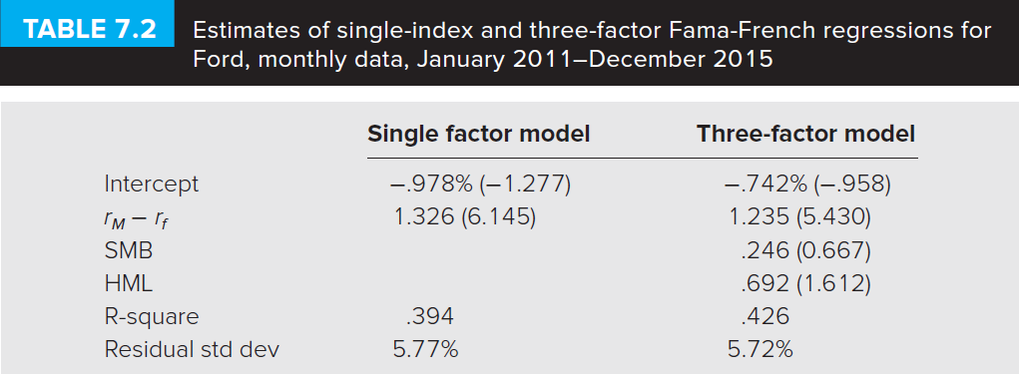
Table 7.2 Multifactor Models and CAPM

Slide 21
7.5 Arbitrage Pricing Theory
Arbitrage
Relative mispricing creates riskless profit
Arbitrage Pricing Theory (APT)
Risk-return relationships from no-arbitrage considerations in large capital markets
Well-diversified portfolio
Nonsystematic risk is negligible
Arbitrage portfolio
Positive return, zero-net-investment, risk-free portfolio

Slide 22
7.5 Arbitrage Pricing Theory
Calculating APT
Returns on well-diversified portfolio

Slide 23
Table 7.5 Portfolio Conversion
Steps to convert a well-diversified portfolio into an arbitrage portfolio:
*When alpha is negative, you would reverse the signs of each portfolio weight to achieve a portfolio A with positive alpha and no net investment.

Slide 24
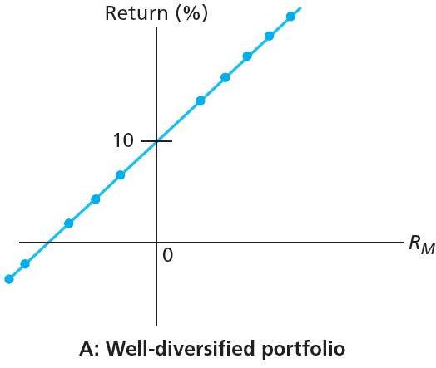
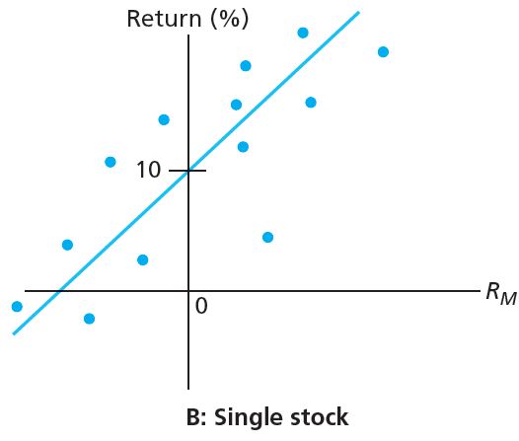
Figure 7.5 Security Characteristic Lines

Slide 25
7.5 Arbitrage Pricing Theory
Multifactor Generalization of APT and CAPM
Factor portfolio
Well-diversified portfolio constructed to have beta of 1.0 on one factor and beta of zero on any other factor
Two-Factor Model for APT

Slide 26
Table 7.9 Constructing an Arbitrage Portfolio
Constructing an arbitrage portfolio with two systemic factors

