Slide 1
Behavioral Finance and Technical Analysis
9
Bodie, Kane, and Marcus
Essentials of Investments Eleventh Edition

Slide 2
9.1 Behavioral Critique
Behavioral Finance
Financial market model emphasizing potential implications of psychological factors affecting investor behavior
Existence of irrational investors is not sufficient to render capital markets inefficient

Slide 3
9.1 Behavioral Finance: Information Processing
Information Processing
Forecasting errors
People overvalue recent experience compared to prior belief when forecasting
Overconfidence
People overestimate precision of beliefs or forecasts, and overestimate abilities

Slide 4
9.1 Behavioral Finance Information Processing
Information Processing
Conservatism bias
Investors too slow in updating beliefs in response to recent evidence
Sample size neglect and representativeness
People prone to believe small sample is representative of population, infer patterns too quickly

Slide 5
9.1 Behavioral Finance: Behavioral Biases
Behavioral Biases
Framing
Decisions affected by how choices are posed, i.e. gains relative to low baseline level or losses relative to higher baseline
Mental accounting
Form of framing; people segregate certain decisions

Slide 6
9.1 Behavioral Finance: Behavioral Biases
Behavioral Biases
Regret avoidance
People blame themselves for unconventional choices that turn out badly, avoid regret by making conventional decisions
Prospect theory
Investor utility depends on gains/losses from starting position, rather than levels of wealth

Slide 7
9.1 Behavioral Critique
Limits to Arbitrage
Fundamental risk: Market changes or irrationality can eliminate profits
Implementation costs: Exploiting overpricing is difficult; costs and time limits can eliminate profits
Model risk: Inaccurate models generate inaccurate stock values

Slide 8
9.1 Behavioral Critique: Prospect Theory
Prospect Theory
Challenges conventional view of the relationship between wealth and utility
Utility is a function of change in wealth
Affect: the feeling of “good” or “bad” that consumers may attach to a potential purchase or investors to a stock

Slide 9
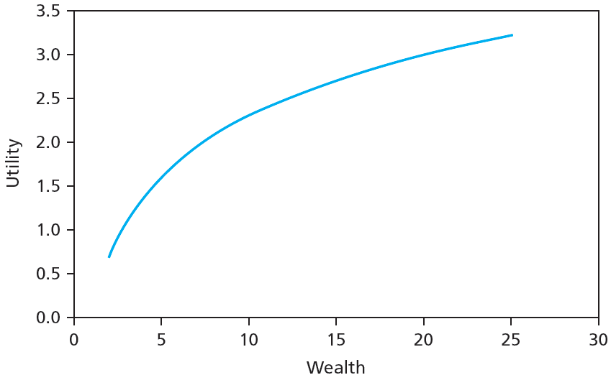
Figure 9.1A Conventional Utility Function

Slide 10
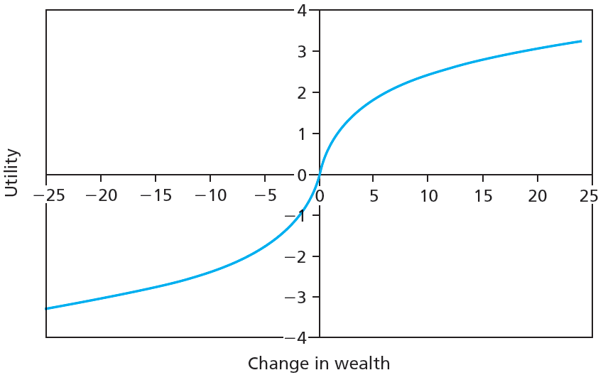
Figure 9.1B Utility Function under Prospect Theory

Slide 11
9.1 Behavioral Critique
Limits to Arbitrage and Law of One Price
“Siamese twin” companies
Dual-listed companies can appear to violate Law of One Price
Equity carve-outs
Can violate Law of One Price due to inability to short sell

Slide 12
9.1 Behavioral Critique
Limits to Arbitrage and Law of One Price
Closed-end funds
Premium of fund over net asset value
$\frac{Price−NAV}{NAV}=\frac{α−ε}{δ+ε−α}$
$δ$: Dividend yield
$α$: Alpha
$ε$: Expense ratio

Slide 13
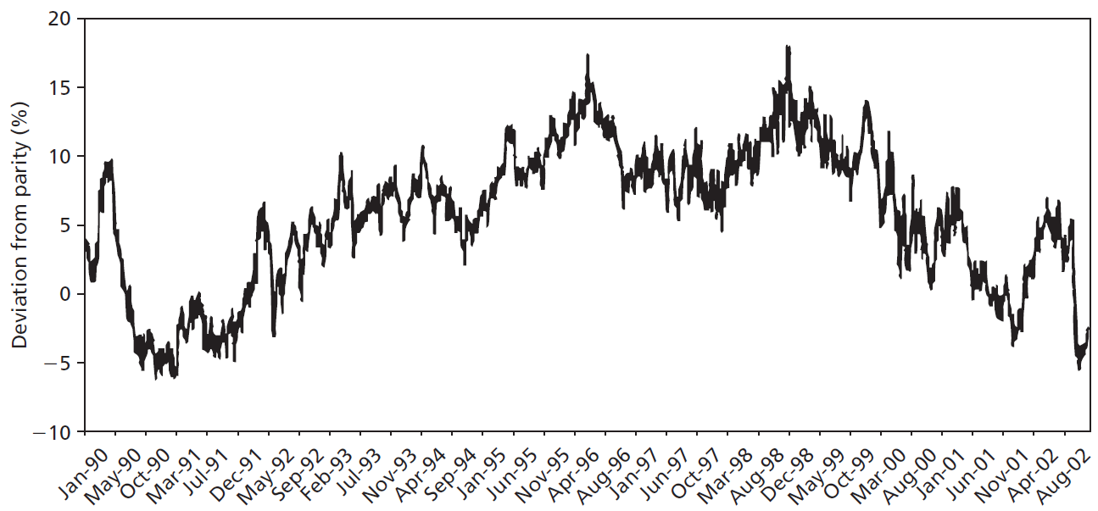
Figure 9.2 Pricing of Royal Dutch Relative to Shell

Slide 14
9.1 Behavioral Critique
Bubbles and Behavioral Economics
Evidence of irrational investor behavior
Easier to identify once over
Evaluating Behavioral Critique
No coherent theory
Most empirical support from one time period: late ‘90s

Slide 15
9.2 Technical Analysis and Behavioral Finance
Trends and Corrections
Moving average
Average price over given interval, interval updated over time
Attempts to identify underlying price directions

Slide 16
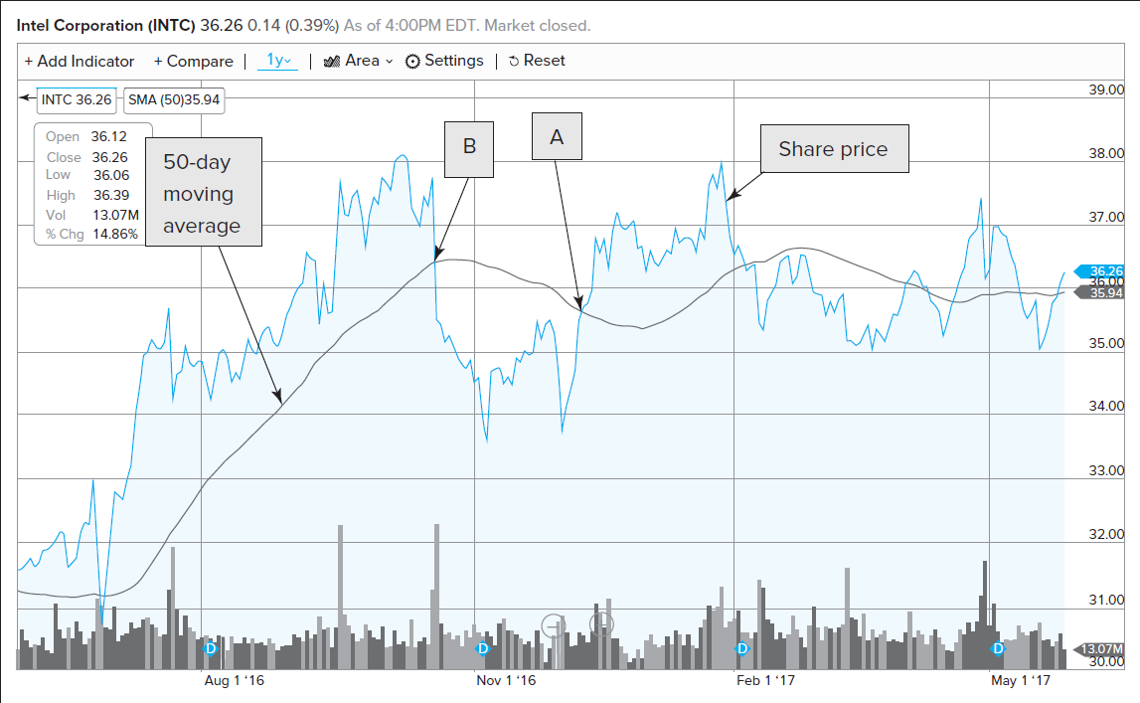
Figure 9.3 Share Price, 50-Day Moving Average for Intel

Slide 17
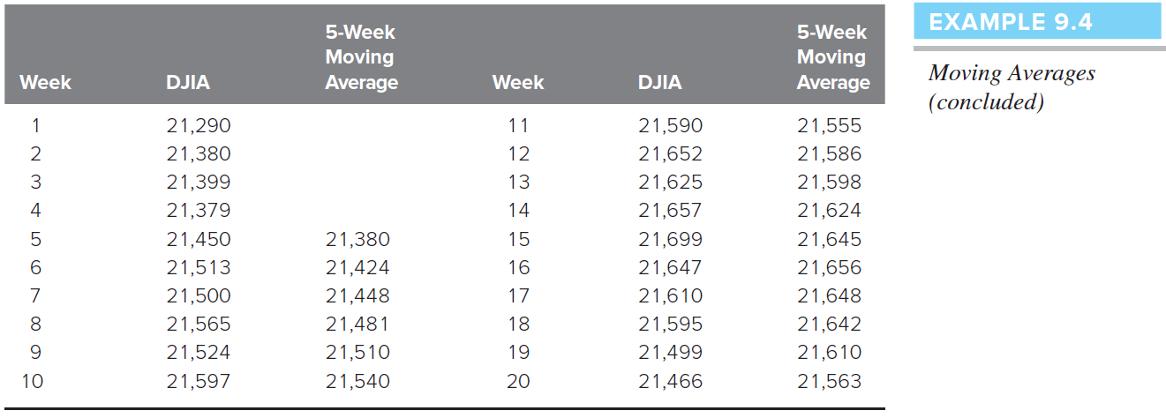
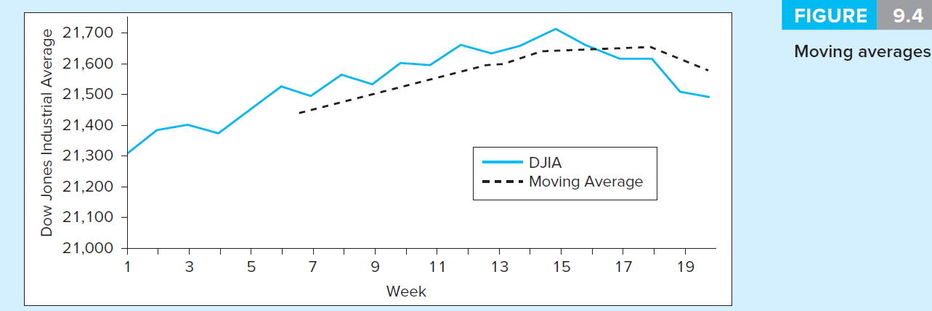
Figure 9.4 Moving Averages

Slide 18
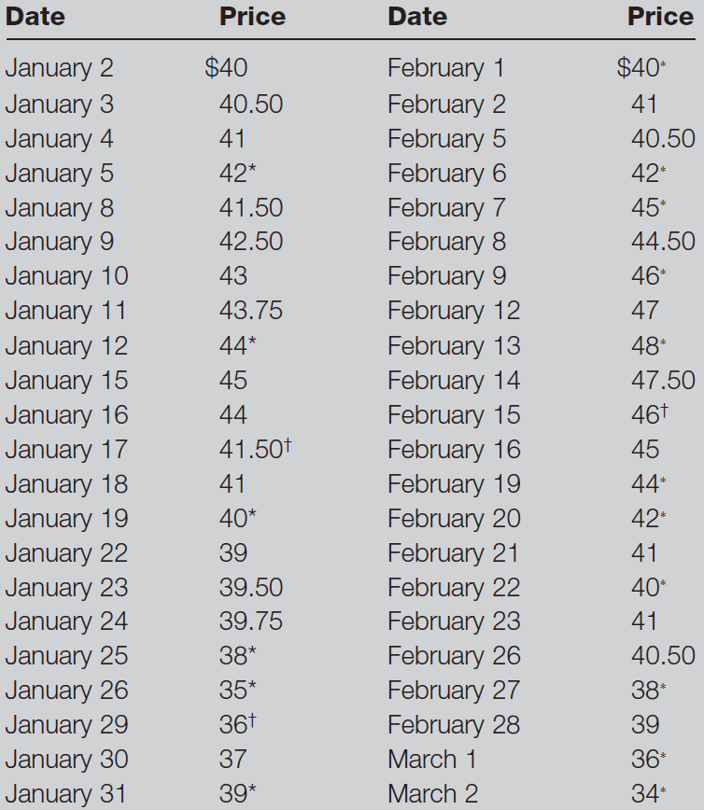
Table 9.1 Stock Price History

Slide 19
9.2 Technical Analysis and Behavioral Finance
Trends and Corrections
Point and figure charts
Traces significant upward/downward movements in prices without regard to timing
X denotes price increase, O denotes decrease
Sell/Buy signals generated when stock penetrates previous lows/highs
Congestion area: Horizontal band of Xs/Os created by price reversals

Slide 20
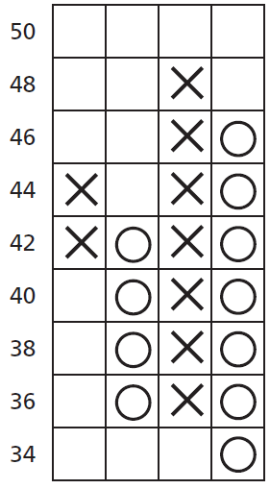
Figure 9.5 Point and Figure Chart for Table 9.1

Slide 21
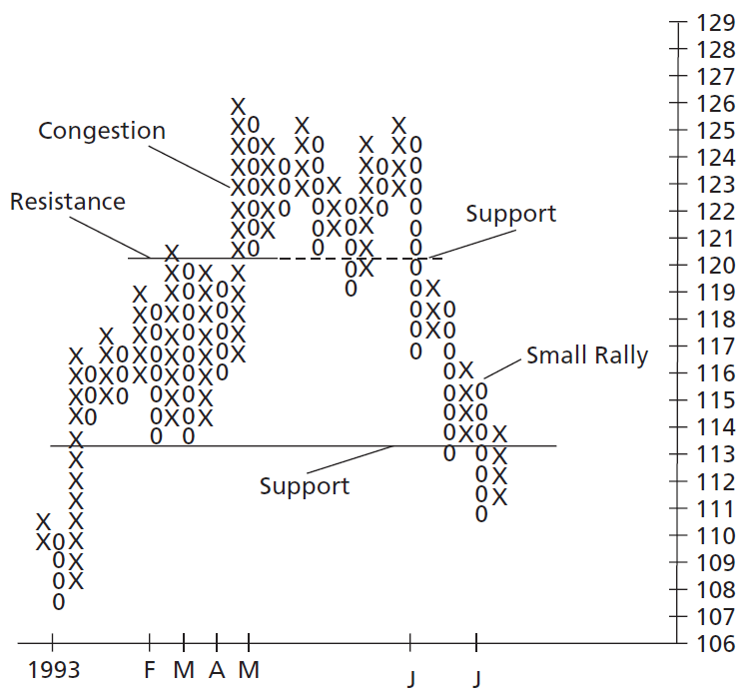
Figure 9.6 Point and Figure Chart for Atlantic Richfield

Slide 22
9.2 Technical Analysis and Behavioral Finance
Trends and Corrections
Breadth
Extent to which broad market index movements affect individual stock prices
Relative Strength
Recent performance of given stock/industry compared to that of broad market index

Slide 23
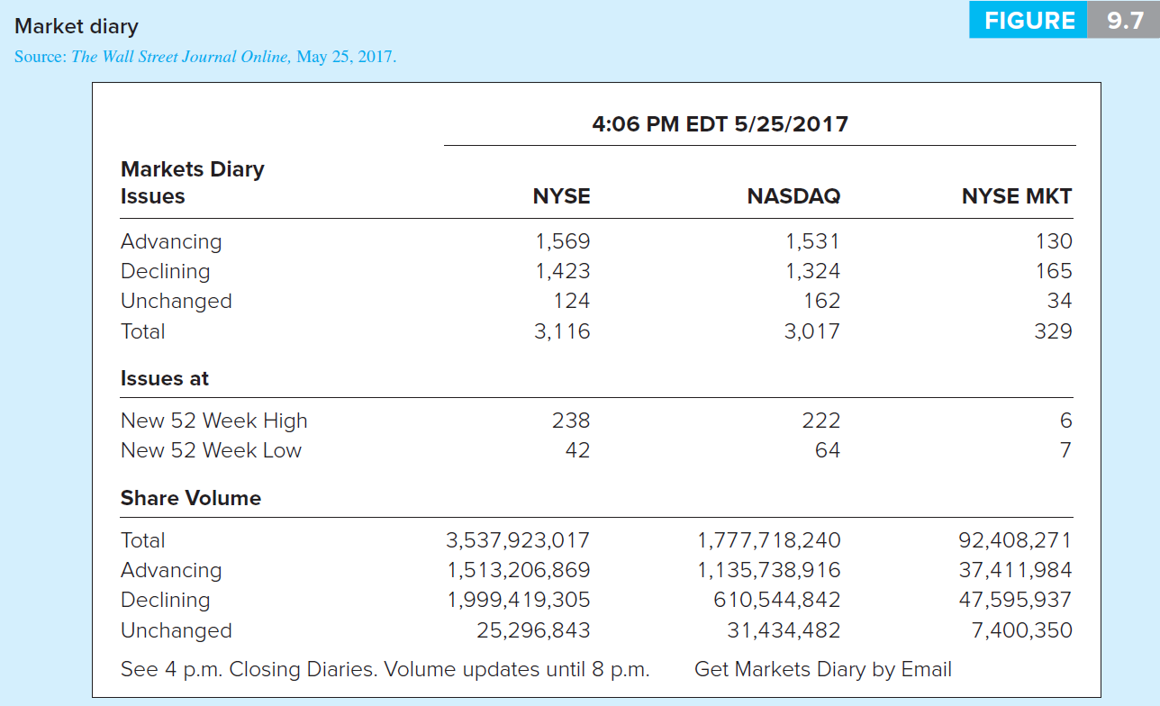
Figure 9.7 Market Diary

Slide 24
Table 9.2 Breadth

Slide 25
9.2 Technical Analysis and Behavioral Finance
Sentiment Indicators
Trin statistic
Ratio of average volume in declining issues to average volume in advancing issues
Confidence index
Ratio of top-rated corporate bond yield to intermediate-grade bond yield

Slide 26
9.2 Technical Analysis and Behavioral Finance
Sentiment Indicators
Short interest
Total number of shares currently short-sold in market
Put/call ratio
Ratio of put options to call options outstanding on stock

Slide 27
9.2 Technical Analysis and Behavioral Finance
A Warning
People perceive patterns where none exist
Data mining generates apparent patterns within limited data sets
When evaluating rules, ask whether rule would be reasonable before looking at data

Slide 28
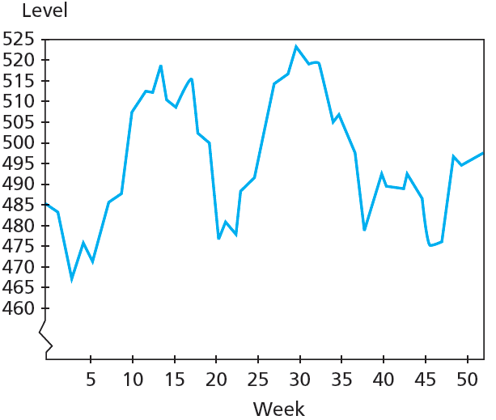
Figure 9.8A Actual Stock Price Levels, 52 Weeks

Slide 29
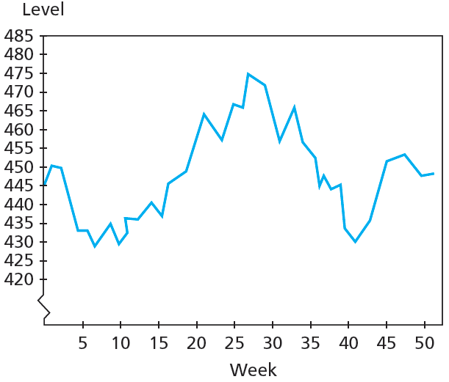
Figure 9.8B Simulated Stock Price Levels, 52 Weeks

Slide 30
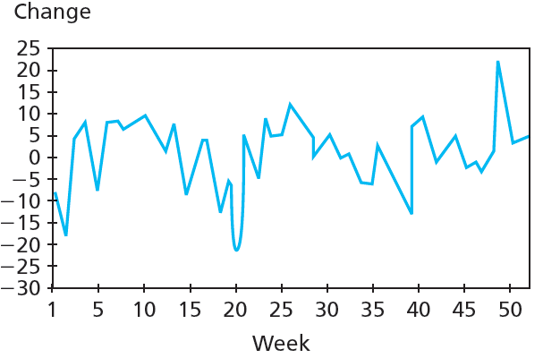
Figure 9.9A Actual Weekly Stock Price Changes, 52 Weeks

Slide 31
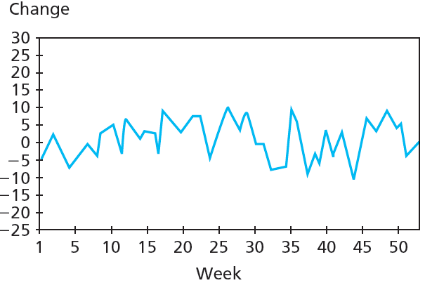
Figure 9.9B Simulated Weekly Stock Price Changes, 52 Weeks

