Slide 1
16
Option Valuation
Bodie, Kane, and Marcus
Essentials of Investments Eleventh Edition

Slide 2
16.1 Introduction
Intrinsic Value
Stock price minus exercise price, or profit that could be attained by immediate exercise of in-the-money call option
Time Value
Difference between option’s price and intrinsic value

Slide 3
16.1 Introduction
Determinants of Option Value
Stock price
Exercise price
Volatility of price
Time to expiration
Interest rate
Dividend rate

Slide 4
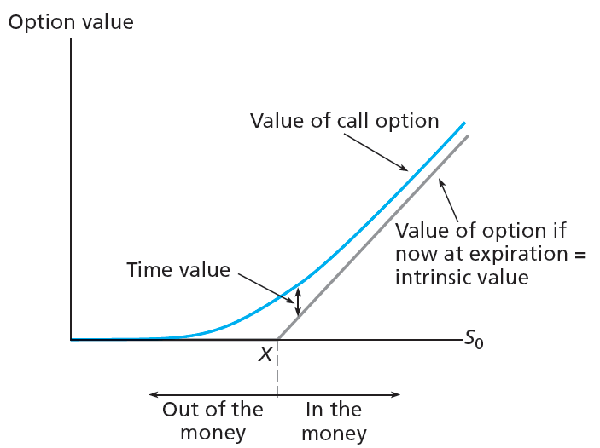
Figure 16.1 Call Option Value before Expiration

Slide 5
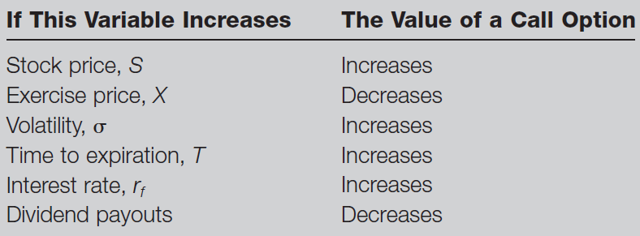
Table 16.1 Determinants of Call Option Values

Slide 6
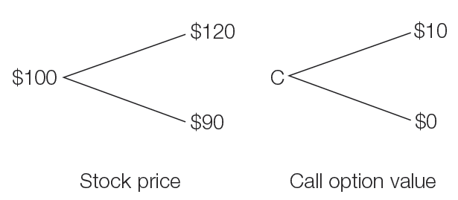
16.2 Binomial Option Pricing
Two-State Option Pricing
Assume stock price can take one of two values
Increase by u = 1.2, or fall by d = .9

Slide 7
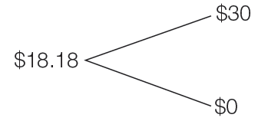
16.2 Binomial Option Pricing
Two-State Option Pricing
Compare payoff to one share of stock, borrowing of $81.82 10% interest
Outlay is $18.18; payoff is three times call option

Slide 8
16.2 Binomial Option Pricing
Two-State Option Pricing
Portfolio of one share and three call options is perfectly hedged
Hedge ratio for two-state option

Slide 9
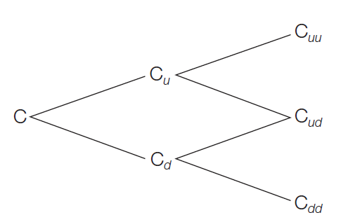
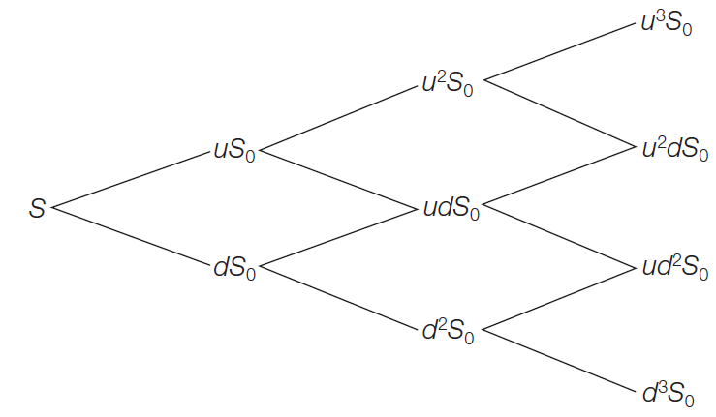
16.2 Binomial Option Pricing
Generalizing the Two-State Approach
Break up year into two intervals
Subdivide further using the same pattern

Slide 10
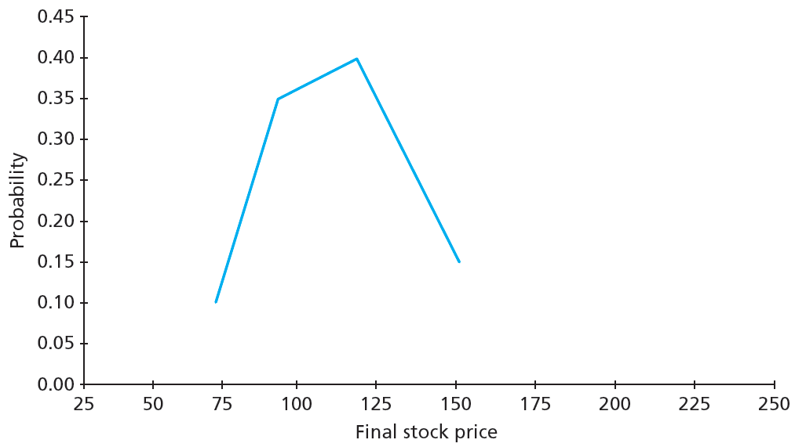
Figure 16.2A Probability Distributions for Final Stock Price, Three Subintervals

Slide 11
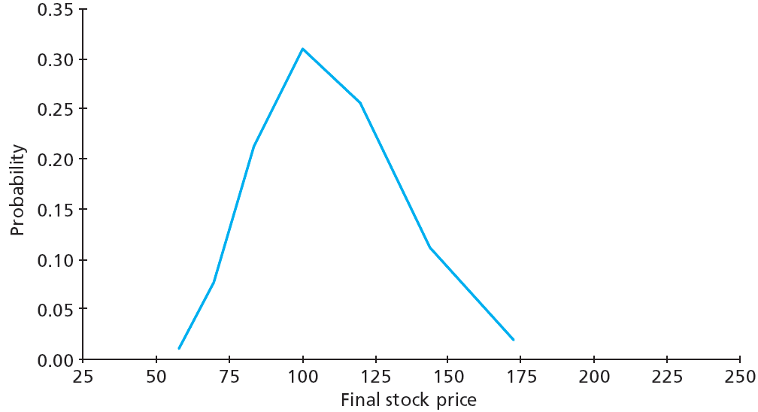
Figure 16.2B Probability Distributions for Final Stock Price, Six Subintervals

Slide 12
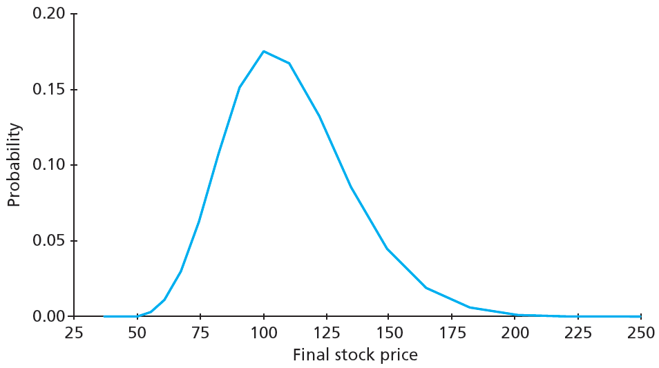
Figure 16.2C Probability Distributions for Final Stock Price, 20 Subintervals

Slide 13
16.3 Black-Scholes Option Valuation
Black-Scholes Pricing Formula
Where

Slide 14
16.3 Black-Scholes Option Valuation
Black-Scholes Pricing Formula
And where
$C_{0}$ = Current call option value
$S_{0}$ = Current stock price
N(d) = Probability of random draw < d
X = Exercise price
e = Base of natural log function, roughly 2.71828
δ = Annual dividend yield of underlying stock

Slide 15
16.3 Black-Scholes Option Valuation
Black-Scholes Pricing Formula
And where
r = Risk-free interest rate
T = Time until expiration
ln = Natural logarithm
σ = Standard deviation of annualized continuously compounded RoR

Slide 16
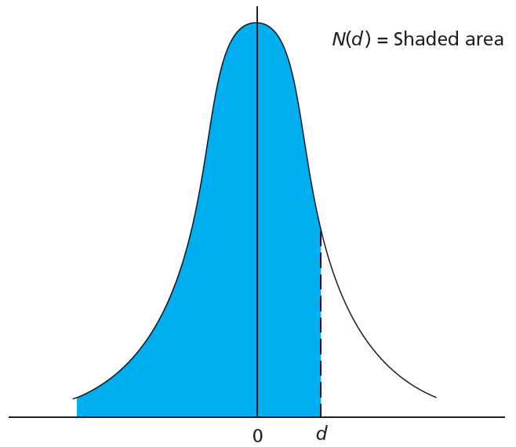
Figure 16.3 Standard Normal Probability Function

Slide 17
16.3 Black-Scholes Option Valuation
Black-Scholes Pricing Formula
Implied volatility
Standard deviation of stock returns consistent with option’s market value

Slide 18
Spreadsheet 16.1 Black-Scholes Call Option Values

Slide 19
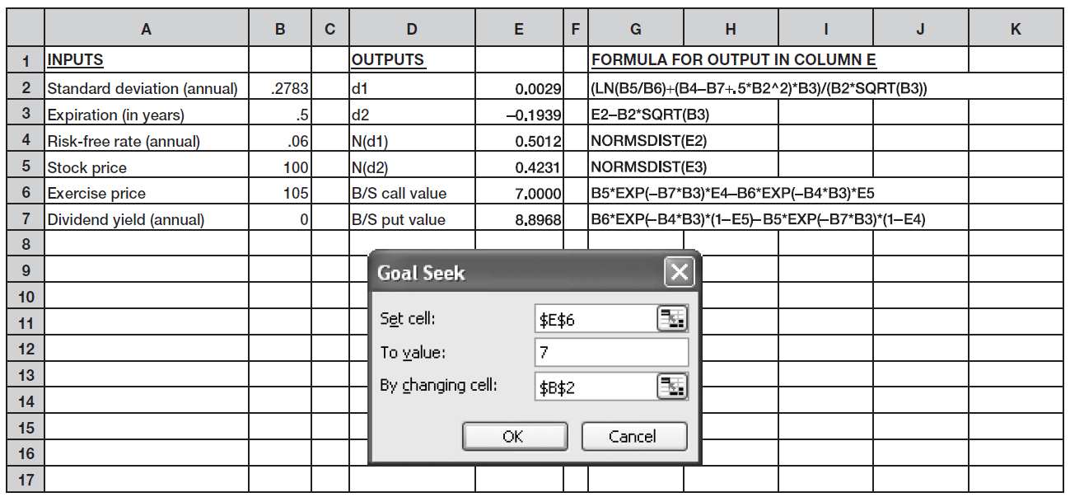
Figure 16.4 Finding Implied Volatility

Slide 20
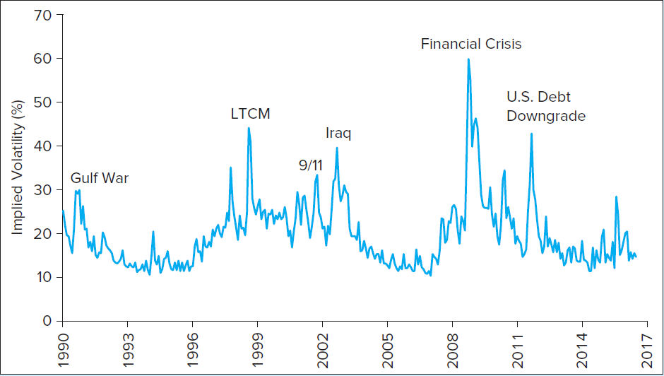
Figure 16.5 Implied Volatility of S&P 500

Slide 21
16.3 Black-Scholes Option Valuation
Put-Call Parity Relationship
Represents relationship between put and call prices
Extension for European call options on dividend-paying stocks

Slide 22
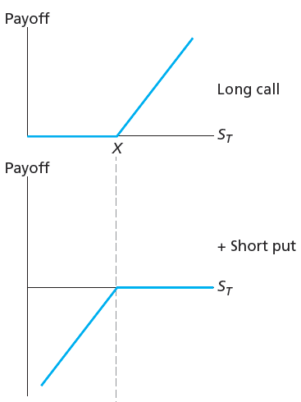
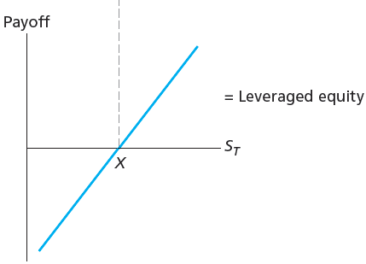
Figure 16.6 Payoff-Pattern of Long Call–Short Put Position

Slide 23
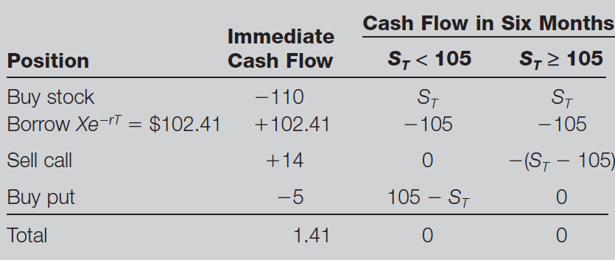
Table 16.3 Arbitrage Strategy

Slide 24
16.3 Black-Scholes Option Valuation
Put Option Valuation
Black-Sholes formula for European put option

Slide 25
16.4 Using the Black-Scholes Formula
Hedge Ratios and Black-Scholes Formula
Hedge ratio or delta
Number of shares required to hedge price risk of holding one option
Option elasticity
Percentage increase in option’s value given 1% increase in value of underlying security

Slide 26
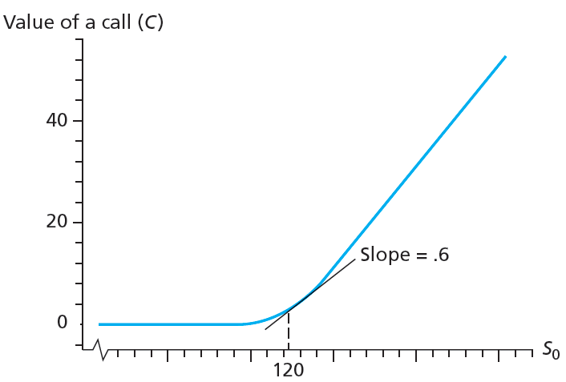
Figure 16.7 Call Option Value and Hedge Ratio

Slide 27
16.4 Using the Black-Scholes Formula
Portfolio Insurance
Portfolio strategies that limit investment losses while maintaining upside potential
Dynamic hedging
Constant updating of hedge positions as market conditions change

Slide 28
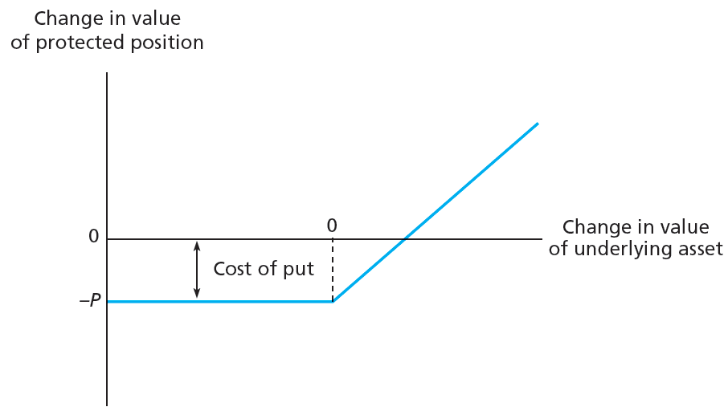
Figure 16.8 Profit on Protective Put Strategy

Slide 29
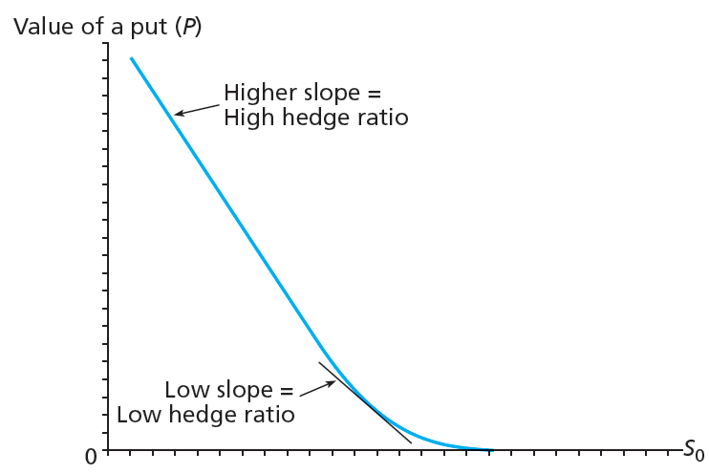
Figure 16.9 Hedge Ratios Change as Stock Price Fluctuates

Slide 30
16.4 Using the Black-Scholes Formula
Option Pricing and the Crisis of 2008-2009
When banks buy debt with limited liability, they implicitly write put option to borrower

Slide 31
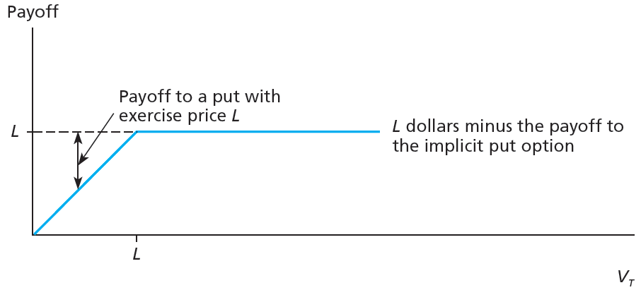
Figure 16.10 Risky Loan

Slide 32
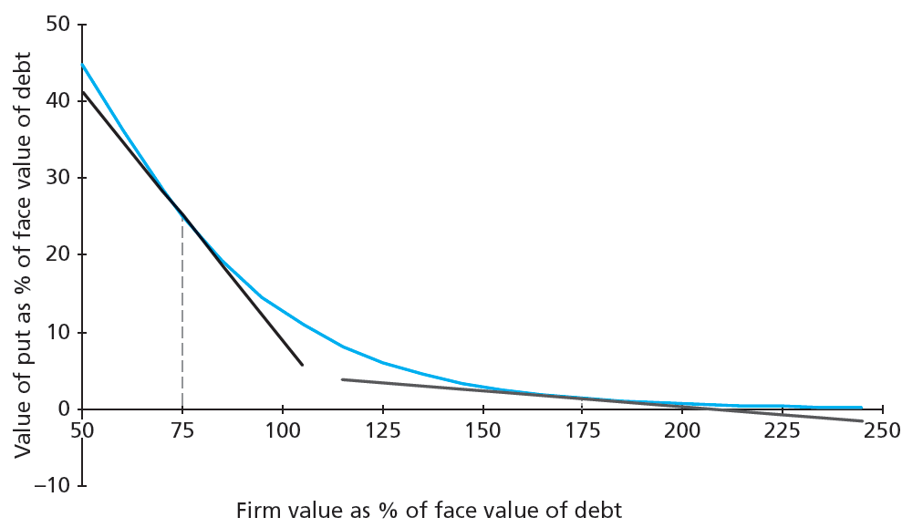
Figure 16.11 Value of Implicit Put Option on Loan Guarantee as % of Face Value of Debt

Slide 33
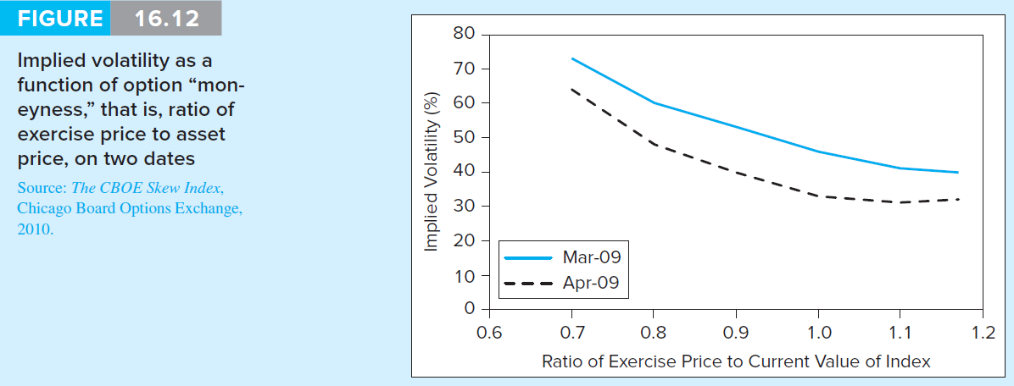
Figure 16.12 Implied Volatility

