Slide 1
Futures Markets and Risk Management
17
Bodie, Kane, and Marcus
Essentials of Investments Eleventh Edition

Slide 2
17.1 Futures Contract
Forward Contract
Arrangement calling for future delivery of asset at agreed-upon price
Basics
Futures price
Agreed-upon price paid on futures contract at maturity
Long position
Trader who commits to purchasing asset
Short position
Trader who commits to delivering asset

Slide 3
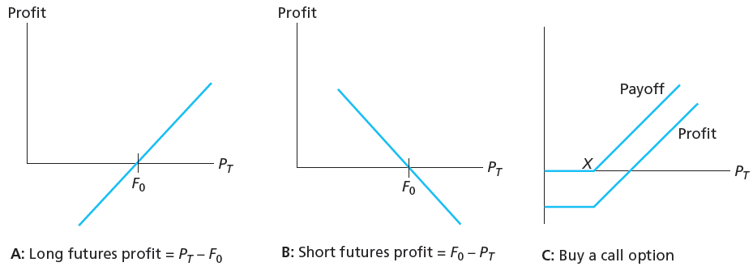
Figure 17.2 Profits to Buyers/Sellers of Futures and Options

Slide 4
17.1 Futures Contracts
Existing Contracts
Single stock futures
Futures contract on shares of individual company

Slide 5
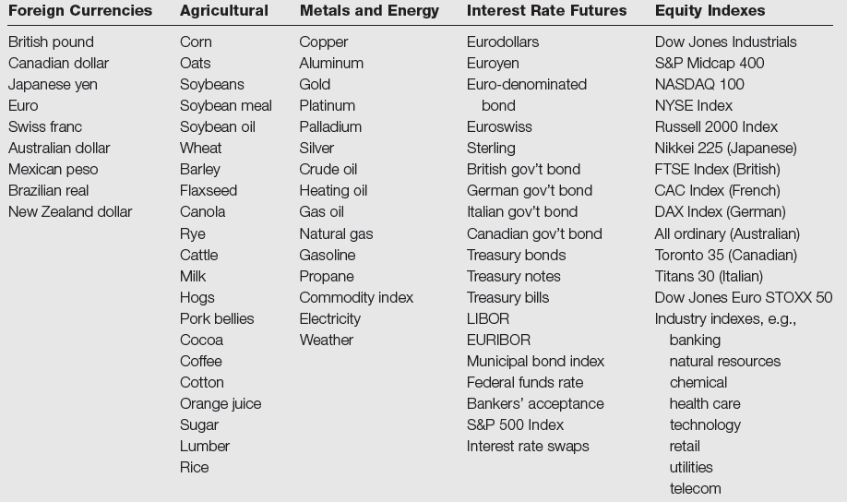
Table 17.1 Samples of Futures Contracts

Slide 6
17.2 Trading Mechanics
Clearinghouse and Open Interest
Clearinghouse
Facilitates trading; may be intermediary between two traders
Closing out positions
Reversing trade
Take or make delivery
Most trades reversed and do not involve actual delivery
Open interest
Opened contracts not offset with reversing trade

Slide 7
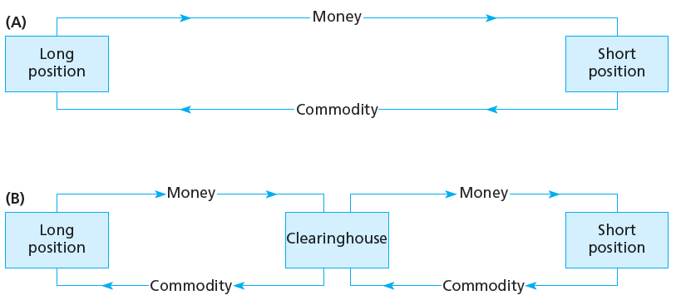
Figure 17.3 Trading with and without Clearinghouse

Slide 8
17.2 Trading Mechanics
Marking to Market and Margin Account
Marking to Market
Daily settlement of obligations on futures positions
Maintenance Origin
Value below which trader’s margin may not fall; triggers margin call
Convergence Property
Convergence of futures prices/spot prices at maturity of futures contract

Slide 9
17.2 Trading Mechanics
Cash versus Actual Delivery
Cash settlement
Cash value of underlying asset delivered to satisfy contract

Slide 10
17.2 Trading Mechanics
Cash versus Actual Delivery
Regulations
Regulated by Commodity Futures Trading Committee (CFTC)
Exchange can set limits on one-day price changes
Taxation
Paid at year-end on cumulative profits/losses regardless of whether position is closed

Slide 11
17.3 Futures Market Strategies
Trading Strategies
Speculation
Short if you believe price will fall
Long if you believe price will rise
Hedging
Long: Endowment fund will purchase stock in 3 months; manager buys futures now to protect against rise in price
Short: Hedge fund invests in long-term bonds; manager worries interest rates may increase and sells futures

Slide 12
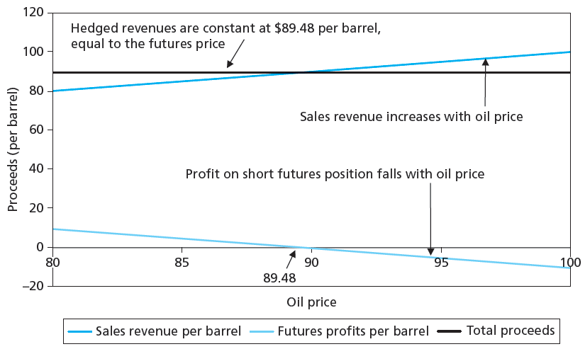
Figure 17.4 Hedging Revenues Using Futures

Slide 13
17.3 Futures Market Strategies
Basis and Hedging
Basis
Difference between futures price and spot price
Basis risk
Risk attributable to uncertain movements in spread between futures price and spot price
Spread (futures)
Taking long position in futures contract of one maturity and short position in another, in same commodity

Slide 14
17.4 Futures Prices
Spot-Futures Parity Theorem
Purchase commodity now, store to T
Simultaneously take short position in futures
“All-in cost” of purchasing commodity and storing it (including cost of funds) must equal futures price to prevent arbitrage

Slide 15
17.4 Futures Prices
No-Arbitrage Condition
Strategy: Cost 0 initially, cash flow at T must = 0, therefore:
F₀ – S₀(1 + r_{f})^{T} = 0
F₀ = S₀ (1 + r_{f})^{T}
Futures price = Spot price – Cost of carry
Action | Initial Cash Flow | Cash Flow at T
1. Borrow S₀ | S₀ | -S₀(1+r_{f})^{T}
2. Buy spot for S₀ | -S₀ | S_{T}
3. Sell futures short | 0 | F₀ - S_{T}
Total | 0 | F₀ - S₀(1 + r_{f})^{T}

Slide 16
17.4 Futures Prices
No-Arbitrage Condition
Strategies have same cash flows at same time, T
F₀/(1 + r_{f})^{T} = S₀
F₀ = S₀(1 + r_{f})^{T}
Futures price = Spot price - Cost of carry
 | Action | Initial Flows | Flows at T
Strategy A: | Buy gold | −S₀ | S_{T}
Strategy B: | Long Futures | 0 | S_{T} − F₀
 | Invest in bills: F₀/(1 + r_{f})^{T} | −F₀/(1 + r_{f})^{T} | F₀
 | Total for B | −F₀/(1 + r_{f})^{T} | S_{T}

Slide 17
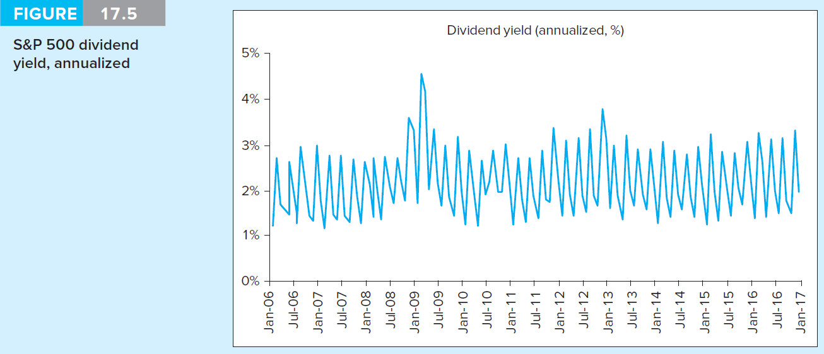
Figure 17.5 S&P 500 Monthly Dividend Yield

Slide 18
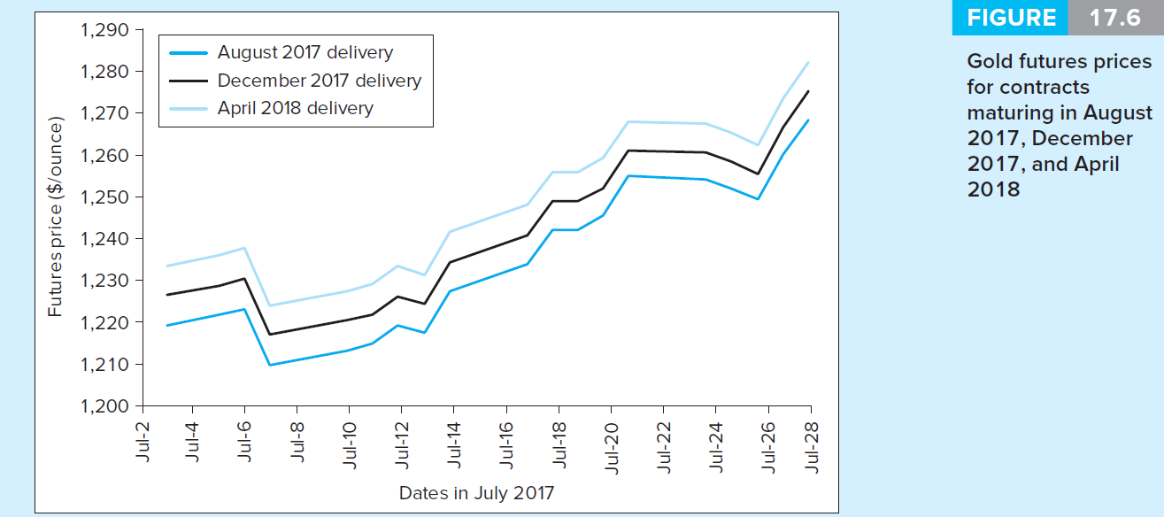
Figure 17.6 Gold Futures Prices

Slide 19
17.5 Financial Futures
Stock-Index Futures
Available on domestic and international stocks
Several advantages over direct stock purchase
Lower transaction costs
Easier to implement timing/allocation strategies

Slide 20
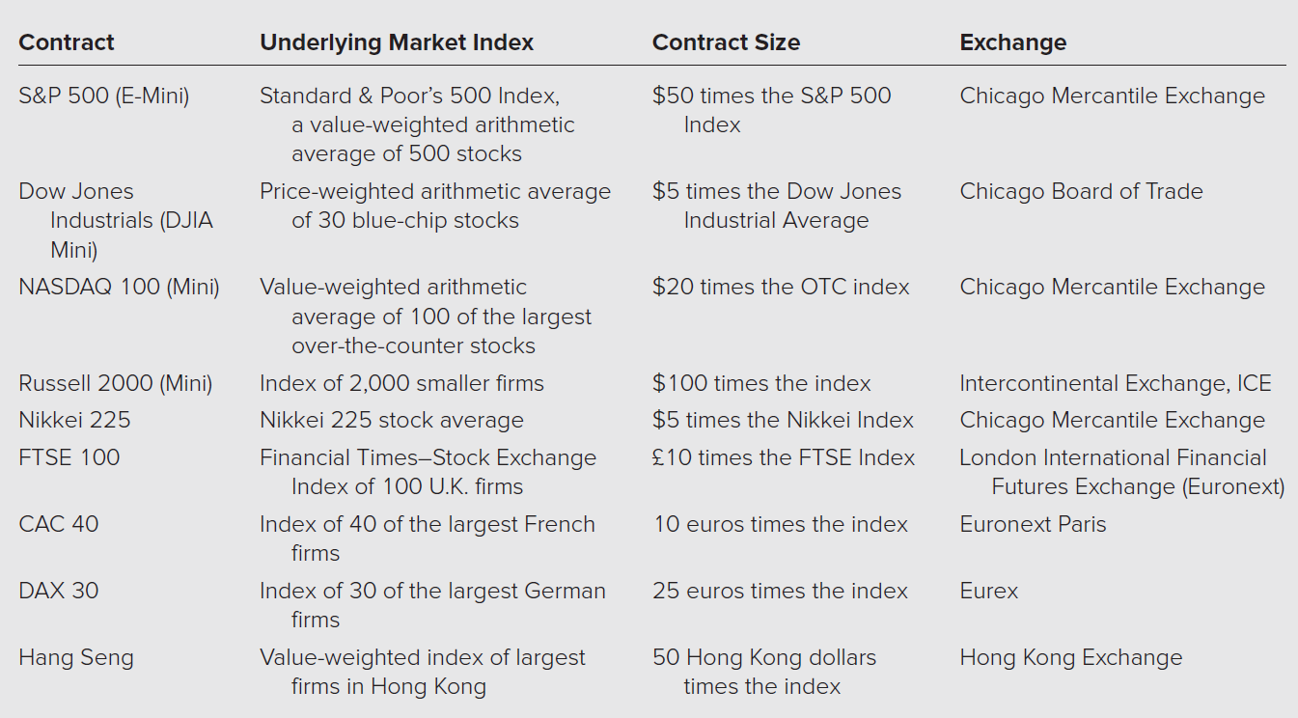
Table 17.2 Stock Index Futures

Slide 21
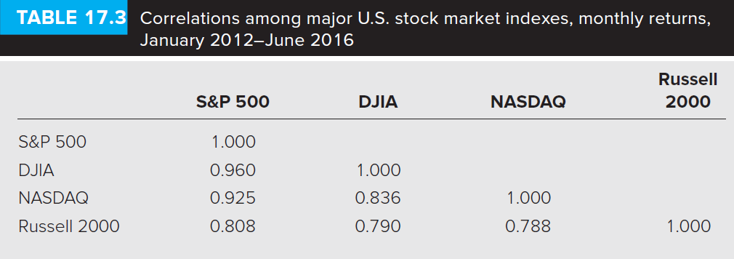
Table 17.3 Correlations among Indexes

Slide 22
17.5 Financial Futures
Creating Synthetic Stock Positions
Synthetic stock purchase
Purchase of stock-index futures instead of actual shares
Allows frequent trading at low cost
Useful for foreign investments
Classic market-timing strategy
Switch between Treasury bills and stocks based on market conditions
Cheaper to buy Treasury bills then shift stock market exposure by buying and selling stock-index futures

Slide 23
17.5 Financial Futures
Index Arbitrage
Exploiting mispricing between underlying stocks and futures index contract
Futures price too high
Short futures; buy underlying stocks
Futures price too low
Long futures; sell underlying stocks

Slide 24
17.5 Financial Futures
Index Arbitrage
Difficult to do in practice
Transaction costs often too large
Trades must be done simultaneously
Program Trading

Slide 25
17.5 Financial Futures
Foreign Currency
Forward contracts
Currency markets largest in world
Available from large banks
Used extensively to hedge foreign currency transactions
Futures contracts available for major currencies at CME, the LIFFE, etc.
March, June, September, December delivery contracts available

Slide 26
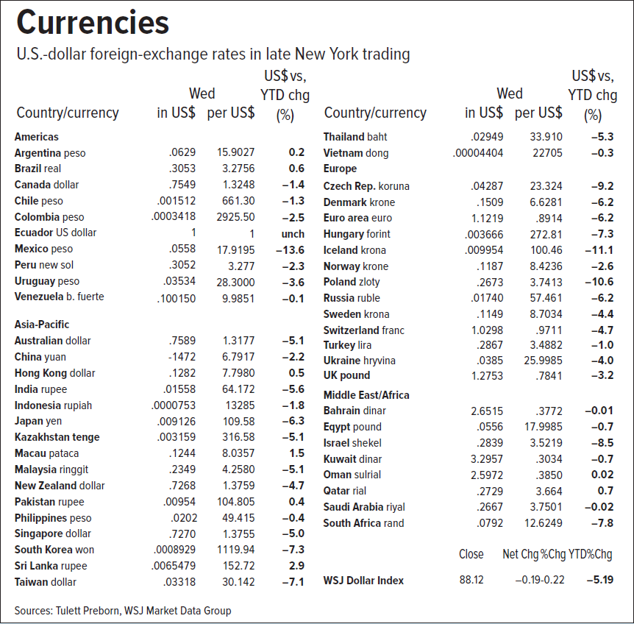
Figure 17.7 Foreign Exchange Rates

Slide 27
17.5 Financial Futures
Interest Rate Futures
Major contracts include: Eurodollars, Treasury bills, Treasury notes, and Treasury bonds
Some foreign interest rate contracts are also available
Short position in contracts will benefit if interest rates increase
Long position benefits if interest rates fall

Slide 28
17.5 Financial Futures
Interest Rate Futures
Hedging with futures often requires cross-hedge
Hedging spot position with a futures contract that has different underlying asset
Example: Hedge corporate bond by selling Treasury-bond futures

Slide 29
17.6 Swaps
Interest rate swaps
One pays the other a fixed rate of interest in exchange for a variable rate of interest
No principal exchanged

Slide 30
17.6 Swaps
Currency Swaps
Two parties agree to swap principal and interest payments at a fixed exchange rate
Firm may borrow money in whatever currency has lowest interest rate and then swap payments into currency preferred

