Slide 1
Investors and the Investment Process
22
Bodie, Kane, and Marcus
Essentials of Investments Eleventh Edition

Slide 2
Table 22.1 Components of Investment Management Process

Slide 3
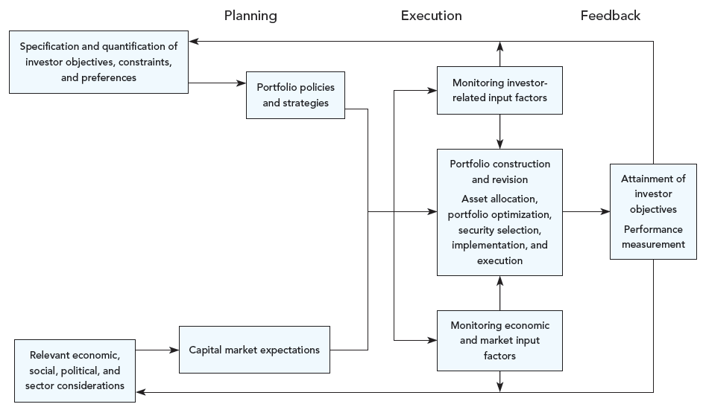
Figure 22.1 Investment Management Process

Slide 4
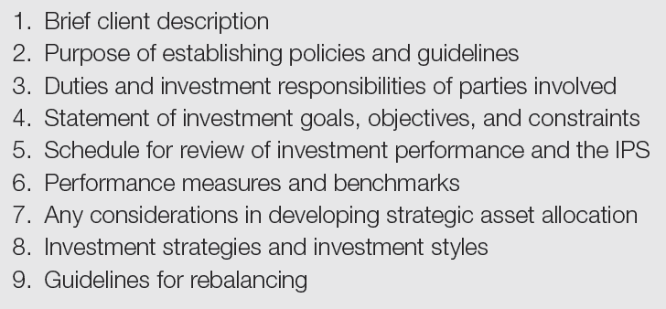
Table 22.2 Components of Investment Policy Statement

Slide 5
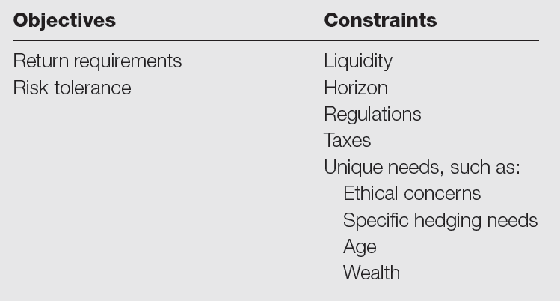
Table 22.3 Determination of Portfolio Policies

Slide 6
22.2 Investor Objectives
Individual Investors
Balance risk/return throughout life
Wealth shifts from human capital to financial capital with age, increasing portfolio choice importance
Life cycle critical in determining risk-return trade-off
Younger investors
Willing to bear more risk for higher returns
Older investors
Willing to accept lower returns for lower risk

Slide 7
22.2 Investor Objectives
Professional Investors
Personal trusts
Trustee holds interest in asset for benefit of another person
Management subject to prudent investor rules
Mutual funds
Objectives vary with type of fund
Detailed in prospectus

Slide 8
22.2 Investor Objectives
Professional Investors
Pension funds
Defined benefit: Depends on tenure, salary; investment risk borne by company
Defined contribution: Employee and employer contribute set amount to individual’s retirement fund; benefit depends on investment performance; investment risk borne by individual

Slide 9
22.2 Investor Objectives
Professional Investors
Endowment funds
Gifts to nonprofits that are invested
Funds from endowment used by the nonprofit

Slide 10
22.2 Investor Objectives
Insurance Companies
Life insurance companies
Term insurance
Whole-life policies (insurance + savings at fixed rate)
Variations of the two with variable-rate savings
Investments set up as hedges against potential claims of policyholders

Slide 11
22.2 Investor Objectives
Insurance Companies
Non-life-insurance companies
Premiums not paid back to policyholders for losses, are invested
Hedge against potential claims

Slide 12
22.2 Investor Objectives
Banks
Sources of funds: predominantly deposits, some borrowed funds
Investment of funds: predominantly loans and fixed-income securities
Active in securitized loan and asset markets
Not active in equity except in trust function

Slide 13
Table 22.4 Matrix of Objectives

Slide 14
22.3 Investor Constraints
Liquidity
Speed and ease with which asset can be converted into cash at or near its value
Need for cash on short notice increases liquidity requirement, decreases return
Investment Horizon
Planned liquidation date
Affects portfolio risk and security maturity dates

Slide 15
22.3 Investor Constraints
Regulations
Institutional investors
Example: Mutual funds may not hold more than 5% of the stock of any publicly traded corporation
Prudent investor rule
The fiduciary responsibility of a professional investor

Slide 16
22.3 Investor Constraints
Tax Considerations
Special considerations related to tax position of investor
Unique Needs
Special considerations related to underlying investors
Diversify away from industry in which they work
Financial needs may determine riskiness of portfolio

Slide 17
Table 22.5 Matrix of Constraints

Slide 18
22.4 Investment Policies
Asset Allocation Decision
Money market assets
Based on liquidity needs
Used to gain more diversification
Fixed-income securities
Primarily bonds
Gain diversification and safety with higher real return than money market

Slide 19
22.4 Investment Policies
Asset Allocation Decision
Stocks
Value versus growth
Large versus small
Sector weights
Dividend versus capital gains

Slide 20
22.4 Investment Policies
Asset Allocation Decision
Non-U.S. stocks and bonds
Real estate
REITs
Direct holdings
Precious metals and other commodities
Difficult to predict value; no cash flow

Slide 21
22.4 Investment Policies
Asset Allocation Decision
Choices determined by:
Capital market expectations
Risk tolerance
Financial needs

Slide 22
22.4 Investment Policies
Top-Down Policy for Institutional Investors
Investment Committee
Comprised of senior management; formulates investment policies and verifies implementation
Establishes asset universe (approved list of assets in which company’s portfolios may invest)
Formulates broad asset allocation decisions

Slide 23
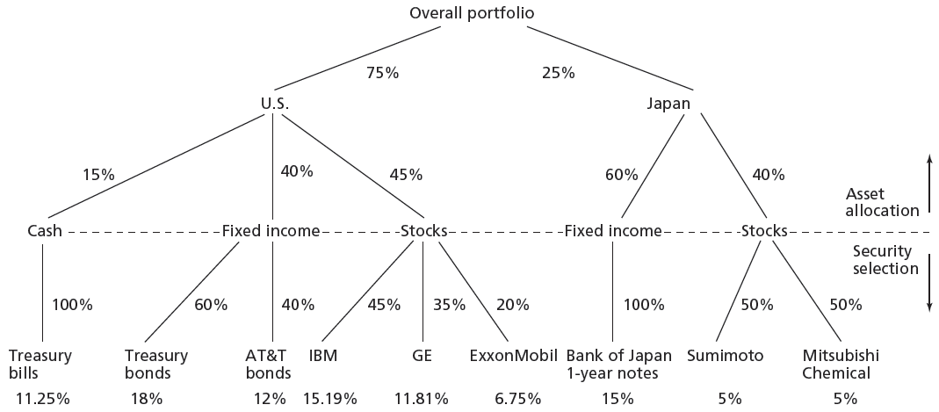
Figure 22.2 Asset Allocation and Security Selection

Slide 24
22.4 Investment Policies: Active vs. Passive
Active | Passive
Aims for Better than Average Returns | Aims for Average Returns
Active Asset Allocation | Does not Attempt to Time the Market
Active Security Selection | Indexing
Balance Likelihood of Better Returns with Costs | Seeks Low Cost Financial Products

Slide 25
22.5 Monitoring and Revising Investment Portfolios
By time of completion, inputs may be out of date → strategy revisions
Client circumstances can change over time
As prices change → Portfolio weights change
Asset allocation will change over time
Investing is a dynamic process: Update and Reevaluate

