Slide 1

A86012 Management and Principles of Accounting (2019/2020)
Session 9
Finance
Accounting & Financial Statements
Paul G. Smith B.A., F.C.A

Slide 2
session Objectives & Overview

Slide 3
Course Overview
1. What is business | 15. Accounting: glossary, vocabulary, terms
2. Types of business | 16. Introduction to financial accounting
3. Management | 17. Accounting for business transactions
4. Review session 1 | 18. Recording transactions, journal and ledger
5. Marketing | 19. Recording owner’s contributions & financing
6. Marketing strategy | 20. Review session 1
7. Review session 2 | 21. Recording long-lived assets and investments
8. Operations | 22. Recording purchases
9. Finance | 23. Recording sales and employee compensation
10. Financial management | 24. Review session 2
11. Review session 3 | 25. Adjusting and closing entries
12. Human resources | 26. Adjusting and closing entries …continued
13. Review session 4 | 27. Cases and exercises
14. Exam | 28. Exam
SG
PGS
PT

Slide 4
Session Objectives
At the end of this session students will be able to define accounting and illustrate the different uses of accounting information, demonstrate the accounting process, understand the purpose and content of the income statement, balance sheet and cash flow statement. Students will also understand the difference between financial accounting and management accounting and the principal control mechanisms over Public Interest Entities (PIEs).

Slide 5
Session 9 Overview
 | Mins
Session objectives and outline | 5
Recap of key points from session 8 – Operations | 15
The accounting process: The nature of accounting, accountants, the accounting equation | 30
Financial accounting: Accounting standards (GAAP), double entry bookkeeping, the accounting cycle, the income statement, balance sheet, statement of cash flows. | 30
Management accounting: Budgeting and forecasting and budgetary control, cost accounting for decision taking, fixed and variable costs, break-even analysis, variance analysis | 20
Audit and control: Audit committees, supervisory boards, reporting on internal control (COSO), internal audit, external audit. | 20
Required reading and research Reading Business Chapter 14 Research RA 9 Europe’s top companies – How are they Financed? | 5
Overview of session 10 – Financial Management | 5
Summary and validation | 5
 | 135

Slide 6
Recap of session 8 - Operations

Slide 7
Session 8 Summary
The nature of operations management in manufacturing and service industries
Planning and designing operations systems
Supply chain management, inventory control
Managing quality

Slide 8
Recap Session 8
What do we mean by operations management?
How does this differ between manufacturing and service organizations?
What decisions need to be made in planning and designing operations systems?
What do we mean by supply chain management?
Name some of the quality frameworks applied by organizations

Slide 9
Overview of Session 9
The nature of accounting, accountants, bookkeeping, uses of accounting information,
The accounting process, the accounting equation, double-entry bookkeeping, the accounting cycle
Financial statements, accounting standards (GAAP)
Ratio analysis
Importance of integrity in accounting

Slide 10
The nature of accounting

Slide 11
The Nature of Accounting 1 of 9
Accounting
  Recording, measurement, and interpretation of financial information
Accountants
  Certified public accountant (CPA)
    State certified to provide accounting services
Source: M Business 6th Edition
Notes:
Accounting is the recording, measurement, and interpretation of financial information.
Individuals and businesses can hire a certified public account (CPA), an individual who has been state certified to provide accounting services ranging from the preparation of financial records and the filing of tax returns to complex audits of corporate financial records.

Slide 12
The Nature of Accounting 2 of 9
Accountants continued
  Legislation
    After accounting scandals of Enron and Worldcom in early 2000s, Congress passed Sarbanes-Oxley Act
      Required firms to be more rigorous in their accounting and reporting practices
    During latest financial crisis, banks developed questionable lending practices, leading to Dodd Frank Act
      Strengthens oversight of financial institutions
Source: M Business 6th Edition

Slide 13

World Com
https://youtu.be/hXSWAK0K5L4
Motivation
Rationalization
Opportunity
The Fraud Triangle

Slide 14
The Nature of Accounting 3 of 9
Accountants continued
  Forensic accounting
    Fit for legal review
    Analyzes financial documents in search of fraudulent entries or financial misconduct
    Function as much like detectives as accountants
    Used since 1930s, but booming since accounting scandals of early 2000s
    Root out evidence of “cooked books” for federal agencies
Source: M Business 6th Edition

Slide 15
accountants

Slide 16
What is an Accountant?
A man past middle age, spare, wrinkled, intelligent, cold, passive, non-committal, with eyes like a codfish; polite in contact but at the same time unresponsive, calm and damnably composed as a concrete post or a plaster of Paris cast; a petrification with a heart of feldspar and without charm of the friendly germ, minus bowels, passion or a sense of humour. Happily they never reproduce and all of them finally go to hell.
Elbert Hubbard

Slide 17
Or
A highly skilled technician – well educated, complex, confident, intelligent, optimistic – who abhors detailed direction. He expects to be influenced, persuaded and enlightened. He wants to be confronted with choices and alternatives, demanding freedom to structure his work, select his alternatives, present his solutions and speak for himself. He refuses to be considered as an automaton who is supposed to respond eagerly to orders, edicts and ultimatums.
Joseph R. Dugan

Slide 18
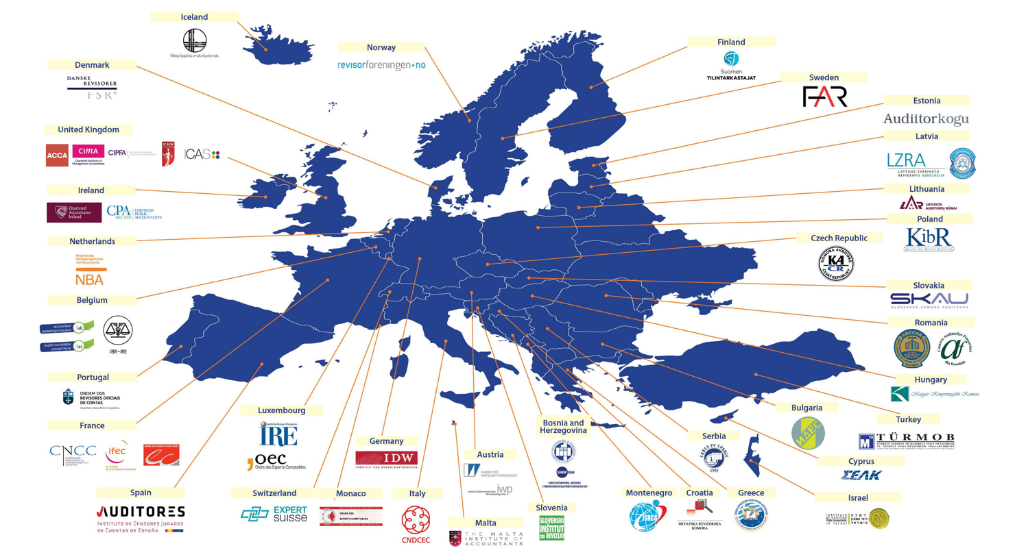
Accountants in Europe - FEE
Source:Fédération des Experts-comptables Européens - Federation of European Accountants |

Slide 19
The Evolution of the Big 4
1984
1. Arthur Andersen (AA) |  |  |  | Ceased business in 2002 post Enron
2. Arthur Young (AY)
3. Coopers & Lybrand (C&L)
4. Deloitte, Haskins & Sells (DHS) |  |  |  | DTT | 1990
5. Ernst & Whinney (E&W) |  |  |  | EY | 1989
6. Peat, Marwick, Mitchell (PMM) |  |  |  | KPMG | 1987
7. Price Waterhouse (PW) |  |  |  | PwC | 1998
8. Touche Ross (TR)
Klynvelt, Main, Goerdeler (KMG)
1989 Failed

Slide 20
accountants

Slide 21
The Nature of Accounting 4 of 9
Accountants continued
  Private accountants
    Employed by large corporations, government agencies, and other organizations to prepare and analyze their financial statements
    Deeply involved in most important financial decisions
  Certified management accountants (CMAs)
    Private accountants who, after rigorous examination, are certified by the National Association of Accountants and who have some managerial responsibility
Source: M Business 6th Edition
Notes:
Private accountants are employed by large corporations, government agencies, and other organizations to prepare and analyze their financial statements.
Private accountants can be CPAs and may become certified management accountants (CMAs), or private accountants who, after rigorous examination, are certified by the National Association of Accountants and who have some managerial responsibility.

Slide 22
Accountants
Accountants
Financial
Management
Governmental
CPA (US)
ACA (UK)
ACCA (UK)
CMA (US)
CIMA (UK)
AGA (US)
CIPFA (UK)

Slide 23
The Nature of Accounting 5 of 9
Accounting or Bookkeeping?
  Bookkeeping is typically limited to the routine, day-to-day recording of business transactions
    Much narrower and far more mechanical
    Require less training
    Responsible for obtaining and recording information accounts require to analyze firm’s financial position
  Accountants usually complete course work beyond basic four- or five-year college degree
Source: M Business 6th Edition

Slide 24
The Nature of Accounting 6 of 9
The Uses of Accounting Information
  Managers and owners use financial statements:
    To aid in internal planning and control
    For external purposes such as reporting to the Internal Revenue Service, stockholders, creditors, customers, employees, and other interested parties
Source: M Business 6th Edition

Slide 25
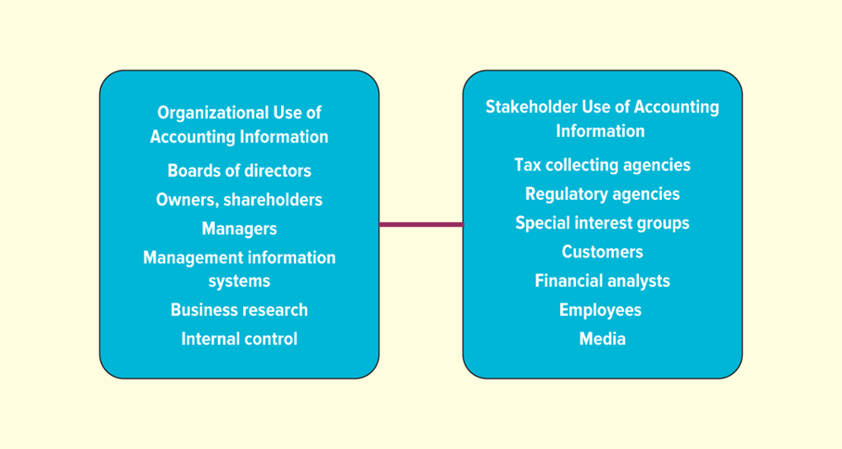
Figure 14-1 The Users of Accounting Information
Source: Adapted from Needles, Belverd E., Anderson, Henry R., and Caldwell, James C., Principles of Accounting, 4th ed. New York: Houghton Mifflin Company, 1990.
Source: M Business 6th Edition
Jump to long description in appendix

Slide 26
The Nature of Accounting 7 of 9
The Uses of Accounting Information continued
  Internal uses
    Managerial accounting
      Used in planning and directing activities
    Cash flow
      Movement of money through organization
    Budget
      Forecasts expenses and income
Source: M Business 6th Edition
Notes:
Managerial accounting refers to the internal use of accounting statements by managers in planning and directing the organization’s activities.
Perhaps management’s single greatest concern is cash flow, the movement of money through an organization over a daily, weekly, monthly, or yearly basis.
Managerial accountants also help prepare an organization’s budget, an internal financial plan that forecasts expenses and income over a set period of time.

Slide 27
financial accounting

Slide 28
The Nature of Accounting 8 of 9
The Uses of Accounting Information continued
  External uses
    Used for filing income taxes, obtaining credit, and reporting results to stockholders
    Annual report
      Summary of financial information, products, and growth plans
      Audited financial statements are signed off on by certified public accountant
Source: M Business 6th Edition
Notes:
The annual report is a summary of the firm’s financial information, products, and growth plans for owners and potential investors.

Slide 29

Annual Reports
Many investors look at a firm’s annual report to determine how well the company is doing financially.
Source: M Business 6th Edition
©kenary820/Shutterstock.com RF

Slide 30
The Nature of Accounting 9 of 9
The Uses of Accounting Information continued
  Greece and deceptive accounting practices
    During global financial crisis, Greece was engaging in deceptive accounting practices
      Used financial techniques to hide massive amounts of debt from public balance sheet
      European Union and International Monetary Fund gave loans and credit relief
    Many states, including Illinois and California, had same debt overload problems
Source: M Business 6th Edition

Slide 31
Fraudsters and Tipsters: Achieving Balance in the Accounting World
Fraud in Businesses
  Remains difficult to spot
  One-third lasts two years before detection
  Up to employees to blow whistle
Methods for Curbing Fraud
  Anonymous employee hotlines
  Watch for employee lifestyle changes
Source: M Business 6th Edition
Notes:
Discussion Questions
1. Why do you think fraud is a significant financial issue in most businesses?
2. What is the best way to prevent fraud?
3. As a manager, how would you try to detect fraud?

Slide 32
The accounting equation

Slide 33
The Accounting Process 1 of 4
The Accounting Equation
  Assets = Liabilities + Owners’ Equity
    Assets
      Economic resources or items of value
    Liabilities
      Debts
    Owners’ equity
      Assets minus liabilities
Source: M Business 6th Edition
Notes:
The accounting equation is assets equal liabilities plus owners’ equity.
Assets are a firm’s economic resources, or items of value that it owns, such as cash, inventory, land, equipment, buildings, and other tangible and intangible things.
Liabilities are debts that a firm owes to others.
Owners’ equity equals assets minus liabilities and reflects historical values.

Slide 34
Accounting standards – Generally accepted accounting principles (GAAP)

Slide 35

Accounting Standards
Different entities have different standards for their accounting methods
Public and private businesses follow the Generally Accepted Accounting Principles (GAAP) method
  GAAP is generally used in the United States as the standard for accounting methods (established by the Financial Accounting Standards Board (FASB))
Local government entities have a different set of accounting standards which are set by the Governmental Accounting Standards Board (GASB)
Federal government follows yet another set of standards determined by the Federal Accounting Standards Advisory Board (FASAB)
Another set of standards for international companies which follow the International Financial Reporting Standards (IFRS)
Source: M Business 6th Edition
Source: M Business 5th edition
Notes:
Accounting Standards
Different entities have different standards for their accounting methods. For example, public and private businesses follow the Generally Accepted Accounting Principles (GAAP) method. GAAP is generally used in the United States as the standard for accounting methods. These principles are established by the Financial Accounting Standards Board (FASB). Local government entities have a different set of accounting standards which are set by the Governmental Accounting Standards Board (GASB), and the federal government follows yet another set of standards determined by the Federal Accounting Standards Advisory Board (FASAB). Further, there is another set of standards for international companies which follow the International Financial Reporting Standards (IFRS).

Slide 36
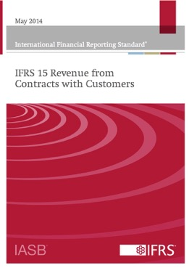
Accounting Standards
Generally
Accepted
Accounting
Principles

Slide 37
The nature of accounting
Recognition
Measurement
Subsequent measurement
Presentation
Disclosure
De-recognition
Language of the Accounting Standards

Slide 38
bookkeeping

Slide 39
The Accounting Process 2 of 4
Double-Entry Bookkeeping
  Requires classification and balancing
    To keep accounting equation in balance, each transaction must be recorded in two separate accounts
    All transactions classified as either assets, liabilities, or owner’s equity
    Assets broken down into cash, inventory, and equipment
    Liabilities broken down into bank loans, supplier credit, and other debts
Source: M Business 6th Edition
Notes:
Double-entry bookkeeping is a system of recording and classifying business transactions that maintains the balance of the accounting equation.

Slide 40
Double-entry Bookkeeping
Every debit must have a credit
Income Statement
Revenues
-
Expenses
=
Profit/Loss
Credit
Debit
Balance Sheet
Assets
-
Liabilities
=
Shareholders’ Equity
Debit
Credit
Credit

Slide 41
The accounting cycle

Slide 42
The Accounting Process 3 of 4
The Accounting Cycle
  Four-step procedure of an accounting system
    Examining source documents
    Recording transactions in accounting journal
    Posting recorded transactions
    Preparing financial statements
Source: M Business 6th Edition
Notes:
In any accounting system, financial data typically pass through a four-step procedure sometimes called the accounting cycle.

Slide 43
The Accounting Process 4 of 4
The Accounting Cycle continued
  Journal
    Time-ordered list of account transactions
  Ledger
    Book or computer file with separate sections for each account
Source: M Business 6th Edition
Notes:
Accountants record each financial transaction in a journal, which is basically just a time-ordered list of account transactions.
They transfer the information from a journal into a ledger, a book or computer file with separate sections for each account.

Slide 44
The Accounting Cycle
Management
Accounting
Management
Accounts
Purchase
Invoices
General
Ledger
Financial Statements
Purchase
Invoices
Journal
Purchase
Invoices
Purchase
Invoices
Purchase
Invoices
(COGE/COIN)
Examine Source documents
Prepare Financial Statements
Record transactions
Post transactions
Codify:
Supplier
Account type (asset/expense)
Record Debits and Credits
Post to asset or expense accounts and supplier account
Post to cost centers
Extract account balances at period end

Slide 45
Table 14-2 Equivalent Terms in Accounting
Term | Equivalent Term
Revenues | Sales Goods or services sold
Gross profit | Gross income Gross earnings
Operating income | Operating profit Earnings before interest and taxes (EBIT)
Income before taxes (IBT) | Earnings before taxes (EBT) Profit before taxes (PBT)
Net income (NI) | Earnings after taxes (EAT) Profit after taxes (PAT)
Income available to common stockholders | Earnings available to common stockholders
Source: M Business 6th Edition

Slide 46
Income statement
Financial Statements

Slide 47
Financial Statements 1 of 10
The Income Statement
  Income statement
    Shows profitability over period of time
  Revenue
    Total amount of money received from sale
  Cost of goods sold
    Amount of money firm spent
Source: M Business 6th Edition
Notes:
The income statement is a financial report that shows an organization’s profitability over a period of time—month, quarter, or year.
Revenue is the total amount of money received from the sale of goods or services, as well as from other related business activities.
The cost of goods sold is the amount of money a firm spent to buy or produce the products it sold during the period to which the income statement applies.

Slide 48
Financial Statements 2 of 10
The Income Statement continued
  Gross income (or profit)
    Revenues minus cost of goods sold
  Expenses
    Costs incurred in day-to-day operations
      Selling, general, and administrative expenses (includes depreciation)
      Research, development, and engineering expenses
      Interest expenses
Source: M Business 6th Edition
Notes:
Gross income or profit are revenues minus the cost of goods sold required to generate the revenues.
Expenses are the costs incurred in the day-to-day operations of an organization.

Slide 49
Financial Statements 3 of 10
The Income Statement continued
  Depreciation
    Spreading costs of long-lived assets over total number of accounting periods in which they are expected to be used
    Example:
      Manufacturer purchases $100,000 machine expected to last about 10 years
      Manufacturer allowed depreciation expenses of $10,000 per year in each of next 10 years
        Better matches cost of equipment to years item is used
      Depreciation “written off” as expense and book value of machine is also reduced by $10,000
Source: M Business 6th Edition
Notes:
Depreciation is the process of spreading the costs of long-lived assets such as buildings and equipment over the total number of accounting periods in which they are expected to be used.

Slide 50
Financial Statements 4 of 10
The Income Statement continued
  Net income
    Total profit or loss
    Most companies present current year’s results along with previous two years’ income statements
  Temporary nature of income statement accounts
    Gross profit, earnings before interest and taxes, and net income are results of calculations made from revenues and expenses accounts; they are not actual accounts
    When corporation elects to pay dividends, it decreases cash account as well as capital account
Source: M Business 6th Edition
Notes:
Net income or net earnings is the total profit (or loss) after all expenses, including taxes, have been deducted from revenue.

Slide 51
Balance sheet
Financial Statements

Slide 52
Financial Statements 5 of 10
The Balance Sheet
  Shows assets and funding used to pay for these, such as bank debt or owners’ equity
  Takes its name from reliance on accounting equation: assets must equal liabilities plus owners’ equity
  Accumulation of all financial transactions since company’s founding
  Traditional format places assets on left side and liabilities and owners’ equity on right
  Vertical format has assets on top followed by liabilities and owners’ equity
Source: M Business 6th Edition
Notes:
The second basic financial statement is the balance sheet, which presents a “snapshot” of an organization’s financial position at a given moment.

Slide 53
Financial Statements 6 of 10
The Balance Sheet continued
  Assets
    Listed in descending order of liquidity—how fast they can be turned into cash
    Current assets
      Used or converted into cash within calendar year
      Cash, temporary investments, accounts receivable, and inventory
    Accounts receivable
      Money owed by clients or customers
Source: M Business 6th Edition
Notes:
Current assets are those that are used or converted into cash within the course of a calendar year.
Accounts receivable refers to money owed the company by its clients or customers who have promised to pay for the products at a later date.

Slide 54
Financial Statements 7 of 10
The Balance Sheet continued
  Liabilities
    Current liabilities
      Financial obligation to short-term creditors
    Accounts payable
      Amount owed to suppliers
    Accrued expenses
      All unpaid financial obligations
Source: M Business 6th Edition
Notes:
Current liabilities include a firm’s financial obligations to short-term creditors, which must be repaid within one year.
Accounts payable is the amount a company owes to suppliers for goods and services purchased with credit.
Accrued expenses are all unpaid financial obligations incurred by the organization.

Slide 55
Financial Statements 8 of 10
The Balance Sheet continued
  Owners’ equity
    Includes:
      Owners’ contributions to organization
      Income earned by organization retained to finance continued growth and development
    Accounts listed as owners’ equity on balance sheet may differ dramatically from company to company
      Corporations sell stock to investors, who then become owners of firm
      Many corporations issue several different classes of common and preferred stock
Source: M Business 6th Edition

Slide 56
Cash flow statement
Financial Statements

Slide 57
Financial Statements 9 of 10
The Statement of Cash Flows
  Explains how cash changed from beginning to end of accounting period
  Balance sheet shows cash account in one point of time
    Most investors want better picture of how cash flows into and out of company
  Takes cash balance from one year’s balance sheet and compares it with next while providing detail about how the firm used the cash
Source: M Business 6th Edition
Notes:
The third primary financial statement is called the statement of cash flows, which explains how the company’s cash changed from the beginning of the accounting period to the end.

Slide 58
Financial Statements 10 of 10
The Statement of Cash Flows continued
  Cash from operating activities
    Calculated by combining changes in revenue, expense, current assets, and current liability accounts
  Cash from investing activities
    Calculated from changes in long-term or fixed asset accounts
  Cash from financing activities
    Calculated from changes in long-term liability accounts and contributed capital accounts in owners’ equity
Source: M Business 6th Edition

Slide 59
Ratio analysis – second semester

Slide 60
Management accounting

Slide 61
Budgeting & Forecasting
 | Budget | Actual | Variance
Sales | 100,000 | 120,000 | +20,000
Expenses | 60,000 | 90,000 | +30,000
Profit/(loss) | 40,000 | 30,000 | -10,000
Daily, weekly, monthly, quarterly, annually
By product, by product line, by division, by company
By location, country, region
Variance analysis:
Price
Quantity
Efficiency
Why?
Materials, labour, overheads

Slide 62
Product Costing
Bill of Materials
Materials
RM 1 3Kg @ €10 = 30
RM 2 pieces @ €20 = 40
Labour
4 hours @ € 40 = 160
6 hours @ € 30 = 180
Overhead
10 hours @ € 10 = 100
€510
Job Costing
Process Costing
Standard costing
Overhead absorbtion rate =
Fixed overheads
Plant capacity
€1,000,000
100,000 hours
= € 10 per hour

Slide 63
Variance analysis
Total Cost Variance
Direct material variance
Direct labour variance
Overhead
variance
Price
Usage
Rate
Efficiency
Volume
Cost
Efficiency
Mix
Yield

Slide 64
Fixed and Variable Costs
Variable Cost
Cost
+
Fixed Cost
Quantity
=
Total Cost

Slide 65
Break-even analysis
€
Sales
Profit
Cost/
Revenue
Variable Cost
+
Loss
Fixed Cost
Quantity
=
Break-even point
Total Cost

Slide 66
Audit & control

Slide 67
Internal Audit vs External
 | External Audit | Internal Audit
Reports to | shareholders or members who are outside the organisations governance structure. | The board and senior management who are within the organisations governance structure.
Objectives | Add credibility and reliability to financial reports from the organisation to its stakeholders by giving opinion on the report | Evaluate and improve the effectiveness of governance, risk management and control processes. This provides members of the boards and senior management with assurance that helps them fulfil their duties to the organisation and its stakeholders.
Coverage | Financial reports, financial reporting risks. | All categories of risk, their management, including reporting on them.
Responsibility for improvement | None, however there is a duty to report problems. | Improvement is fundamental to the purpose of internal auditing. But it is done by advising, coaching and facilitating in order to not undermine the responsibility of management.
Source: Chartered Institute of Internal Auditors

Slide 68
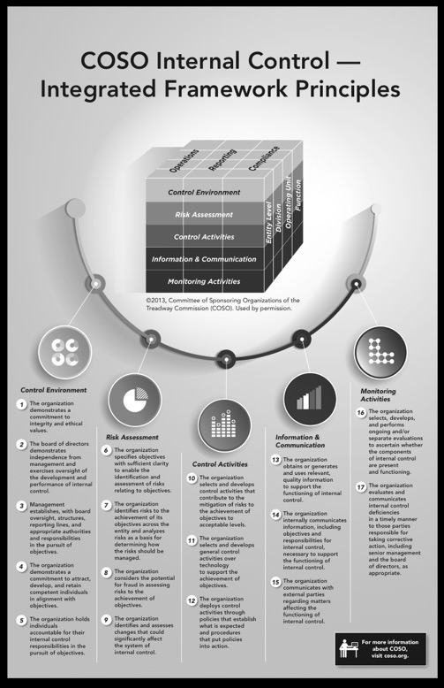
Reporting on Internal Control
Report of Novartis Management on Internal Control over Financial Reporting
The Board of Directors and management of the Group are responsible for establishing and maintaining adequate internal control over financial reporting. The Novartis Group’s internal control system was designed to provide reasonable assurance to the Novartis Group’s management and Board of Directors regarding the reliability of financial reporting and the preparation and fair presentation of its published consolidated financial statements.
All internal control systems, no matter how well designed, have inherent limitations. Therefore, even those systems determined to be effective may not prevent or detect misstatements and can provide only reasonable assurance with respect to financial statement preparation and presentation. Also, projections of any evaluation of effectiveness to future periods are subject to the risk that controls may become inadequate because of changes in conditions or that the degree of compliance with the policies or procedures may deteriorate.
Novartis Group management assessed the effectiveness of the Group’s internal control over financial reporting as of December 31, 2015. In making this assessment, it used the criteria established in Internal Control – Integrated Framework (2013) issued by the Committee of Sponsoring Organizations of the Treadway Commission (COSO). Based on its assessment, management has concluded that, as of December 31, 2015, the Novartis Group’s internal control over financial reporting was effective based on those criteria.
PricewaterhouseCoopers AG, Switzerland, an independent registered public accounting firrm, has issued an opinion on the effectiveness of the Group’s internal control over financial reporting which is included in this financial report on the following pages 243 and 244.
^{Joseph Jimenez}
Chief Executive Officer Basel, January 26, 2016
^{Harry Kirsch}
^{Chief Financial Officer}

Slide 69
Independent Audit
Report on the Financial Statements and Internal Control over Financial Reporting

Slide 70
Required reading and research assignment session 10

Slide 71
Required Reading and research assignment
Reading
  M Business
    Chapter 14 Accounting and Financial Statements
Exercises
  M Business
    Test Bank Questions Chapter 14
Research assignment 9
  Europe’s Top Companies – How are they financed?

Slide 72
Research Assignment 9
Europe’s Top companies. How are they financed?

Slide 73
Session summary and validation, Overview session 10

Slide 74
Session Summary
The accounting process: the nature of accounting, accountants, the accounting equation
Financial accounting: Accounting standards, double entry bookkeeping, the accounting cycle, the financial statements
Management accounting: Budgeting and forecasting, budgetary control, cost accounting for decision taking, fixed and variable costs, break-even analysis, variance analysis.
Audit and control: Audit committees, supervisory boards, reporting on internal control (COSO), internal audit external audit

Slide 75
Session Validation
Define accounting
What is the difference between a financial accountant and a management accountant?
What is the accounting equation?
What is double-entry bookkeeping?
What are the 4 steps in the accounting cycle?
What is the purpose of the income statement, balance sheet, cash flow statement?
What is the break-even point?

Slide 76
Overview of Session 10
Financial management
  Working capital management: Managing current assets and liabilities
  Capital budgeting and investment appraisal: Managing fixed assets, assessing risk, pricing long-term money, IRR, NPV; Payback
  Long-term financing: Financing options using long-term debt or owners’ equity
  Investor relations: Stock markets, communicating with investors, measures that matter, TRS

