Slide 1
COMPANIES NETWORKS
(BUSINESS NETWORKS)

Slide 2
Business networks (networks of companies)
Introduction
(cenni) - indice (1)
Introduction
Definitions of networks
Targets of networks
Typologies of networks
Networks’ analysis
Transactions’ contents
Transactions’ targets
Transactions’ properties
Networks’ structures.
Networks’ coordination mechanisms
Nodes’ organization
Att. 1

Slide 3
Business networks (networks of companies)
Introduction
«What does companies’ network mean?»
«Simply, in many cases we’ve seen that links with the external companies arise, like the need of learning, open innovation etc. in the innovation framework’s lectures, in modularity’s purchasing modules etc. Of ccourse such links could be extemporary or continuative».
«I see. So could one say that in such cases we should look how the companies organize their relationships rather than how their internal organization is?»
«Smart! Actually:
just a paradigm: working on companies’ networks is like taking care of the forest’s life instead of the single tree’s life.
with more refined words: companies’ network implies a perspective of organizations’ (companies’) actions more likely than the actions’ organization.

Slide 4
Business networks (networks of companies)
Network’s definitions
And now some definitions of companies’ networks.
… plot of not competitive relationships which links legally independent entities, without any undermining of the formal authonomy and without and any unitary management. So, companies’ networks are organizational typologies based on the cooperation and the coordnation among companies or other organizations which are under interdependency’s conditions.
[abstract from G. Soda – Reti tra imprese]
… any set of social relationships may be called a “network” if it consists of at least three individuals or institutions and is characterised by some redundant vertical relationships that are incompletely specified.
a group of legally independent companies or subsidiary business units that use various methods of coordinating and controlling their interaction in order to appear like a larger entity.
a system of multiple of recognizable and multiple connections within which highly self-regulated nodes interact at the purpose of mutual targets’ achievement and output’s sharing.
[K. Koschatzky, M. Kulicke, A. Zenker – Innovation Networks]
[www.businessdictionary.com]
[abstract from Butera, 1990 / E. Bartezzaghi, M. Sassatelli – Migliorare le reti di fornitura ]

Slide 5
Business networks (networks of companies)
Network’s definitions (comment)
Looking at previous definitions there are some key words useful to characterize and infer on companies’ networks. Lest’s see:
… not competitive relationships
… legally independent entities
… set of social relationships
… redundant vertical relationships that are incompletely specified
… in order to appear like a larger entity.
... purpose of mutual targets’ achievement and output’s sharing
different from the market economy and from hierarchy as well
need of cooperations’ rules
networks are not only business oriented
need to include something which substitutes relationships’ incompleteness
one of the target could be economy scale. Are there others?
need of targets’ communication and for output’s sharing
what above expresses different topics but there a common denominator: networks are based on
cooperation
Anyway in order to suitably manage a network, it’s necessary both a classification and the related setting of suitable rules as well (you can find them on next pages).
«cooperation» is the key characteristic of networks.

Slide 6
Business networks (networks of companies)
Network’s targets
That said, before talking on networks’ typologies, it’s to consider that anything (and everywhere and for any issue) is done for itsown aim. Now, some of the sentences mentioned in the previous page could subtend several targets (as shown by the below table), anyway the two main objectives of a company in a network are:
… which, throughh open innovation’s concept is in direct relation with technological innovation.
Knowledge acquisition
Transaction costs’ control
… which, can be better understood thinking at supply chains, that’s supply chain as a network. Indeed, transaction costs are costs arising from transactions. They can be splitted in three types accordingly to the three typical phases of a transaction: connection (between the parties), negotiation and control (on the transaction’s thing and on the corresponding part behaviour as well).
Some other possible objectives are deducible by the below list
network related to suppliers
network of patents
network for marketing and distribution
network for manufacturing
network for research
network for financial issues
network for partnerships (ref. consortium)
network for joint ventures
network for specialized personnel sharing
[abstract from A. Lomi – Reti organizzative ]

Slide 7
Business networks (networks of companies)
Network’s typologies
First classification (i/ii)
Now. taking into account the spread of the targets, one could get a classification of them Actually, one could classify them as strategic (may be the case of scientific research’s network) or related to the efficiency and effectiveness increase, that’s to the technical dimension (for instance, it could be related to the cases of suppliers’ and manufacturing’s network etc.). Again may be some companies join in order to afford specific commitments, so legal rules must be stated.
Such consideration let’s to define some criteria for networks’ classification :
degree of legal cohesion:
degree of strategic cohesion
degree of technical-economic cohesion
the presence fo ownership’s bond on the outputs are predomiinant
predominancy of overlapping’s some degree related to the single campanies strategies.
the dominant variable ais the complementarity of companies’ processes (that’s how to integrate them in order to increase efficiency and effectiveness).
[abstract from A.M. Arcari – Il coordinamento e il controllo nelle organizzazioni a rete

Slide 8
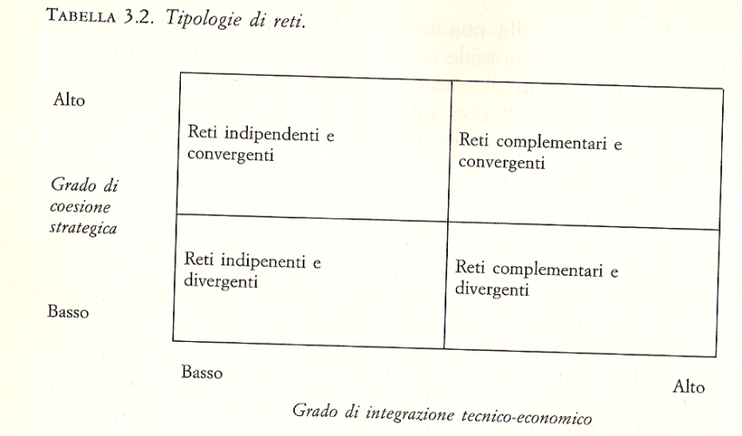
Business networks (networks of companies)
Network’s typologies
(cenni) - le tipologie di rete (2)
First classification (ii/ii)
some networks definitions come from the combining of the above cohesion levels
first typlogy is proprietary networks, which are characterized by an high legal cohesion degree, that’s the underlying legal bonds are in order to guarantee the fruition of the outputs (coming from the carried out activities) and the admission to the property rights.
combining strategic and technical-economic degrees produces some other networks’ types named:
- indipendent and convergent
- indipendent and divergent
- complementary and convergent
- complementary and divergent
Networks Typologies
High
Independent and convergent networks
Complementary and convergent networks
Degree of strategic cohesion
Independent and divergent networks
Complementary and divergent networks
Low
High
Degree of technical-economic cohesion
Low
[abstract from A.M. Arcari– Il coordinamento e il controllo nelle organizzazioni a rete]
D. Sorrenti – Corso di “Modelli per le scelte tecnologiche” – Università C. Cattaneo LIUC – A.A. 2016-2017
7

Slide 9
Business networks (networks of companies)
Network’s typologies
… both bureaucratic and proprietary networks are quite similar to the «proprietary network» mentioned in first classification (previous pages).
Second classification (i/ii)
bureaucratic forms, which stand for coordination’s ways among companies, are generally formalized in swap’s or association’s agreements … the impersonal character symbolized by the contract or by some rules lets the coordination achievement … agreements don’t exclusively concern economic obligations among the nodes, but also the behaviours, the information rights and the ones related to resolution and control. (*)
bureaucratic networks
… are related to relationship forms whose participants jointly benefit of property rights and/or of the results coming from the network activity (*)
proprietary networks
companies maintain social relations accordingly to the degree to which people belonging to the companies themselves are taking part in a plot of an emphatetic information’s sharing, generally neither codified nor referable to any explicit contract or rule. (*)
social networks
(*): [abstract from G. Soda – Reti tra imprese]

Slide 10
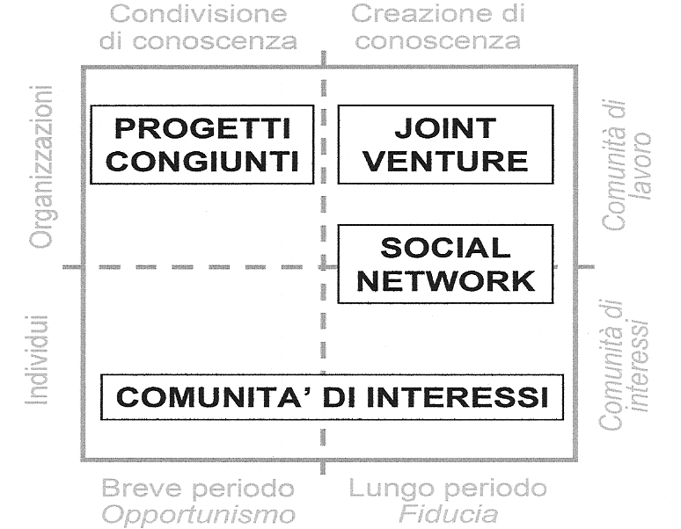
Business networks (networks of companies)
Network’s typologies
Second classification (ii/ii) – notes abour social networks
Knowledge sharing
Knowledge creation
It’s interesting to look at the differences between companies networks (ref. organizations) and individual networks. Taking into account that «companies are made of people», networks of companies and of people must live together; such cohabitation is let through social networks, which act both towards companies targets and individuals expectations.
In other words: things’ achievements are facilitated or obstructed by people’s groups (about which social networks is a synonymous).
JOINT PROJECTS
JOINT VENTURE
organizations
Business community
SOCIAL NETWORK
[ abstract from NfM1 – dalla progettazione al modello di network lombardo ]
individuals
Community of expectations
COMMUNITY OF EXPECTATIONS
Short period
Opportunism
Long period
Trust
… by the way, just for this an organization analysis includes «social variables» as well.

Slide 11
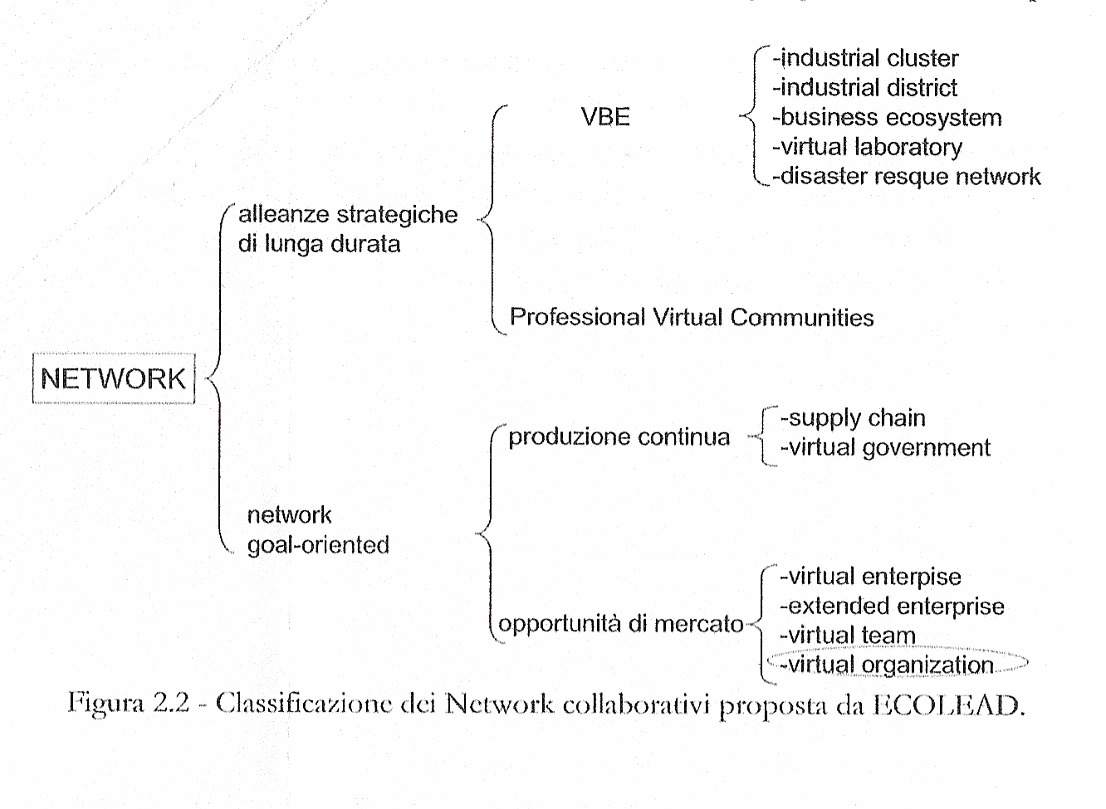
Business networks (networks of companies)
Network’s typologies
Third classification (ii/ii) – notes abour social networks
A third classification is related to the prospect, showed as «long term», that’s the typical necessary period for strategy’s implmentation, and «short-medium term», that is about contingent needs (see Att. 1 for some further details)..
What displayed by the drawing could be considered:
in the case of «long term strategic alliances»: quite alike the strategic cohesion degree mentioned in the previous pages.
… while goal-oriented network is next to the networks typologies related to the technical-economic degree.
(*)
long term strategic alliances
operations (ref. to manufacturing processes)
market’s opportunities
[abstract from Classificazione dei network collaborativi proposta da ECOLEAD]
(*) VBE: Virtual Breeding Environment.
See Att. 1 for defintions. .

Slide 12
Business networks (networks of companies)
Network’s analysis
«So, that’s all about networks?»
«What do you guess?»
«No, I don’t think it’s all. Indeed, for instance: it would be the same to say that some companies doing the same product are alike, or the similar thing for same aged people. These sentences would be just a description and one can’t say to know such companies or people».
«You’re fully right, so in order to approach a network one must analyze it focusing some specific factors».
some typical variables to be considered for a network’s analisys are the:
transactions’ contents,
transactions’ targets,
transactions’ properties,
network’s structure.
… networks are just based on transaction, then it’s quite evident that most of its characterization must be referred to its typical transactions. .

Slide 13
Business networks (networks of companies)
Network’s analysis – transactions’ contents
It should be quite clear to classify the transaction contents. Indeed if one think both to the main aim of a network (that’s the knowledge improvements and the control of transaction costs) and to the classification of the networks (expecially about social networks), one could come to hisown/herown list. So, the transactions’ contents can be classified as:
information … it could be the case of a network for an innovation, or in a supply chain where comakership criteria are applied.
products and/or services … for instance for some types of bureaucratic networks or, looking at the traditional relationship client-supplier, in a supply chain.
good relationship/friendship … which of course is the main content of the social networks and a «key ingredient» that must be active in any kind of networks (ref. to the second classification of networks typologies pages),
«values sharing» … which is typical of social networks again, like voluntary organizations or, considering economic values, of affiliations aimed to the protection of such values.
…

Slide 14
Business networks (networks of companies)
Network’s analysis – transactions’ targets
Again quite easy to define, indeed one should wonder what are the transactions aimed at. So, the transactions’ targets can be listed as:
knowledge improvement … that’s one of the standard networks target.
transactions’ costs (control of …) … another standard target of networks,
flexibility … which could be related to the transaction of products/services.
risks sharing … that’s could be of some economic associations, so following some content of value sharing,
entry or trade barriers … again possibly related to economic values sharing.
lobbying … which could be related to values sharing as well, that’s to associations or affiliations.
…

Slide 15
Business networks (networks of companies)
Network’s analysis – transactions’ properties
Just about the meaning: transactions can be frequent or rare, stand for many or few years, related to two nodes (two people) or to several nodes, specific rules for transactions’ regulation have or haven’t been put in place, etc. So, the transactions’ properties can include:
frequency
longevity
extemporary or regulated
«high range of action» … when they involve several nodes.
mutuality … mutuality is a very important characteristic of the transactions in networks, as a matter of fact their prime mover is cooperation.
…
Just as additional note: don’t forget that cooperation is the prime mover of networks. Indeed it realizes an organization form different by hierarchy, where the driver is the authority, and by the market, for which the driver is the financial transaction.

Slide 16
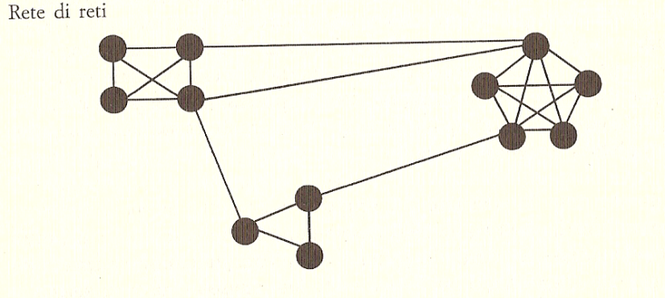
Business networks (networks of companies)
Network’s analysis – networks’ structure
With simple words: a network can be small or big, transaction can always or never follow specific paths, transaction could or couldn’t be concentrated among some groups or nodes (people), so networks’ structure can include:
dimension … that’s related to the number of nodes.
connectivity … that, for instance, will be high when information will touch most of or all the nodes.
«brokers’ existance» … when any transaction must always involve one or few nodes.
clustering … when transactions are more frequent or exclusive among some nodes.
…
… graphic representation of clusters. .

Slide 17
Business networks (networks of companies)
Networks’ coordination mechanisms
«Ok, I see. At any rate, looking at cooperation as the base ingredient which characterize networks, could we say that no organizational tools are necessary?»
«No, I wouldn’t say so. Just as rough example: consider a dinner which is going to be organized among same class-room people, let’s say ten people; do you think it’ll be easy to do it?»
«Crazy! Evryone was glad to partecipate, but some people wanted to go in a specific pub, some others in a different one. Someone said if he or she will come I won’t etc.».
«In the end, did you succeed for such dinner organization?»
«Yes, finally I’ve been able to coordinate them»
«Good, right word: coordination …».
Summing up: notwithstanding cooperation (or, in other words; individual goodwill to partecipate) is the key factor of the networks, it’s important to state some coordination mechanisms, which are generally listed as:
institutional
contractual
organizational
social
…. but, there’s but! Would you be able to speak with a person who doesn’t know your language and vicevesa? Of course not, and so ….

Slide 18
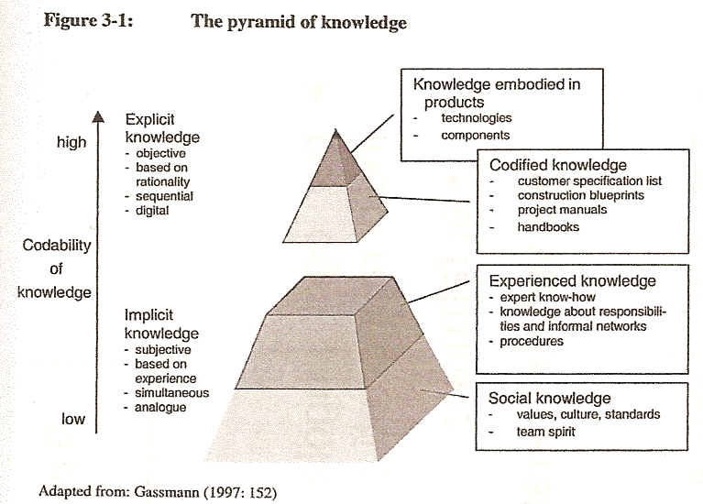
Business networks (networks of companies)
Networks’ coordinations mechanisms
…. and so, companies which or people who interface each other must share the languages (and of course have the humbleness to listen and learn!)
Coming to the knowledge acquisition:
first it’s important to note that it passes through the experienced knowledge, that’s the «uncodified one»,
anyway good relationships are the base ingredient.
Let’s note that such «uncodified knowledge» reminds the technology’s definiton. It can’t be different, indeed some of technology’s components are related to the experience.
[K. Koschatzky, m. Kulicke, A. Zenker – Innovation Networks]

Slide 19
Business networks (networks of companies)
Networks’ coordination mechanisms
…. and now about the coordination’s mechanism
they’re defined as mechanisms following shares’ exchange.
A note: cooperation is strenghtened by such exchange, at the same time the network, meant as organizational form, gets near hierarchical form (that’s the standard for of companies’ internal organization).
institutional mechanisms
Contractual mechanisms can be based on formalized clauses (agreement’s content, contributions, incentives, time horizon etc.) and/or on informal conditions described by a set of unmade clear interactions but characterized by imperative contents.
contractual mechanisms
Just as additional note: criminal organization have mandatory/imperative «contractual mechanisms» which of course can’t be written!

Slide 20
Business networks (networks of companies)
Networks’ coordination mechanisms
organizational mechanisms
they’re about the organizational structures and the roles necessary for the targets’ achievement.
social mechanisms are more or less present in any type of transaction. They can be based on trust, on reciprocity , on the relations’ intensity etc. Anyway, basic ingredients for the are direct contact and cohesion.
social mechanisms
both about organizational and social mechanism, it’s to note a distinctive role of networks, that the «meta-organization». Now, such organizational form is so called because network can’t have a typical hierarchical form like companies. Anyway, as shown by the picture meta-orgaization is aimed to faciitate relationships, which in the first phase of a network are quite loose, and then to establish the upmentioned direct contact and cohesion conditions.
Networks’ lifecycle
no. of. transactions
[abstract form G. Antonelli – Organizzare l’innovazione]

Slide 21
Business networks (networks of companies)
Nodes’ organization
«And that’s all? But what should be the behviour of a single node, that’s of a company belonging to the network? »
«Good question! You’re right, one thing is how the network as a whole would act in order to optimize its outcome, another thing is how the single node should work in order to optimize as well its investment, that’s the partecipation to the network».
So, about nodes’ organization there are two topics that one should consider, that’s how to manage
… opportunities, which (in the context of a network) would mostly mean creation of knowledge.
…risks, that’s how to face opportunistic behaviours.

Slide 22
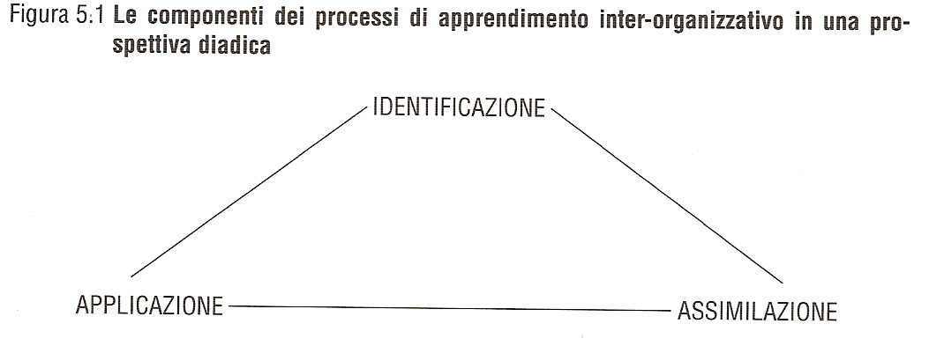
Business networks (networks of companies)
Nodes’ organization
…. about the creation of knowledge
The creation of knowledge is linked to the absorptive capacity construction, that the «ability of a company to give value to the information coming from an external source, to assimilate them and to apply for the company’s otuputs ^{(*)}».
That’s to say: through a suitable mix of organizational mechanisms as procedures and others having motivational characteristics, the organization of the node (single company) must let the implementation of identification, assimilation and use.
Components of the learning inter-organizational processes
IDENTIFICATION
[abstract form G. Padula – Reti di imprese e apprendimento]
USE
ABSORPTION

Slide 23
Business networks (networks of companies)
Nodes’ organization
…. about opportunist behaviour
Apart form any formal ties (contracts, regulations etc,) the only substantial prevention of opportunistic behaviours comes off the growth of trust concept meant as indispensable factor for transactions.
“… taking into account possible information asimmetries, the different contractual relationships of the involved parts, the risks which could undermine such relationships (violation of industrial secrets, opportunistic behaviours) and increase costs, the only possibility to manage transactional interdipendences through a really effective coordination is trust, that’s the «expectation of a foreseeable, correct and cooperative behaviour». Only trust lets transformation of the network cooperation into sound advantages.
Trust strenghtens itself in time and is based on personal relationships which consolidate information’s transactions and expand a variety of interaction’s processes.
Time and experience are base factors for the achievement of a sound trust’s level, so its intensity and stability. About such topic, personal relationships are important because they facilitate the information sharing and support the multiplication of interaction’s events. “
[abstract from A. Ricciardi – Le reti di imprese ]

Slide 24
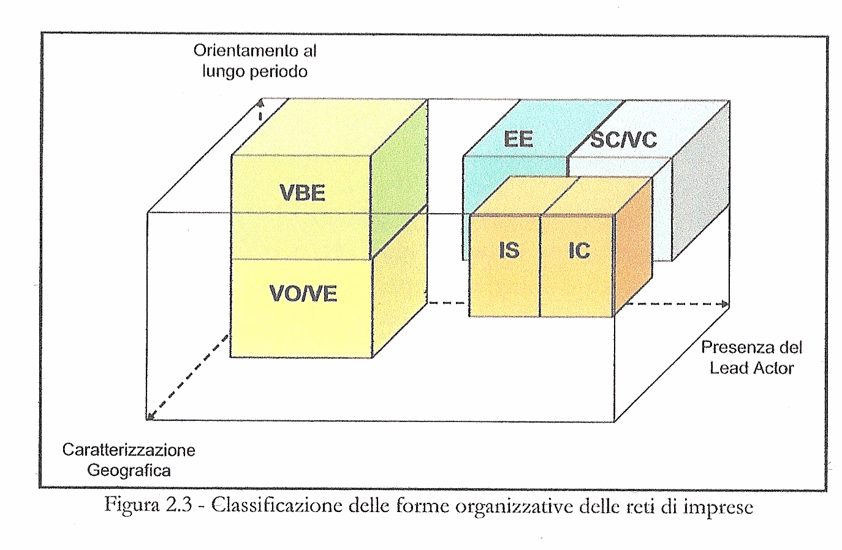
Business networks (networks of companies)
Att. 1 (i/iii)
Long term trend
Presence of a Lead Actor
Geographic characterization
Classification fo some networks organizational forms
[abstract from P. Lunghi, F. Tonelli, R. Rinaldi – Modelli e strumenti innovativi per la gestione dei network di imprese ]
… see next pages about the showed acronysms.

Slide 25
Business networks (networks of companies)
Att. 1 (ii/iii)
Virtual Breeding Enterprise (VBE)
VBE is a whole of companies and foundations which agree to a long term cooperation by the implementation of some mutual operating principles and by the using of mutual facilities in order to enlarge their potentialities in possible Virtual Organizations (VO).
Industry Cluster
Industry Cluster is made by some companies generally located in the same geographic area and belonging to the same business sector which relate to each other in order to enlarge they competitiveness.
Industry District
Industry Cluster is mostly an Italian phrase which which subtends same industry cluster concept by which it can different because of the involving of companies belonging to several business sectors.
Business ecosystem
Business ecosystem takes its name from biological ecosystems. Its purpose is to proserve local features, traditions and cultures; indeed it’s often incentivated by local public administrations. It’s like an industry district characterized by companies belonging to the same territory and having the same operating culture.
Virtual laboratory network (VLN)
VLN is a whole of reaserch independent entities which share their resources (tools, information etc.) in order to achieve a common target. Such laboratories can be located in far-off territories.
Disaster rescue network
The disaster rescue network is a strategic alliance of public and not-public structures finalized to come to the aid iin case of any disaster
Professional Virtual Communities
Professional Virtual Communities is an individuals and freelances who relate each other in order to establish virtual teams, like Virtual Breeding Enterprise does for Virtual Organizazion.

Slide 26
Business networks (networks of companies)
Att. 1 (iii/iii)
Supply Chain (SC)
A supply chain encompasses all activities associated with the flow and tranformation of goods from the raw material stage (extraction), through to the end user, as well as the associated transformation flows. Material and information flow both up and down a supply chain.
[R. Handfiled, E. Nicholson – Introduction to supply chain management]
Virtual Enterprise (VE)
Transitory grouping of companies which join up in order to share costs and know-how related to a specific business opportunity they couldn’t afford alone..
[Iabstract from D’Atri, Solvberg, Wilcocks – Open Enterprise Solutions]
Extended Enterprise (EE)
Extended Enterprise is a cooperative form in which the taking part companies strategically put together their competences through thesharing of know-how and resources and by communication and synchronization among the separate companies.
[Iabstract from P. Lunghi, F. Tonelli, R. Rinaldi – Modelli e strumenti innovativi per la gestione dei network di imprese ]
Virtual Organization (VO)
A Virtual Organization is made by some independent entities which work together for a shared mission, that’s for the supply to the their own market of services, products and competences as a single entity would do.
[Iabstract from P. Lunghi, F. Tonelli, R. Rinaldi – Modelli e strumenti innovativi per la gestione dei network di imprese ]
Both EE and VO defintions are very next the network’s ones.

